Slide 1
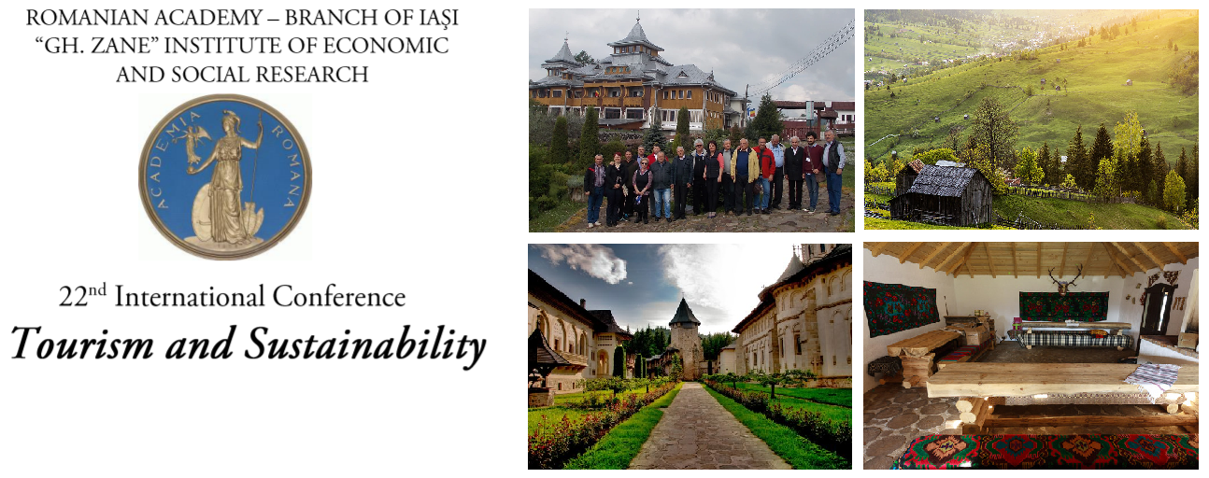
ROMANIAN ORTHODOX CHURCH, AN ECONOMIC SUBJECT WITH IMPACT ON TOURISM AND ITS BEHAVIORAL AMBIGUITY IN CONTRAST TO THAT OF OTHER CHURCHES IN EUROPEAN UNION
Author: Prof. habil. Gheorghe SĂVOIU PhD.
University of Pitești, Romania,
Contact e-mail: gsavoiu@yahoo.com

Slide 2
CONTENTS
INTRODUCTION
S1. A BRIEF, OBVIOUSLY INCOMPLETE AND SUBJECTIVE HISTORY OF CHRISTIANITY (ORTHODOXY AND CATHOLICISM, WITH A BRIEF MEANING OF CHRISTIAN FREEDOM IN PROTESTANTISM)
S2. QUESTIONS GENERATING HYPOTHESES FOR FUTURE RESEARCH ON THE RELATIONSHIP BETWEEN RELIGION AND ECONOMICS, WITH AN EMPHASIS ON TOURISM
SOME FINAL REMARKS
BIBLIOGRAPHY
Keywords: religious or pilgrimage tourism, economic behavior of the Orthodox church, economic agent, GDP, taxes, income, Romania, European Union (EU).

Slide 3
INTRODUCTION
The modern Romanian society experiences a continuous change, adaptation and integration in the space of the European Union (EU), and thus, the population multiplies the spiritual needs, and finally becomes more and more diversified and complex.
Reforming religious traditions of the Middle Ages and the interruption of the obsolete superstitions, derived from some of these traditions are a necessity for Romania's inhabitants and economy.
Starting from the idea that the Orthodox church is also an economic subject to general European regulations, which aim remains the real integration and faster convergence of our country in EU, the synchronization with the requirements of technological progress and of the permanent education remains essential aspects and trends in this paper.

Slide 4
SECTION 1. A brief, obviously incomplete and subjective history of Christianity (Orthodoxy and Catholicism, with a brief meaning of Christian freedom in Protestantism)
The research itself, but especially the discussions related to the specificity of the association of the tourism with religious impact or the related aspects to the economy of the Romanian churches, analyzes and presents statistical information or data regarding the extent to which the behavior of such an economic subject as the Orthodox Church is already.
Is this economic behavior of the Orthodox Romanian Church (ORC or BOR) clearer, more correct and unambiguous one, which adapts or not, especially with regard to the calculation of GDP, specific taxes and revenues, ethics and integrity of ORC’s representatives, in contrast to other churches in the European Union (EU)?

Slide 5
IS THE Christian History a long series of persecutions suffered by Christians or applied to non-Christians or even to OTHER CHRISTIANS TOO?
A good research can start with a question and at the end, instead of answers, the same reserch can discover two other important questions for such a complex and uninvestigated field.
This is also the purpose of this article, to investigate and identify more questions, rather defining a preliminary research.

Slide 6
SECTION 1. A brief, obviously incomplete and subjective history of Christianity (Orthodoxy and Catholicism, with a brief meaning of Christian freedom in Protestantism)
Christianity became a structural component of the Roman Empire, initially persecuted, after a long period tolerated and finally integrated into the intersections of power, after 380.
Christians, who were initially persecuted, turned from persecuted to persecutors of all other cults and religions which they practically forbid, as well as of philosophers and their academy or Lyceum which are closed
Christianity after three major edicts given by Galerius (Edict of Tolerance of 311), Constantine the Great and Licinius (Edict of Milan of 313), and of Theodosius (Edict of Thessalonica of 380), became the secular arm of Roman imperial power…

Slide 7
SECTION 1. A brief, obviously incomplete and subjective history of Christianity (Orthodoxy and Catholicism, with a brief meaning of Christian freedom in Protestantism)
The word Christian had a double origin, benefiting both:
from a popular Latin origin (christianus, derived from Christos), Jesus of Nazareth being simultaneously the Messiah and son of God
and
from a Greek one, in Christós (Χριστός or the anointed one), initially used as a nickname (cognomen) and later as a common appellation for those who followed the teachings of Jesus Christ in the Roman Empire.

Slide 8
IS THE CHRISTIAN HISTORY A LONG SERIES OF PERSECUTIONS SUFFERED BY CHRISTIANS OR APPLIED TO NON-CHRISTIANS OR EVEN TO OTHER CHRISTIANS TOO?
Geographically, Christianity appeared in Jerusalem, and gradually spread throughout the Middle East, acquiring the character of a dominant religion later in: i) Armenia (314); ii) Ethiopia (325); iii) Georgia (337). In 380, Christianity spread throughout the Roman Empire, gradually outlining three distinct areas delimited by: a) Western Europe; b) Eastern Europe and Asia Minor; c) The Middle East and Palestine. Between the first two areas, the Western (later Catholic, and much later Protestantism) and Eastern (Orthodox) churches were delimited, and Trinitarian and Christological theological dissensions arose, actually masking the patriarchs' desire for power (Pope of Rome and Patriarch).
The third Christian area fell apart primarily as a result of the Synod or Council of Chalcedon (451), which resulted in the schism of the Monophysite Eastern churches, considered heretical, because they considered Jesus Christ to be of an exclusively divine nature. , and later due to the emergence of Islam, after the unification of Arabia and the declaration of the new Hegira era, in 622, amid extensive pressures and wars beyond the seventh century with the role of converting Christians to peace and submission to Allah.

Slide 9
SECTION 1. A brief, obviously incomplete and subjective history of Christianity (Orthodoxy and Catholicism, with a brief meaning of Christian freedom in Protestantism)
From the beginning Christianity was and has remained even now a revealed religion, because God made himself known to people and had revealed to all of them the covenant promises for their happiness, as evidenced by the word dedicated to believers in the Bible (Gaudin, 1995, pp. 22).
In its essence, the Church became and remained the specific institution of the manifestation of Christianity in time, and the doctrinal authority was constituted by the Bible, including both the Old and, especially, the New Testament (Holy Scripture, bringing together the Gospels), to which Orthodoxy added the tradition of the Church, and Catholicism the Church Magisterium, represented by the authority of the Pope.

Slide 10
IS THE CHRISTIAN HISTORY A LONG SERIES OF PERSECUTIONS SUFFERED BY CHRISTIANS OR APPLIED TO NON-CHRISTIANS OR EVEN TO OTHER CHRISTIANS TOO?
Christianity became a structural component of the Roman Empire, initially tolerated and later integrated into the interstices of power, after 380, following three major edicts given by Galerius (Edict of Tolerance of 311), Constantine the Great and Licinius (Edict of Milan of 313), and of Theodosius (Edict of Thessalonica of 380), Christians becoming persecuted, persecutors of all other cults and religions which they practically forbid, as well as of philosophers and their Academy or Lyceum which are closed.
Multiple internal divergences of Christianity, from the real nature of Jesus Christ, to the degree of man freedom in terms of his divine salvation, from the institutional organization of Christians, to their relations with political power, along with dissensions about how to interpretation of sacramental texts, rites and moral norms generated either specific doctrinal crises (Gnosticism, Manichaeism, Docetism, Nestorianism, Pelagianism, etc.), or Christian heresies that appeared after the councils and condemned as heretical (Arianism, after Nicaea in 359, Nestorianism), after Ephesus in 431, Monophysitism, after Chalcedon in 451 etc.).

Slide 11
The Great Schism of 1054
The Great Schism of 1054 generated a rupture that would be considered a complete implosion of Christianity, continued by unimaginable or unbelievable expansions and religious wars ....
Many communities in Eastern Europe were forcibly Christianized under the Eastern Church, which called itself Orthodox, the new meaning intending to underline the right faith, and thus trying to identify it as the only church that knew and preached the true path of Christianity, in contrast. with which all other forms of Christianity became mere heresies, by a simple renaming.

Slide 12
The Great Schism of 1054
The Western Church, which called itself Catholic in its desire to be the sole descendant of Christianity, forcibly Christianized human populations in Western Europe and then generated eight crusades between 1096 and 1270, representing organized military expeditions to liberate Palestine (Holy Land) and implicitly Jerusalem from Muslim domination and religion... However, these religious wars were also started out of the desire for adventure, with obvious aims of enrichment and power or conquest of the monarchs of Western Europe.
The main difference between Orthodoxy and Catholicism remains the role of primus inter pares given to bishop of Rome or Pope.

Slide 13
inquisition AND ITS Famous Christian Persecutions
The mere fact that the Inquisition as a Christian religious institution survived for seven centuries, being abolished only at the beginning of the nineteenth century, underscores the persistence of the inhumanity and immorality of Christianity.

Slide 14
SOME NecesSarry REFORMS
However, Catholicism or the Western Church has gone through various attempts to reform or return to the purity of the original Christian faith. Of all the attempts, it was perhaps most intensely changed by the emergence of the Anglican Church and the Protestant Reformation of the sixteenth century.
Martin Luther offered the Lutheran solution, appropriate to German Catholicism, Calvinism Jean Calvin through his sermons the Calvinist version and Ulrich Zwingli an authentic and profound Protestant approach.

Slide 15
SECTION 1. A brief, obviously incomplete and subjective history of Christianity (Orthodoxy and Catholicism, with a brief meaning of Christian freedom in Protestantism)
ROMAN EMPEROR JULIAN (APOSTATE) ANTICIPATED AN EXTENSIVE ECUMENISM
Even after 1700 years, the apostasy or renunciation of the Christian religion of a Roman emperor who knew very well the abuses of Christianity under Constantine the Great, does not escape contemporary theological rage, his decree being considered an anti-Christian act, which is why, according to some historical hypotheses unlikely, he was also assassinated by Christians, an irony of history.
Some contemporary Orthodox historians partially recognize the balance of the edict of 362:
At the beginning of his brief period as Roman emperor Julian the Apostate (Apostate being a surname or a cognomen from apostasy or abdication from Christianity) “did not persecute Christians, treating them with indifference. By virtue of the principle that every individual is free to believe and worship as his heart dictates, Julian commanded the opening of temples and allowed the ancient sacrifices in honor of the gods […] Thus, the temples reopened their pagan gates, sacrifices being allowed again. " (Rămureanu, 1987, p. 261).

Slide 16
A SAD MILLENIUM OF DARKNESS?
After the apocalyptic manifestation of the zealots, during the Roman Emperor Constantine the Great, in which Christianity had devastated the scientific evolution of mankind and the architectural works, libraries and ancient works of art in antiquity, more than 90% of Greek and Roman culture disappeared (Nixei, 2018).
Thus, a dark period followed, a period for at least a millennium, in which the bishops transformed the church from a full and life-giving form, into a form of governing, based on principles of forced and mandatory or universal Christianization, focused on extensive censorship, in a twilight world, which often turned grotesque, macabre, and predominantly gray under the Inquisition.

Slide 17
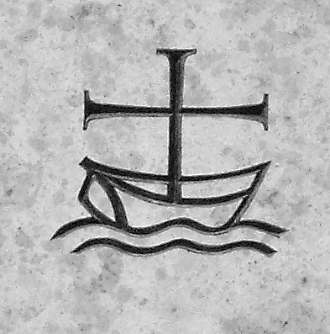
OIKUMENIKE
Ecumenism (from the Greek term oikumenike), permanently offered an original Christian solution, and gradually turned into a movement with a character of religious pacification, pursuing the reunion of all Christian churches into one. Belonging to the World Council of Churches, who profess Jesus Christ as God and Savior and seek to fulfill their common calling to the glory of a God, the Father, the Son and the Holy Spirit (World Council of Churches), the adjacent graphic symbol of ecumenism represents the Christian church as a seagoing vessel carrying as a mast a massive cross "over seas and lands", on the path of unity in one faith.
Sursa https://www.oikoumene.org/en/resources/logo/wcc-logo

Slide 18
SECTION 2. QUESTIONS GENERATING HYPOTHESES FOR FUTURE RESEARCH ON THE RELATIONSHIP BETWEEN RELIGION AND ECONOMICS, WITH AN EMPHASIS ON TOURISM
The research itself, but especially the discussions related to the specificity of the association of the tourism with religious impact or the related aspects to the economy of the Romanian churches, analyzes and presents statistical information or data regarding the extent to which the behavior of such an economic subject as the Orthodox Church is already.
Is this economic behavior of the Romanian Orthodox Church (ROC) clearer, more correct and unambiguous one, which adapts or not, especially with regard to the calculation of GDP, specific taxes and revenues, ethics and integrity of ROC’s representatives, in contrast to other churches in the European Union (EU)?

Slide 19
SOME QUESTIONS ABOUT B.O.R. BEHAVIOUR
Is it increasingly obvious that the economic behavior of the Romanian Orthodox Church (BOR) became not only unclear and unambiguous, but also not at all closer to the concept of fairness, and like any other type of intelligent behavior, can this ancient behaviour be defined by an ever-expanding capacity for adaptation?
What is interesting here, in particular, are the associations not internal to a dominant Orthodox geography and specific to modern religious mosaics, but to the external correlations of Orthodoxy with other religious spaces, and also with its own host economy where it survives with success.

Slide 20
SOME QUESTIONS ABOUT B.O.R. BEHAVIOUR
In terms of GDP calculation, but also in the evolution of its specific taxes and revenues, as well as in the tourist impact is indeed our contemporary Romanian Orthodox Church (BOR) a better economic partner or a better and adequated ethic and moral menthor?
What does the ethical behavior and moral integrity of some priests and representatives of the BOR look like, compared to their own moral laws and then in comparison with that of other priests and representatives of other churches in the European Union (EU)?

Slide 21
SOME QUESTIONS ABOUT B.O.R. BEHAVIOUR
A first set of questions starts from the contemporary place and the importance of the Romanian Orthodox Church (BOR) in the Romanian economy and in the behavior of the inhabitants who adhered to Orthodox religion.
Is BOR, through its contribution, a more relevant economic subject and a much more intense factor of influence of the political, economic or social behavior of Romanians, compared to other Christian churches in the European Union?
Why can't a scientifically valid answer to such a question be formulated today?
What needs to be done as a matter of priority in order to provide truthful results to such a justified and useful question for everyone, including BOR?
Derived from this, a new question arises about the results of tourism activities. Are these results estimated with an acceptable level of statistical error, starting from the lack of the real impact of tourism motivated by or based on religious pilgrimage and what could be done to include more correctly a significant volume of economic activity in the tourist area?

Slide 22
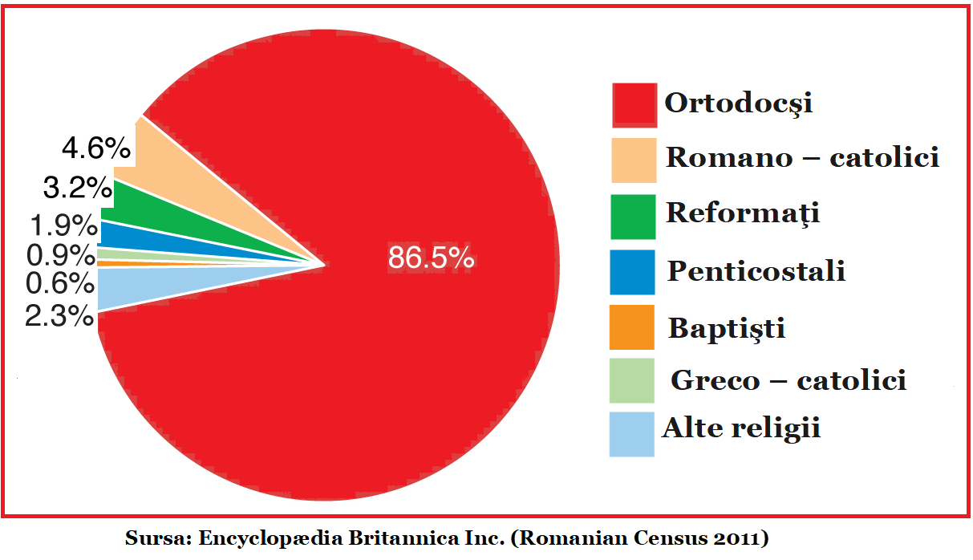
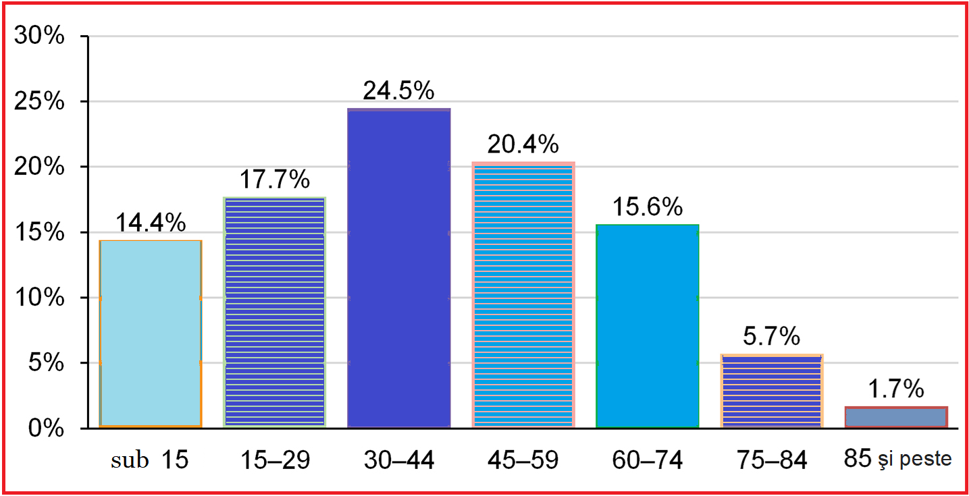
Religious structure at the 2011 census and population by age groups on 1.01.2018
Source of data: Enciclopædia Britannica Inc. (Romanian Census 2011)
Available online at https://www.britannica.com/place/Romania, Accessed on the 25th of July, 2020.
Religious structure at the 2011 census and population by age groups on 1.01.2018

Slide 23
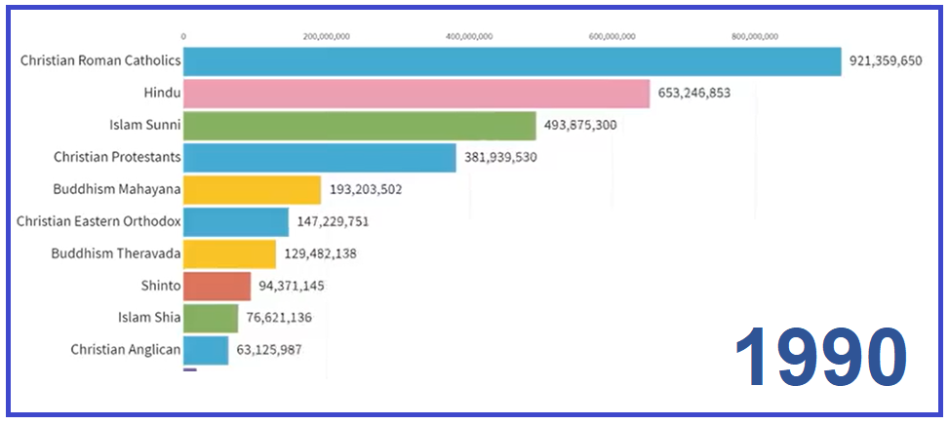
The world's top ten religions and the number of their adherents (1990)
Source: World Religions Ranking - Population Growth by Religion,Available online at: https://www.youtube.com/ watch? v=q3EneZhsM0Y accessed on 24th of July 2020.

Slide 24
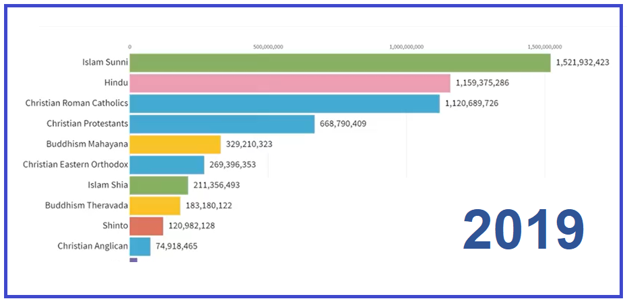
The world's top ten religions and the number of their adherents (2019)
Source: World Religions Ranking - Population Growth by Religion,Available online at: https://www.youtube.com/ watch? v=q3EneZhsM0Y accessed on 24th of July 2020.

Slide 25
SOME RESULTS OF OUR TEAM RESEARCHES
However, the inner hierarchies of Christianity in relation to welfare are much more stable. I did some researches, conducted individually or as team and all of them ranks Orthodoxy in relation to Catholicism and Protestantism, in terms of association with the well-being of the communities in which Christian churches preach (Săvoiu, 2006; Săvoiu, Cruceru, 2006; Săvoiu, Iorga - Siman, 2011) and I found out that Protestantism is most intensely and positively correlated with well-being (R = 0.758) followed by Catholicism (R = 0.503), while Orthodoxy reveals a strong negative association or inverse correlation (R = - 0.562), starting from the variables GDP per capita and the religious adherence of the inhabitants of the countries of the world, (according to the annual CIA report).

Slide 26
SOME RESULTS OF MY INDIVIDUAL RESEARCHES
A very important requirement for further useful research, in order to formulate a rational answer, is to maintain transparency and develop the content of the necessary information of the BOR, available on the website of this institution (http://patriarhia.ro/), which must be in fact in total contrast with the contemporary tendency to abandon messages, communiqués, reports with political, economic and social impact.

Slide 27
SOME RESULTS OF MY INDIVIDUAL RESEARCHES
In order to see how big the gap between the relative informational truth and the absolute lie or contemporary fake news can be or has already become, two paradoxical examples can be provided, instantly solvable by the real informational transparency gathered in detailing the contribution of religious economic subjects to GDP. jointly by INS, BNR and BOR:
a) information based on salary law contrasts deeply with the reality Nicolescu, 2020);
b)“BOR's contribution to social-philanthropic activities has increased almost four times (between 2007 and 2017), is an information in major contradiction with the existence within this amount “of direct financial aids (for example of 14 million lei in the same year 2017) and of personnel expenses (another 33 million lei also in 2017)” (Oncioiu, 2018)

Slide 28
SOME RESULTS OF MY INDIVIDUAL RESEARCHES
Unfortunately, Orthodox life in Romania has born a proverb or a simple saying : You do what the priest says and not what the priest does.
Who is the author of this proverb?
An Orthodox priest or Catolic one, an atheist or an unbeliever?
When an entire community ceases to believe that the author was a clever priest who wanted to save the appearances of Romanian Orthodoxy, a parishioner who aspired to brighten a moral and Christian community or an atheist, drunkard and thief, but instead the same community will simply erase it from her memory, maybe the Orthodox Church will have another moral chance …

Slide 29
SOME FINAL REMARKS
Is it the current behavior of most BOR representatives, an unambiguous one or closer to Christian love, and like any intelligent behavior can it be defined by an ever-expanding capacity for adaptation?
The entire Romanian society is certainly in a real decline period of education, health care and, especially an unprecedented state of immorality and BOR can only be a part of this deeply ethical decline, like any constituent part of the system of Romanian society.

Slide 30
New Questions
Did Romanian Orthodoxy feel so strongly the need for a so called national cathedral?
It can be such a cathedral springing from the tradition of some rural churches or monasteries preserved and admired today for their golden dimensions, perfectly integrated in the landscape of the Romanian soul, where care is not directed to the size of the porch, a very small one, but the presence obsessive of flowers?
Is it possible to continue the decrease of the current level of trust in the church, of the population of Romania, below 55.2%, where it arrived after 30 years from 90% as it was in 1990?
Does the perspective offer chances for a real ecumenism not only shared by Orthodoxy, but also practiced in rural or urban churches?
Can poor parishes and rich parishes in BOR and other churches still coexist in non-discriminatory positions?
Are wealth declarations necessary for all BOR employees as well as for other churches, paid from public money?
Can pilgrimage tourism save Romanian tourism by offering a new ethics, morality and a new integrity to tourism in general?

Slide 31
SOME FINAL REMARKS
From these premises, the whole narrative and historical approach of this paper must be understood by the readers.
In this article, the author does not analyze a faith or a religion, does not rank churches or adherents and communities, does not discriminate or compare the ethical behavior or moral integrity of some priests, monks or nuns, but he really wants to put the light on a much broader topic, asking questions that may become benchmarks for future research on the Christian faith and education in rural areas, the impact of Orthodox holidays on rural tourism programs, moral models and their impact on rural tourism, the echo of a great cathedral in the heart of a humble nation, the need for the historical adequacy of rurality and the blindness to economic and social developments, the mention of the religious dead without such enormous costs and profits for the churches, the Orthodox institutional labyrinth and the thread of rural faith, the pandemic and the impact of Covid-19 on Orthodoxy and tourism, etc.

Slide 32
SOME FINAL REMARKS
Romanian tourism is going through a staged but abrupt crisis that will intensify at the end of 2020 and will probably calm down in 2021, no matter how many interfaith meetings or dialogues with some ministers will take place on behalf of the BOR at the Patriarchate. Drama was, is and will remain after this economic crisis, but a deeply moral, ethical or related to the integrity of BOR, the lack of transparency of this very important economic subject, whose behavior in relation to contemporary people and modern times must it changes or loses its adherents. Without a necessary adaptation to modern times and an understanding of the political, economic, social and cultural standards of these times, people and their beliefs risk disappearing. There can be no oases of antiquity, nor can surviving realms of the Middle Ages…

Slide 33
BIBLIOGRAPHY
Allen, J. W. 2010. A History of Political Thought in the Sixteen Century, London: Routledge.
Chaillot, C. 2011. Biserica Ortodoxă din Europa de Est în secolul XX, Bucureşti: Editura Humanitas.
Claudio Moreschini, Enrico Norelli, Istoria literaturii creștine vechi grecești și latine, vol. I: De la apostolul Pavel la Constantin Cel Mare, traducere de Hanibal Stănciulescu și Gabriela Sauciuc, Polirom, Iași, 2001,
Delumeau, Jean. 1996. Religiile lumii. Traducere: Rodica Buburuzan. București: Humanitas.
Diţu, G. 2003.Biserica ortodoxa romana - Scurta istorie. Available on line at: http://www.crez.org/istorie.asp, Accessed on the 31th of July, 2020.
Eliade, M. 1988. Istoria credințelor și ideilor religioase. Traducere: Cezar Baltag . București: Editura Științifică și Enciclopedică.
Gaudin, P. 1995. Marile religii, București: Editura Orizonturi
Huxley, A. 2019. Filosofia perenă, Iaşi: Editura Polirom.
Ibn ‘Arabi. 2003. Geneza cercurilor. Filiația spirituală. Traducere din limba arabă, prefață și note: Rodica Firănescu și George Grigore. București: Editura Kriterion.
Iordache, M. 2017. Cauzele Reformei Protestante și noțiunea de libertate la marii reformatory: Martin Luther, Jean Calvin și Ulrich Zwingli, Revista Teologică. Studii şi articole, vol. 3 pp. 36-59.
Lao Tzi, 2003.Cartea despre Tao şi virtuţile sale. Bucureşti: Editura Meteor Publishing
Lupu, A., Damian, S. D. 2009. Viețile episcopilor Romei socotiți sfinți în Biserica Ortodoxă, București: Editura Herald.
Niculescu, M. 2020. Sute de preoți din Iași și din împrejurimi nu mai au ce mânca. Mitropolia pregătește un ajutor de urgență. Cât câștigă un slujitor al Domnului, Libertatea, 25 aprilie 2020. Available online at: https://www.libertatea.ro/stiri /preoti-din-iasi-si-imprejurimi-nu-mai-au-ce-manca-2970461 accessed on the 23th of July.
Oncioiu, D. 2018. Preafericiţi de banii primiţi, Să Fie Lumină, available online at: https://safielumina.ro/author/diana-oncioiu/ Accessed on the 22 th of July,

Slide 34
BIBLIOGRAPHY
Peticilă, M. 2018. Banii de la Buget pentru Culte s-au triplat în ultimii 10 ani. Peste 5,7 miliarde de lei, din ’90 până azi, din care 1,6 miliarde pentru construcția de biserici, 17 noiembrie 2018, Available online at: https://www.edupedu.ro/author/mihai/ Accessed on the 21th of June, 2020.
Pietri, L. (coord.) 1999. Histoire du Christianisme, Eglises d'Orient et d'Occident, tome 3, French Edition, Bilbao: Editorial Desclée De Brouwer.
Rămureanu, I. 1987. Istoria Bisericească Universală, vol. 1(1-1054), perioada II (325-787), Bucureşti: Editura Institutului Biblic şi de Misiune al Bisericii Ortodoxe Române.
Săvoiu, G., 2006. Populaţia lumii între explozie şi implozie demografică, Bucharest: International University Press.
Săvoiu, G., Cruceru, G., 2006. Religia şi demografia - factori de risc şi incertitudine ai deciziei şi ai dezvoltării economice, Progrese in teoria deciziilor economice in condiţii de risc şi incertitudine, vol III, Iaşi: Editura Performantica, pp. 47-61.
Săvoiu, G., Iorga – Siman, I. 2011. A Demographic, Economic and Statistical Approach to Religion and Welfare, ESMSJ vol.2, pp.4-14.
Sourdel, D. 1995. Islamul. Traducere: Liliana Saraiev. București: Editur Humanitas.
Stark, R., Finke, R. 2000. Acts of Faith: Explaining the Human Side of Religion. Berkeley: University of California Press. In The Secularization Debate (chapter by Rodney Stark).
Tenace, M. 2005. Creștinismul bizantin. Istorie, teologie, tradiții monastice, Trad. de Al. Cistelecan, Chişinău, Editura Cartier Istoric.
Tertulian, 2007. Tratate dogmatice şi apologetice, Iaşi: Ediţie bilingvă, Polirom.

Slide 35
BIBLIOGRAPHY
Vidal, G. 2011, Iulian, Iaşi: Editura Polirom
*** 2002. Biblia sau Sfinta Scriptură - ediţie jubiliară a Sfântului Sinod al Bisericii Ortodoxe Române, traducător Anania Bartolomeu Valeriu Anania, Bucureşti: Editura Institutului Biblic şi de Misiune al BOR.
*** 1995. Scrierile Părinţilor Apostolici, Bucureşti: Editura Institutului Biblic şi de Misiune al Bisericii Ortodoxe Române.
*** 1997. Apologeți de limbă greacă, Bucureşti: Editura Institutului Biblic și de Misiune al Bisericii Ortodoxe Române, Iustin Martirul, Dialog cu iudeul Tryfon.
*** 2001. Coranul, traducere Silvestru Octavian Isopescul, București; Editura Cartier.
*** 2002. Bhagavad-Gita, traducere din sanscrită, notă introductivă, comentariu şi note, ediţie bilingvă (Vlad Şovărel, ed.), Bucureşti: Editura Herald,
***2005. Coranul, traducere de George Grigore, Bucureşti: Editura Herald.
***Creştinism, Wikipedia, available online at: https://ro.m.wikipedia.org/wiki/Creștinism, accessed on the 6th of July, 2020.
*** Legea salarizării prevede majorări pentru personalul clerical până în 2022, available online at:https://a1.ro/news/social/ce-salariu-are-un-preot-in-romania-veniturile-personalului-clerical-vor-fi-majorate-pana-in-2022-id950102.html, accessed on the 23th of July.

Slide 36
Thank you FOR THIS OPPORTUNITY MY DEAR FRIENDS !
Prof. univ. dr. habil.
Gheorghe SĂVOIU
University of Pitesti
e-mail : gsavoiu@yahoo.com
gheorghe.savoiu@upit.ro

