Slide 1
SOVEJA- MEDICAL HYSTORY AND BALNEOTHERAPY Oana Nicole Stoican, Facultatea de Medicină, Universitatea Transilvania din Brașov, Prof. dr. ec. Mirela Stoican, CNEAB, Braşov Prof. dr. Daniela Vărvăruc, Liceul Tehnologic de Servicii Sf. Andrei, Ploiesti

Slide 2
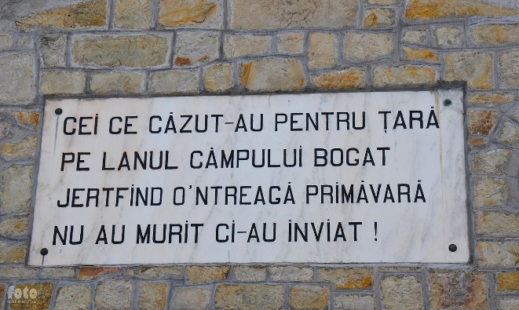
Historical data
- The toponymy of the word Soveja is a special one, because some authors consider
that it comes from the Serbian language, "from Sova, which means night and owl,
so a settlement with dark forests"
- On the other hand, other authors state the Hungarian origin of the place,
"meaning place with salt water so-viz, so = salt and viz = water" .
- For the Hungarian origin of the word, the name of the neighboring
locality Vizantea also pleads, which attests the coming of the Transylvanian shepherds,
on the occasion of the transhumance, beyond the Carpathians.
- Also, the Hungarian armies that fought on this territory with the Tartars, in the XII-XV centuries,
are remembered by Nicolae Iorga"Some Hungarian names mean the unsuccessful attempt
of a Hungarian permanence".
- The archaic name Sohoveja appears for the first time in a document from 1616,
signed by Radu, the voivode of Moldavia.

Slide 3
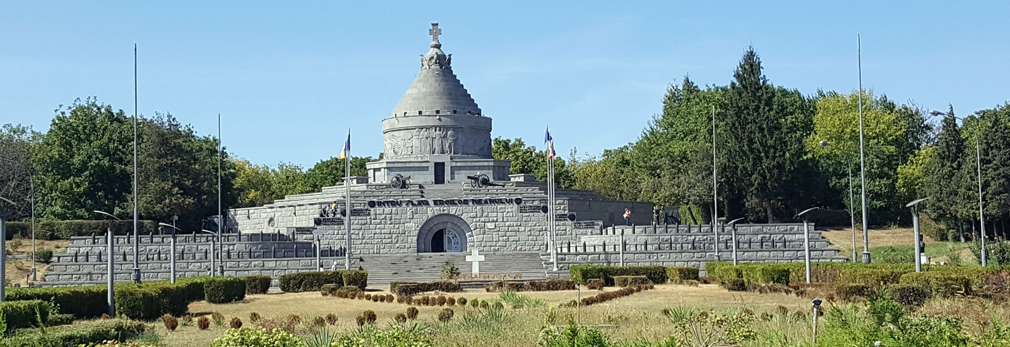
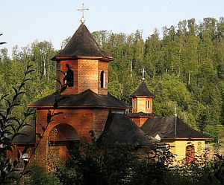
Spending free time The anthropic tourist patrimony of Soveja resort, includes:
- The Mausoleum of the Heroes, in memory of the heroes of the First World War,
as the Soviet Union was located on the front of Mărășești-Mărăști-Oituz;
The military museum, located near the Mausoleum of the Heroes;
The German cemetery;
Matei Basarab Monastery, built in 1645 ;
Soveja Hermitage.

Slide 4
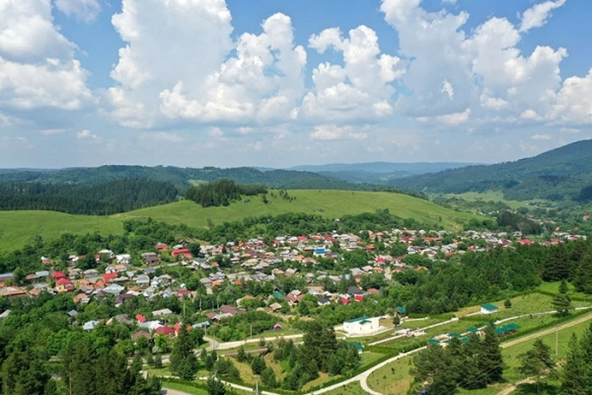
Treatment indications include:
physical and intellectual overwork;
neurosis;
rheumatism;
dermatoses;
thrombophlebitis;
diseases a gynecologist, o respiratory:
▪ Silicosis,
▪ Pulmonary fibrosis;
o of the musculoskeletal system.

Slide 5
The resort of Soveja, once called the Pearl of Vrancea, was abandoned
after the communist era and deteriorated markedly.
Its therapeutic capital can be exploited, given the lack of economic
investment in the development of the area.
Local mayors have started projects to bring the resort back to life.

