Slide 1
24th Academic Conference on
Tourism and Rural Space in National and International Context (TARS)
Sustainable mountain tourism in the Alps:
The ‘Mountaineering Villages’ concept: a local model for sustainable mountain tourism in the Alps
27 May 2022 (online), Romanian Academy
Thomas Dax and Oliver Tamme,
Federal Institute of Agricultural Economics, Rural and Mountain Research (BAB)
Vienna, Austria
thomas.dax@bab.gv.at and oliver.tamme@bab.gv.at

Slide 2

Sustainable mountain tourism
Challenges of strong concentration of tourism trends on mountain regions (85% of national tourism in AT),
leading to engagement of CIPRA (1952), the agreement on the Alpine Convention (1991), with other mountain ranges following the approach (e.g. Carpathian Convention, Pyrenees, Appenine, ICIMOD, Caucasus; Andean initiative)
Considerable diversity of tourism intensity across Austrian mountain areas
Mountain support program (since early 1980s,
with focus on most remote/less developed tourist
areas in Austria
Dichotomy of development trends: strong concentration in few „hotspots“ (threat of overtourism) and various approaches of „slow trends“.

Slide 3
Map: Population based Tourism Function Index
(overnight stays) 2010
Source: Alpine Convention 2013, 63

Slide 4
Origin and objectives
Elaborated on initiative of Austrian Alpine Club (OeAV/Abt. Raumplanung),
16 founding villages/small regions (2008)
Main targets: Realization and support of sustainable, ecological tourism offer – oriented at specificity of mountaineering community
Contribute to development of economically weak mountain municipalities in remote location
Implementing project of Alpine Convention
(according protocols of tourism, spatial planning, transport etc.)
Extension of initiative to other Alpine countries, beyond Austria (D, CH, I, SLO)
36 Dörfer (2022) davon 22 (A)
„To provide an alternative to technologically advanced tourism, …, avoids the threatening growth constraint of touristic infrastructure, … an example to agree on limits for development, … instrument to preserve large-scale, close-to-nature spaces as a supplement to intensively used economic and tourism regions“ (Haßlacher 2013; translated by authors)

Slide 5
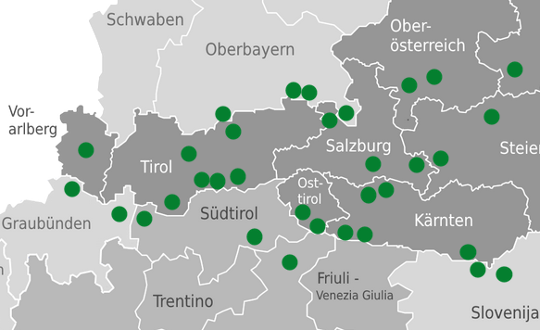
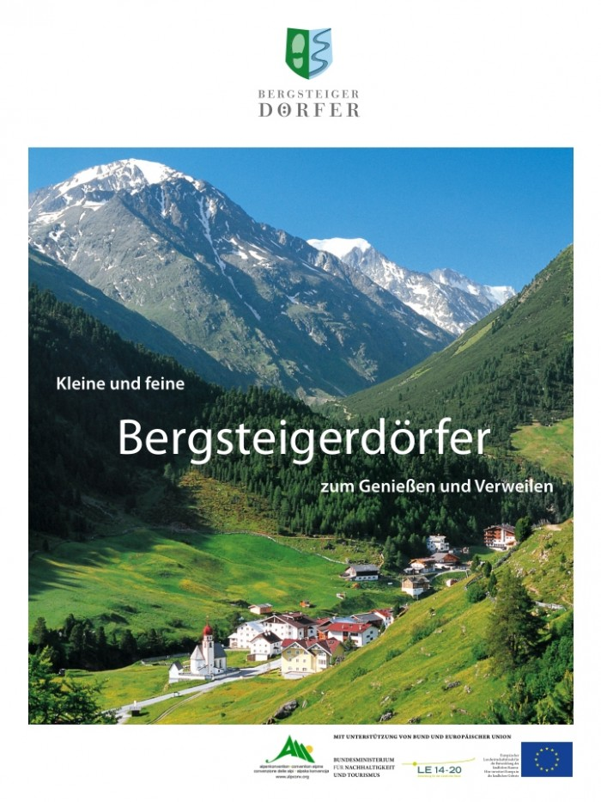
Basic criteria and implementation
Elaboration process (first selection of potential
villages, local engagement), new applications
Criteria for approving ‘Mountaineering villages’:
Exclusion criteria (lack of tourism infrastructure, little mountain specificities,
lack of village character, high impact from traffic routes);
Mandatory criteria (tourism quality, Alpine competence, quality of
appearance of locality, landscape quality, mobility quality, cooperation quality);
Target criteria (tourist quality, cultural and regional specific features, Alpine competence re. support information, landscape quality re. relevant service offer)
Supported by OeAV marketing platform
(website, printed products, members of OeAV)
Cooperation with partner units:
networking with municipalities, tourism boards, partner enterprises, administration units of protected areas
Some support through Rural Development Program (implementation in initial phase)
„Fit for municipalities which were not included in cable car improvement, and which are not eager to be included. An antithesis to gigantism and anonymity in mainstream tourism“ (Haßlacher 2008, translated by authors)

Slide 6
Organization and certification procedure
Source: Gulde 2021, 60

Slide 7
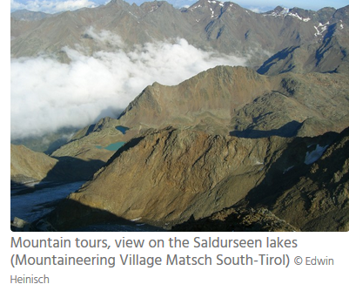
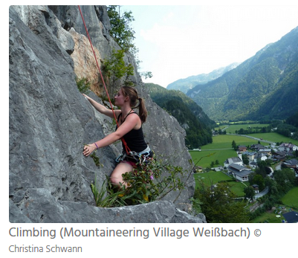
Challenges and expectations
Establishing the label ‘mountaineering villages’, to raise awareness, unique selling proposition (USP), and destination marketing
Stabilization and (slight) increase of overnight stays and visits to villages, reduce seasonality dependency
Improvement of partner enterprises in quality of offer
Achieve enhanced value-added
Networking of communities and cooperation of local Alpine Club sections
Utilizing existing infrastructure to secure “living villages” and achieve sustainable local development
Realize alternative transport organization and routing (enhance accessibility and reduce negative ecological effects)
Common promotion design (platform, coordinate offer and provision of packages)

Slide 8
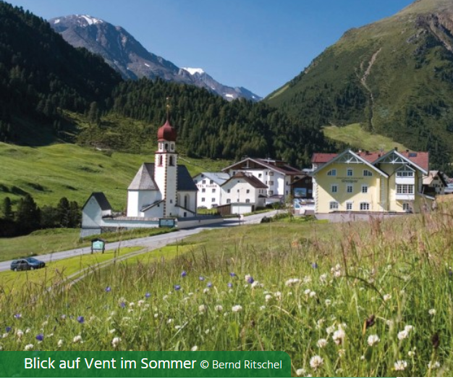
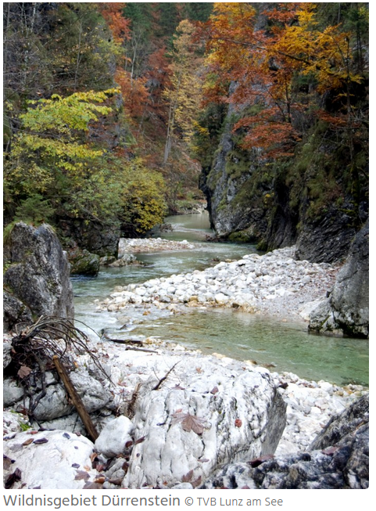
Performance and assessment
Heterogeneity of villages, and diverse awareness level of label „Mountaineering Villages“
Some contribution to local and regional development Punktuell Beitrag zur Regionalentwicklung
Tourism trends since 2008: for 2/3 of villages slightly positive or stable (1.6 mio overnight stays)
Typical pathways focus on „soft tourism“, as part of strategies for protection areas in mountains, in contrast to tourism „hotspots“, no big investments and local opposition to infrastructure projects (transport, energy, big tourism investments)
Exclusionary strategy for niche tourism development of high-quality, preserving characteristics of „pristine“ nature and mountaineering appeal
(two villages, Klas and Reichenau/Rax had to quit the initiative)

Slide 9
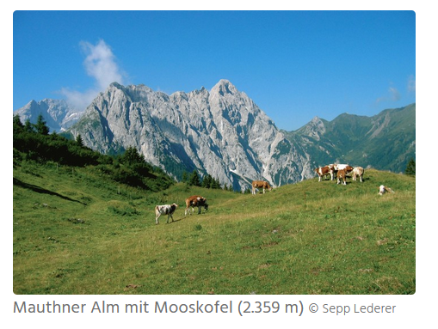
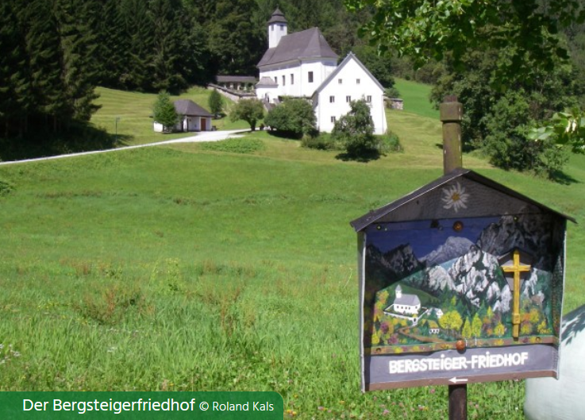
Findings in three case studies
Villages: Johnsbach (Stmk), St.Jodok/Schmirn/Vals (T),
Mauthen (Ktn)
qualitative interviews with stakeholders und local experts (∑23 interviews):
involving main local promotors, tourism board, local administration, partner enterprises, local sections of Alpine Club, managers of protection areas, and top-down guidance by AAC
Performance of implementation dependent on commitment of these actors, institutions and networking
Confirming niche product characteristic, target orientation (family tourism, pasture and “hybrid” guest structure)
Strong contrast to “overtourism” in some neighbouring mountain contexts

Slide 10
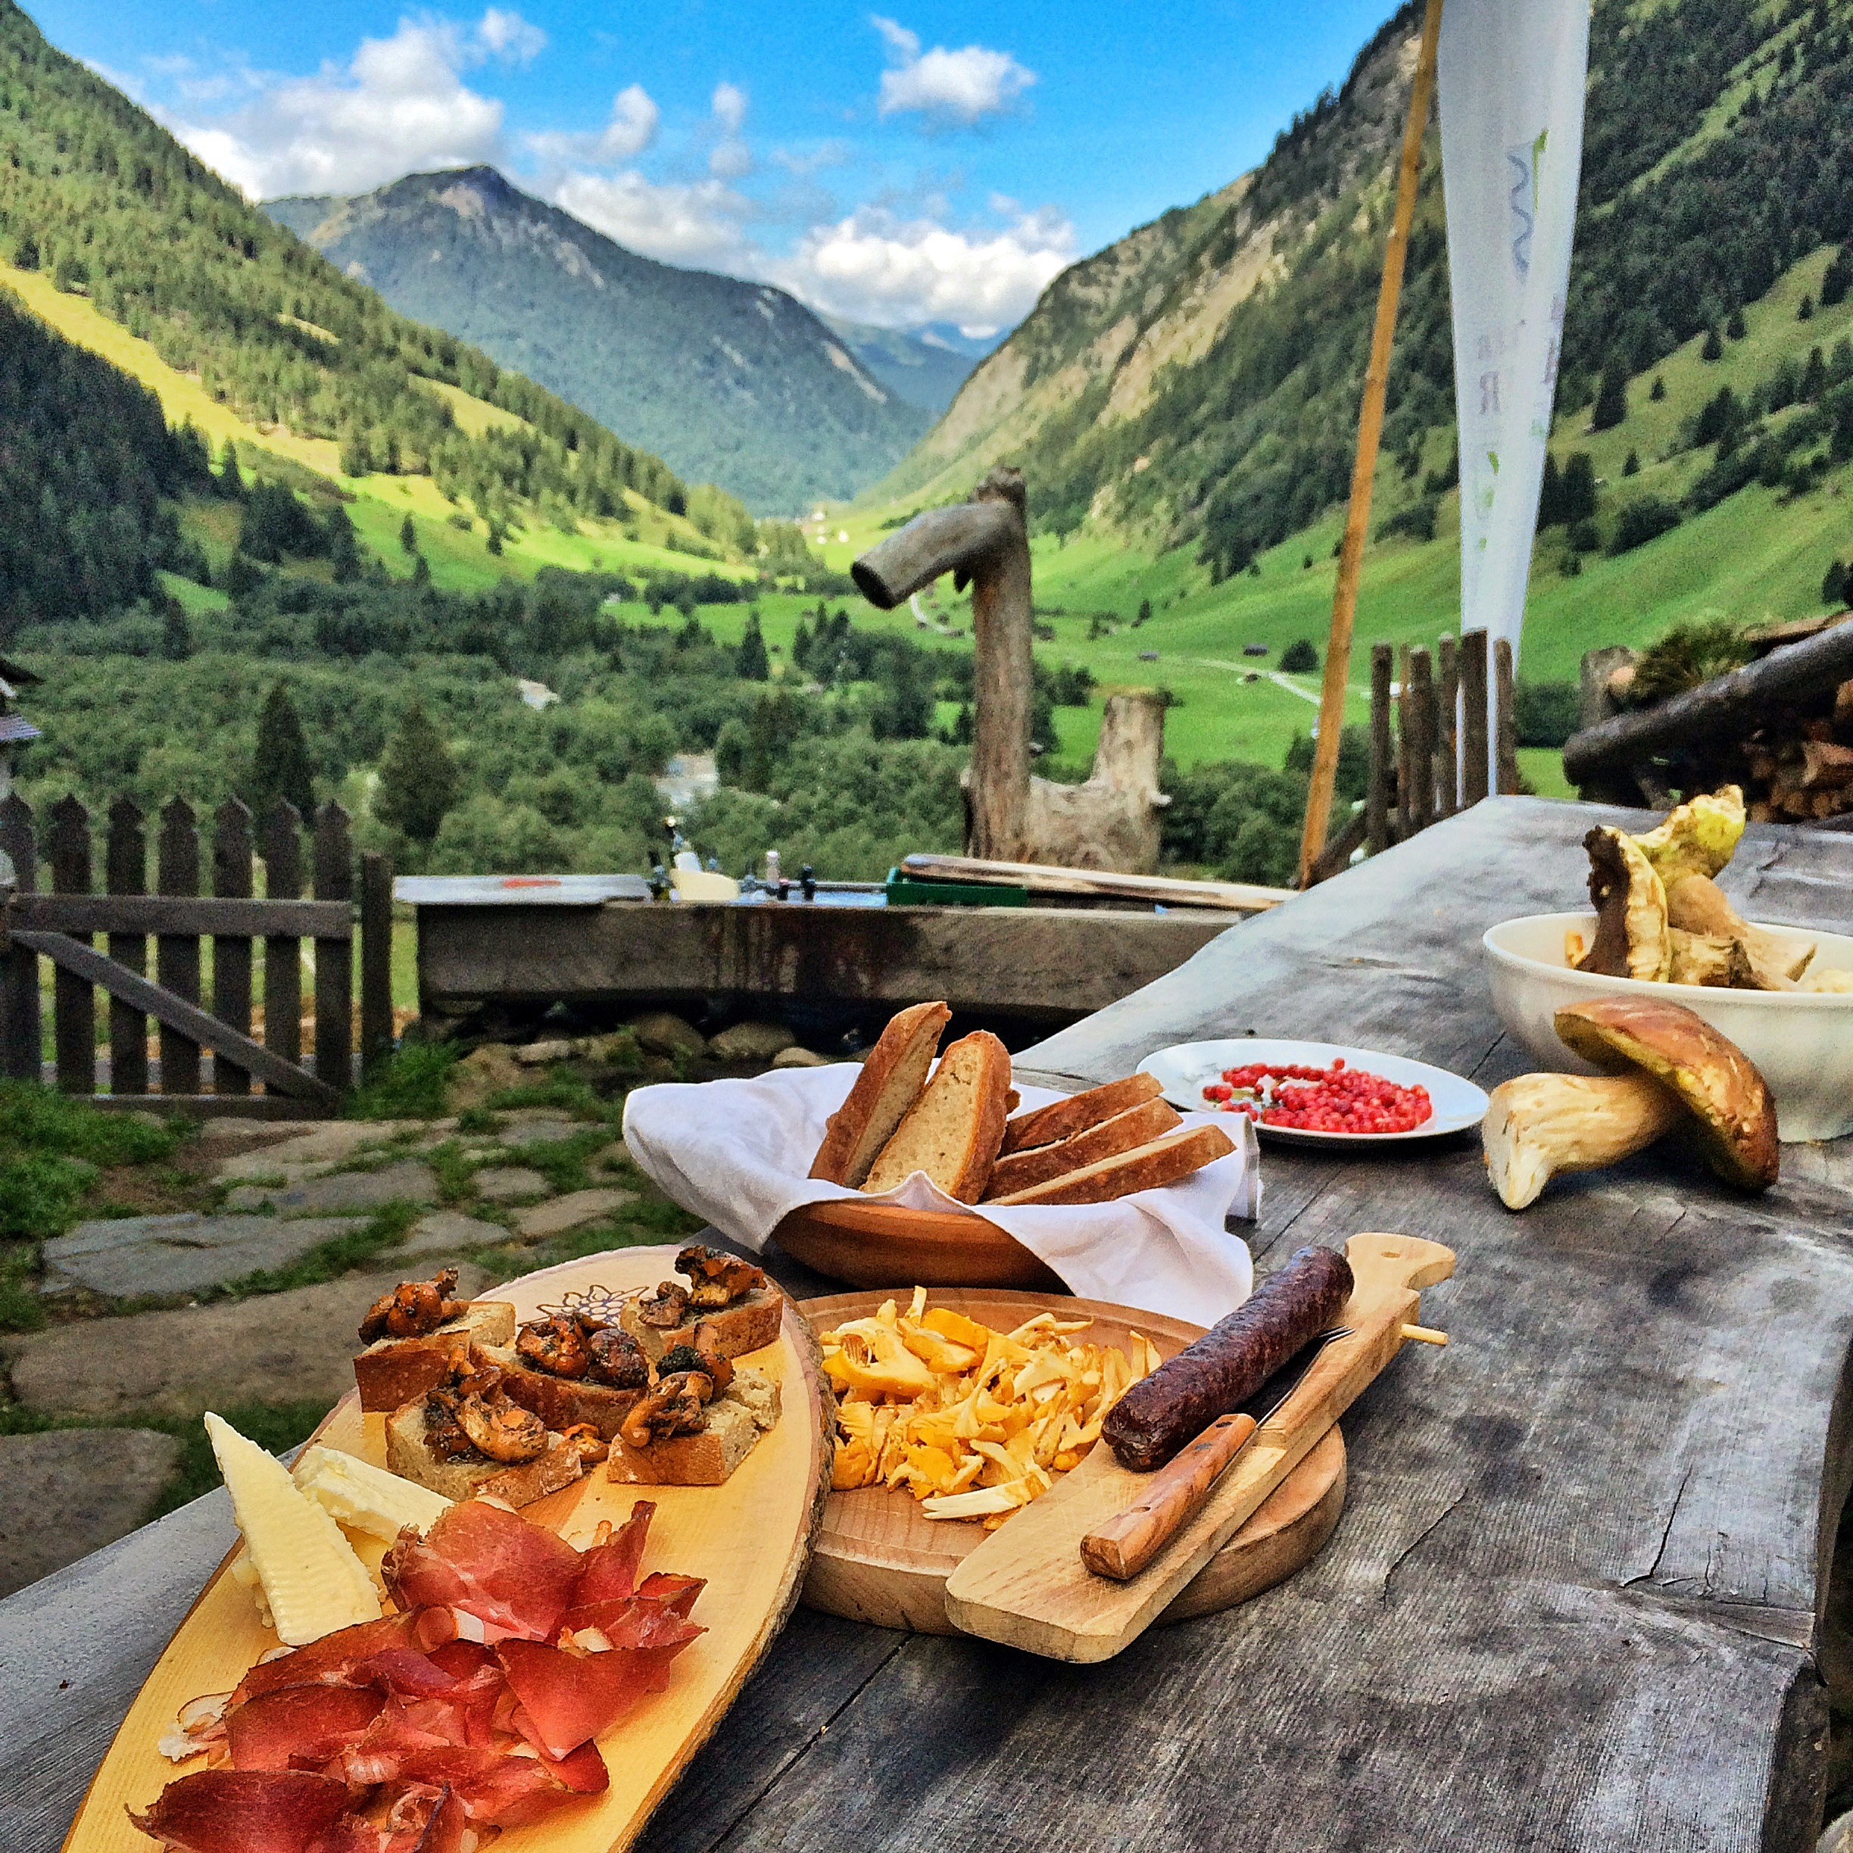
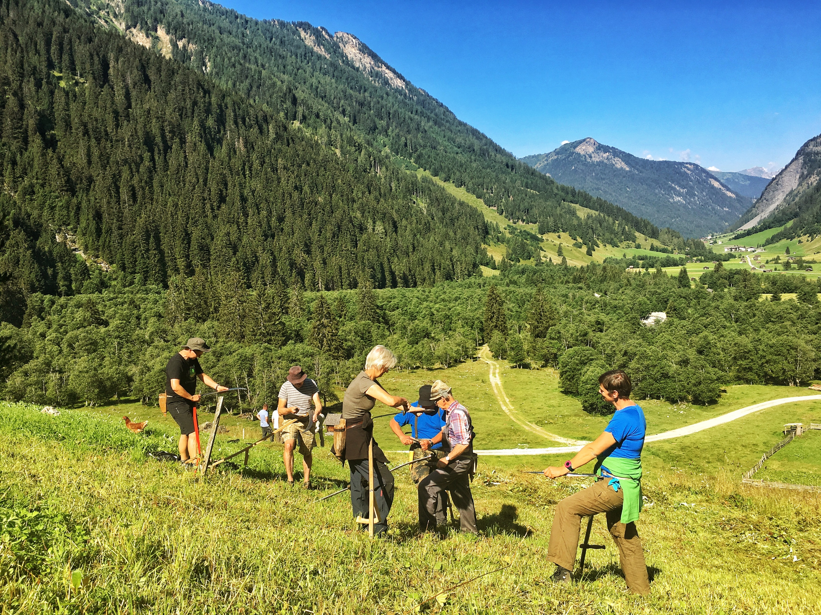
Conclusions
Initiative dominated by tourism strategies (despite reference to local development objectives)
Limited involvement of local population, farm structures, recognition of resources
Label only partially contributing to awareness and tourism performance: potential to improve professional organization of label implementation
Further potential: close cooperation with different types of protection areas (according to geographical specificities),
enhance credibility (vs flexibility) of criteria,
increase inter-municipal cooperation and nurture creation of adapted strategies and innovative ideas
Helgas Alm, Vals © Werner Kräutler
Schule der Alm, Vals © Werner Kräutler

Slide 11
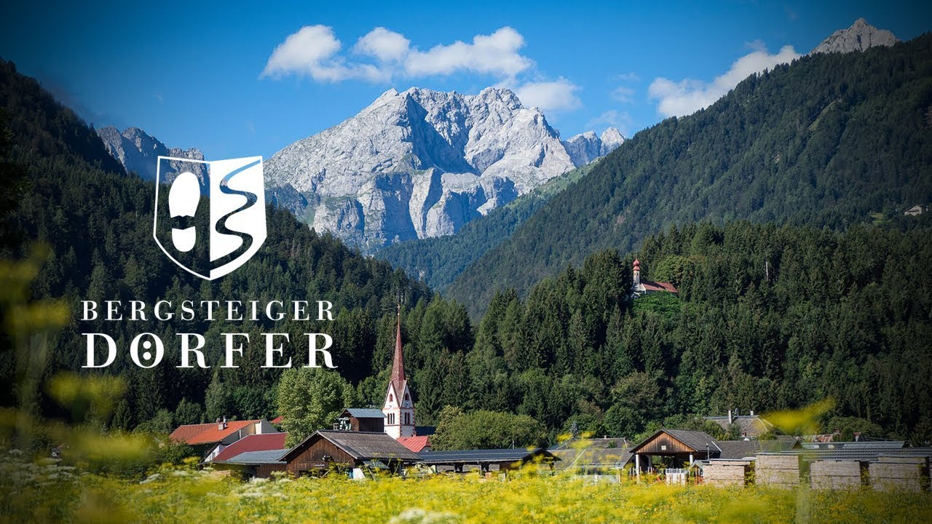
Thank you for your attention

