Slide 1
International Conference Romanian Rural Tourism in International Context. Present and Prospects
INCREASING TRANSPORT QUALITY IN THE REPUBLIC OF MOLDOVA BY USING AN INTELLIGENT ROAD TRAFFIC MONITORING SYSTEM
Authors: Svetlana GOROBIEVSCHI, dr. qualified Technical University of Moldova, svetlana.gorobievschi @ imi.utm.md
Diana MUNTEANU, email: buciumasdiana@yahoo.com
September 2020

Slide 2
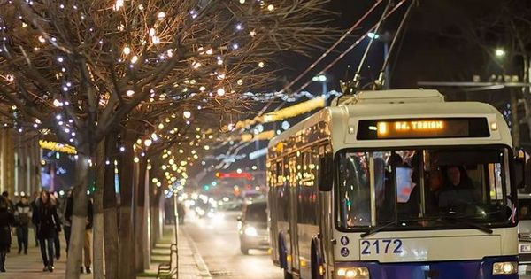
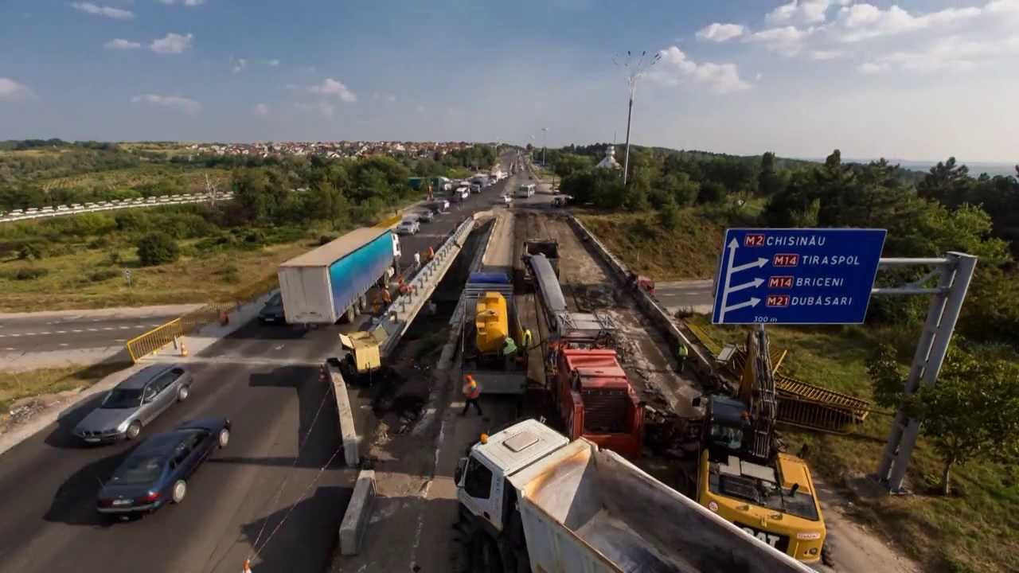
What will we research?
transport;
economic activities;
monitoring system ;
road traffic;
road management;
the quality of road transport.

Slide 3
Absract
Economic developments are closely linked to the possibilities of transporting the products of economic activities and the formation of ever closer relations between different economic entities at different stages of economic cycles.
The authors of the article examine the need for continuous improvement of means of transport and the creation of new transport networks by implementing and using an intelligent road traffic monitoring system, which is a specific process for developing national and international economic relations.
The implementation of the new road management system at national level is to be achieved through the prism of appropriate European policies and strategies and through through the prism of appropriate European policies and certain strategies, as well as concrete action plans, so the research in the field comes to support this desideratum.

Slide 4
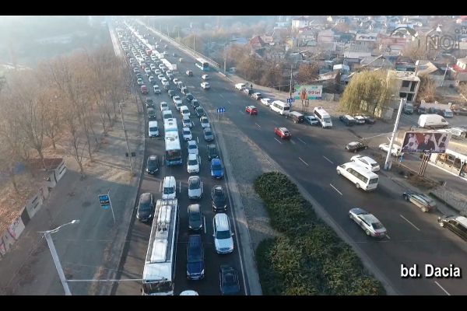
Overcrowding and congestion during peak hours
Road category (m) Width of the protection zone
Express roads 15.0
Republican and regional roads 10.0
Local roads 5.0
The solution of the approached problem also provides an extension of at least urban roads, because according to the statistics in 2019 in our country were registered total sales / registrations of 6,843 cars. The figure is 8.7% higher than that reached in 2018 (6,293 cars) and just 22.5% higher than in 2017 (5,584 cars). Thus, we can see that the pace of sales is upward, only in a period of two years the number becoming almost 1/4 higher.

Slide 5
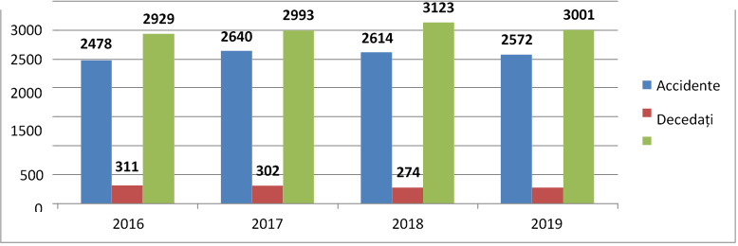
Analysis of the current situation of road traffic in the Republic of Moldova
The main elements of a road traffic system can be conventionally grouped into three components:
road infrastructure (road, streets, highways);
road vehicles (all means of transport);
users (people).
Figure 1. Frequency of accidents for the period 01.01.2018-31.12.2018.
It is essential to create a regulatory basis in this area, which would ensure the safe conduct of road traffic. Law of the Republic of Moldova no. 131 of 07.06.2007 on road traffic safety regulates the legal and social relations in the field of road traffic, establishes the rights, obligations and responsibilities of the relevant authorities and traffic participants. At the same time, for the permanent monitoring of road traffic and the implementation of possibilities to reduce traffic jams, the video system for monitoring road traffic is to be fully used.

Slide 6
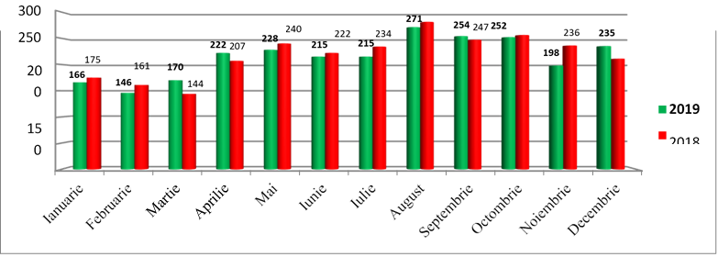
Analysis of the current situation of road traffic in the Republic of Moldova
According to the information from the Automated Information System Road Accident Register managed by the Information Technology Service of the Ministry of Internal Affairs of the Republic of Moldova, in 2019 there were 2572 road traffic accidents, in which 274 people died and another 3001 people were traumatized.
Figure 2. Monthly dynamics of road accidents

Slide 7
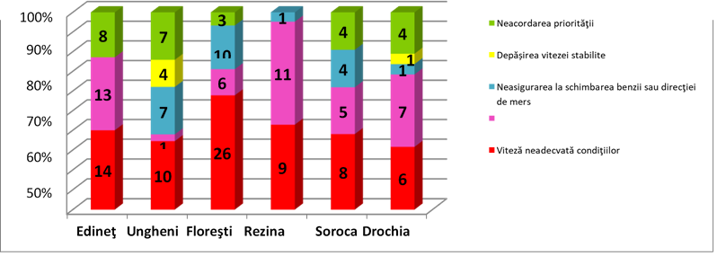
Causes of accidents in the listed districts
non-priority
exceeding the set speed
failure to change direction
speed inappropriate to the conditions
The problem of ensuring the safety of road traffic is becoming more acute, having a major social importance with the intensification of road traffic and increasing its role in the national economy. In the context of the desideratum of the Republic of Moldova, regarding the accession to the European Union, an important role belongs to the modernization of the transport sector, especially in terms of increasing the security of road traffic.

Slide 8
The main causes that lead to road accidents on a republican level:
non-compliance with the distance between vehicles
alcoholic and psychotropic intoxication
irregular crossing of the road by pedestrians
not giving priority to other vehicles
inappropriate speed.
Globally, there are also victims of road accidents. At this stage of transport development, road transport is perceived as a killing machine, which is also an important factor beyond the efforts to change this mode of transport. About 47,000 people are killed annually on the roads of the European Union, 1,700,000 are injured, of which 150,000 remain permanently disabled. In the European Union, the economic costs of accidents are estimated at EUR 50 billion per year.

Slide 9
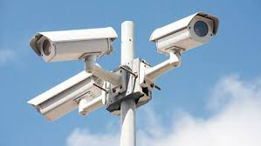
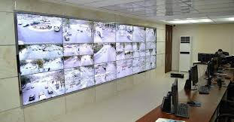
CONCLUSION (I)
Starting from the gravity of the problems faced by the Republic of Moldova in this regard, the Government, by Government Decision no. 1214 of December 27, 2010 (Official Gazette of the Republic of Moldova, 2011, no. 43-45, art. 186) for road safety, establishes as a priority objective the establishment of a basis for an efficient and sustainable road safety policy, which includes the organization of the road safety field from a strategic and institutional point of view, the creation of an efficient management system in the field of road safety, as well as raising awareness road safety at national level.
The implementation of the video monitoring system as well as the directing, its continuous development is an essential contribution on improving the quality of road management. The nominated system used in the necessary directions, allows the identification of persons who favor the commission of road accidents, the location by permanent monitoring of overcrowded regions, the reporting of these places through the means of connection between police officers. Once identified, traffic jams and congestion are most common in urban areas and can be directed by patrol officers.

Slide 10
Conclusion (II)
Permanent monitoring of road traffic throughout the Republic of Moldova is a key step towards increasing the quality of national transport. The benefits of this system were affirmed after the first years of implementation, being that as mentioned above, it allows the identification of the most obvious problems facing national transport, this being a first step towards solving urban congestion, while being a trigger for road accident issues.
The normal functioning of the mechanism of the national economy - ensuring the good technical and material supply of each branch, sub-branch, enterprise or administrative-territorial unit, carrying out foreign trade tasks, organizing the sale of products, meeting the needs of consumer goods - depends largely measure of the management and operation of the transport network. Thus, special attention is paid to the development and modernization of transport, as well as to increasing the economic efficiency of activities in this field, in which both the interests of individuals and institutions and those of society as a whole are involved.

Slide 11
Bibliography
1. Law no. 1194 of 21.05.1997 on transport available on:
http://www.law-moldova.com/laws/rom/transporte-ro.txt
2. Government Decision no. 965 of 17.11.2014 for the approval of the Regulation on the operation of the Automated Road Traffic Monitoring System “Traffic Control” and the modification of the Concept of the Automated Road Traffic Monitoring System “Traffic Control” available on:
https://www.legis.md/cautare/getResults?doc_id=113618&lang=ro
3. National strategy for road safety 2011-2020 available on: http://files.asd.md/legislatie/siguranta%20rutiera.pdf
4. Automated information system Road accident register managed by the Information Technology Service of the Ministry of Internal Affairs available on: https://stisc.gov.md/ro/content/sistemul-automatizat-de-supraveghere-circulatiei-rutiere-controlul-traficului
5. Law no. 85 of 07.07.2011 for the amendment and completion of the Road Law no. 509-XIII of June 22, 1995 available on the website / link:
http://www.justice.gov.md/file/Centrul%20de%20armonizare%20a%20legislatiei/Baza%20de%20date/Materiale%202010/Acte/L%2085%2007.07.2011.pdf
6. Stancu Gh. Transport law course, Bucharest: Lumina Lex, 2007, p.98
7. Dungan P., Analysis of the content of crimes against traffic safety on public roads through the prism of the New Criminal Code, Revista Dreptul, no.3 / 2011, p. 142
8. https://biblioteca.regielive.ro/cursuri/transporturi/managementul-traficului-rutier-si-telematica-2-155392.html
9. https://www.creeaza.com/tehnologie/auto/MODELAREA-TRAFICULUI-RUTIER-UR517.php

Slide 12
We are moving towards a Moldova with good roads, high economy and more lives saved !

