Slide 1
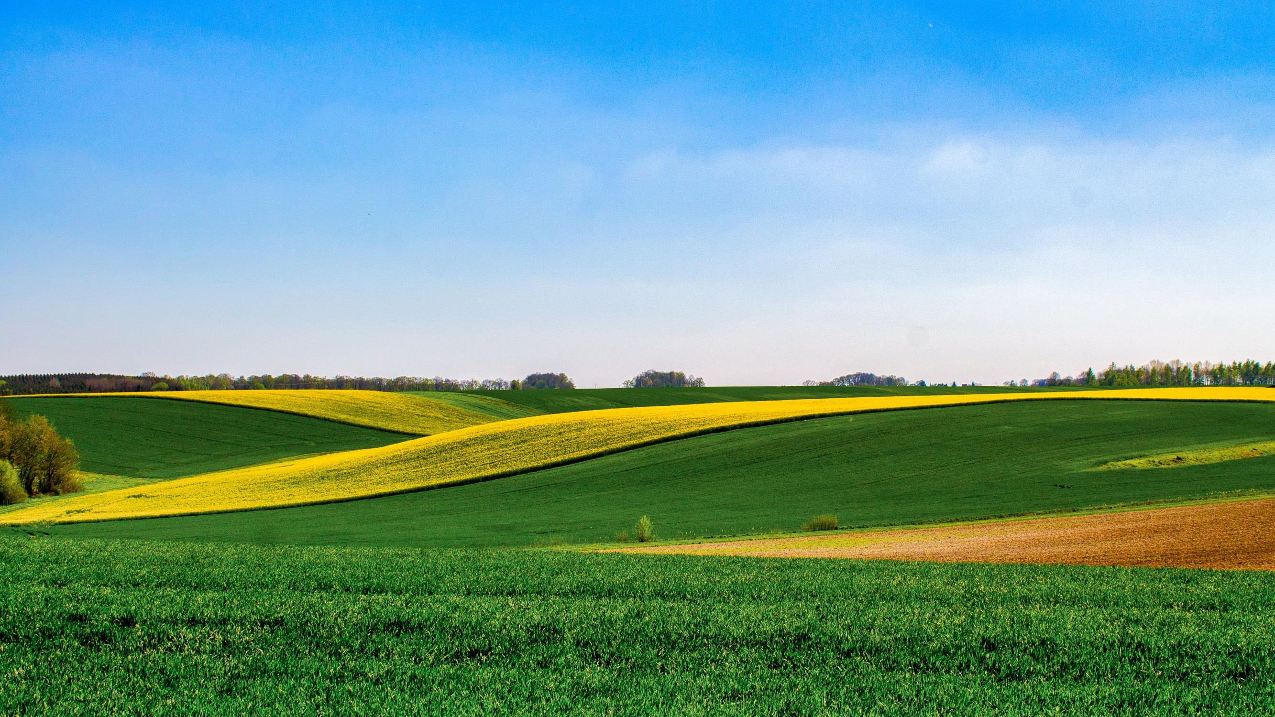
Environmental features of interest for tourism in Romanian rural destinations
L. Velea^{1,2}, S. Puiu³, M.T. Udristioiu^{4,5}, A. Irimescu², A. Gallo¹
¹ Department of Humanities, Ca’Foscari University of Venice, Italy; Liliana.velea@unive.it; alekos@unive.it
² National Meteorological Administration, Bucharest, Romania; Liliana.velea@meteoromania.ro; anisoara.irimescu@meteoromania.ro
³ Department of Management, Marketing and Business Administration, Faculty of Economics and Business Administration, University of Craiova, Romania; silvia.puiu@edu.ucv.ro
⁴ Department of Physics, Faculty of Science, University of Craiova, Romania; mtudristioiu@central.ucv.ro
⁵ Georgia Southern University, Department of Physics and Astronomy, Stasboro, Georgia, USA.

Slide 2
Motivation
The climate and environmental features of the destination play an important role in tourism, as they contribute to build the destination image.
The link between climate, environment and tourism is well acknowledged, as for example that some features are common to all destination types (e.g., low wind), others are specific for each destination type (urban/rural/mountain/seaside) or for specific tourism activities (e.g., trekking, surf).
Little attention has been given to the identification of the natural environmental features of most interest for tourists when choosing a certain rural destination.

Slide 3
Objective
Exploratory approach - aiming to provide an answer to the following research question: which are the most appealing natural features for tourists in relation to a rural destination?
This issue has been addressed by using an online survey disseminated in Romania
during January-February 2023.
The definition of a ‘rural touristic destination’ is limited to the following aspects, following (Velea et al, 2022):
to have an independent administrative status (e.g., village, city);
to have a population of fewer than 10,000 inhabitants if their administrative
status was ‘city’;
not be associated with mountain sports facilities (i.e., ski slopes) or to be located in the seaside.

Slide 4
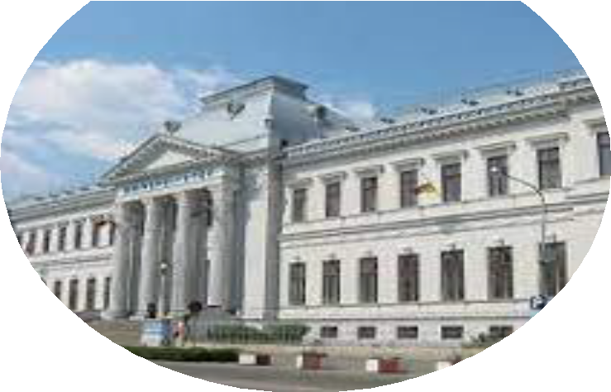
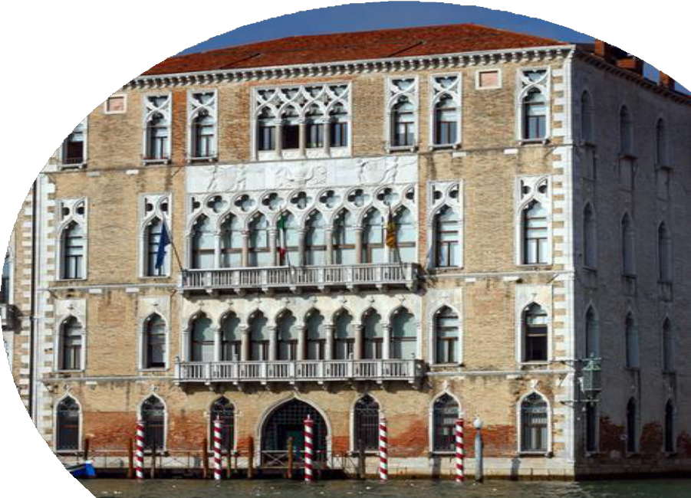
Data and methods
A total of 70 answers were received for the survey. As no personal data was collected, it is not possible to establish with certainty the provenience country of respondents.
Therefore, all answers are included and treated equally in the analysis.
Study design and population
The survey was conducted during January 2023 - March
2023, online.
Eligible participants were adults (≥18 years old).
The survey was available in English and it was disseminated through social media (Facebook groups) targeting mainly people associated with the University of Craiova, Romania and Ca’Foscari University of Venice (e.g., students, academic and non-academic staff).

Slide 5
Data and methods
Data collection
The survey included 3 questions; first question involve a five-fold Likert-type items, while two are multiple-choice questions.
The survey did not collect/require any kind of personal/identification data
The questions of the survey focused on the following
aspects:
degree of tourists’ interest on natural environmental features regarding orography, water presence and vegetation associated with a rural destination (e.g., Wartmann and Mackaness, 2020).
general tourists’ preference for either built or natural
landscape (e.g., Seresinhe et al, 2017). ;
importance of population density in the rural destination
as a decision factor in the tourists’ preferences.

Slide 6
Data and methods
Statistics analysis
The answers were analyzed using descriptive statistical methods (median, mode, frequencies) as considered
more suitable in the association with the Likert-type items used (Boone and Boone, 2012; Guerra et al., 2016).
For the first question the attention focuses on answers receiving marks 4 and 5, thus indicated to be 'important' and 'very important' for the respondents. This particular choice of analysis is based on the practical implications derived from the results, namely the identification of attractive' natural features (compared to others) of a rural destination with the final aim of developing a climate product based on these findings.
The answers to the multiple-choice question are analyzed in terms of frequencies of each proposed choice.
The sample size is appropriate for the type of questionnaire selected (i.e., based mainly on Likert-type items) (e.g., Guerra et al., 2016; Lund, 2021).
In order to estimate the representativeness of the sample size used in the study, we approximated the targeted population as being around 1 3500 000 (i.e., approximative number of tourist arrivals in 2019 in accommodation units in Romania, according to National Institute of Statistics www.insse.ro, table TUR104A in TEMPO database) and requiring a confidence level of 90%, with a margin of error of 10%. In this conditions, the sample size provided by the answers to the survey is representative, although this condition is fulfilled at its lower limit.

Slide 7
Results: Q1. Please rate how important would be for you the following natural features of a rural
destination as contributors to an enjoyable time off (1= not at all important; 5=very important)’.
FREQUENCY OF ANSWERS MARKED WITH 4 AND 5 (%)
NO 1
NATURAL FEATURE
MEDIAN
MODE
presence of water surface (e.g., pond, lake,
river, waterfall etc.)
75.71
5
5
2 | presence of natural vegetation (e.g., forest,
 | shrub, grass etc.) | 5 | 5 | 90.00 | a clim | ate
3 | a high degree of green vegetation cover (i.e., more than 75% of vegetation at its maturity) |  |  |  | product referring to the degree of
 |  | 5 | 5 | 82.86
4 | small (less than 20m) terrain height |  |  |  | green veget | ation
 | differences in the view (e.g., only plain) | 3 | 3 | 38.57
⁵ medium (20-50m) terrain height differences in the view (e.g., small hills) | 4 | 3 | 55.71
⁶ high terrain height differences in the view (e.g., high hills, mountain walls ) | 4.5 | 5 | 71.43
⁷ a high degree of snow cover during winter (i.e., more than 75%) | 4 | 5 | 64.29

Slide 8
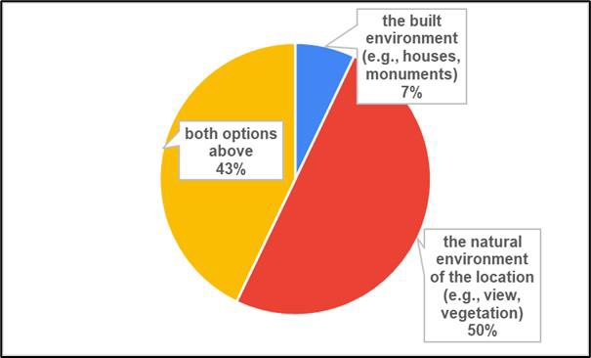
Results: Q2. If you would have to choose from several rural destinations for your vacation, provided all the conditions are similar (e.g., prices, accommodation conditions, leisure opportunities etc.) what characteristics would be more important for you:

Slide 9
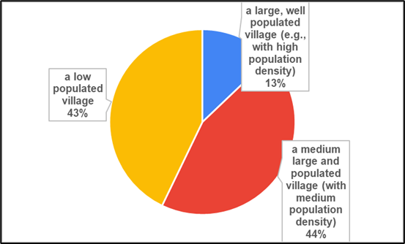
Results: Q3. If you would have to choose from several rural destinations for your vacation, provided all the conditions are similar (e.g., prices, accommodation conditions, leisure opportunities etc.) you would choose

Slide 10
Discussions
The relevance of the findings is limited by several aspects:
The number of the answers - although assuring the statistical relevance of the results, may be
interpreted as too low to be relevant large scale (e.g., national).
As the survey has been disseminated in Romania and Italy, only in English, the number of answers may have been limited also by this aspect, as from all possibly willing people to respond, only those with good English knowledge may have undertaken this effort.
Lack of information on personal aspects (e.g., country/region of provenience, age, social status etc.) provides another limit to the insights offered by the survey.
Furthermore, a later analysis of the relief height for the surroundings of Romanian touristic destinations indicated that differences in relief height within 5 km around the locality are usually much larger than those indicated in the survey (i.e., less than 20m, 20-50m). Nevertheless, this deficiency in the selecting these thresholds in the survey are likely to have been surpassed by the additional use of the relief units as examples: ’only plain’, ‘small hills’, ‘ high hills, mountain walls’.

Slide 11
Conclusions
The survey provides useful information on the hierarchy of the natural features appealing to tourists
in relation to a rural touristic destination, contributing to the research oriented to rural tourism.
The green natural vegetation cover is in the top of tourists’ preferences for a rural destination,
which support the development of tourism-oriented climate products based on this feature.
The presence of water surfaces and the vicinity of high relief are also important natural assets of
such a destination.
Overall, the natural features are of major interest for 44% of the respondents, while 43% are equally
attracted by natural and built environment in a rural destination.
The population density of the destination may also play a role in tourists’ decision regarding the choice of a particular rural destination, with 87% of the respondents preferring middle-low populated localities.
These findings may contribute to explain, even partially, the relatively higher tourism flow in some
rural touristic areas compared to others.

Slide 12
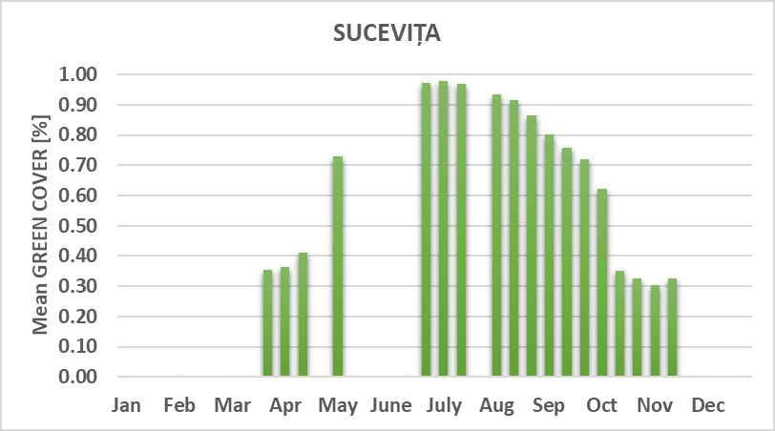
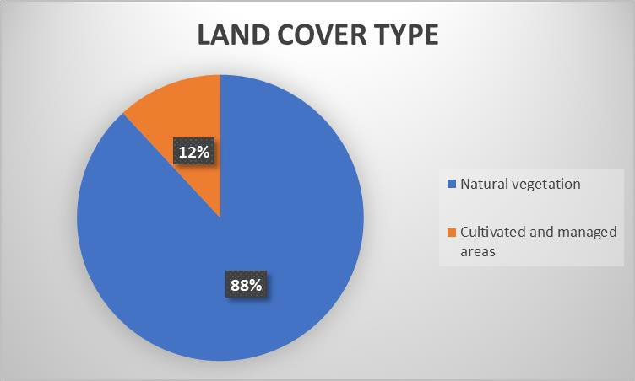
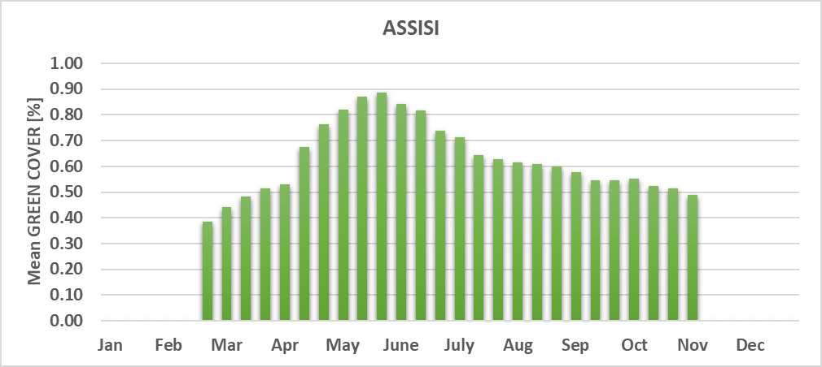
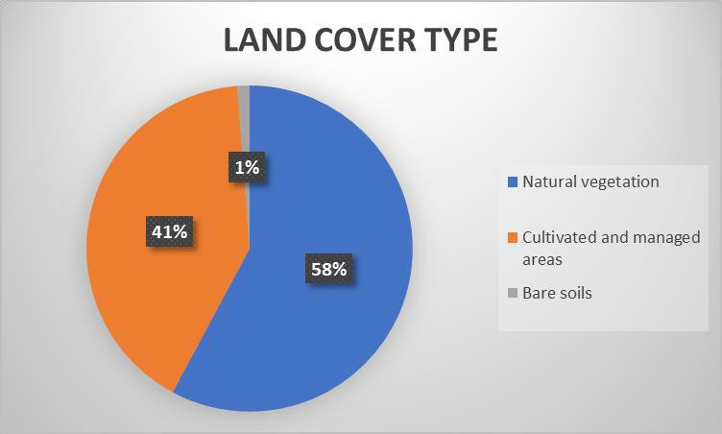
Climate product related to the degree of green vegetation cover
for 10 rural
destinations in Romania and Italy
Freely available from the WeCENT project website https://pric.unive.it/projects/wecent/home along with other climate products

Slide 13
References
Boone, H. N., & Boone, D. A. (2012). Analyzing Likert Data. The Journal of Extension, 50(2), Article 48. available from
https://tigerprints.clemson.edu/joe/vol50/iss2/48
Guerra, A. L., Gidel, T. and Vezzetti, E. (2016): Toward a common procedure using Likert and Likert-type scales in small groups comparative design observations, INTERNATIONAL DESIGN CONFERENCE - DESIGN 2016, Dubrovnik - Croatia,
May 16 - 19, 2016. available from
https://www.designsociety.org/download-
publication/38812/TOWARD+A+COMMON+PROCEDURE+USING+LIKERT+AND+LIKERT- TYPE+SCALES+IN+SMALL+GROUPS+COMPARATIVE+DESIGN+OBSERVATIONS
Lund, B. (2021). The questionnaire method in systems research: an overview of sample sizes, response rates and statistical approaches utilized in studies, VINE Journal of Information and Knowledge Management Systems, doi:10.1108/VJIKMS-08- 2020-0156
Seresinhe, C. I., Preis, T., & Moat, H. S. (2017). Using deep learning to quantify the beauty of outdoor places. Royal Society Open Science, 4, 170170., available at https://rsos.royalsocietypublishing.org/content/4/7/170170
Velea, L., Gallo, A., Bojariu, R., Irimescu, A., Craciunescu, V., Puiu, S (2022): Holiday Climate Index:Urban — Application
for Urban and Rural Areas in Romania, Atmosphere, vol. 13, pp. 1519, https://doi.org/10.3390/atmos13091519
Wartmann, F.M. and Mackaness, W.A. (2020): Describing and mapping where people experience tranquillity. An exploration
based on interviews and Flickr photographs, Landscape Research, 45:5, 662-681. doi: 10.1080/01426397.2020.1749250
This project has received funding from the European Union’s Horizon 2020 research and innovation programme under the Marie
Sklodowska-Curie grant agreement No. 887544

