Slide 1
THE IMPORTANCE CONSUMPTION
OF HONEY
IN THE HEALTHY ALIMENTATION
Ing. Șurlea CRISTINA
CS 3 Ing. Roșu LAURENȚIU

Slide 2

On one hand, the roumanians eat too much, too fat, too sweet and far too much meat; on the other hand, they eat too few vitamins, minerals and fibrous foods. The question is how did this wrong alimentation become so popular?
One reason would be the industrial processing of many aliments. Over 60% of the aliments offered are industrially finite products. The daily necessary of energy is ensured – at present – in a percentage of 75- 80%, by overprocessed foods, such as the meats, the margarine, the extraction flour, etc.

Slide 3
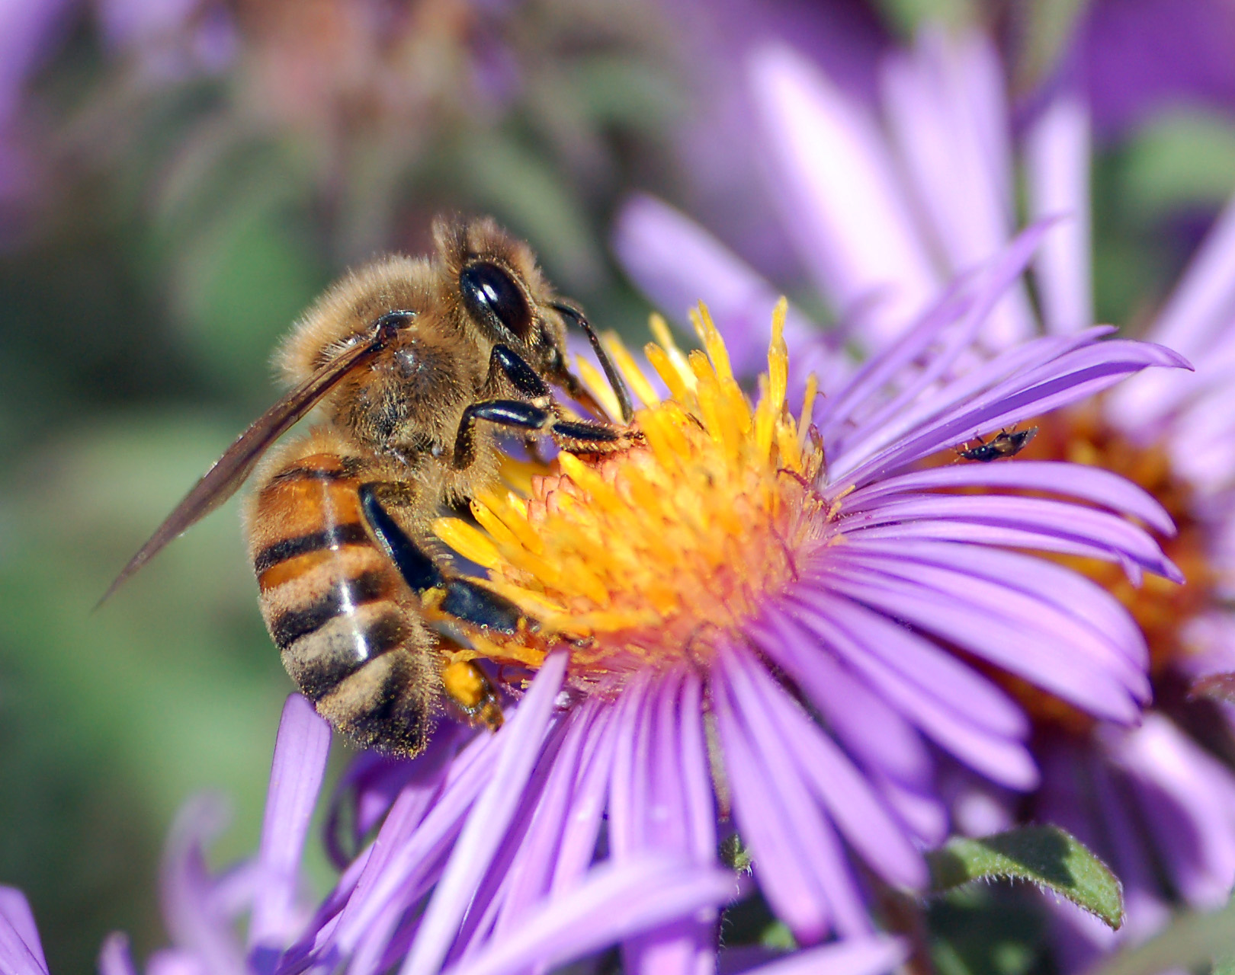
Very often, honey and sugar are “put in the same pot” and it is stated that honey is as harmful as the sugar is. As honey is not an isolated aliment and it differs very much from the table sugar by its chemical composition, it would have different effects on the human organism.

Slide 4
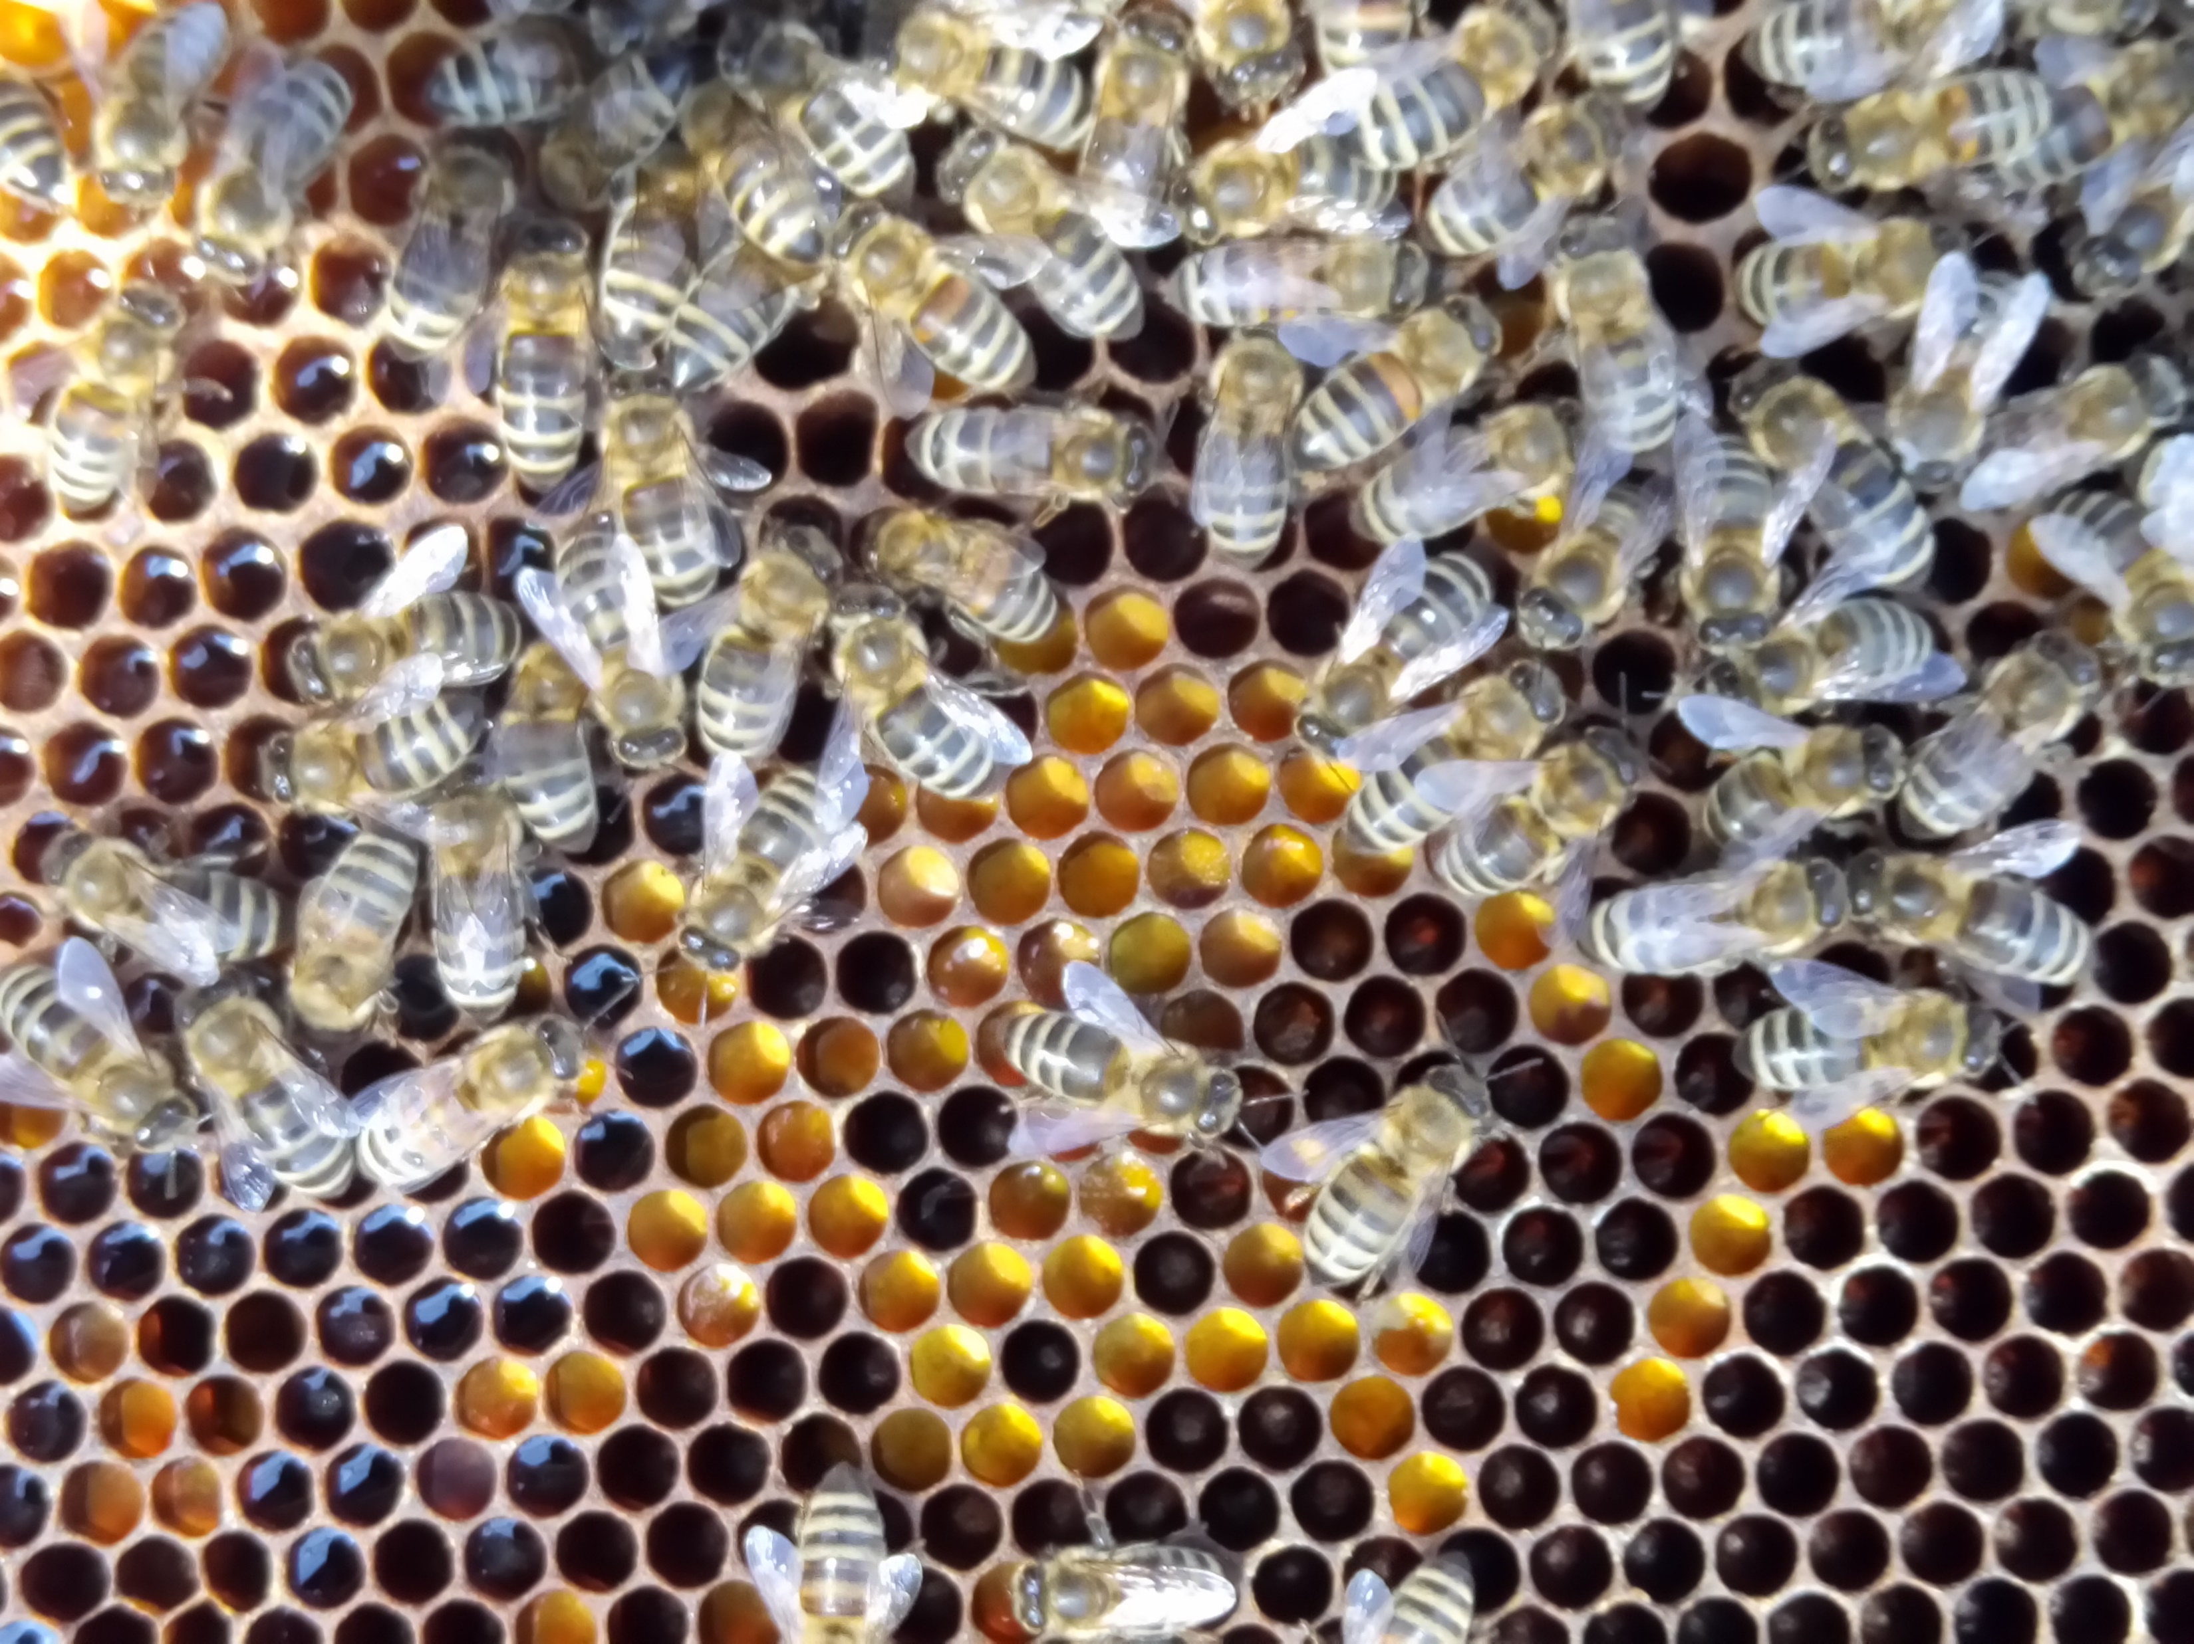
  Ferments
Of course, honey maintains this action of destroying bacteria only if it is treated carefully. Most of its ferments are photosensitive, as well as sensitive to heat. The invertase is very sensitive to heat. At a temperature of 45 ^{O}C, it has a more reduced action after a short time of heating, while after a short heating, at 70 ^{O}C, it is completely destroyed. The action of light also has negative effects on many ferments.
.

Slide 5
The Influence of the Temperatures on the Preservation of the Ferments in Honey*
* Table according to Maurizio (bibliography 9)
Temperature, ^{O}C | The Halving Time
 | Diastase | Saccharase
10 | 12.600 days | 9.600 days
20 | 1.480 days | 820 days
35 | 78 days | 28 days
50 | 15,4 days | 1,3 days
71 | 4,5 hours | 40 minutes
80 | 1,2 hours | 8,6 minutes

Slide 6
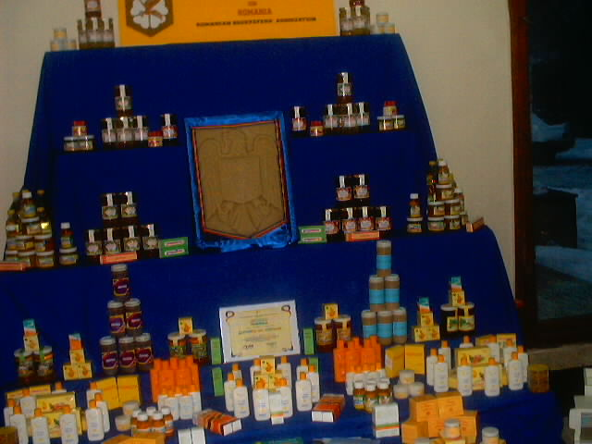
For the maintainance in good health of the human organism, not only the consumption of some nutritive substances, in sufficient amounts is important, but also their quantitative ratio, as well as the form under which they are offered to the organism. If these nutritive substances still belong to a natural association of aliments, then, the chance of a complete utilization of all the components is greater.

