Slide 1



The 25th International Conference on
Tourism and Rural Space in National and International Context
Local Gastronomic Points, an innovative transition path towards sustainable food systems
Dr. Camelia Apetroaie
Iași County Directorate for Agriculture
Dr. Krisztina Melinda Dobay
“Gheorghe Zane” Institute for Economic and Social Research
Ministry of Agriculture and Rural Development
Vatra Dornei
25 - 27 May 2023
Romanian Academy – Iași Branch

Slide 2
Context
In the current period, in the Romanian rural areas the valorization of products from own holdings encounters difficulties caused by:
- the generous offer of vegetable (vegetables, fruits, etc.) and livestock products (dairy, meat products);
- reduced purchasing power for economic reasons;
- the low degree of association for capitalization or the low diversification of activities in most communities.

Slide 3
Established in 2016, at the initiative of the Ivan Patzaichin Association, 23 Mila, the Local Gastronomic Points (PGL) are units represented by private kitchens in the countryside, which can operate in permanent or seasonal households, in agricultural farms, animal farms, sheepfolds, fish farms, wine cellars, wine farms, fruit farms, hunting grounds, monasteries, etc., where culinary products prepared according to recipes specific to the area are prepared and served, directly to the final consumer, for a maximum number of 12 people.
"The story of the local gastronomic points began a few years ago, when the late Ivan Patzaichin, through the Association he led, laid the foundations of such points in the Danube Delta. He took steps so that the people who prepared the meal and served it to the tourists would no longer perform this activity ‘in the dark’. He made approaches to the Ministry of Agriculture and managed to develop many such local gastronomic points in the Danube Delta", explained Dorian Lungu, founder of Gastro Local.
(https://adevarul.ro/stiri-locale/brasov/mostenirea-lasata-de-ivan-patzaichin-punctele-2254809.html).

Slide 4

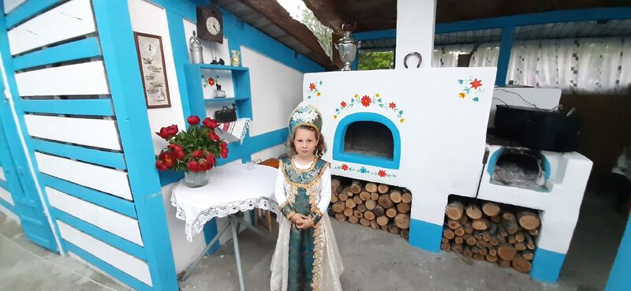
Source: https://www.linkedin.com/feed/, posted by Cristina T. 23.05.2023. Mila 23-Delta Dunării

Slide 5
Context
The establishment of the Local Gastronomic Points represents an opportunity to capitalize on products from own holdings.
Culinary products must be prepared from raw materials predominantly from primary production of one’s own holding, as well as from local producers or from authorized units.

Slide 6
Stages regarding the concerns of economic research and DAJ Iași in the area of Local Gastronomic Points
Year 2021
“Gheorghe Zane” Institute for Economic and Social Research, Department of Rural Economy - 14 October 2021
The Academic Days of Iași - Scientific Meeting
Vectors of rural development in the North-East Region of Romania
DAJ Iași representative – paper presentation:
Local Gastronomic Points: Alternative for capitalizing on own products from family holdings

Slide 7
Stages regarding the concerns of economic research and DAJ Iași in the area of Local Gastronomic Points
Year 2021
DAJ Iași: Information actions regarding the establishment and operation of Local Gastronomic Points.
The collaboration of DAJ Iași with the National Agency for Mountain Areas (ANZM) Vatra Dornei and DSVSA Iași for the organization of an online course for people who serve Local Gastronomic Points (6 - 9 September 2021).
Number of graduates: 21
Opportunity to exchange ideas with participants from Sibiu County.

Slide 8
Vocational training course for people from Iași County
To benefit from the European funds granted by the Ministry of Agriculture and Rural Development for the financing of non-agricultural activities in the transition period 2021 - 2022, including the Local Gastronomic Points, the Iași County Directorate for Agriculture had the initiative to collaborate with the National Agency for Mountain Areas based in Vatra Dornei, Suceava County to organize a course in the city of Iași.
In this context, between 6 and 9 September 2021, the online course was held within the "Professional training program for people who serve Local Gastronomic Points".

Slide 9
Vocational training course for people from Iași County
The participants were young farmers who intended to submit funding applications for the establishment of Local Gastronomic Points, identified by the councilors of the Iași County Directorate for Agriculture during information meetings in the countyside, processors, research representatives and public institutions from Iași County.
The course lecturer came from the National Agency for Mountain Areas, and the Iași County Directorate for Agriculture provided the logistics in its own headquarters for people who chose this way and for those who do not had technical possibilities or internet connection, while the others attended online.

Slide 10
Vocational training course for people from Iași County
An important aspect was also the collaboration during the course with the Iași Sanitary Veterinary and Food Safety Directorate, whose representative informed the participants about the specific legislation and the conditions to register Local Gastronomic Points, giving explanations about the concrete situations presented.
The organization and running of the course in the online system, as well as the presentation of examples of good practice, offered the possibility of an exchange of experience between people from several localities in Iași County (Aroneanu, Bârnova, Bălțați, Dobrovăț, Ion Neculce, Popricani, Rediu, Moțca, Todirești, Iași), as well as with participants from Sibiu County.

Slide 11
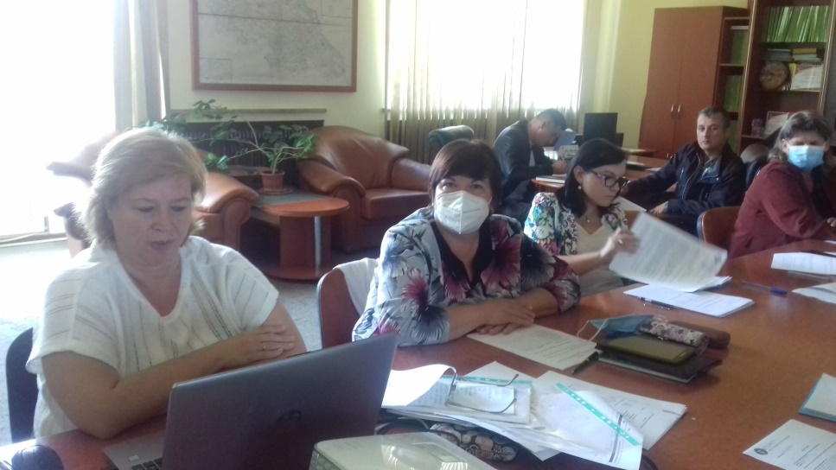
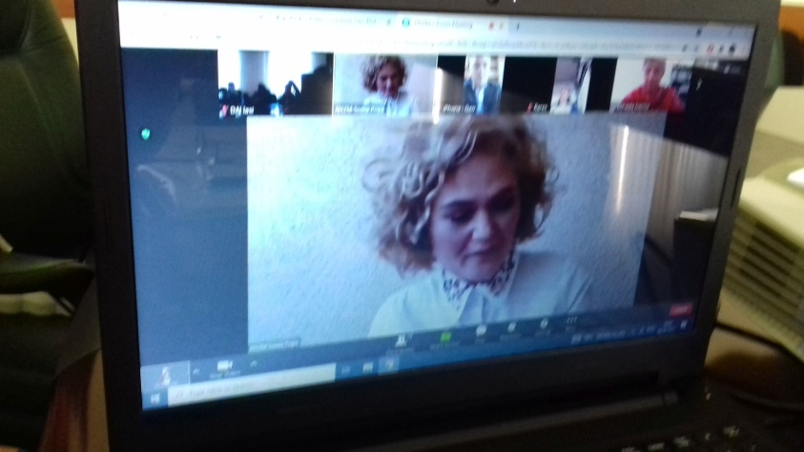
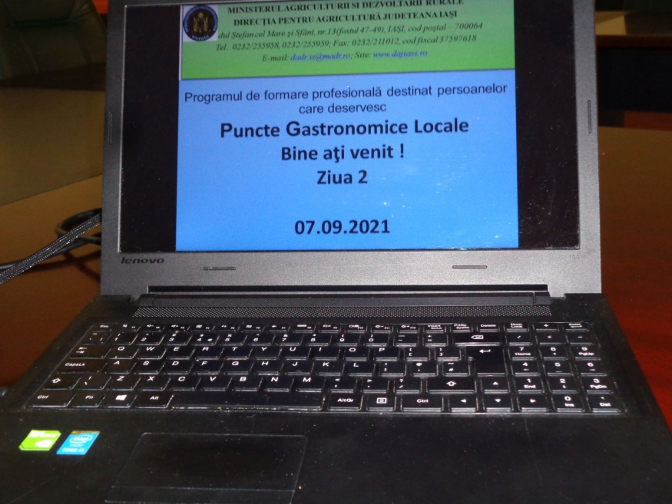
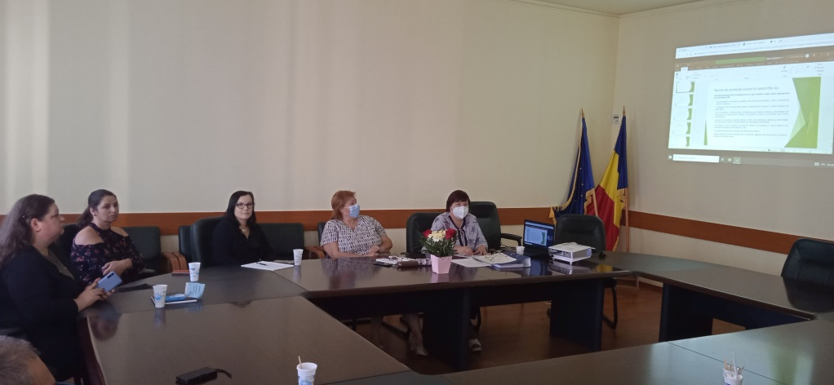

Slide 12
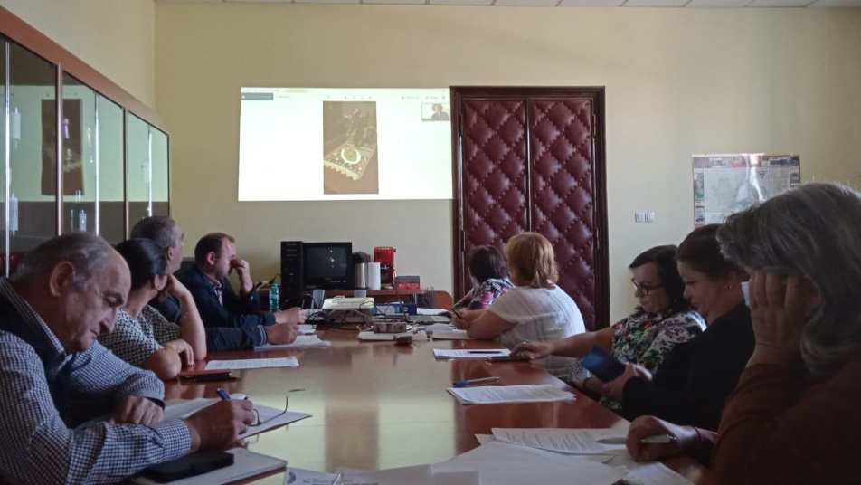
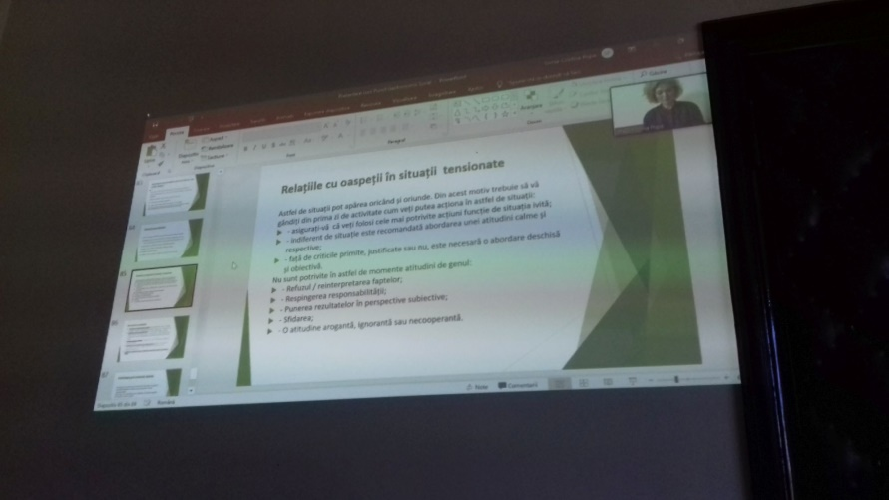
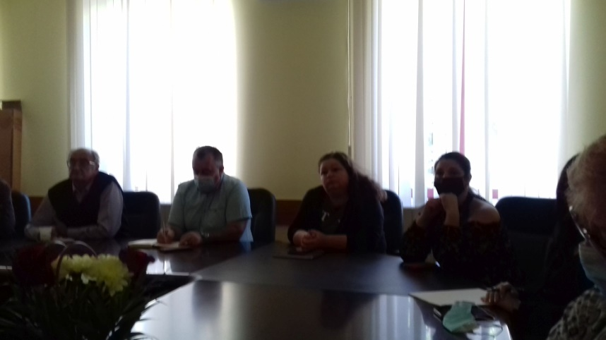
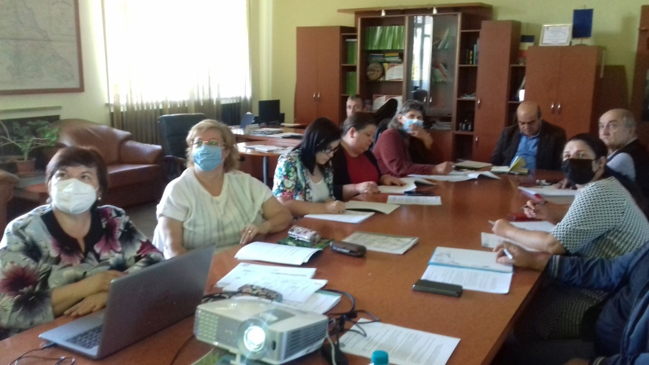

Slide 13
Stages regarding the concerns of economic research and DAJ Iași in the area of Local Gastronomic Points
Period 2021 - 2022
DAJ Iași: Information actions regarding access to European funds for the establishment of Local Gastronomic Points.
PNDR 2014 – 2020 Sub-measure 6.2 "Support for the establishment of non-agricultural activities in rural areas": including sanitary-veterinary and food safety registration for the activities of the Local Gastronomic Points.
PNDR 2014 – 2020 Sub-measure 6.4 "Support for investments in the creation and development of non-agricultural activities": for investments in Local Gastronomic Points.

Slide 14
Stages regarding the concerns of economic research and DAJ Iași in the area of Local Gastronomic Points
Period 2021 - 2022
Clarifications regarding public food services, including Local Gastronomic Point
restaurants
Only restaurants classified according to Order 65/2013 with subsequent amendments and additions, from areas with high tourist potential, are eligible for the approval of methodological norms regarding the classification of tourist reception structures, but insufficiently developed from a tourist point of view, in accordance with Emergency Ordinance no. 142 of October 28, 2008 regarding the approval of the National Territorial Development Plan, Section VIII - areas with tourist resources, with subsequent amendments and additions.
Applicants who propose such investments must also consider submitting the documentation related to the proposed investment to ANSVSA so that, upon completion of the investment, they can obtain the operating authorization.
Source: Applicant Guide – Sub-measure 6.2,
Version 04 – 2021

Slide 15
Stages regarding the concerns of economic research and DAJ Iași in the area of Local Gastronomic Points
Period 2021 - 2022
Clarifications regarding public food services, including Local Gastronomic Point
The areas of diversification covered under the sub-measure are: tourist activities (eg: camping accommodation structures, caravan parks, bungalows, leisure tourist services and public catering, including the Local Gastronomic Point).
The Local Gastronomic Points will operate at the registered office or at the applicant's workplace.
The non-refundable public support is 50,000 euros/project
Source: Applicant Guide – Sub-measure 6.2,
Version 04 – 2021

Slide 16
Stages regarding the concerns of economic research and DAJ Iași in the area of Local Gastronomic Points
Clarifications regarding public food services, including Local Gastronomic Point
Selection principles Scoring
The principle of stimulating tourist activities Max. 25 points
(except for the establishment /modernization/
the expansion of agro-pensions, guesthouses,
hotels) and/or leisure and/
or public catering establishments
in areas with high tourist potential
Source: Applicant Guide – Sub-measure 6.2,
Version 04 – 2021

Slide 17
Stages regarding the concerns of economic research and DAJ Iași in the area of Local Gastronomic Points
Clarifications regarding public food services, including Local Gastronomic Point
Selection criteria Score
Projects aimed at investments in activities of Max. 25 points
leisure and/or public catering units,
in areas with high tourist potential
The score given to this criterion is calculated
depending on the location of the investment (municipality),
in localities with a very high concentration of resources
and in localities with a high concentration of resources.
Source: Applicant Guide – Sub-measure 6.2,
Version 04 – 2021

Slide 18
Stages regarding the concerns of economic research and DAJ Iași in the area of Local Gastronomic Points
Period 2021 - 2022
Types of eligible investments and expenses:
New investments/ modernizations/ expansions of public food structures, including the Local Gastronomic Point.
The intensity of non-reimbursable public support is 70% of the total eligible expenses.
The amount of eligible non-refundable expenses (corresponding to the percentage of 70%) will be a maximum of 200,000 euros, in compliance with the conditions of the de minimis aid.
The minimum ceiling accepted for a project financed by this sub-measure is 10,000 euros, this amount representing the total eligible value of the project.
Source: Applicant Guide – Sub-measure 6.4,
Version 04 – 2021

Slide 19
Stages regarding the concerns of economic research and DAJ Iași in the area of Local Gastronomic Points
Clarifications regarding public food services, including Local Gastronomic Point
Selection principles Scoring
The principle of stimulating tourist activities and/ Max. 15 points or leisure and/or public catering units located in areas with high tourist potential
Source: Applicant Guide – Sub-measure 6.4,
Version 04 – 2021

Slide 20
Stages regarding the concerns of economic research and DAJ Iași in the area of Local Gastronomic Points
Clarifications regarding public food services, including Local Gastronomic Point
Selection criteria Score
Projects aimed at investments in activities of Max. 15 points
leisure and/or public catering units,
in areas with high tourist potential
The score given to this criterion is calculated
depending on the location of the investment (municipality),
in localities with a very high concentration of resources
and in localities with a high concentration of resources.
Source: Applicant Guide – Sub-measure 6.4,
Version 04 – 2021

Slide 21
Stages regarding the concerns of economic research and DAJ Iași in the area of Local Gastronomic Points
Period 2022 - 2023
DAJ Iași: Information actions regarding the establishment and operation of Local Gastronomic Points.
Promoting examples of good practice from the North-East Region and from the national level.
Participation in the Seminar organized by DAJ Suceava: "Local Gastronomic Points - a way to develop rural communities and local tourism, a way of capitalizing on the products obtained on the farm" and contacting the representative of the Local Gastronomic Point.

Slide 22
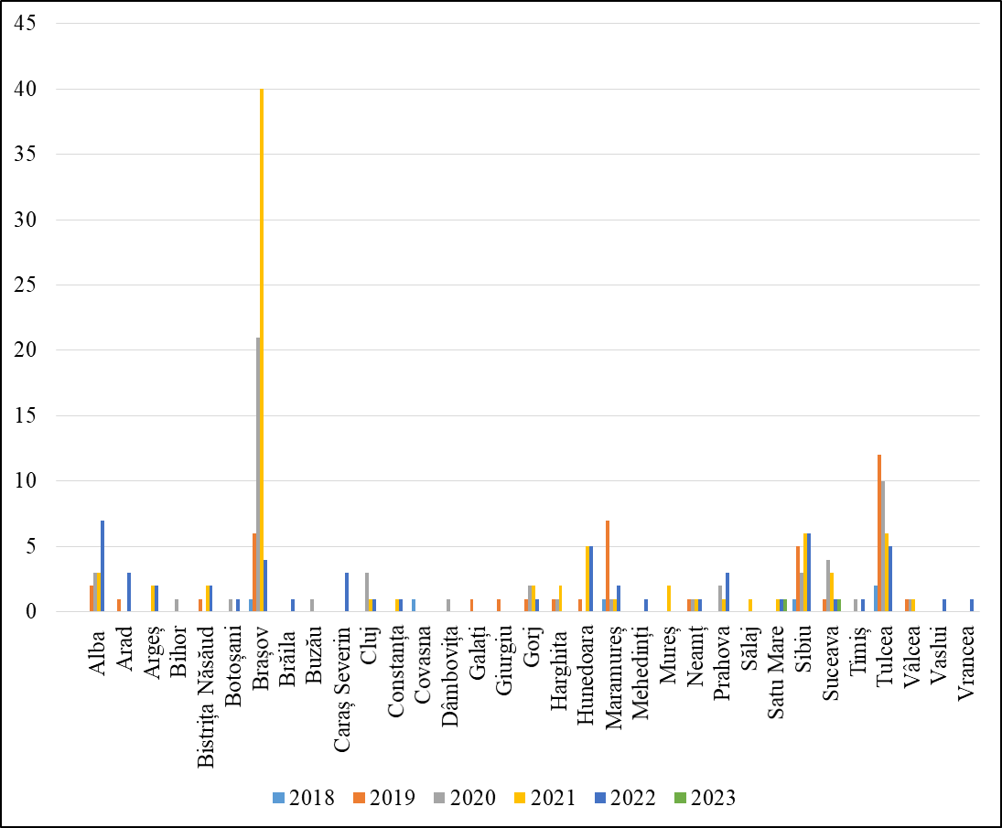
Evolution of Local Gastronomic Points
In the period 2018-2023 (until March), 242 PGL were established, of which, most in the counties: Brașov (72), Tulcea (35), Sibiu (21), Alba (15), Maramureș (12) , Hunedoara (11).

Slide 23
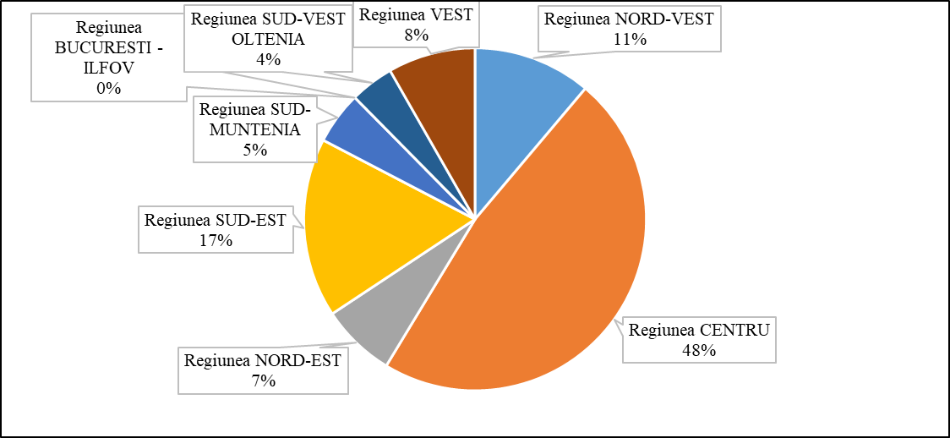
Regional distribution of Local Gastronomic Points (March 2023)
Most of the PGL are located in the Center and the North-West.

Slide 24
Local Gastronomic Points from
the North - East Region
In the North-East Region, 17 PGL are registered in the counties: Neamț (4), Botoșani (2), Suceava (10), Vaslui (1).
      Source: ANSVSA 2023 processed data

Slide 25


PGL Neamț County
Vis Împlinit Copii fericiți SRL
Date of registration: 15 January 2020
Location: Horia village, Horia commune, Neamț County

Slide 26


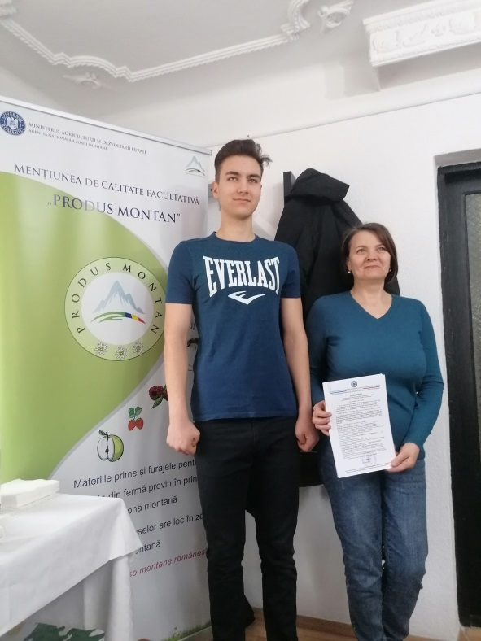
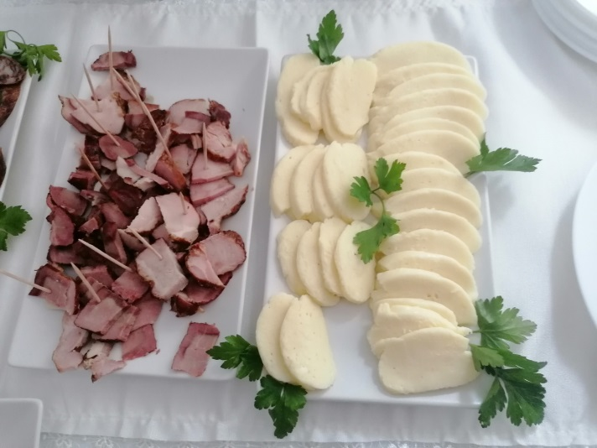
PGL Neamț County
Bucate Tradiționale Bicazu Ardelean PGL

Slide 27
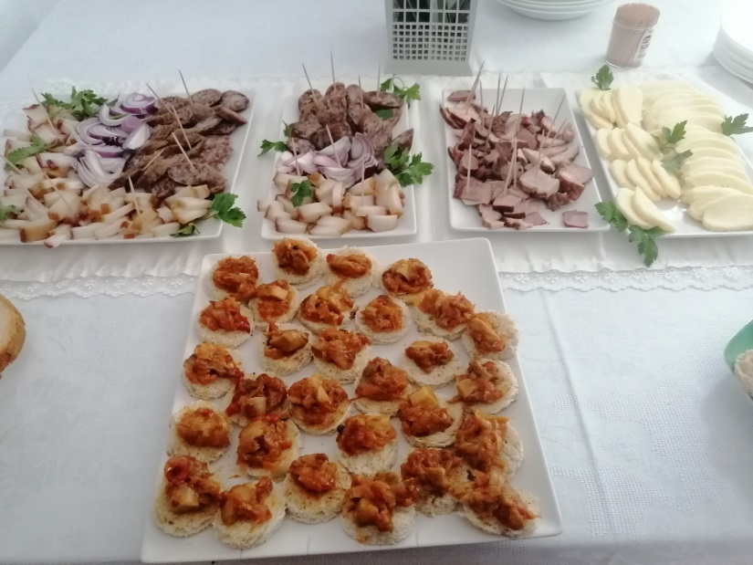
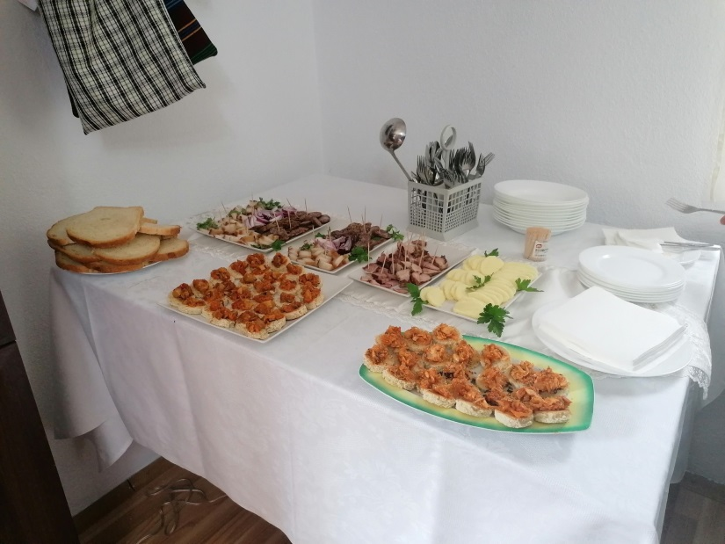

PGL Neamț County
Bucate Tradiționale Bicazu Ardelean PGL
Location:
Bicazu Ardelean commune
Date of registration: 22 December 2022

Slide 28

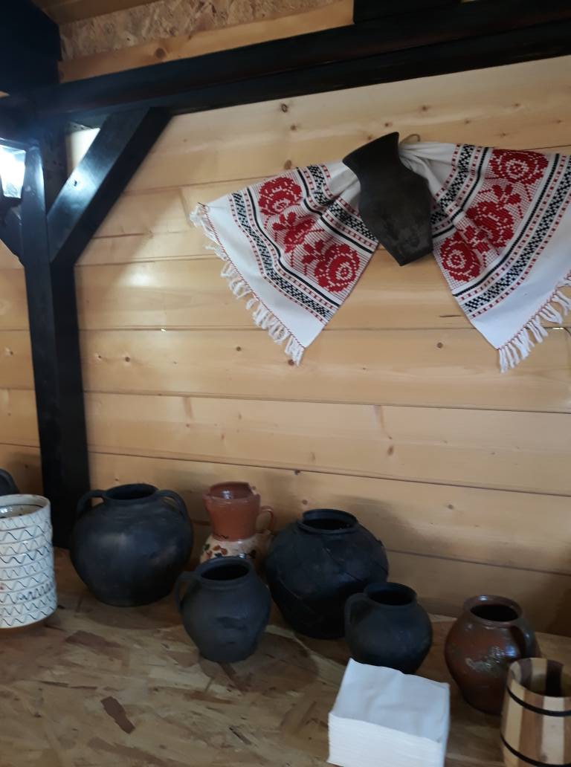
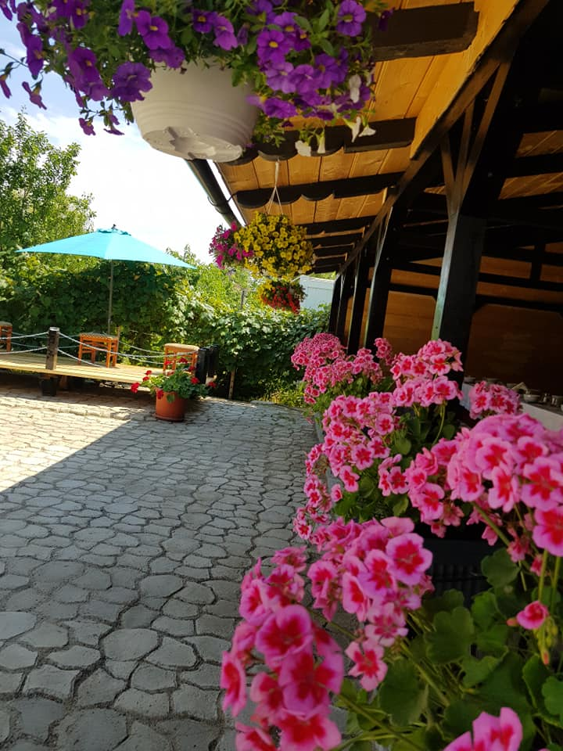
Local Gastronomic Point
Botoșani County
I.I. Simion C. Ioan

Slide 29
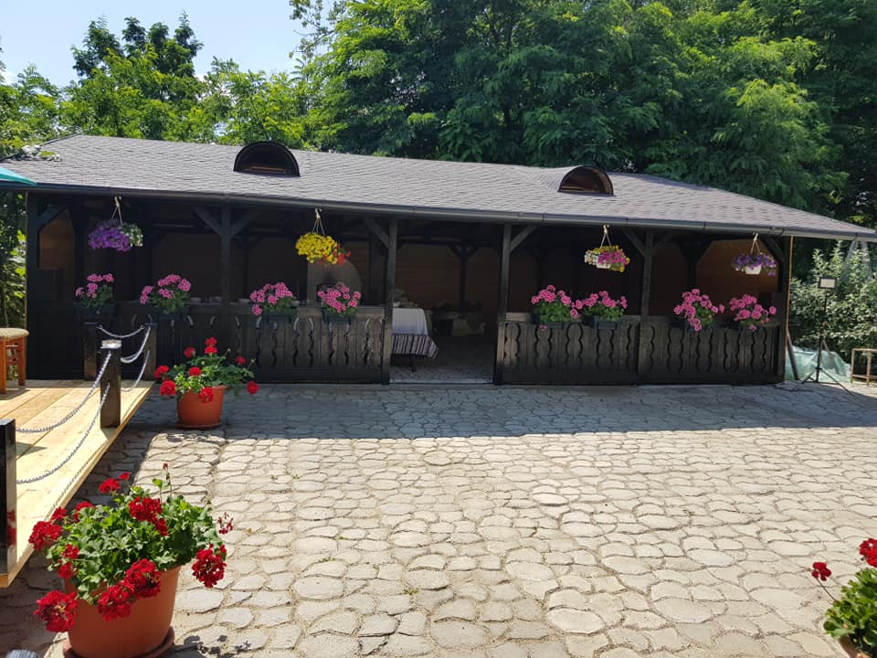
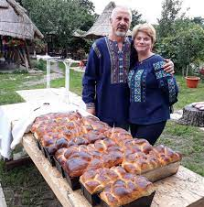
Inființare
Date of registration: 4 August 2020
Location: Brehuiești village, Vlădeni commune, Botoșani County

Slide 30
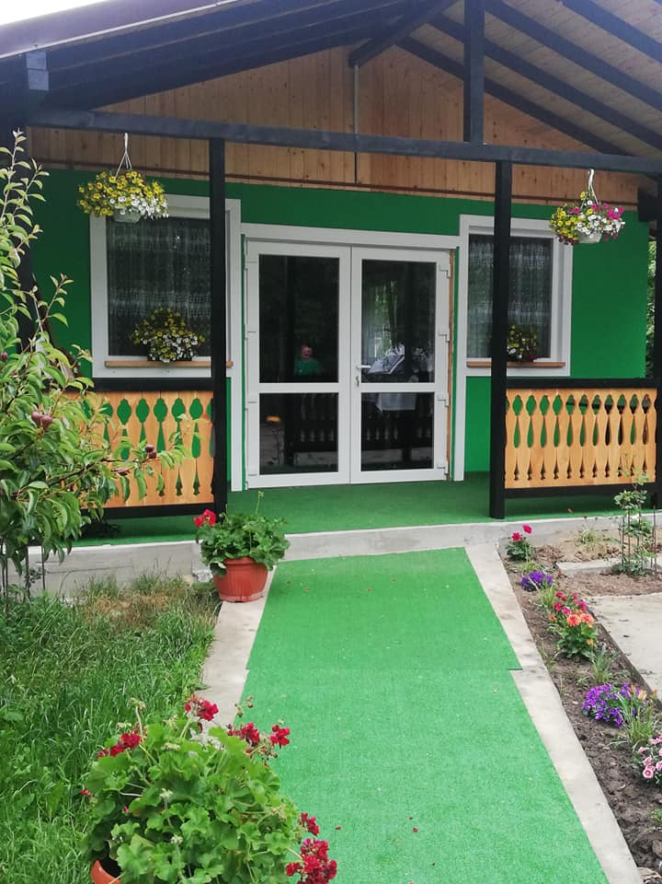
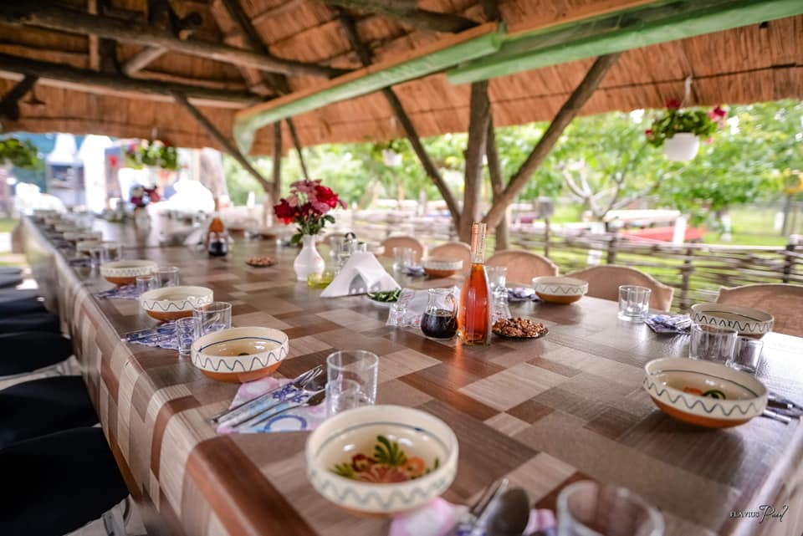

Slide 31
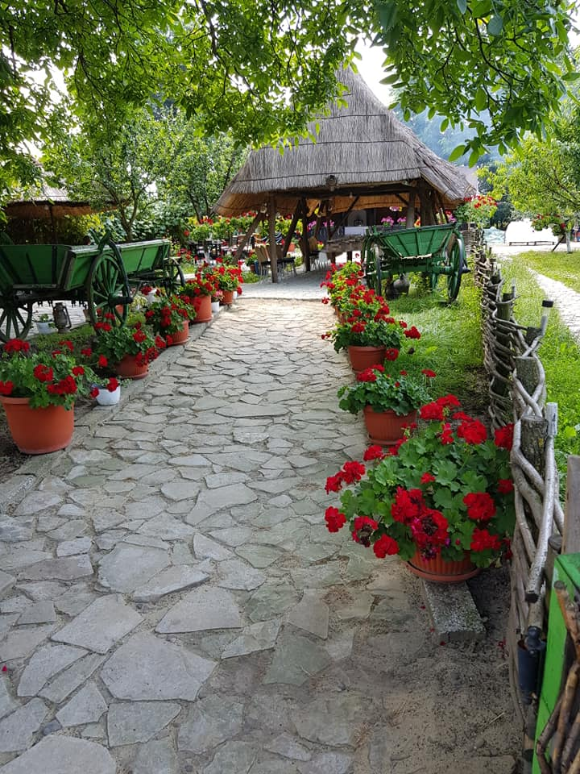
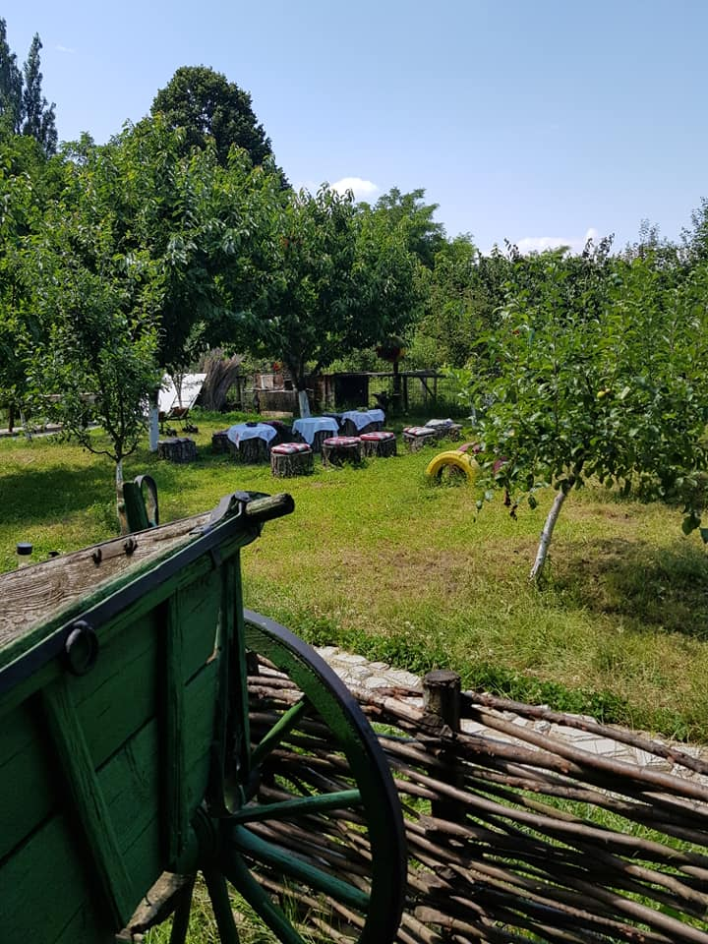
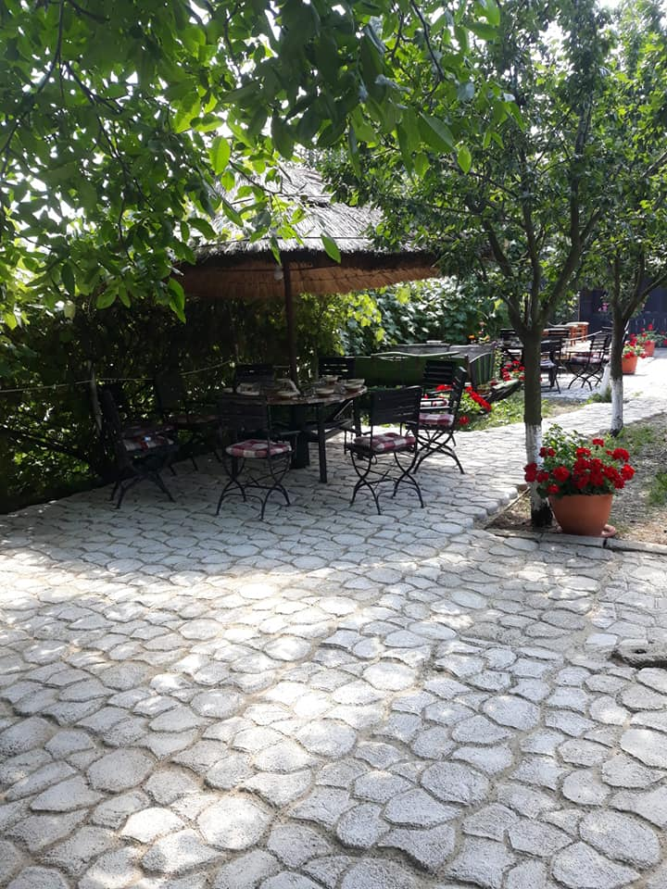

Slide 32
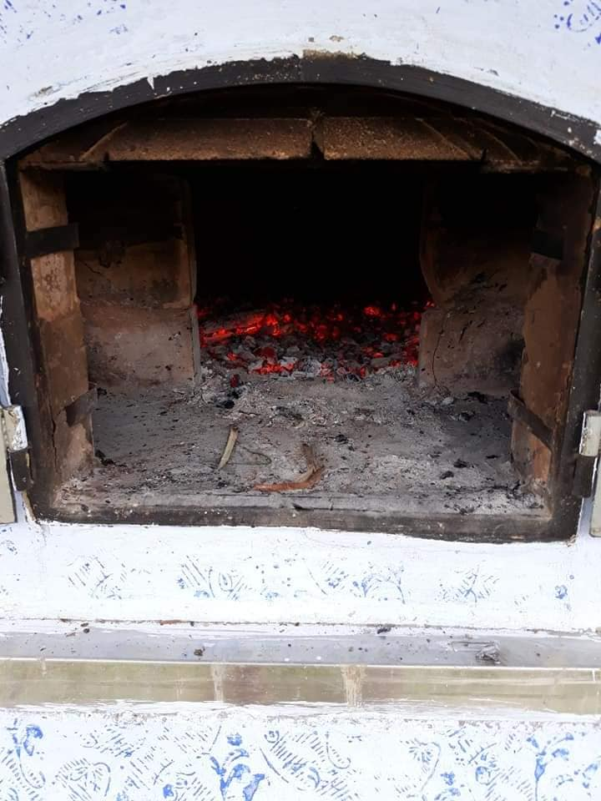
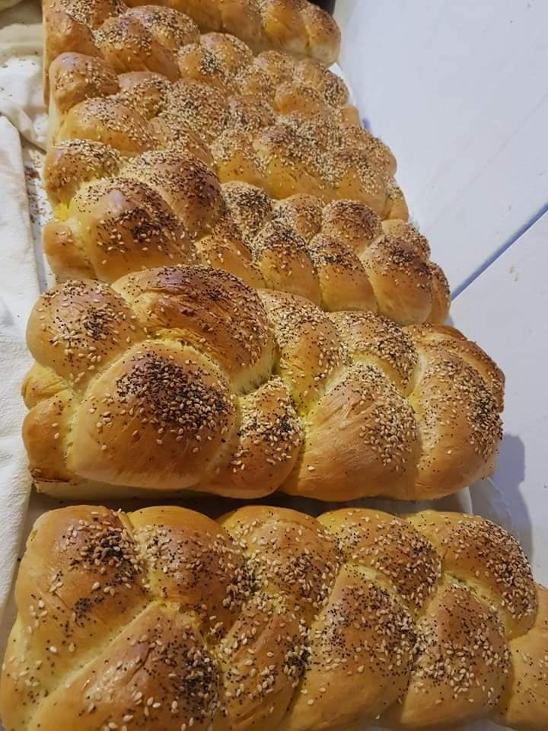

Slide 33
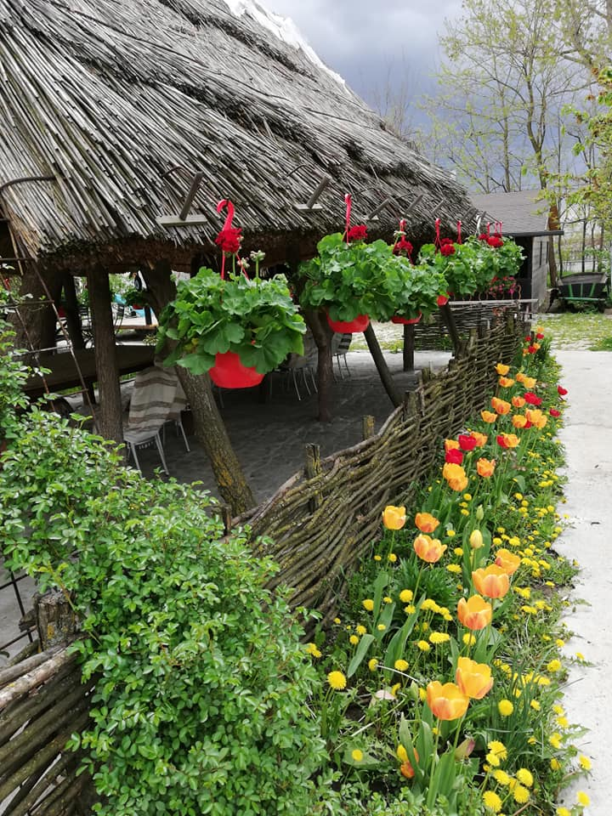
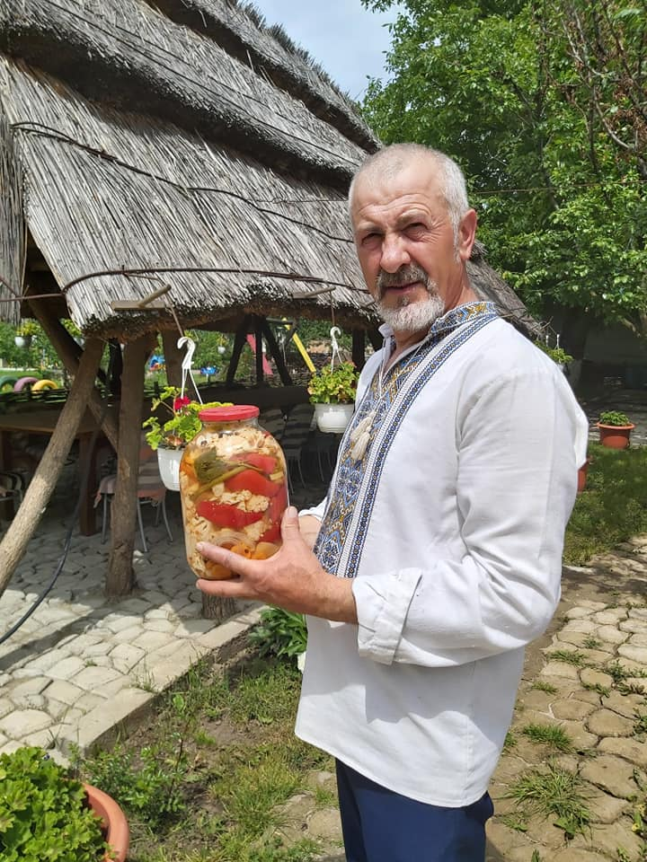

Slide 34
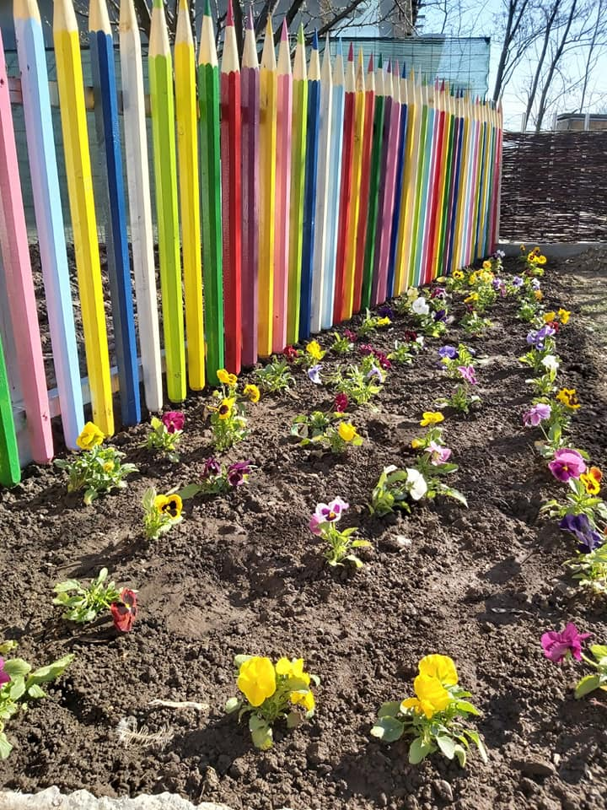
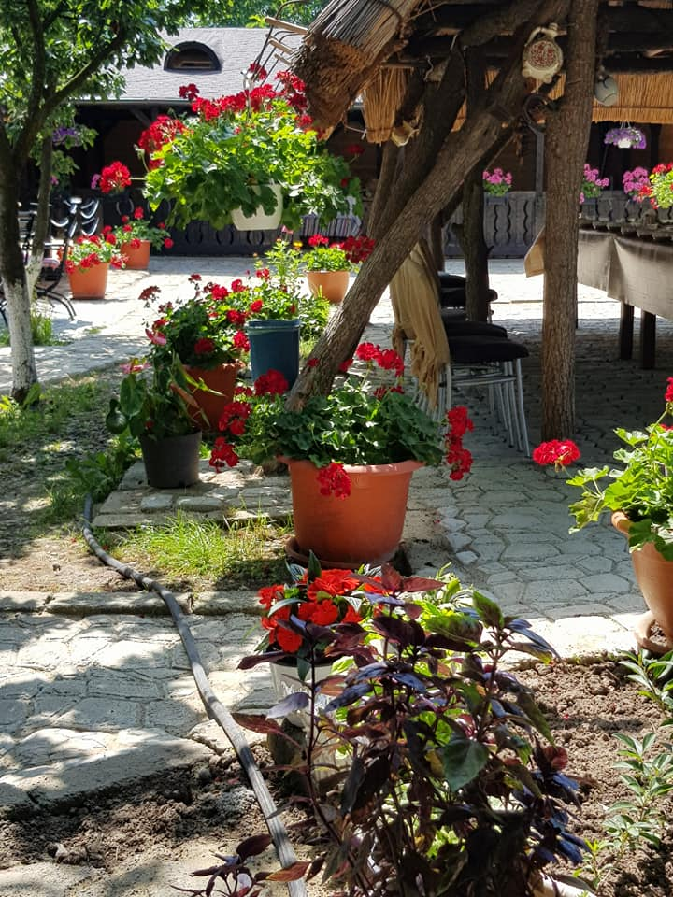
Source: Facebook La nea Titi Brehuiești

Slide 35
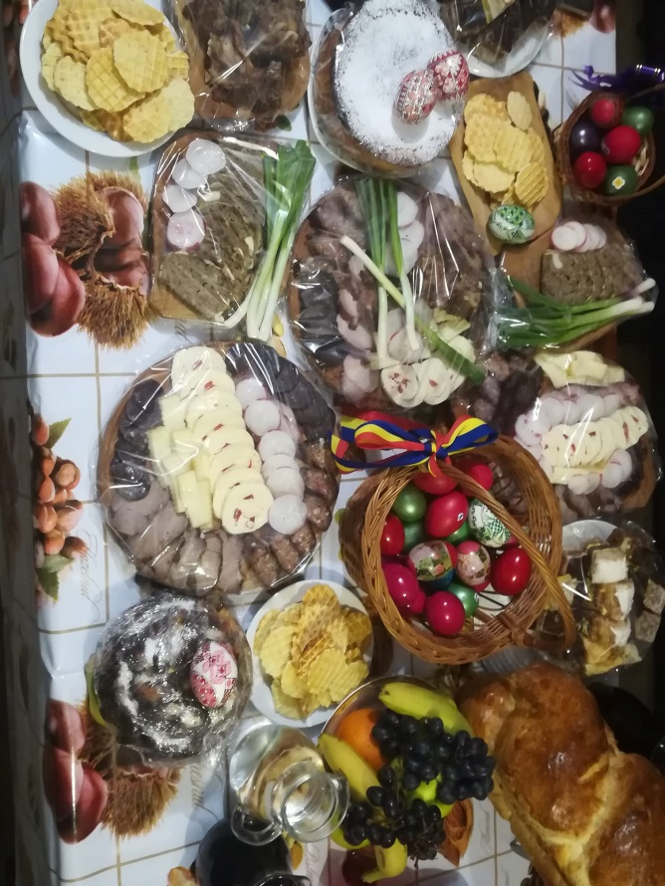
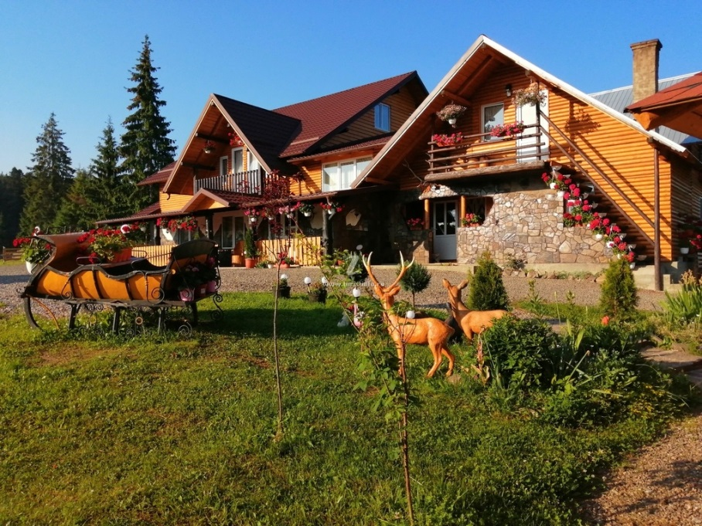
PGL Suceava County
Cabana Măgura –
Dorna Candrenilor

Slide 36
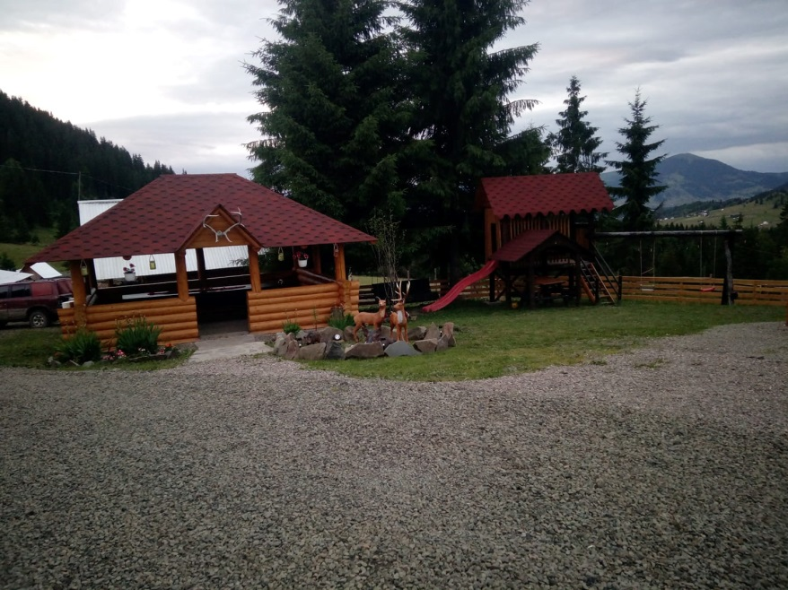
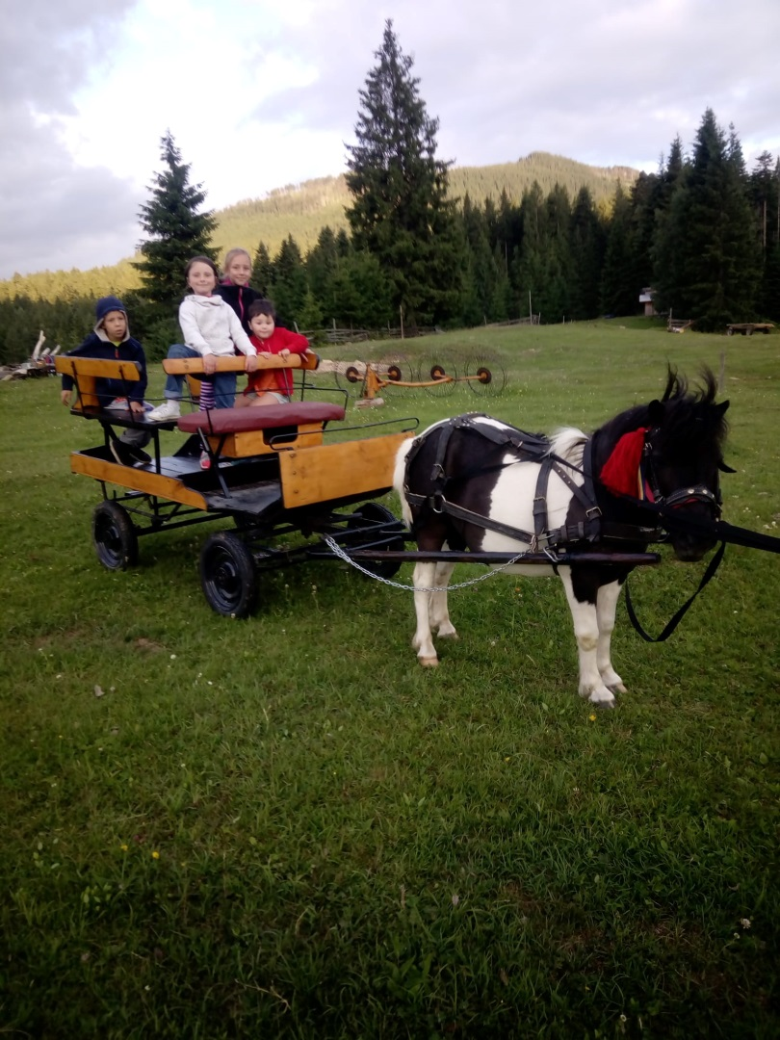
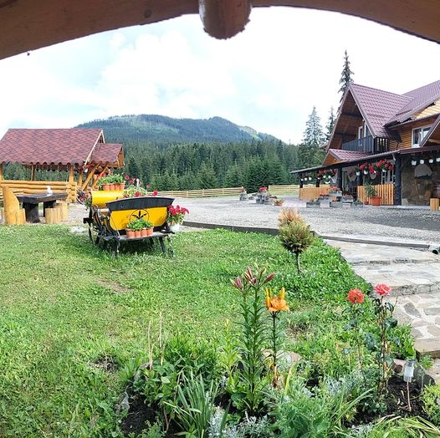

Slide 37
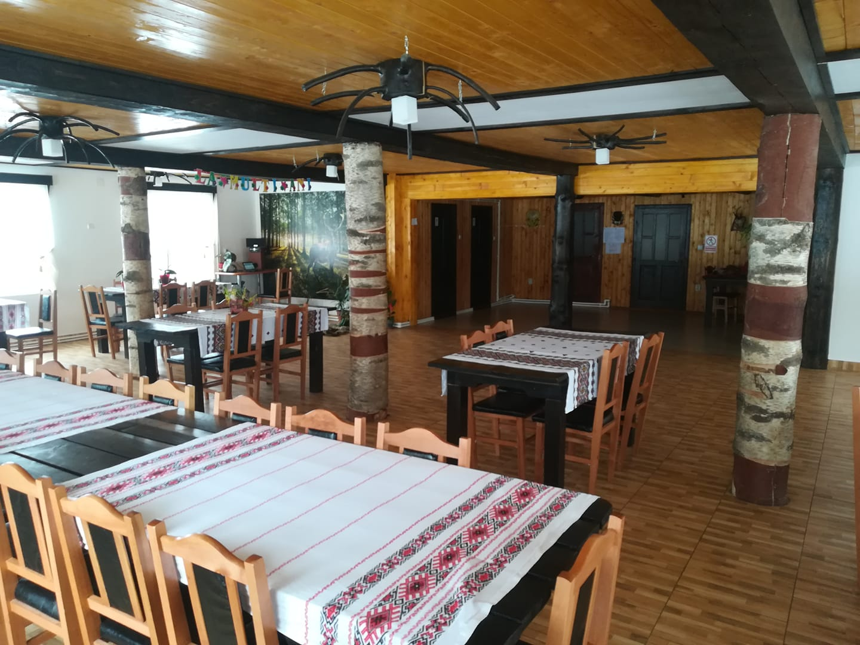
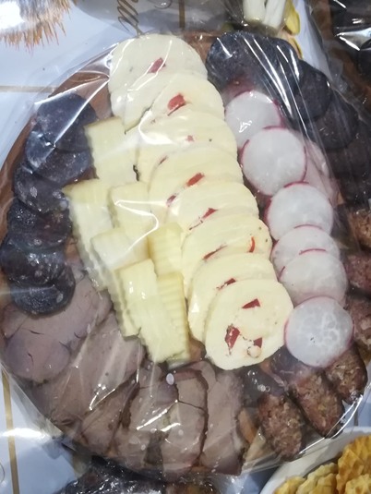
Date of registration: 19 March 2020
Location: Poiana Negrii village, Dorna Candrenilor commune

Slide 38
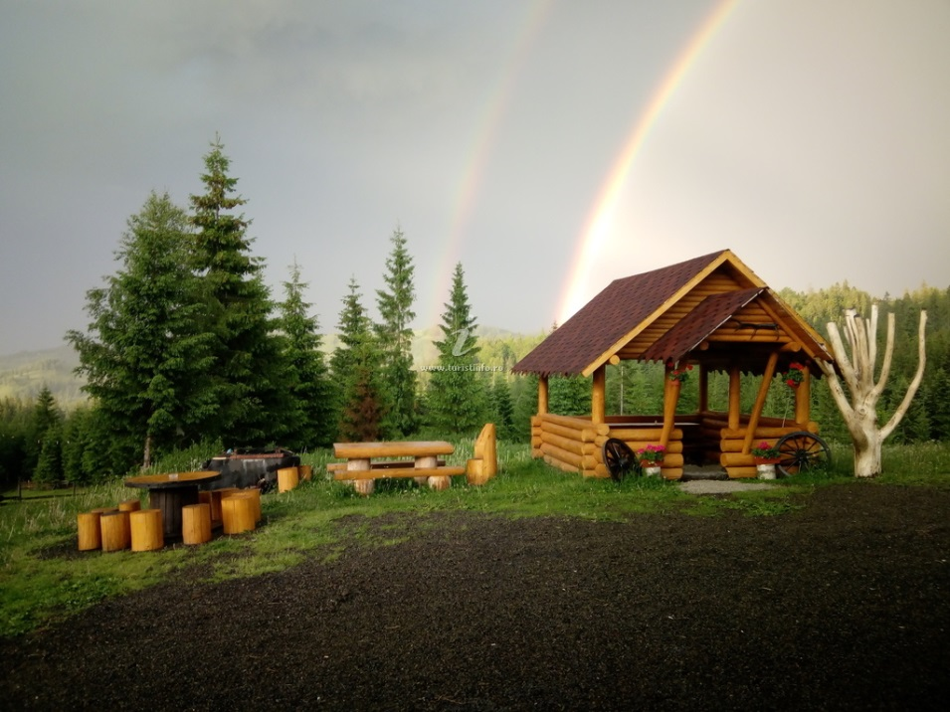
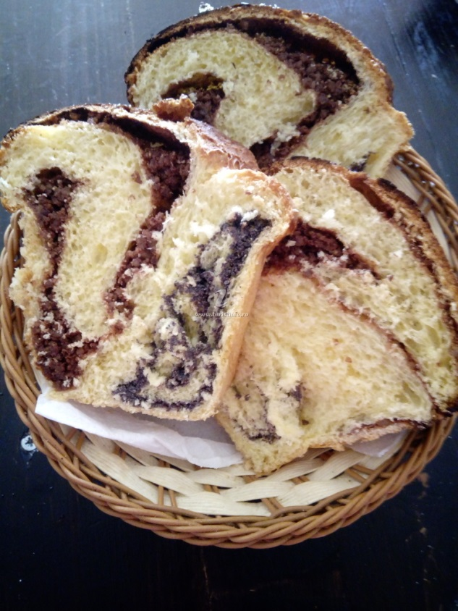
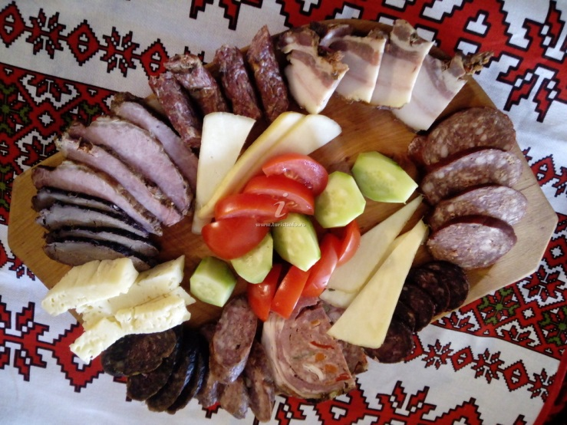

Slide 39
Example of good practice - Bălțati commune, Iasi County
Young participants in the "Professional training program for people who serve Local Gastronomic Points" organized by the National Agency of the Mountain Area.
Intention to access European funds through Sub-measure 6.2 for the establishment of a Local Gastronomic Point.
As a result of the impossibility of having a score regarding the location of the investment (municipality), in localities with a very high concentration of resources and in localities with a high concentration of resources: Initiation of action for UAT Bălțăti.

Slide 40
Example of good practice - Bălțati commune, Iasi County
At the proposal of the Ministry of Development, Public Works and Administration, the Government approved 21 new localities as areas with tourist resources in 11 counties.
BĂLȚAȚI COMMUNE, IAȘI COUNTY – AREA WITH TOURIST RESOURCES

Slide 41
Example of good practice - Bălțati commune, Iasi County
GD no. 89/31.01.2023, Official Gazette no. 99/6 February 2023
BĂLȚAȚI COMMUNE, IAȘI COUNTY –
AREA WITH TOURIST RESOURCES

Slide 42
Example of good practice - Bălțati commune, Iasi County
ELoGE – THE EUROPEAN LABEL FOR EXCELLENCE IN GOOD GOVERNANCE
First Edition – 11 May 2023
Project implemented in partnership with the Council of Europe - Democratic Governance Division - Expertise Center for Good Governance.
The Council of Europe has been implementing the ELoGE Label for 15 years, in 20 member states. 2023 is the first year in which this distinction of good governance was also awarded to local authorities in Romania.
It is an award granted by the Council of Europe to local public administration authorities, based on an analysis made through a European and international evaluation mechanism regarding the quality of local government (Benchmark) and represents a way of certifying, appreciating and recognizing those local authorities whose activity is carried out in accordance with the standards of the Council of Europe and international standards.
Out of the 30 local public authorities selected for evaluation in the first edition of this competition, the Bălțati Town Hall is the only participating authority from Iasi County.

Slide 43
Example of good practice - Bălțati commune, Iasi County
ELoGE – THE EUROPEAN LABEL FOR EXCELLENCE IN GOOD GOVERNANCE
Of the 12 principles of good democratic governance, the following can be mentioned:
  Receptivity.
  Openness and transparency.
  Innovation and openness to change.
  Sustainable development and long-term orientation.
The local public administration authority has presented evidence of good practice, which can be disseminated and developed further, ensuring sustainable and long-term process improvement.

Slide 44
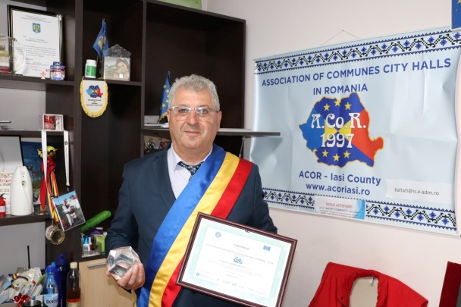
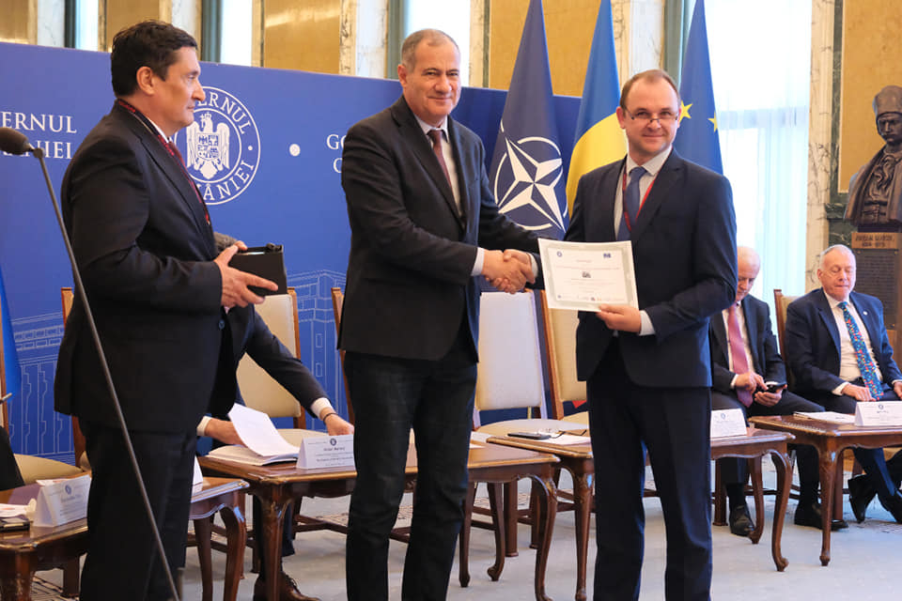
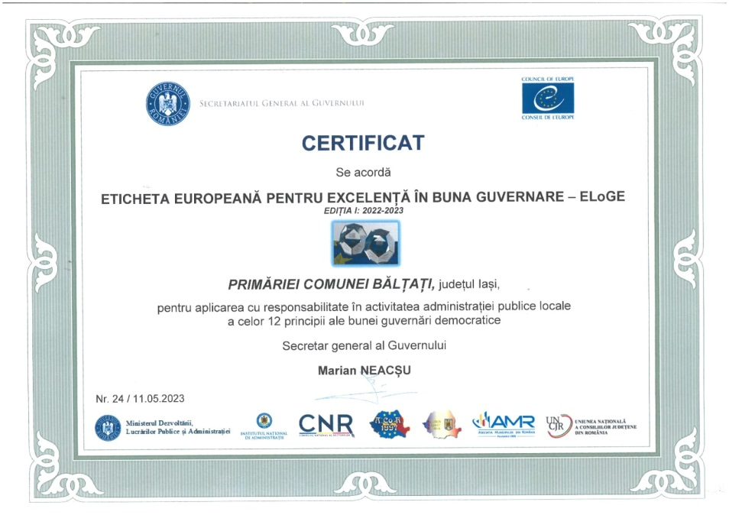
Example of good practice - Bălțati commune, Iasi County
ELoGE – THE EUROPEAN LABEL FOR EXCELLENCE IN GOOD GOVERNANCE

Slide 45
Example of good practice - Innovative project LAG
QR 4 ALL – innovative project that brings together 9 Local Action Groups from the Iași area, was awarded for innovation and creativity by the Association of Journalists and Writers of Tourism from Romania.
The 9 LAGs are: GAL Colinele Iașilor - project coordinator, GAL Stejarii Argintii, GAL Valea Prutului, GAL Rediu - Prăjeni GAL, GAL Ștefan cel Mare, GAL Dealurile Bohotinului, GAL Microregion Belcești - Focuri, GAL Siret - Moldova, GAL Codrii Pașcanilor – partners in the project.
The QR4ALL project aims to stimulate tourism by identifying and capitalizing on local objectives in the territories of the partner Local Action Groups, using innovative and interactive methods and including the development of an interactive tourist guide.
Source: National Rural Development Network

Slide 46

Example of good practice - Innovative project LAG

Slide 47
European funds – National Strategic Plan
DR-29 Investments in the creation and development of non-agricultural activities
Specific objectives :
Promoting employment, economic growth, gender equality, including women's participation in agriculture, social inclusion and local development in rural areas, including the circular bio-economy and sustainable forestry.
The needs addressed by the intervention:
Increasing the number of jobs in the non-agricultural sector in rural areas
Supporting non-agricultural activities to increase alternative rural incomes.

Slide 48
European funds – National Strategic Plan
DR-29 Investments in the creation and development of non-agricultural activities
Principles of selection
Within the intervention, projects that contribute to encouraging the diversification of agricultural activity towards non-agricultural production activities, the development of digitization, environmental protection, bio-economy and circular economy activities, will be prioritized in order to make the proposed activities more efficient.
Also, priority will be given to agricultural/handicraft-themed tourist activities and agreement activities and public catering units.

Slide 49
European funds – National Strategic Plan
DR-29 Investments in the creation and development of non-agricultural activities
Eligible beneficiaries
micro-enterprises in rural areas;
the beneficiaries will comply with the provisions of the European and national legislation in force regarding the granting of de minimis aid.
Conditions of eligibility
The investment must be made in the rural area.
The applicant must not be insolvent or in difficulty.
The investment must fall into at least one of the areas supported by the intervention.
The applicant must demonstrate the ability to secure the co-financing of the investment.
The economic viability of the investment must be demonstrated based on the presentation of a technical-economic documentation.

Slide 50
European funds – National Strategic Plan
Support is granted for investments necessary for the development of non-agricultural businesses in rural areas, targeting the following areas:
→ production,
→ services,
→ tourism.
In the year 2021, under Sub-measure 6.4 "Support for investments in the creation and development of non-agricultural activities" from the PNDR under Tourist Activities, it was foreseen: the modernization/expansion/equipment of agro-pensions, the establishment/modernization/expansion/equipment of camping-type accommodation structures, caravan parks, bungalow, leisure tourist services and public catering, including the Local Gastronomic Point.
The maximum amount of public support/project is 200,000 Euros.
The intensity of non-reimbursable public support related to the eligible costs per project will be 65%.
Source: Report on the PAC 2021 Strategic Plan approved by the European Commission with Decision C(2022) 8783 on December 7, 2022

Slide 51
Perspectives
The Local Gastronomic Points represent an alternative for the valorization of own products from family holdings, under the conditions that the culinary products must be prepared from raw materials predominantly from the primary production of the level of these holdings and from local producers.
Organized tourist activities in rural areas will determine the development of communities and promote the specifics of the areas.
The establishment of Local Gastronomic Points in the rural areas of Iași County represents an opportunity. Currently no such initiative has been carried out in Iași County.

Slide 52
Perspectives - continued
The sustainable development of agriculture and rural space depends not only on people's aspirations, individual skills and knowledge, but above all on collective actions, which facilitate the exchange of information and knowledge, joint learning and the generation of new, more integrated solutions.
The cooperation between the members of the rural communities will also develop through the economic relations that are the basis of the supply of the Local Gastronomic Points.
European funds can represent support for the establishment and development of these entities, with medium and long-term impact on the development of rural communities.

Slide 53
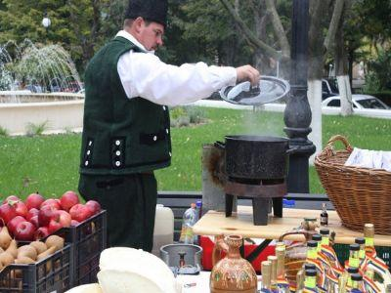
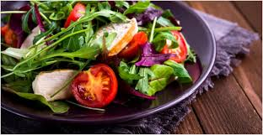
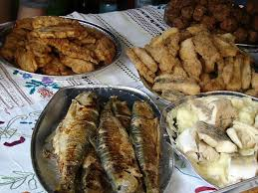
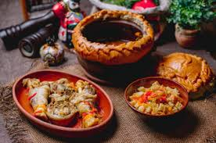
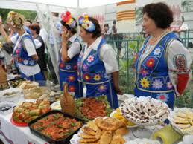
Thank you for your attention !
Local
Gastronomic
Point
Community members
Rural communi-ties

