Slide 1
Conference
Romanian Rural Tourism in International Context.
Present and Prospects
THE IMPACT OF INFORMATIZATION ON TOURISM DEVELOPMENT AND ECONOMIC GROWTH
Authors: Svetlana GOROBIEVSCHI
Tatiana COLUN

Slide 2
Abstract
In the modern economic sphere, information technology plays an important role. Modern society is under the enormous influence of such information technologies as television, internet, mobile communications, specialized information programs (electronic banking transfers, accounting programs, electronic systems for monitoring the transport of resources, etc.). Due to the close interdependence of information technologies, the mutual understanding of economic counterparts - individuals, households, firms, state - is simplified, leading to an increase in general welfare.
The stimulating effect of information technologies on tourism development is also noted. Tourism, in all its forms (business, cultural-historical, educational, ecological, etc.), represents a possibility of establishing and developing international economic relations, and highlighting the development prospects of tourism of the Republic of Moldova for its deeper integration, in the regional and global market, by implementing information technologies, it must be a priority.

Slide 3
Introduction
An important area of ​​the IT sector in which IT has a very high potential is the tourism industry, where the use of new technologies allows greater exposure for businesses and makes it easier for customers to make more informed choices.

Slide 4
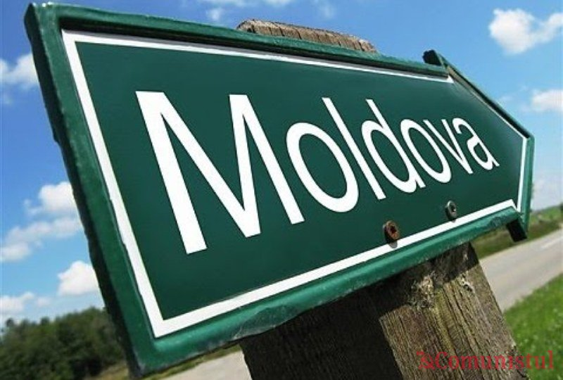
Tourism in the Republic of Moldova
Tourism in the Republic of Moldova (Moldova) has a high potential for development, presenting a complex combination of natural environments (natural areas, forest forests in the center of the country, taltra, gorges, meadows) and artificial (medieval places, cities, cities with various architectural styles , spas, festivals, wineries, etc.) [1].

Slide 5
Forms of tourism in the Republic of Moldova
- rural tourism - represented by agricultural communities and picturesque villages, offering various services to tourists who want to rest in nature;
- wine tourism - as a wine country, the Republic of Moldova offers special chances in choosing favorite routes, so that tourists can visit, as desired, cellars and underground cities, wine cellars, enterprises primary processing of wine, production of champagne, divine, heresy, balms, etc.
- cultural tourism - Moldova has a rich cultural heritage, which can be successfully capitalized in tourism. In total, 140 historical monuments of cultural heritage were identified;
- health tourism - the balneoclimateric resorts in the Republic of Moldova could become a substantial balneoclimateric tourist product of international level, provided that an adequate infrastructure is created around them.

Slide 6
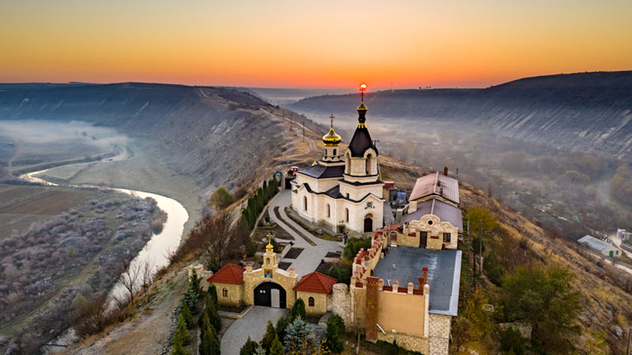
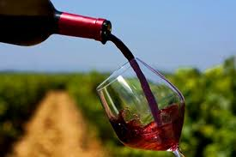
The several tourist attractions in the Republic of Moldova
Monuments of nature: “Toltrele Prutului”,
“A hundred mounds”, “Emil Racoviţă” Cave, Ţaul Park;
Reservations: Pădurea din Domneasca, Codrii, Iagorlîc,
Prutul de Jos, Plaiul Fagului;
Mansion: “Zamfir Ralli Arbore” Mansion,
Manuc Bei Hunting Castle;
- Wineries: Wineries: Cricova, Milestii Mici, Purcari;
- Museums: “Alexei Mateevici”, “Aleksandr Pushkin”, “Constantin Stamati”, “Igor Vieru”, “Orheiul Vechi” Museum Complex, National Museum of Ethnography and Natural History, National Museum of Archeology and History of Moldova, Museum of Folk Crafts, Gagauz National Museum "Dumitru Cara-Ciobanu";
- Monasteries and churches: Căpriana, Hîncu, Rudi, Saharna, Ţîpova, Curchi, Frumoasa, Cosăuţi, Japca. Church of the Assumption of the Blessed Virgin in Causeni.

Slide 7
The impact of computerization on tourism development and economic growth
Currently, tourism services are one of the main export categories for developing countries, totaling 30% of global exports of services.
In 2017, the tourism industry contributed 10.4% to the Global Gross Domestic Product, generating 292 million jobs (1 in 10 jobs worldwide).

Slide 8
Development of tourism in the Republic of Moldova
According to the data of the National Bureau of Statistics (NBS) of the Republic of Moldova, the number of departures of Moldovan visitors abroad in the period 2014-2018, also experienced a significant increase
The citizens of the Republic of Moldova prefer tourism as a form of rest and leisure, it becomes a trend of relevant rest, thus, in the period 2014-2018, there is a total number of departures from the country, which increased during the research period 2.64 times, which the number of vacations and recreation of rest - 1.46 times.
In the Republic of Moldova, in the period 2014-2018, there was an increase in the number of all kinds of tourist activities of Moldovan citizens abroad, through travel agencies and tour operators, to spend their holidays, recreate and rest.

Slide 9
Number of Moldovan departures abroad and their purpose, 2014-2018
Indicators Period | 2014 | 2015 | 2016 | 2017 | 2018
1. Holidays, recreation and rest, thousands of departures | 178, 26 | 188, 13 | 175, 36 | 226, 85 | 261, 26
2. Growth temp compared to the basic year, % | 100,0 | 105,5 | 98,4 | 127,3 | 146,6
3. Business and professional motives, units | 1 144 | 676 | 863 | 1 417 | 1 390
4. Growth temp compared to the basic year, , % | 100,0 | 59,1 | 75,4 | 123,9 | 121,5
5. Visits for other purposes, visits | 1 242 | 983 | 1 025 | 1 078 | 1 403
6. Growth temp compared to the basic year, , % | 100,0 | 79,1 | 82,5 | 86,8 | 113,0
7. The total number of departures of Moldovan visitors abroad, thousands of departures | 180, 65 | 189, 79 | 177, 25 | 229, 35 | 264, 05
8 Growth temp compared to the basic year, , % | 100,0 | 105,06 | 98,12 | 129,96 | 141,2

Slide 10
Investments related to the implementation of new technologies
The authors of this article consider that investments related to the implementation of new technologies in tourism must be a priority, because their advantages are certainly visible and remarkable, starting with the diversification of the variety of offers and services, ensuring customer trust, including through information management, avoiding the leakage of confidential information and the loss of important information (new technologies also allow the recovery of lost data), increasing productivity by reducing operational risks and greater availability in the operation of services provided, credibility, accessibility, integrity and trust given to customers, employees, contractual partners, etc.

Slide 11
Study on the computerization of the tourism sector in the Republic of Moldova (2019)
most tourist companies (93.6%) own a website.
97% of the managers and operators of the interviewed travel companies have basic computer knowledge and 91.6% have recent information programs (software).
36.6% of managers pay attention to the training of staff in the field of ICT on a regular basis, 63.4% - as needed.
about 70% of consumers use ICT, reserving means of transport, tickets and accommodation, mainly hotels.
55.1% combine virtual communication with visiting the office to buy tourist services, 38.3% come only to the office.
93.4% of consumers still do not trust the virtual ways of buying tourist services.
more than half of the companies (53.3%) have the opportunity to be informed in view of the situation on the tourism market and the opportunities for the development of the tourism business, using the information network in partnership with other travel agencies or tour operators.
31.0% appreciate the relevant information provided by government structures, and 21.7% ensure the appropriate information, due to their own research.

Slide 12
Conclusions (I)
The development of tourism in the world is influenced by scientific and technological progress, improving the quality of life of the population, increasing leisure, vacations, economic and political stability and a number of other factors.
Tourism, through its variety of leisure services provided to the population, is a constantly growing economic activity in the structure of GDP, for some countries becoming the fundamental basis of the economies of many developed and developing countries.
Opportunities in the tourism market exist when there are unmet needs or desires, and tourism enterprises have the interest and capacity to satisfy them.

Slide 13
Conclusions (II)
An opportunity for tourism development consists, including, in the analysis of international practices, in order to identify strengths and weaknesses, which would contribute to strengthening and strengthening national capacities, as the external environment is characterized by elements that represent favorable opportunities or possibilities for development.
Many companies have advanced in the computerization of operations, as a result it has been possible to obtain more rational solutions to solve managerial problems, ensure the accuracy of information, reduce the volume of paper documents, improve the structure of information flows and work system in the company, provide consumers unique remote services, etc.

