Slide 1
TOURISM TRENDS OF MILLENNIALS TOURISTS
Associate Professor Hatice SARI GÖK
Isparta University of Applied Sciences

Slide 2
Generation theory was born from the idea that individuals born in the same period and affected by the same economic, technological and political changes share similar values, behaviors and lifestyles. Understanding generations is one of the issues that need to be addressed in many sectors. Similarly, understanding generations in the tourism sector contributes to the sector’s making the necessary preparations in accordance with consumer characteristics, needs and expectations. More and more diversity between generations today plays an increasingly significant role in understanding tourist behavior.

Slide 3
Today, the majority of individuals of the millennials are married, have double earnings, and have become a standard that guarantees good conditions for their children’s personal development. For this generation, respect for ethics, multiculturalism, awareness of social problems, use of information and communication technology are of great importance. Millennials, which is extremely mobile, consists of individuals who travel willingly, move from one place to another and are not ready to make the decision to migrate quickly because of economic reasons.

Slide 4
Millennials are considered to cover individuals born between 1980-1996. This generation in the literature; It is also described as an internet belt, millennial, echo-boomers, generation next, nexters.
Individuals of the millennials travel more than past generations, visit more places and discover more locations in their destinations. Although they spend more on their travels, they are more eager for interesting experiences and information. They are especially environmentally friendly tourists who do not want to be more independent, who prefer travel for special interests rather than mass tourism.

Slide 5
In the tourism sector, in order to divide the market into segments and reach potential customers, the method of separating tourists according to age groups is preferred. In particular, an age-based segmentation is used to reach consumers by taking into account the similar characteristics, expectations and desires. In this context, the characteristics of Millennials, tourist behavior, travel adoptions and travel tendencies are emphasized in the study.

Slide 6
Millennials Travel Adoptions
For Millennials tourists, friendliness, flexibility and comfort are key words, and today 76% of Millennials members choose traditional hotels for their travels. Creativity is another subject of interest for the Y generation tourists who want to visit at any time and wish their favorite shops and restaurants to be open in the middle of the night. Environmentally conscious businesses with high social responsibility are attractive for the millennials. For the members of this generation who prefer healthy and delicious foods, it is the most natural act for them to directly express their likes and to make critical comments immediately.

Slide 7
According to a research by the American Center for Hospitality Industry Research, millennials will make up 50% of all travelers in America by 2025. Millennials travel adoptions differ from traditional travel adoptions. Millennials research on the destinations they will travel to, and exploring local heritage and traditions is the first reason for travel. In addition, 90% of Millennials tourists want to have unique experiences that differ from their daily lives. Therefore, private sector and public institutions need to synthesize different age groups, their characteristics, life experiences, issues that are important to them, renew their products and keep up with the changing era in order to win the millennials consumers.

Slide 8
Some hotel businesses are making changes in their concepts for the increasing millennials tourists, and especially, they are implementing holiday and travel projects that include fast internet and the latest technological infrastructure. It is among the issues that should be taken into consideration by tourism businesses, where millennials tourists have high environmental awareness, love surprises, wonder about different experiences and visit places where they can establish intimate relationships. In addition, tourism businesses need to keep up with the change, as the majority of those who have recently traveled will be millennials tourists. Within this, the concepts of “personalized experiences”, “digital comfort” and “information required in social media” stand out as the three most important instruments.

Slide 9
Trends in Millennials tourism
Generation Y members whose expectations and demands differ from previous generations, who are extremely sensitive to the environment, who are interested in the culture of their destination, and who always desire to learn and experience unique experiences are indispensable elements of the concept of “New Tourism”.

Slide 10
Wellness Tourism
Wellness tourism, which is a type of tourism that covers both physical and mental health, is especially preferred by those who care about their health, and those who aim to escape from the negative effects of modern life. Wellness is a life philosophy based on being healthier by keeping body, spirit and mental health in balance.

Slide 11
Wellness is defined as a combination of health and happiness, and body care is included in the scope of wellness with nature and natural products such as massage, skin care, thalassotherapy, mud and moss baths, bathtub treatments that make the person feel mentally, physically, mentally and relationally well and fit.

Slide 12
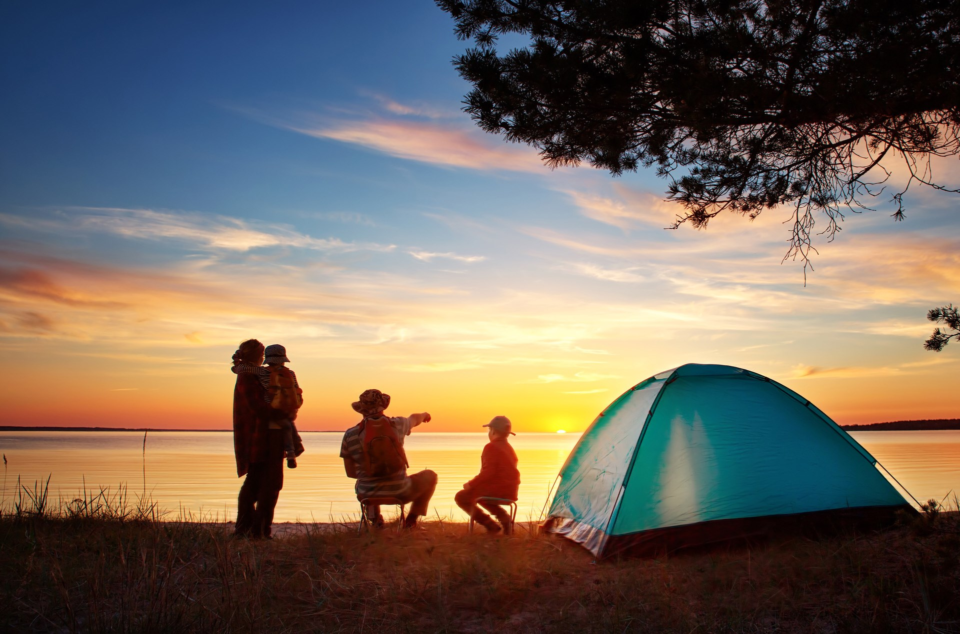
Camping
Camping is a form of recreation performed by making use of accommodation vehicles such as tents, huts, caravans for different purposes such as having recreational or sports activities in nature, staying for a short time, resting.

Slide 13
Campings / camping areas, which are the places where this activity is held, are areas that are established in highways routes and their immediate surroundings, at city entrances, in places with natural beauty such as sea, lakes and mountains, and where campers generally meet their overnight, eating and drinking, entertainment, recreation and sports needs with their own means. Camp tourism stands out as a lively accommodation vehicle, especially in terms of symbolizing “freedom”.

Slide 14
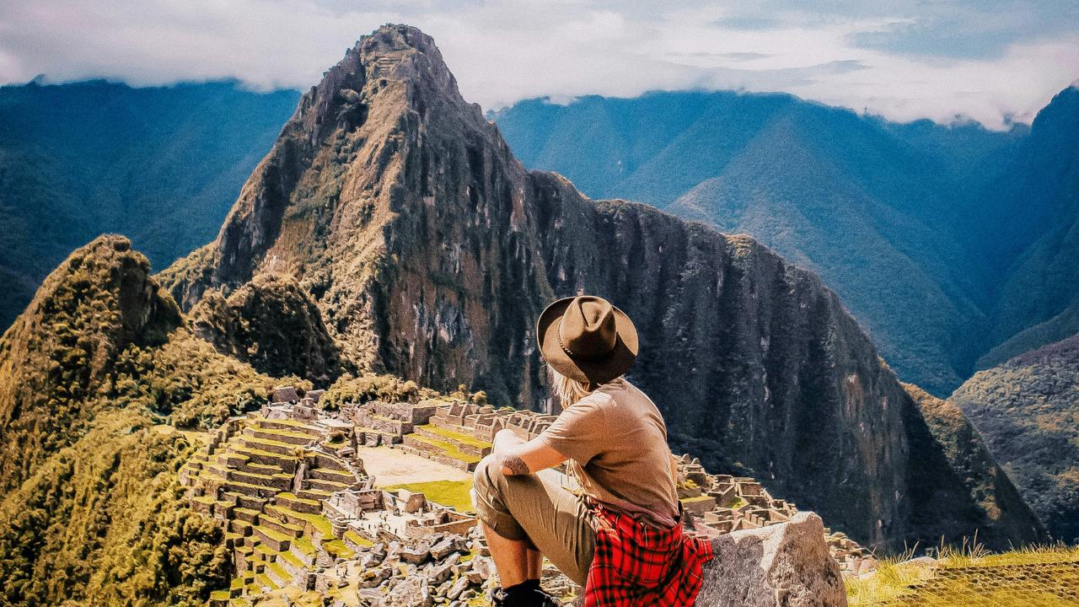
Solo Travel
The history of solo travel goes back to the travels of backpackers. In the 1990s, the terminology “backpacker tourist” began to be widely used for the concepts of an explorer or researcher. Although the term “backpackers” are frequently used in tourism literature, today, solo travel movement is becoming more common, defining individuals who want to travel alone and experience a sense of discovery.

Slide 15
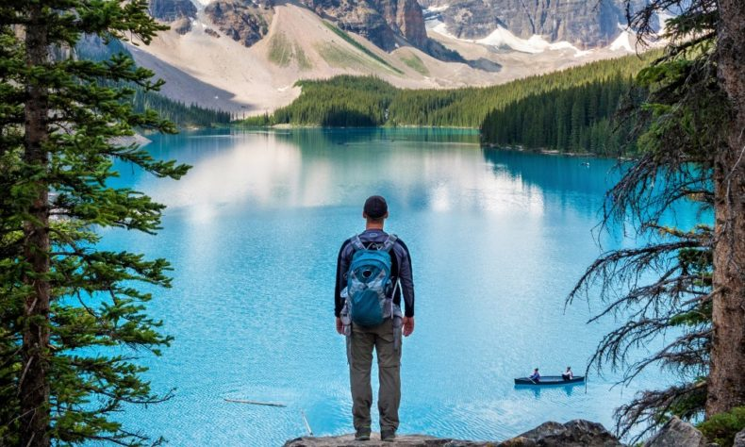
This type of tourist is young and a budget tourists who spend a long time on vacation. Most backpackers travel alone or in small groups, seeking suitable travel conditions, and are very flexible in their accommodation and tourism preferences. This tourist group seeks experiences that are a journey of discovery and wants to explore unusual places.

Slide 16
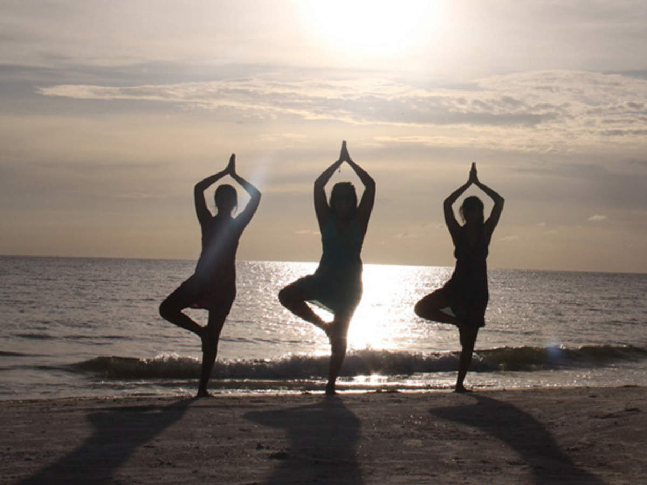
Spiritual Tourism
Spiritual travels are interpreted as “a contemporary and cultural movement”. A psychological quest embedded in the spiritual travel practices of spiritual tourism movements that encourage the use of mind while developing spirituality has brought spirituality tourism movements with it and turned it into a field that can be studied and also applied.

Slide 17
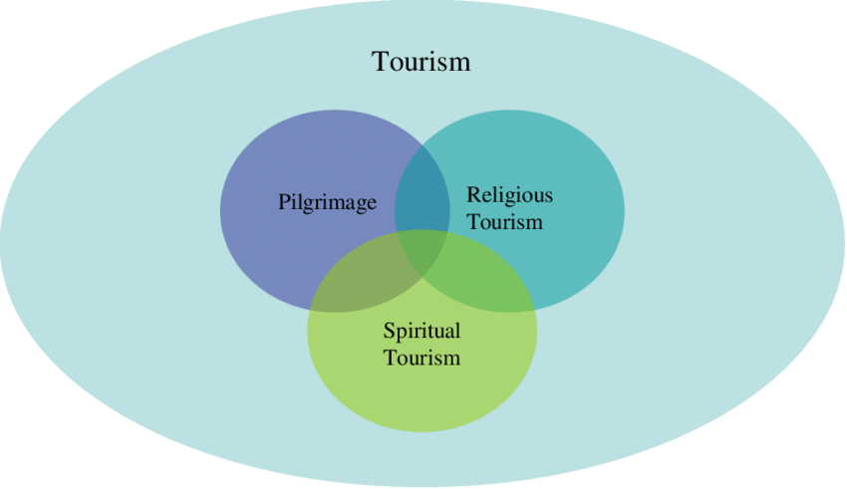
The role travel takes in the movement in the pursuit of contemporary spirituality is seen as an interruption to the daily routine pursuit, and also causes spiritual popularity as a reason for the tourism experience. Within the scope of the tourism movement, if spirituality is the main goal, the idea in search or self-discovery will definitely become an accessible travel to experience renewed connections with others or to take advantage of the opportunities offered by life. In this case, spiritual tourism forms touch people, promise to change and improve them.

Slide 18
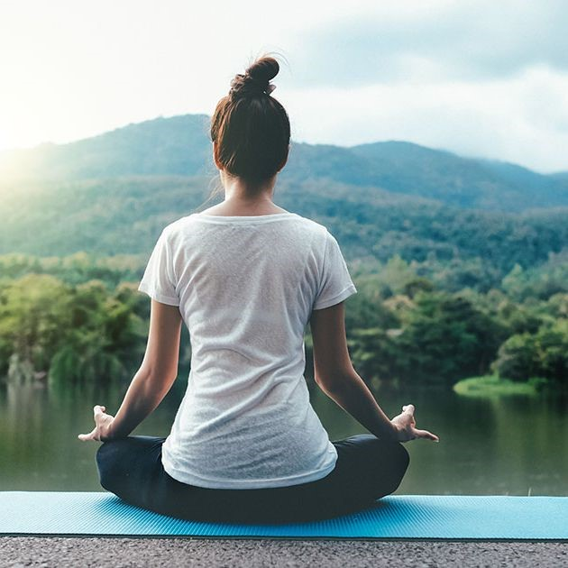
Yoga Tourism
Yoga tourism is a type of tourism that focuses on the unification of the body, mind and soul, that relaxes and brings peace to people spiritually. The breath and the self are trained in yoga; meditation, physical asanas and breathing techniques are applied to strengthen the body, calm the mind and ultimately provide spiritual enlightenment. Thus, the road to enlightenment is opened and tourists who prefer this route find themselves in yoga tourism.

Slide 19
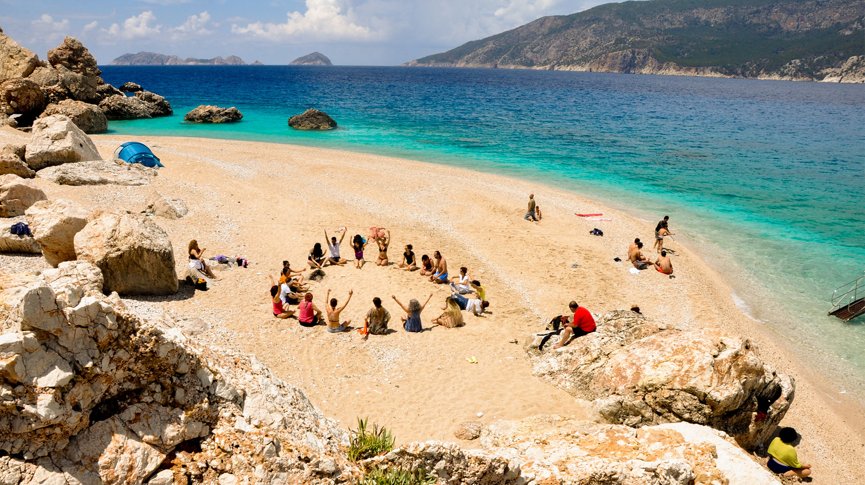
One of the reasons for the increase in yoga-related travels is the increased interest in activities such as meditation and spa within the scope of health tourism. Another reason is that yoga has begun to be a big step towards spiritual development. Stress, ailments, insomnia, difficulty of city life, fatigue etc. faced by people in modern society life encourage people to participate in yoga tourism due to reasons such as being in touch with nature, desire for an authentic life experience and longing for spiritual peace.

Slide 20
Conclusion
Millennials, which uses technology effectively and actively, has a tendency to adopt by obtaining information about fashion and trends quickly. When the tourist behavior of this generation in making travel decision is examined; features such as entertainment seeking, price tracking, motivational action, perfectionist-seeking high quality, pursuit of innovation, adherence to adoptions draw attention.

Slide 21
In addition, 9 out of every 10 Millennials tourists are definitely in search of a new experience during their travels and research about the destination they will go from various information sources before going out on the trip. In terms of travel adoptions, “personalized experience”, “digital comfort” and “social media” are indispensable for the millennials who seek adventure and discovery.

Slide 22
Millennials, who will determine the shape of the tourism sector in the near future, demand to discover new experiences such as excursions full of activities, authentic experiences, spiritual relaxations and purification, freedom instead of the general tourism trends, which are the relaxation and rest-oriented tourism approach shaped in the sea, sand, sun triangle. Although the older generations still have a tendency to relax and rest, millennials prefer tourism types that are focused on personal experience, called “experience tourism”. Millennials, who tend to experience the life of the local people living in their destination and explore more virgin areas, adopt more freedom to travel with less goods.

Slide 23
With the changing social order, people's lifestyles have begun to change. Especially in Europe, more and more people live alone, pushing people to search for new freedom. Solo tourism activities are included in the travel preferences of people who live alone or live in a crowded family and want to travel alone, who want to move freely in their travels.

Slide 24
Camp tourism, which is carried out by those who want to be alone with nature, preferred by solo travel, responds to the understanding of socially distant vocation in recent years, especially due to the pandemic in 2020. The last trend of 2020 has been accepted as the tourism activity.
As a result, people's desire to stay alone with themselves in nature, the desire to go on an internal journey, mental renewal, camp tourism, spiritual tourism, wellness tourism, yoga tourism and solo tourism, which are among the types of tourism that give the opportunity to feel better, are tourism activities with increasing demand in recent years. It would be beneficial for travel agencies to follow the tourist behavior and travel adoption of this segment and to act according to the current demands in order to respond to the waits of this generation.

Slide 25
Thank you for listening to my Presentation
Hatice SARI GÖK

