Slide 1
Evaluation of Rural Tourism Potential of a Taurus Highland: Case of Ağla, Köyceğiz
İ L A L
A s s o c . P r o f . D r I ş ı l A R I K A N S A L T I K
A s s s t . P r o f . D r . N u r Ç E L İ K
M u ğ l a S ı t k ı K o ç m a n U n v e r s t y
25th International Conference on Tourism and Rural Space in National and International Context – TARS, 25-27 May 2023

Slide 2
Summary
Literature review Methodology
Results and Discussion Conclusions
2

Slide 3
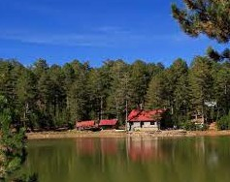
Rural tourism has been developing as a type of tourism, which is of great importance in terms of providing additional income to the agricultural producer, whose income level is low compared to other sectors. Rural tourism
solves the economic, social, and
the
psychological problems arising from concentration of tourists in the space.
Besides, it also liberates tourism from the dominance of traditional coastal tourism and provides the opportunity to benefit from the relaxing atmosphere of rural areas (Olalı & Timur, 1988).
4

Slide 4
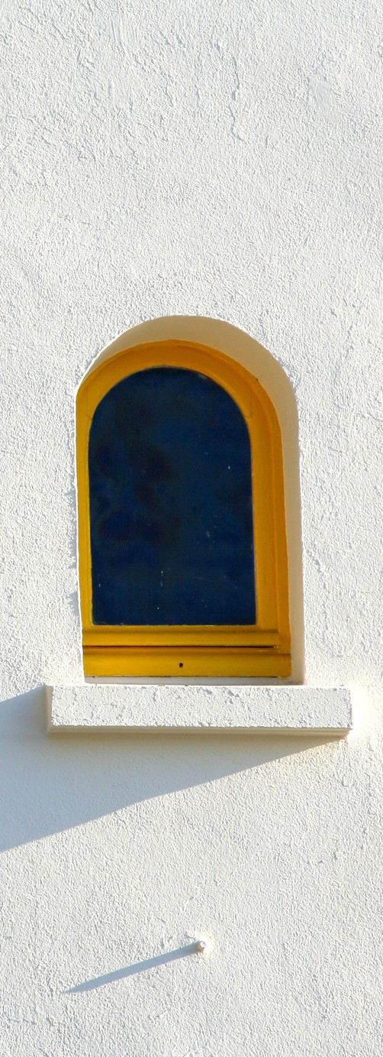
There are various studies that deal with the perspectives and attitudes of local people in rural tourism (Çeken, Uçar, Dalgın, 2012; Uçar et al., 2012; Rahmani et al., 2013; Chuang, 2013; Falak et all, 2014; Muresan et all, 2016; Ünal, Yücel, 2018; Baykal, Ataberk, 2020) the number of studies examining the subject in terms of plateaus included in rural tourism is limited (Dalgıç & Birdir, 2015; Gümüş Dönmez & Topaloğlu, 2018; Lun et al., 2021; Qi et al., 2022).
4

Slide 5
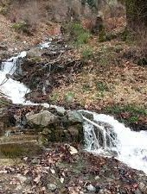
Aim of the study
This research is aimed at determining the
current situation potential of the Plateau in Muğla.
and evaluating the rural tourism of Ağla
4

Slide 6
Methodology
The research methodology is based on primary data collection through face-to-face via a semi-structured question form.
The qualitative data of the research were collected by on-site observation and interview techniques. Interview questions were based on a literature review (Uçar, et al., 2012; Rahmani et al. 2013; Akbaş & Koday, 2020) and refined in discussions between researchers.
Interviews were conducted in April and May 2023.
4

Slide 7
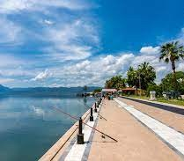
Study Field
The study has been carried out in Ağla village of Köyceğiz district of Muğla province in Türkiye.
4

Slide 8
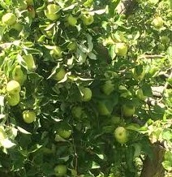
Data Collection
Semi-structured questionnaire form
The semi-structured interview form consists of two parts
Snowball sampling method
25 minutes and 1 hour 15 minutes and the average duration was calculated as 40 minutes
4

Slide 9
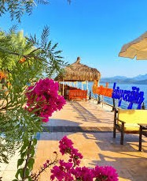
Analysis
All interviews (audio recorded and noted) were transcribed in the computer environment. The data were subjected to content analysis (Krippendorf, 2004), which is considered a useful method for making meaningful inferences from the text and establishing connections between concepts. Then, the obtained data were evaluated by SWOT analysis.
4

Slide 10
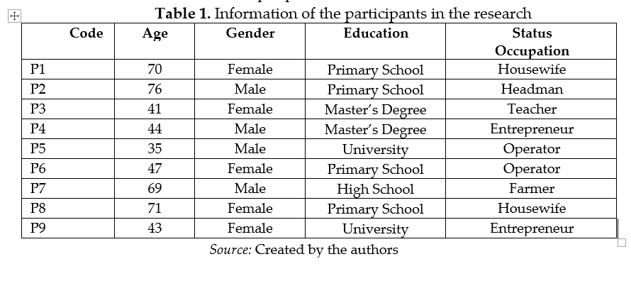
Results and Discussion
Demographic information of participants
4

Slide 11
Rural tourism awareness and level of interest
Except for three of the participants, the others were born and are living in the Ağla plateau. However, the concept of rural tourism is not known to people born and living in Ağla plateau while people who settled and live in Ağla plateau from outside are aware of the concept.
"I have never heard of the concept of rural tourism before, but what I understand from tourism is that if there is no tourism I will generate income, if someone else will come here outside and earn money from tourism, I don’t want like that tourism…” (P2)
2

Slide 12
Rural tourism awareness and level of interest
The participants, especially those who have settled in the region from outside, see the development of tourism as a way out because the livelihood in the region is very limited.
“…We prepared two tents in our garden and started to host tourists here. The villagers who saw us started to build such structures in the garden of their houses...” (P4)
2

Slide 13
Natural attractions and different features of
Ağla Plateau
Among the natural attractions of Ağla Plateau, the participants highlighted the rich and high-quality water resources, the beauty of its geographical structure, the silence, the diversity of flora and seen it as a difference compared to other places. Some of the opinions are as follows:
“…You will not find the taste of water here anywhere…” (P7)
“… there is no humidity and if you have your own vehicle, you can easily reach many seas…” (K44)
2

Slide 14
Social, cultural, and economic attractiveness
and different features of Ağla Plateau
According to the participants, the most important cultural event in the region is the Mahya festival. Mahya festival is consisted of the celebrations which are held every year on the second Thursday of August in the Plateau of Ağla. The participants stated that even though sackcloth weaving is very important in the region, there is lack of sackcloth weaving craftsman in recent years. In addition, they stated that while the region used to make a living from agriculture and animal husbandry, they are now looking for different livelihoods.
2

Slide 15
Things to do for the development of rural
tourism in Ağla
Participants provided some suggestions for the development of rural tourism.
Internet and sewerage infrastructure there should be a restaurant
the village coffeehouse should be run as it used to be
the limited number of accommodation opportunities should be developed
lack of personnel
the most important cultural event in the region is the Mahya festival. sackcloth weaving is very important in the region
2

Slide 16
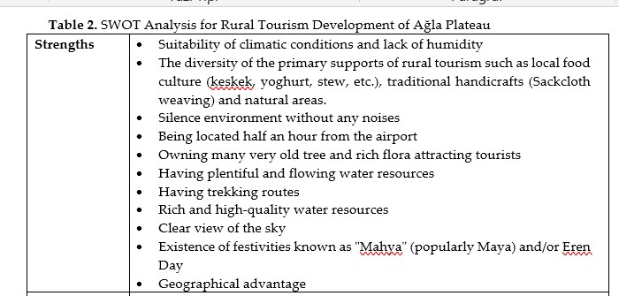
SWOT Analysis Results
2

Slide 17
SWOT Analysis Results
2

Slide 18
SWOT Analysis Results
2

Slide 19
Conclusions
This study revealed that Ağla Plateau, with its historical, natural, and cultural values, can be an important destination in the context of rural tourism. Although there are natural, cultural, and authentic supply sources in the region, it is of great importance to plan and develop tourism in a sustainable and comprehensive way
due to reasons infrastructure, accommodation
such as insufficient
inadequacy of facilities, lack of
personnel, and unconsciousness of the local people.
6

Slide 20
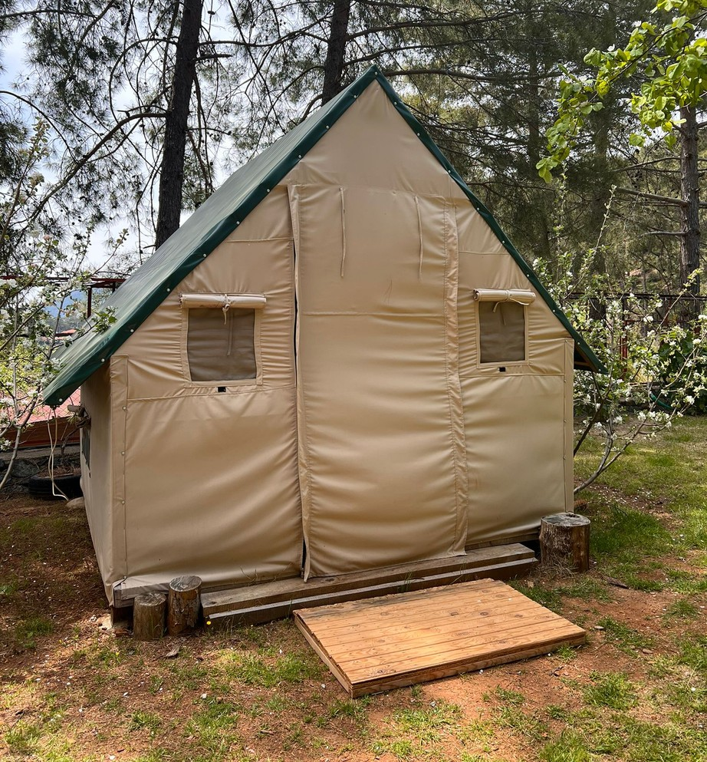
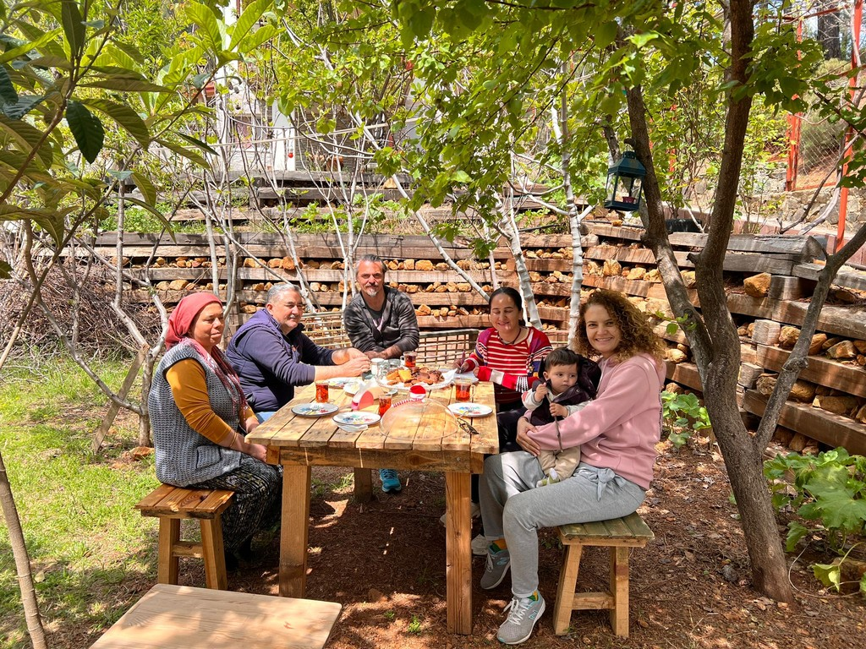
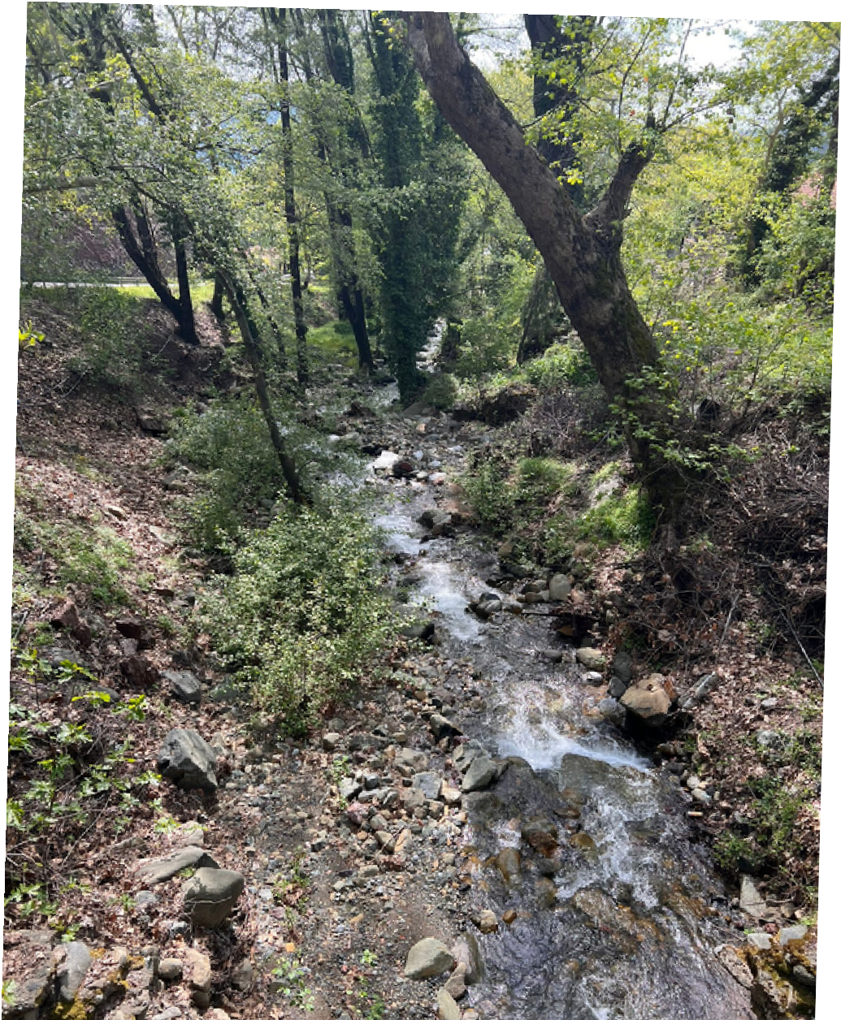
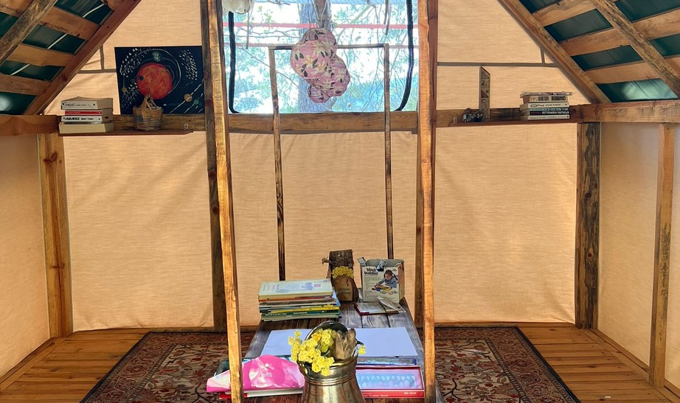
Thank you for your attention

