Slide 1
The correlation between regional tourist and the South Muntenia community
PhD Student: Mirea Cosmin Nicolae
Bucharest Academy of Economic Studies
BUSINESS ADMINISTRATION
Professor PhD Puiu Nistoreanu
Bucharest Academy of Economic Studies

Slide 2
Tourism stakeholders
Stakeholder in tourism = any entity that is positively or negatively affected by the development of tourism" (Minnaert, 2020, p. 2).
According to Hardy and Pearson (2018, p. 248), there are four categories of tourism stakeholders: tourists, the local community, economic operators and governments.

Slide 3
The tourists - stakeholder in tourism
The tourists can influence:
the sustainability of the tourist product
the income and expenses of the local community
behavior of the local community
the quality of the environment
The purpose of tourists:
To discover new things and to benefit from unique experiences

Slide 4
Local communities - stakeholder in tourism
The purpose of local communities:
To ensure its socio-economic well-being
The local community is:
the main source of employees in the tourism field
Manufacturer and consumer of local resources
Keeper of local traditions
Local resource trader

Slide 5
The tourist-local community relationship
Social relationship
Economic relationship

Slide 6
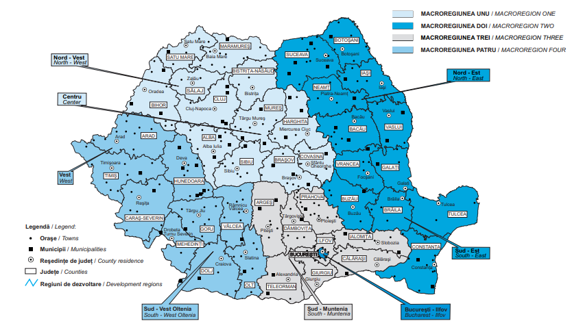
Study region – South Muntenia
Fig. no. 1 Development regions and macro-regions
Source: National Institute of Statistics, 2019, Romanian Tourism. Brief Statistic, p.62

Slide 7
South-Muntenia Development Region
The region consists of the following counties: Argeş, Călăraşi, Dâmboviţa, Giurgiu, Ialomiţa, Prahova and Teleorman.
Landforms:
mountains - 9.5% of the region
hills - 9.8% of the region
plains - 70.7% of the region

Slide 8
Research methodology
The research involved establishing the statistical correlation between the presence of tourists in the studied area, using an indicator of tourist traffic (tourist arrivals in accommodation units) and three economic indicators related to the studied area, namely: total average monthly income / household, total average expenditures monthly / household and unemployment rate among people aged 15 and over.

Slide 9
Research methodology - continued
The independent variable: arrivals of tourists in accommodation units
The dependent variables: total average monthly income / household, total average expenditures monthly / household and unemployment rate among people aged 15 and over.
Calculation method: Pearson correlation coefficient (The excel spreadsheet program was used).

Slide 10
The tourist-income correlation
Table no.1 Tourist - income correlation
Source: calculated by the author
Hypothesis 1: The presence of tourists contributes to the increase of incomes in the South-Muntenia Development Region – validated.
Due to the fact that the value of the correlation coefficient falls in the range [0.75, 0.95], the correlation between the two variables is strong.
The positive value of the correlation coefficient indicates a directly proportional relationship between the two variables, which means that an increase in the number of tourist arrivals in accommodation units generates an increase in the average total monthly income / household.

Slide 11
Tourist - expenditure correlation
Table no. 2 Tourist - expenditure correlation
Source: calculated by the author
Hypothesis 2: The presence of tourists in the region influences the cost of living of the local community – validated.
The value of the correlation coefficient falls within the range [0.75, 0.95], so the correlation between the two variables is strong.
The relationship between the total average monthly / household expenses and the number of tourist arrivals in the accommodation units is directly proportional (the increase in the number of tourist arrivals implies an increase in the total average monthly / household expenses).

Slide 12
Tourist- unemployment rate correlation
Table no. 3 Tourist - unemployment rate correlation
Source: calculated by the author
Hypothesis 3: The unemployment rate in the South-Muntenia Region decreases with the increase of the number of tourists - is not validated.
Because the t_{calculated} is lower than the t_{critical} , the correlation coefficient has no statistical significance, so there is no correlation between the number of tourist arrivals in the accommodation units and the unemployment rate among people aged 15 and over.

Slide 13
Conclusions
For the South Muntenia community, it was observed that the number of tourists has generates the increase of incomes, but also of expenses.
Also, the increase in income generated by the number of tourist arrivals in accommodation units is higher than the increase in expenses generated by tourist arrivals in accommodation units.
The correlation coefficient between the number of tourist arrivals and the average total monthly income / household is higher than the correlation coefficient between the number of tourist arrivals and the average total monthly expenses / household, which has an economic advantage for local communities.

Slide 14
Conclusions - continued
Local communities must pay attention to tourism and contribute to strengthening a sustainable relationship with tourists.
The number of tourists does not influence all economic indicators in the analysis. Thus, it was found that in the South-Muntenia community there is no correlation between the number of tourists and the unemployment rate.
The standard of living of the South-Muntenia community is positively influenced by the tourist circulation.

Slide 15
References
Chen, Y., Cottam, E., & Lin, Z. (2020). The effect of resident-tourist value co-creation on residents’ well-being. Journal of Hospitality and Tourism Management 44 (2020) 30–37. [online] available at: <https://www-sciencedirect-com.am.e-nformation.ro/ > [accessed 16 august 2016]
Hardy, A., & Pearson, L. (2018). Examining stakeholder group specificity: An innovative sustainable tourism approach. Journal of Destination Marketing & Management 8 (2018) 247–258. [online] available at < https://www-sciencedirect-com.am.e-nformation.ro/ > [accessed15 august 2020].
Minnaert, L. (2020). Stakeholder stories: Exploring social tourism networks. Annals of Tourism Research 83 (2020) 102979. [online] available at < https://www-sciencedirect-com.am.e-nformation.ro/ > [accessed 15 august 2020].
National Institute of Statistics. (2019). Romania's tourism. Brief Statistics. Bucharest: National Institute of Statistics.
Slivar, I. (2018). Stakeholders in a tourist destination - Matrix of possible relationships towards sustainability. Open Journal for Research in Economics, 2018, 1(1), 1-10. [online] available at < https://www.researchgate.net/ > [accessed 16 august 2020].
South Muntenia Regional Development Agency. (2013). South Muntenia Regional Development Plan 2014-2020. [online] available at <https://adrmuntenia.ro/planul-de-dezvoltare-regionala-2014--2020/static/16> [accessed17 august 2020].

Slide 16
Thank you for your attention!

