Slide 1
Digital technologies and their use for the development of cultural heritage in Europe and Romania. revealing some advantages and disadvantages
Alina Niculescu
Dr. Cristi Frenț
25th TARS Intenational Conference, 25-27 May 2023, Vatra Dornei (Romania)

Slide 2
Outline
Why we chose to research the activities of digitization of cultural heritage?
Relevant statistics
The importance of digital skills
Advantages and disadvantages of using digital technologies in the field of cultural heritage
Conclusions
Conceptual clarifications

Slide 3
Why we chose to research the activities of
digitization of cultural heritage?
More and more industries rely on new technologies, including cultural tourism.
The constant support and recommendations of the Parliament and the Council of Europe.
The digital transformation of cultural tourism has been amplified during and after the Covid-19 pandemic.
Digital technologies have changed the way tourist trip is planned and the way cultural tourism products are created and consumed.
To identify the main advantages and disadvantages.

Slide 4
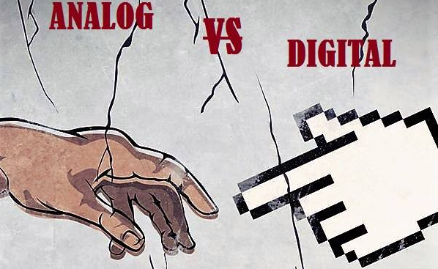
Conceptual clarifications
Digitization
- conversion of goods from analogue to digital format.
Digitalization
- the process by which digital tools and techniques are used.
- digitalization = digitization + cataloguing + online exposure (according to the Ministry of Culture).

Slide 5
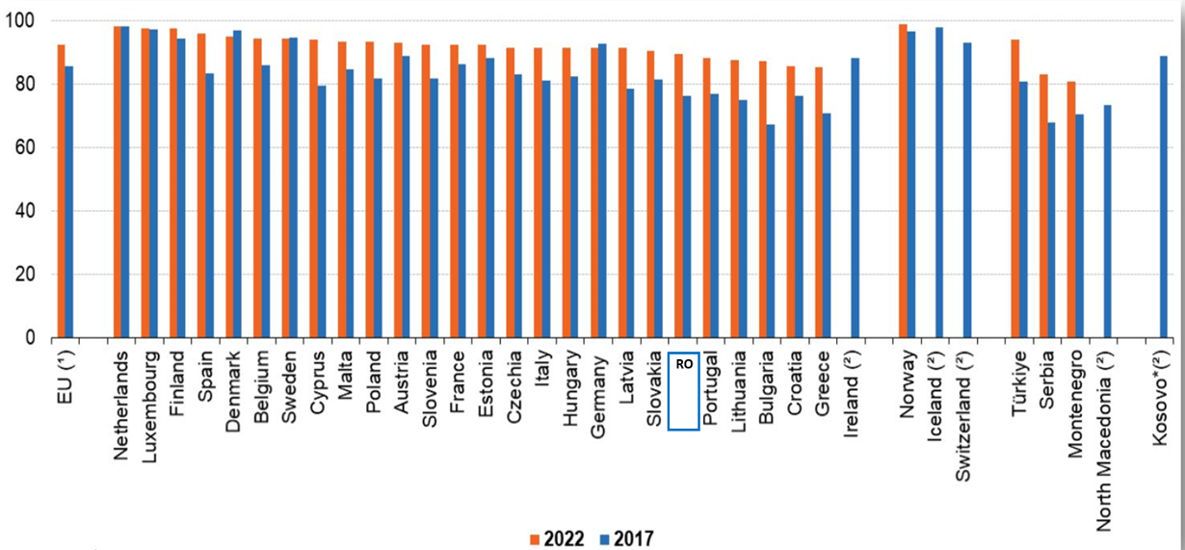
Internet access of households in European Union countries, comparison between 2022 and 2017
Source: Eurostat
Primary data: https://ec.europa.eu/eurostat/statistics-explained/index.php?title=Digital_economy_and_society_statistics_-_households_and_individuals

Slide 6
Internet use in Romania
- from year to year there have been increases in the number of Internet users.
- 82% of all households in Romania were connected to the Internet in 2022.
- the share of people aged 16-74 who use the Internet reached approximately 13 million people in 2022 (+1.3% compared to 2021).

Slide 7
Internet use in Romania
by age categories (2022)
- age group 16-34 years: 98,1%.
- age group 55-74 years: 73,3%.

Slide 8
Internet use in Romania
on residential environments (2022)
- urban environment: 88,6%.
- rural environment: 73,7%.

Slide 9
Internet use in Romania
for cultural and educational activities
According to the National Institute for Cultural Research and Training (Culturadata)
In 2018:
- 12% of the people who used the Internet for cultural and educational activities visited the websites of museums, libraries or other specialized websites.
- 17% were looking for information about cultural events and products.

Slide 10
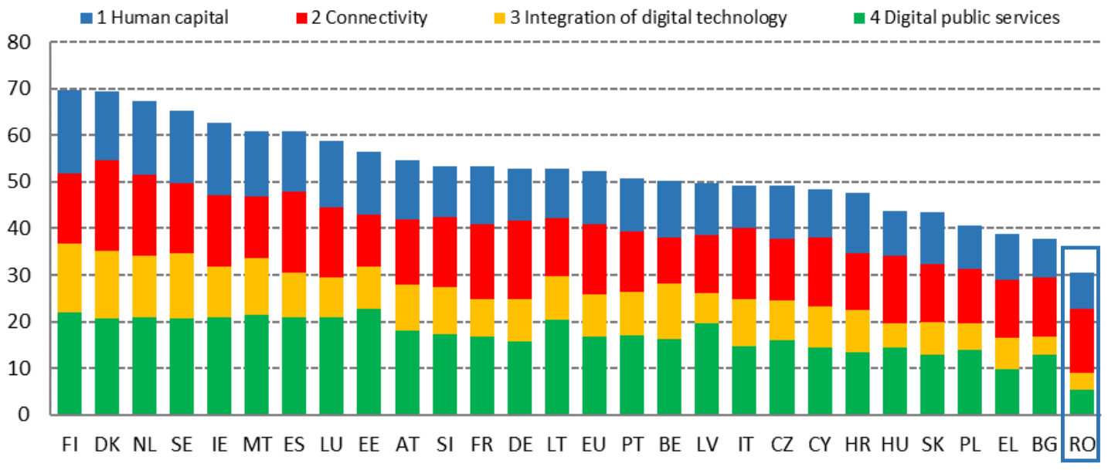
Ranking European Union countries in terms of the Digital Economy and Society Index (DESI) – 2022
Source: European Commission
Primary data: https://digital-strategy.ec.europa.eu/en/policies/countries-digitisation-performance

Slide 11
Digital skills in Romania (results from DESI report)
- 2022 -
Insufficient basic digital skills among the population
Digital skills beyond elementary level in Romania: 9% (compared to 26% - UE average).
Basic skills for creating digital content in Romania: 41% (compared to 66% - UE average)
Basic digital skills in Romania: 28% (compared to 54% - UE average)
Source: European Commission
Primary data: https://digital-strategy.ec.europa.eu/en/policies/countries-digitisation-performance

Slide 12
The importance of digital skills
According to the National Institute for Cultural Research and Training (Culturadata)
The digital environment can be useful in all aspects of cultural heritage (promotion, valorization, exploitation, interpretation).

Slide 13
The advantages of using digital technologies in the field of cultural heritage
communicating to tourists the information about the diversity of cultural-tourist resources;
digital technologies have become a support of leisure activities and social interactions;
positive impact on the image of the destination, by facilitating access to tourist and cultural information;
digitization has stimulated the production of cultural goods (new cultural platforms, virtual tours, 3D digitized cultural goods);
increased access to cultural heritage for all categories of the public (reducing the level of social inequities and increasing the level of culture);
virtual reality technologies are useful when it is desired to visualize certain environments, buildings or cultural objects that no longer exist or that cannot be easily visited;
digital preservation of cultural heritage contributes to avoiding the loss of cultural assets.

Slide 14
Disadvantages of using digital technologies in the field of cultural heritage
disruption of traditional practices (negative consequences in the music and audiovisual sectors - digital piracy);
maintaining user interest is not easy (low degree of user loyalty);
old devices must be replaced with better performing ones, but unable to reproduce previous productions;
project management costs; digitization is a continuous process, it requires a permanent and sustained effort (time and financial resources);
increasing the technology addiction;
increasing energy consumption.

Slide 15
Conclusions:
Covid-19 has led to an increase in online interactions.
The digital skills of young people are higher than those of older people.
Internet access in urban areas is higher than in rural areas.
People who have access to Internet and digital technologies do not automatically develop digital skills.
Digital technologies can enhance tourists' cultural experiences.
Digital resources do not replace the physical cultural visit, they must be used to complement it.
The positive effects are predominant for now.

Slide 16
Thank you for your attention!
Alina Niculescu
Cristi Frenț
www.incdt.ro
niculescu@incdt.ro, cristi.frent@incdt.ro
00 40 21 316 25 65

