Slide 1
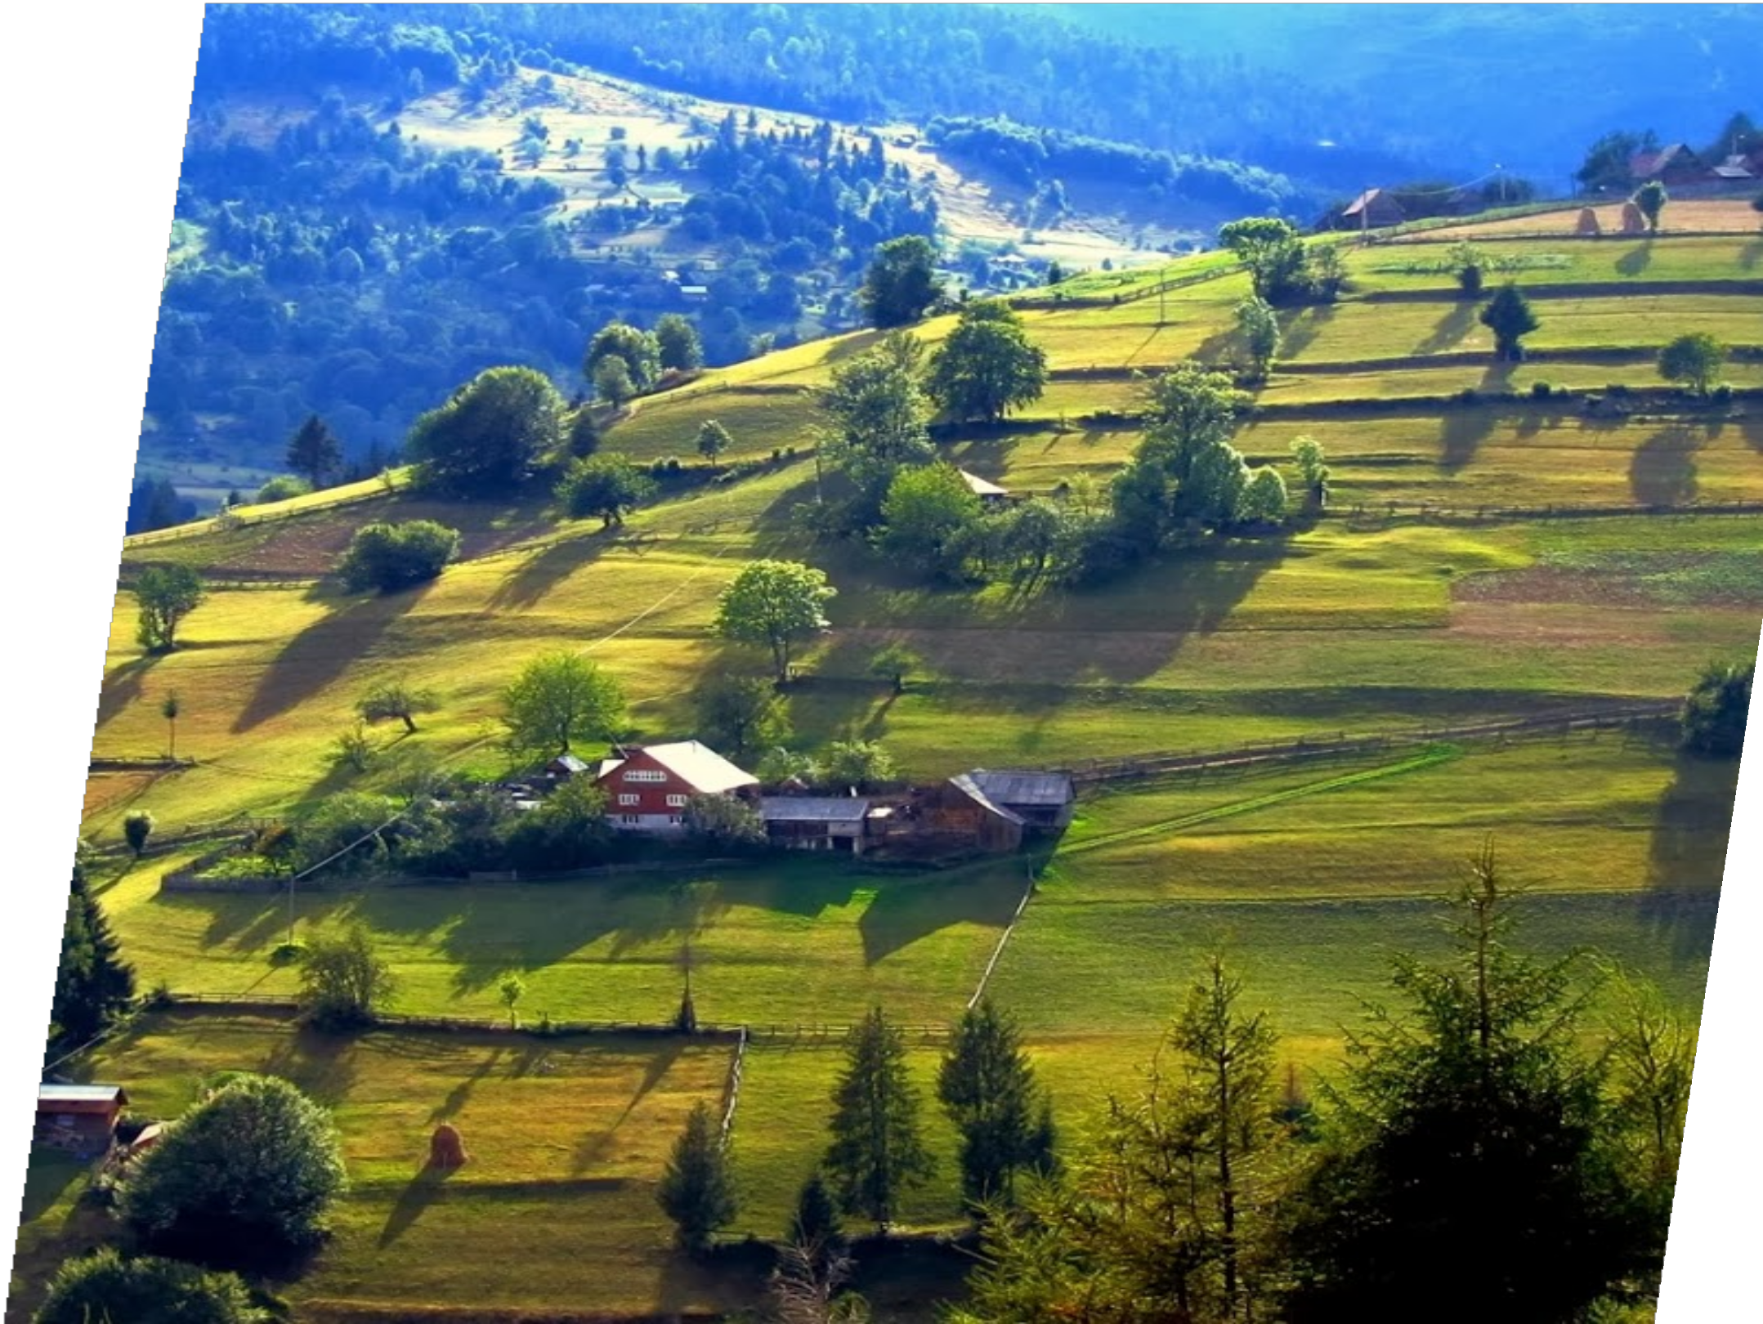
SOCIAL MEDIA AND
T R A D IT IO N A L A D V E R T ISING
E F F E C T S O N C U ST O M E R
B E H A V IO R A L IN T E N T IO N S:
A C T IV A T IO N, IN T E N T IO N
A N D W O M I NTEN T I ON
Author: PhD candidate Leonardo-Mihai Mărincean Supervisor: Prof.univ.dr.habil Dan-Cristian Dabija

Slide 2
R E S E A R C H
P R O B L E M
Little is still known however about the interaction effects of social media influencer content and traditional advertising content on tourism motivation (Customer Inspiration - Activation) and toursim consumption (Customer Inspiration - Intention), as well as the relation between these phenomena and WOM Intention. This paper will bridge this gap with an experimental design which measures the effect of different types of content exposure on Activation, Customer Intention and WOM Intention.

Slide 3
R E SE A R C H D E S I G N
Experiment
Step 1
Step 2
Step 3
A collection of video, photo and text content will be extracted from social media about a tourism destination from the Apuseni region. We will create 2 sets of materiales: influencer content and advertising content.
3 experimental groups will be created:
A - participants will be exposed to only influencer content; B - participants will be exposed to only advert. content;
C - participants will be exposed to both types of content;
4 constructs of interest will be measured for all participants based on established scales:
1 - PREFERENCE FOR CONSISTENCY:
PFC (Cialdini, Trost, and Newsom 1995)
2 - CUSTOMER INSPIRATION (ACTIVATION): CIA Böttger et al. (2017) 3 - CUSTOMER INSPIRATION
(INTENTION): CII Böttger et al. (2017) 4 - WORD-OF-MOUTH INTENTION:
WOM Lim, Lee, and Foo (2017)

Slide 4
R E SE A R C H D E S I G N
Hypotheses: Direct Relations
H1 Activation
H2 Intention
H3 WOM
H1a: Participants exposed to influencer content will have higher levels of activation (CIA) compared to participants exposed to advertising content;
H1b: Participants exposed to both types of content will have higher levels of activation (CIA) compared to participants exposed to either one type of content;
H2a: Participants exposed to influencer content will have higher levels of intention (CII) compared to participants exposed to advertising content;
H2b: Participants exposed to both types of content will have higher levels of intention (CII) compared to participants exposed to either one type of content;
H3a: Participants exposed to influencer content will have higher levels of WOM intention (WOM) compared to participants exposed to advertising content;
H3b: Participants exposed to both types of content will have higher levels of WOM intention (WOM) compared to participants exposed to either one type of content;
Maldives
Maldives
Maldives

Slide 5
R E SE A R C H D E S I G N
Hypotheses: Moderation
H4 Activation
H5 Intention
H6 WOM
H4a: The relation between type of content and customer activation (CIA) will be moderated by customer preference for consistency (PFC).
H5a: The relation between type of content and customer intention (CII) will be moderated by customer preference for consistency (PFC).
H6a: The relation between type of content and customer WOM intention (WOM) will be moderated by customer preference for consistency (PFC).
Maldives
Maldives
Maldives

Slide 6
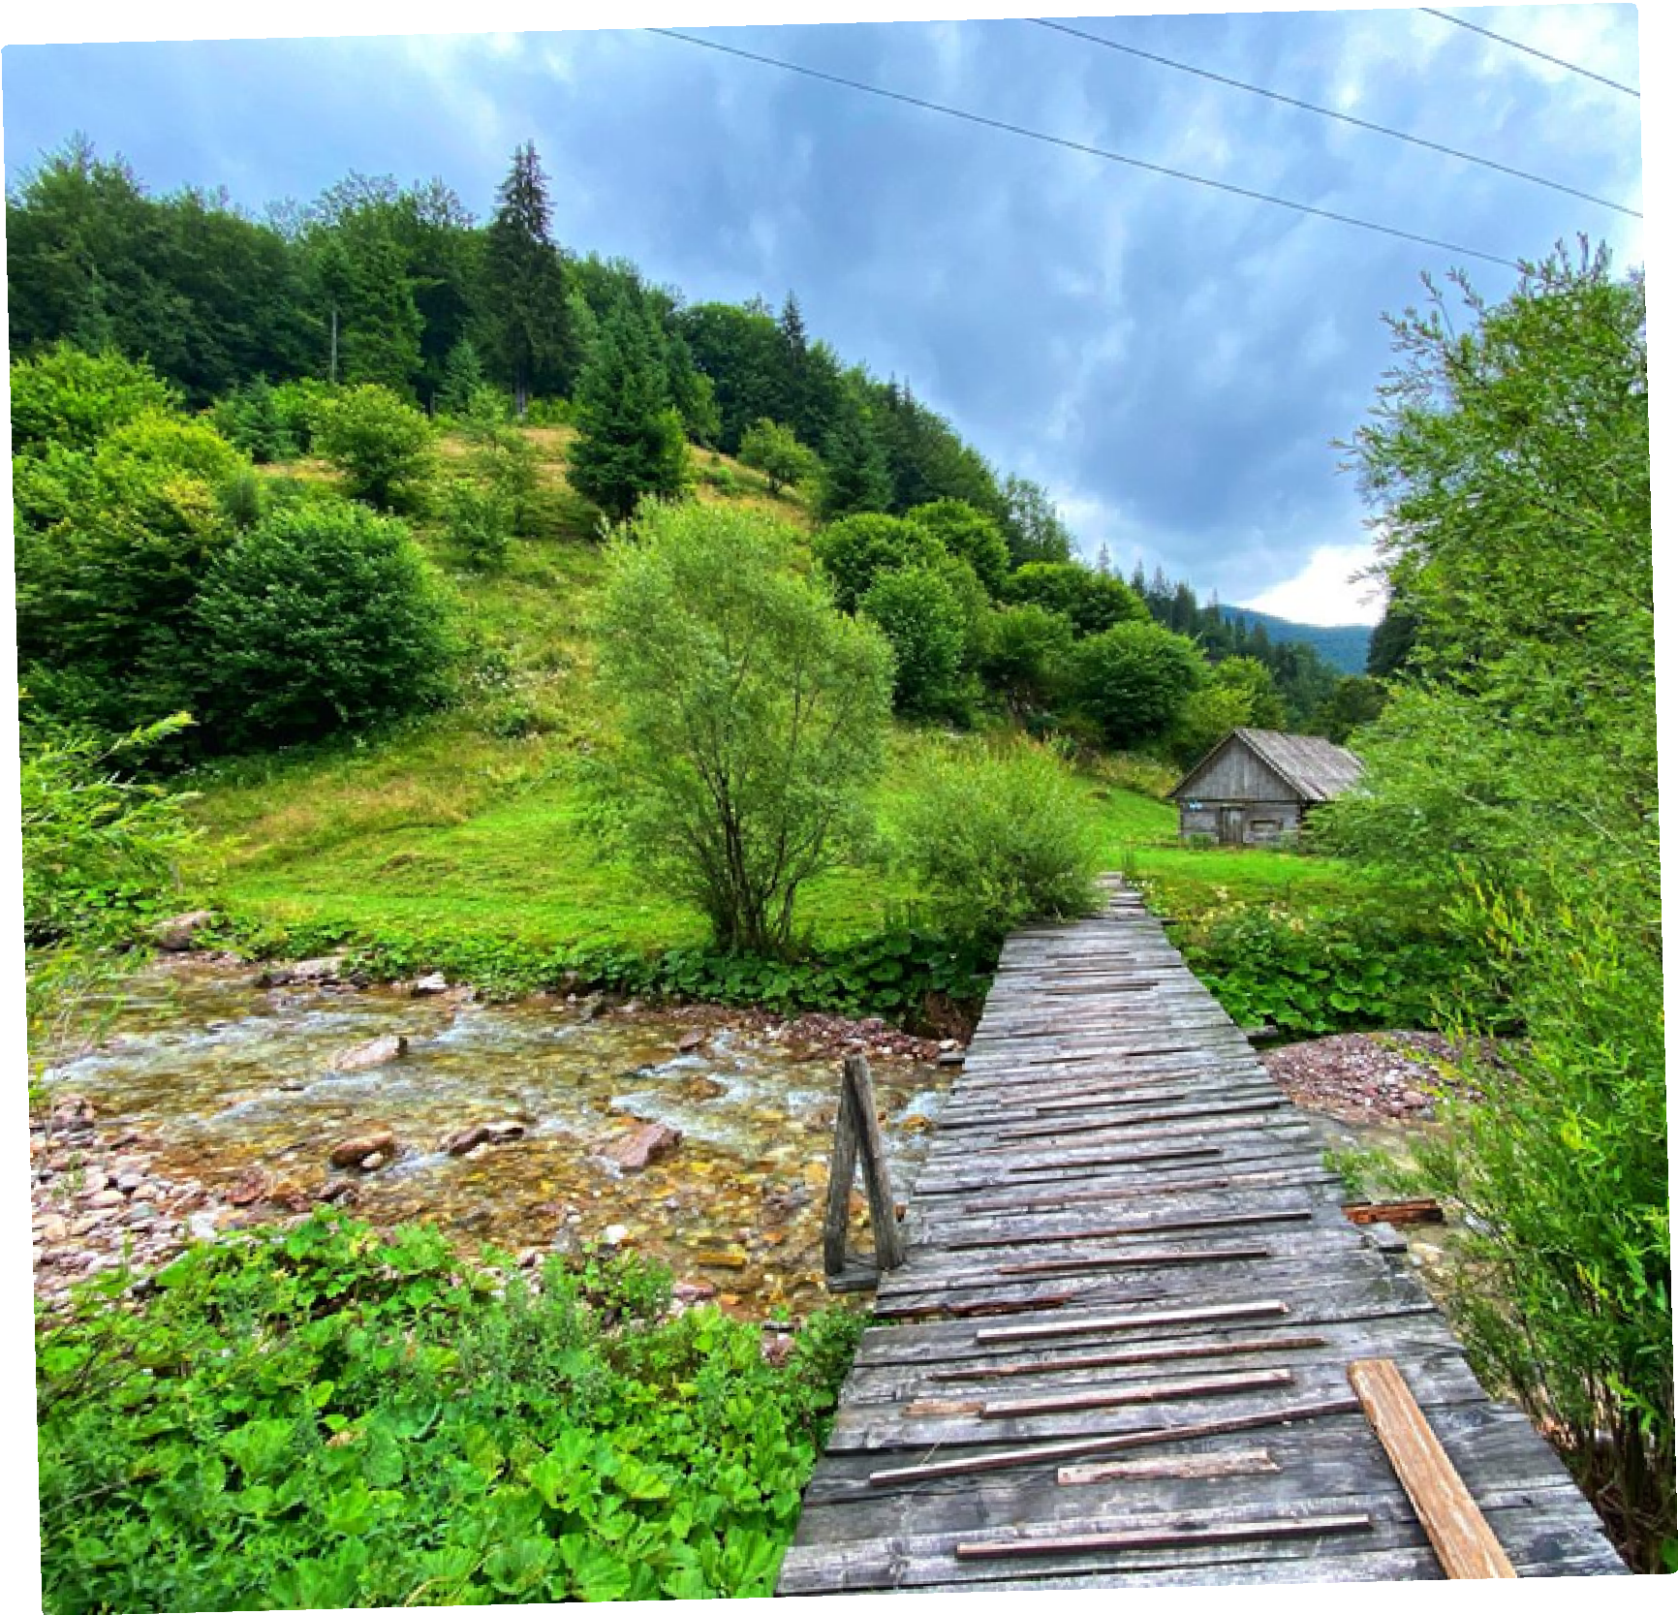
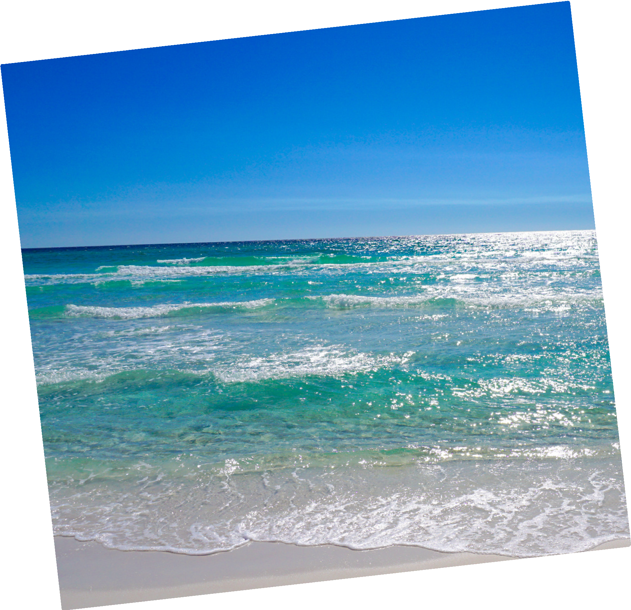
R E S E A R C H IM P L I C A T I O N
Academical: This research will bridge the gap between the interaction effects of social media influencer content and traditional advertising content on tourism motivation (Customer Inspiration - Activation) and toursim consumption (Customer Inspiration - Intention), as well as the relation between these phenomena and WOM Intention.

Slide 7
R E S E A R C H IM P L I C A T I O N
Practical: This research will give marketers insight into the effects of different types of content advertising on consumers, as well as the interaction between the type of content and consumer characteristics (PFC), aiding marketing managerial decisions.

