Slide 1
BLUE ECONOMY NEXUS MOUNTAIN LAKES: FOLLOWING THE PATH OF EUROPEAN TOURISM
Brîndușa Covaci¹, Mihai Covaci²
¹Centre for Mountain Economy & CBM International University
²Hyperion University & CBM International University
*Email: zealandina.agency@gmail.com, mihaicovaci@hyperion.ro

Slide 2

KEYWORDS. Mountain tourism, Blue economy, Mountain lakes, the European mountains
ABSTRACT:
Mountain lakes - parts of the blue deal, and support for the blue economy - represent an agritourism segment insufficiently used. The potential of these areas is huge and should be one of the major keys of the European mountain area.
Throughout Europe are important mountain chains, as Scandinavian (1762 km), Carpathian (1500 km), Alps (1200km), Caucasus (1100 km), and Apennine (1000 km). The European mountain lakes present a high diversity, from natural likes to artificial and from glacial lakes to current ones.
Mountain lakes tourism is well-developed in the Alps and some Scandinavian and Apennine areas, but in the rest of the European area investments and entrepreneurship represent an imperative. The infrastructure of the European mountain area does not favor the development of mountain lakes tourism.
The research methods have been qualitative through exploration of the existent scientific literature and official website regarding tourism and mountain entrepreneurship throughout Europe.
The paper presents some successful tourism models of the European mountain lakes to be followed by the other regions.
Notes:
In Slide Show mode, select the arrows to visit links.

Slide 3
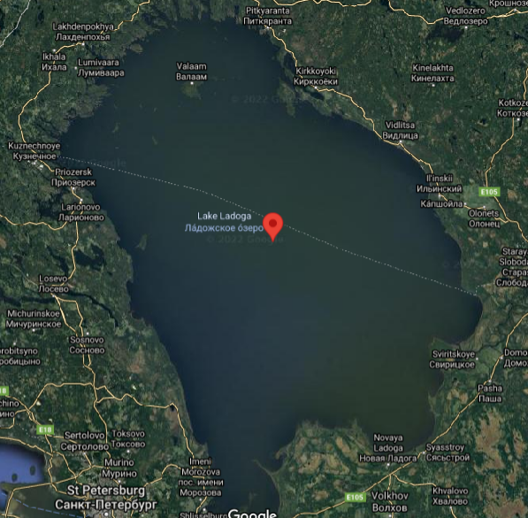
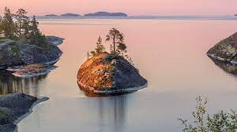
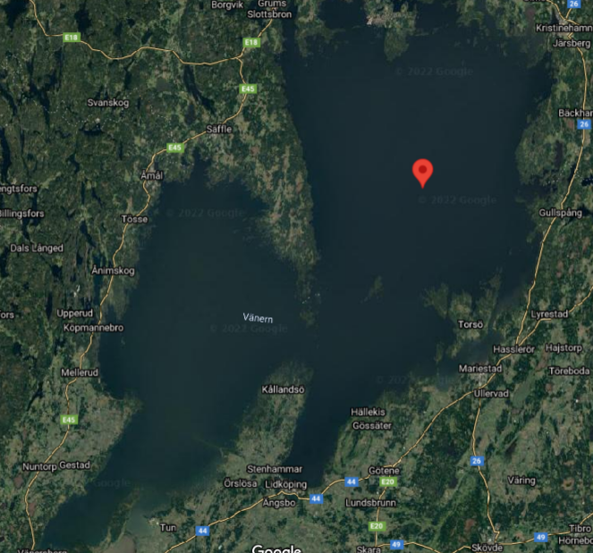
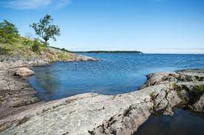
Mountain lakes, blue economy and agritourism
1
Blue economy (EU): All economic activities related to oceans, seas and coasts. It covers a wide range of interlinked established and emerging sectors.
The mountain lakes in the world have a surface of 1070609 km2 (here are included the lakes larger than 2,000 square kilometres)
2
3
The European mountain lakes are in surface of 113536 km2 (photo: Lagoda lake – Russia & Vanern lake – Sweeden, Google maps & Wikipedia)
4
Mountain tourism in mountain lakes area:
- Industrial heritage tourism principally provides tourist attractions.
- Rural tourism provides a complete tourism experience, offering both accommodation and attractions.
- Agricultural tourism offer a combined form of tourism between rural tourism and agro-pastoral and education tourism
- Religious tourism provides attractions for believers and non-believers.

Slide 4
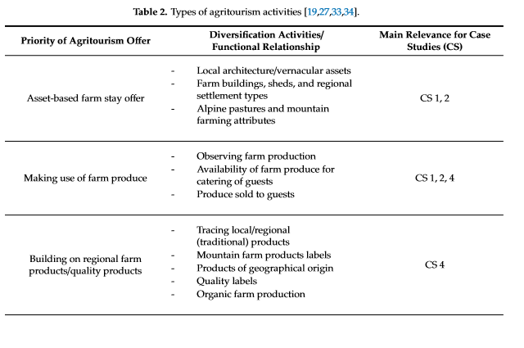
Dax, T., Zhang, D., & Chen, Y. (2019). Agritourism initiatives in the context of continuous out-migration: comparative perspectives for the Alps and Chinese mountain regions. Sustainability, 11(16), 4418.

Slide 5
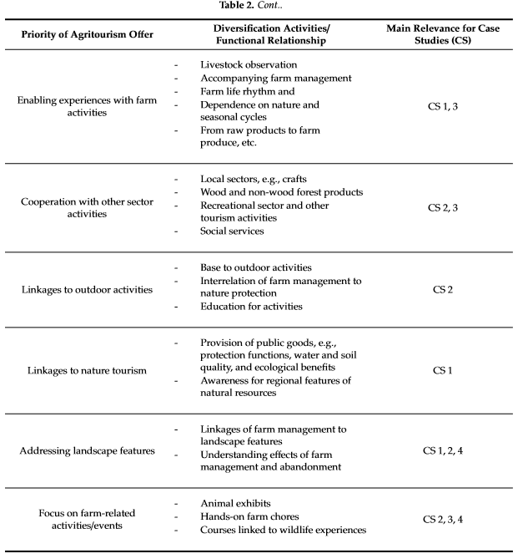

Slide 6
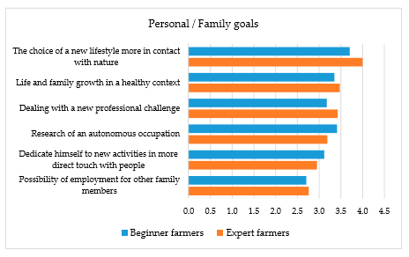
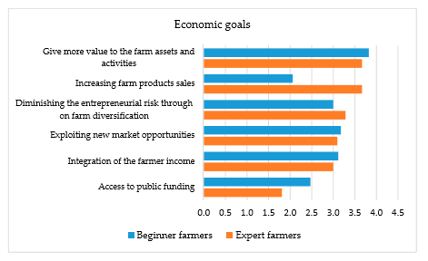
Chiodo, E., Fantini, A., Dickes, L., Arogundade, T., Lamie, R. D., Assing, L., ... & Salvatore, R. (2019). Agritourism in mountainous regions - Insights from an international perspective. Sustainability, 11(13), 3715.
(USA, Brazil, Italy & France)

Slide 7
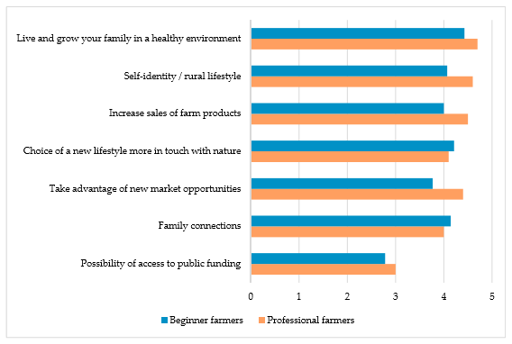
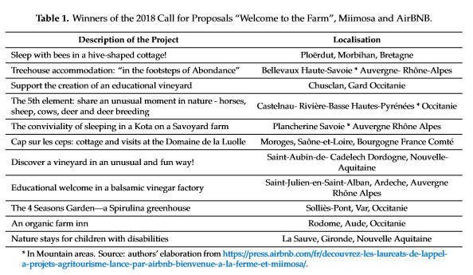

Slide 8
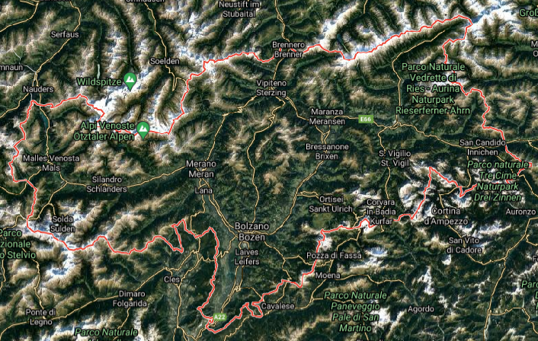
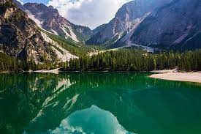
Sidali, K. L., Spitaler, A., & Schamel, G. (2019). Agritourism: A hedonic approach of quality tourism indicators in South Tyrol. Sustainability, 11(13), 3747. (Italy)
South Tyrol is close to the Austrian border and counts two ethnic minorities: The German speaking and the Latin speaking minority. The alpine setting hosts a varied agricultural structure. Out of the17,133 individual farms, the ones producing wine and fruits - especially apple - are set mainly on the plain, while dairy farming is concentrated in the higher regions. The area used for agricultural purposes in South Tyrol amounts to 267,000 hectares (660,000 acres), corresponding to 36% of South Tyrol’s total area. This expanse consists, for the most part, of meadows, grazing land and arable land (90%), orchards (7%), vineyards (2%), and other (1%). In the summer time, South Tyrol is a hallmark for hiking and biking tourism as well as for food and wine tourism and for cultural and rural tourism.
Agritourism-related activities cannot prevail over normal agricultural activities (fiscal regime)
Farmers who oﬀer hospitality or catering to agritourists are allowed to label their business as agritourism only if their hospitality-related activity is connected to the agricultural one.
The legislator imposes that agritourism is exercised only by a farm in activity.
1
2
3

Slide 9
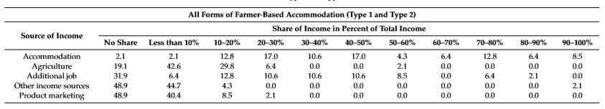
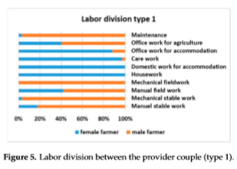
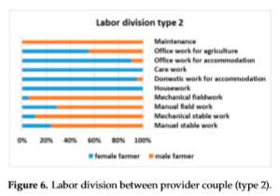
Stotten, R., Maurer, M., Herrmann, H., & Schermer, M. (2019). Different forms of accommodation in agritourism: the role of decoupled farmer-based accommodation in the Ötztal Valley (Austria).
Sustainability, 11(10), 2841.
1
Food production – mountain products
2
Holistic approach – farming and tourism: Urlaub am Bauernhof (Holidays on the Farm, UaB) (type 2)
3
Non-agricultural activities:
leisure, gastronomy, agro-marketing, equipments, local/social activities, structural/technical investments

Slide 10
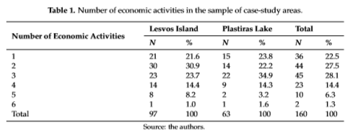
Karampela, S., Papapanos, G., & Kizos, T. (2019). Perceptions of agritourism and cooperation: comparisons between an island and a mountain region in Greece. Sustainability, 11(3), 680.
1
Mountain tourism, included:
accommodation,
cafés,
restaurants,
visited farms,
visited processing facilities and
cooperatives
2
Mountain tourism was associated with all kind of activities in the countryside.
3
Mountain tourism as a broader spatial term encompassing a diversity of activities offered in rural settings.

Slide 11
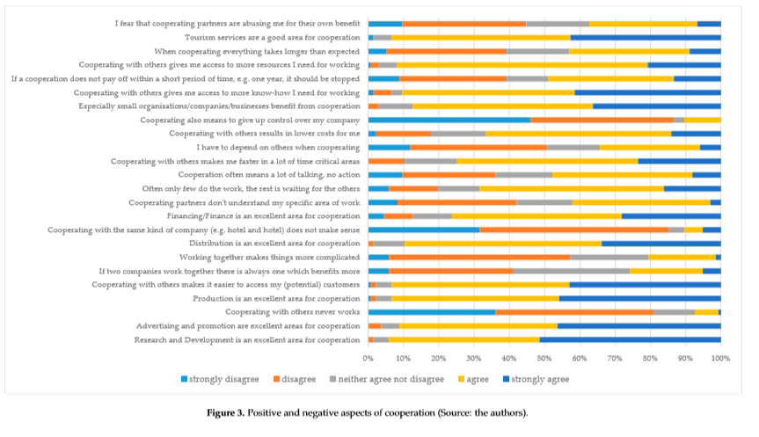

Slide 12
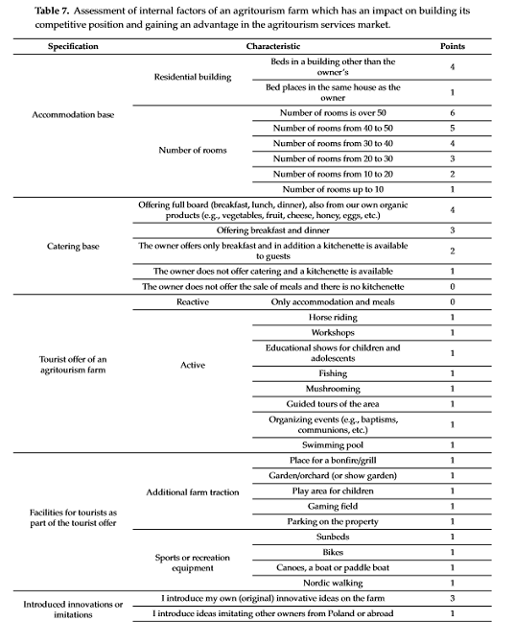
Roman, M., Roman, M., & Prus, P. (2020). Innovations in agritourism: Evidence from a region in Poland. Sustainability, 12(12), 4858.
Notes:
In Slide Show mode, select the arrows to visit links.

Slide 13
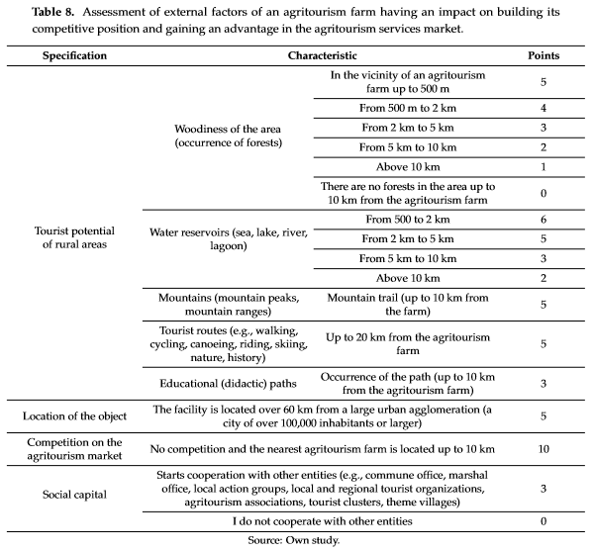
Innovations in agritourism can emerge in various forms, e.g., by making the stay, weekend or trip oﬀer more attractive. A farm stay can be organized for the disabled, those in need of health care (e.g., care farming as an example of innovation), the non-self-reliant, the elderly, for families or caretakers with small children, for those who love horse-riding, ﬁshing and mushroom-picking, those interested in working in the ﬁeld, trekking or health food.
Notes:
In Slide Show mode, select the arrows to visit links.

Slide 14
Norwegian rural tourism has been developing lately, especially in the light of the progress of the various ways in complementary of classic tourism, such as: sports, medical tourism, educational trips, cultural and artistic tourism, ecological and ethnic tourism, etc. The complexity of rural tourism is mainly given by the wide range of services and products that it offers. The valences of rural tourism in recent times harmoniously combine work with passivity, recreation with education, modernity with tradition. A special attribute of rural tourism is the provision of an environment close to family life. In such an area, tourists feel closer to nature, the values ​​of the community and the traditional family. In rural tourism with educational purposes, focus on customer is stronger than in other types of tourism

Slide 15
In Norway, the practice of rural tourism for educational purposes is carried out especially in mountain areas where, compared to the others, the conditions of the natural and social environment described above are better met. Returning to nature for educational purposes, including in agrarian production locations, is the defining element for the considerable growth of Norwegian tourism in recent years.
In Romania, one of the promoters of this type of tourism is the Center for Mountain Economics of the National Institute of Economic Research from the Romanian Academy.

Slide 16
Proposals – Rural/urban childhood education in Norway and Romania, around mountain lakes:
Educational farm a rural educational model for primary and pre-school children and their families. Within this, children can learn about country life in a direct and friendly way, by participating directly in daily activities on the farm.
The edutainment center an educational model for children in pre-school, primary and secondary education and their families. In these centers children learn about life in the country but do not participate directly in farm activities. In these types of centers children learn practical things such as: how the world is applied in gardening, how math and physics can be used in the construction of a hut, the use of language skills in dialect and toponomy research, the development of artistic skills in the realization exhibitions, pottery, etc., while music is used in studying traditional instruments.
Rural/urban thematic centers Rural/urban art centers, Centers aimed at the harmonious development of the environment, Eco-friendly rural centers, Rural adventure centers
Science centers children and young people are geared towards making scientific discoveries and experimenting with different techniques
Recreational centers children and young people learn by practicing various recreational activities, especially through winter sports, water sports, extreme sports
Notes:
In Slide Show mode, select the arrows to visit links.

Slide 17
Conclusion
More and more tourists, visitors of the European mountain area, prefer mountain lakes tourism and rural tourism than any other form of tourism.
In this context, the European Commission proposes plans and investments for the blue deal and blue economy.
The public and private governance from all over Europe must concentrate the efforts for project proposals and attract funds in order to sustain the European mountain area, especially lakes tourism.
Notes:
In Slide Show mode, select the arrows to visit links.

Slide 18
Bibliographical references:
Centrul Nordic de Dezvoltare Spațială – Nordregio (2013), Small-scale Tourism in Rural Areas – Trends and Research in the Nordic Countries, http://www.diva-portal.org/smash/get/diva2:700296/FULLTEXT01.pdf
Chiodo, E., Fantini, A., Dickes, L., Arogundade, T., Lamie, R. D., Assing, L., ... & Salvatore, R. (2019). Agritourism in mountainous regions - Insights from an international perspective. Sustainability, 11(13), 3715.
Covaci B., Rural tourism in support of Romanian education. Considerations on the Norwegian model, Journal of Montology, 2017
Dax, T., Zhang, D., & Chen, Y. (2019). Agritourism initiatives in the context of continuous out-migration: comparative perspectives for the Alps and Chinese mountain regions. Sustainability, 11(16), 4418.
Innovation Norway (2016), Key figures for Norwegian travel and tourism – Report, www.innovasjonnorge.no
Innovation Norway (2015), Key figures for Norwegian travel and tourism – Report, www.innovasjonnorge.no
Institutul Național de Statistică (2016), Turismul României – breviar statistic http://www.insse.ro/cms/ro/content/turismul-rom%C3%A2niei-breviar-statistic
Karampela, S., Papapanos, G., & Kizos, T. (2019). Perceptions of agritourism and cooperation: comparisons between an island and a mountain region in Greece. Sustainability, 11(3), 680.
Roman, M., Roman, M., & Prus, P. (2020). Innovations in agritourism: Evidence from a region in Poland. Sustainability, 12(12), 4858.
Sidali, K. L., Spitaler, A., & Schamel, G. (2019). Agritourism: A hedonic approach of quality tourism indicators in South Tyrol. Sustainability, 11(13), 3747.
Stotten, R., Maurer, M., Herrmann, H., & Schermer, M. (2019). Different forms of accommodation in agritourism: the role of decoupled farmer-based accommodation in the Ötztal Valley (Austria).
Sustainability, 11(10), 2841.
Statistics Norway (2017), Transport and Tourism Statistics, https://www.ssb.no/en/transport-og-reiseliv?de=Tourism+
United Nations Joint Programme ”Sustainable Tourism for Rural Development” & National Tourism Organization of Serbia (2011), Child and youth Educational Tourism https://www.unicef.org/serbia/Child_and_Youth_Educational_Tourism(1).pdf
PROJECT: "Integrated system for development of mountain areas in Romania", funded under the call for proposals launched by the Foundation for Local and Regional Development (contract number 2/7.02.2017), implemented between 7.02.2017 – 30.06.2018. The project was carried out under the aegis of the Center for Mountain Economics of the National Institute of Economic Research "Costin C. Kiriţescu" of the Romanian Academy.
THANK YOU FOR YOUR ATTENTION! Q&A

