Slide 1
Implications of smart Tourism in Planning and Developing Protected Areas
Oscar Rodriguez - PhD Candidate, Tourism and Marketing Research Centre, University of Greenwich, London, United Kingdom

Slide 2
Introduction
Importance of studying smart tourism in protected areas for sustainable tourism → enhance visitor experiences, → promote sustainable tourism→ and mitigate the adverse impacts of traditional tourism on biodiversity, and cultural heritage
Existing literature mainly focus on smart tourism in cities, → limited research in protected areas.
The objective of this research is to explore how smart tourism enhance visitor experiences and sustainable tourism in protected areas.

Slide 3
Conceptual Perspective
Investigation of opportunities and challenges of smart tourism in protected areas.
Use of critical discourse theory to analyses the application and implications of smart tourism in protected areas.
Focus on preserving cultural and natural heritage.

Slide 4
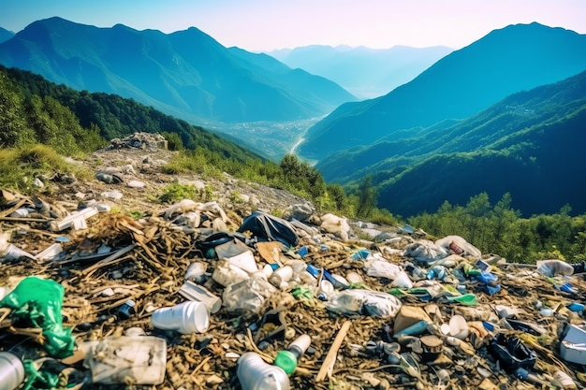
Traditional Tourism Development
Negative impacts on biodiversity in protected areas.
﻿The Green List for Protected Areas by the International Union for the Conservation of Nature findings that only a small percentage of protected areas have effective management practices (Bushell and Bricker, 2017).
Infrastructure construction disruption, unsustainable tourist behaviour wildlife habitats, and poor management
Result in the loss of natural ecosystem integrity and cultural heritage fragmentation.

Slide 5
Smart Tourism
A key factor for any smart tourism project
is an appropriate connectivity system that ensures
effective information exchange between tourists
governance actors, tourism sites, and businesses ﻿ (Errichiello and Micera, 2021).

Slide 6
Smart tourism Destination concept
Experience Layer (consumption of data i.e., co-cocreation, technology enhanced experience
Business Layer smart business( i.e. user driven innovation, living labs, value cocreation)
Data Layer technologies allowing processing (i.e. data storage, processing analysis and sharing)
Technology Layer smart tourism technologies ( i.e. IoT, sensors, virtual and augmented reality)
Physical Layer elements present in the destination (i.e. infrastructure, flora, fauna, landscape, artefacts)

Slide 7
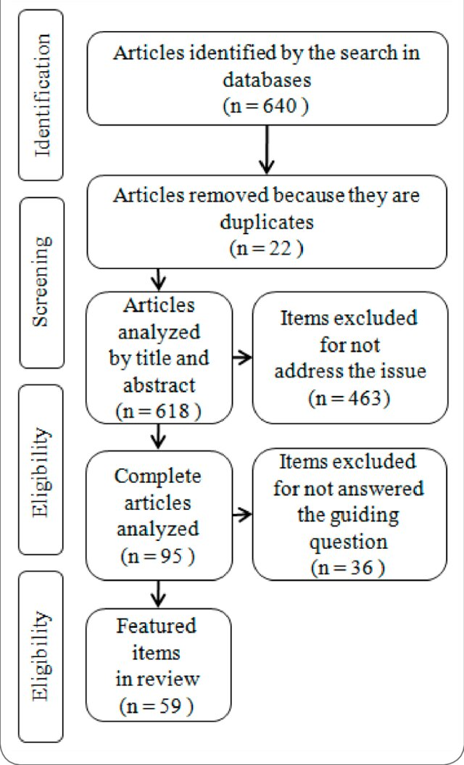
Research Method
Integrative literature review approach
Critical assessment and synthesis of existing literature
Aim: Advance knowledge in theoretical frameworks related to ecosystems in protected areas

Slide 8
Findings
Opportunities of smart tourism in protected areas → Enhanced visitor engagement and experiences with the development of cloud services enables better information searches, and the integration of GPS, smartphones, and 5G networks allows new travel experiences through mobile phones ﻿(Gao, 2021)
Sustainable management of resources → the installation of wireless sensors allows real-time data on the temperature, humidity, light, and moisture of ancient trees to be transmitted to the analysis center and analyzed through intelligent modules, aiding in the protection of famous trees ﻿(Wang et al., 2021).
Digitalization in cultural heritage → smart tourism enhances sustainability by integrating multidisciplinary fields such as archaeology, architecture, and art, → addressing key questions about the "what, where, how, why, and by whom" of its implementation ﻿(Sonuç and Süer, 2023).
Challenges of smart tourism implementation → Technological infrastructure system and connectivity issues → Balancing conservation with tourism demands.

Slide 9
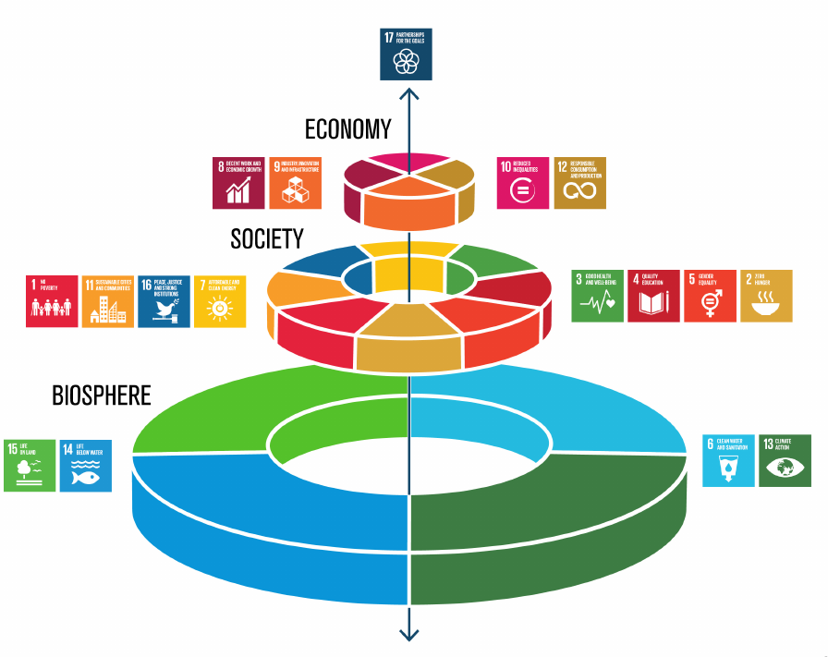
Discussion
Smart sites protection analyses the preservation of the precious cultural heritage, water, pest and disease, overtourism, survival of natural relics, external wind and sand that and more can be monitored in real-time.
SMART sites are defined as individual protected or conserved areas, including national parks, wildlife sanctuaries, and conservancies, that implement the SMART approach (Wyatt, Singh and Read, 2023).
Dynamic big data mining and artificial intelligence, combined with emotional intelligence, can identify in real-time what each tourist wants (Gajdošík, Maráková and Kučerová, 2020)
Potential for smart tourism to mitigate traditional tourism’s negative impacts in protected areas

Slide 10
conclusion
The implication of smart tourism within protected areas offers significant opportunities for → enhancing visitor experiences → promoting conservation awareness, and → fostering sustainable economic development
Collaboration among stakeholders for effective implementation policymakers is essential to develop effective strategies and policies that reconcile the dual objectives of conservation and smart tourism development within protected areas.
Need for further research and practical application.

Slide 11
Questions and Answers
Thank you for your attention. I am now happy to take any questions you may have.

Slide 12
Thank You
Oscar Rodriguez
or2532v@gre.ac.uk

Slide 13
references
Castillo Vizuete, D. D., Gavilanes Montoya, A. V., Muñoz Jácome, E. A., Chávez Velásquez, C. R. and Borz, S. A. (2021) An Evaluation of the Importance of Smart Tourism Tools in the Riobamba Canton, Ecuador, Sustainability, 13(16), p. 9436, (Accessed 10 May 2024).
Cavalheiro, M. B., Cavalheiro, G. M. do C., Mayer, V. F. and Marques, O. R. B. (2021) Applying patent analytics to understand technological trends of smart tourism destinations, Technology Analysis and Strategic Management, Routledge, (Accessed 12 May 2021).
Cheng, T.-M., Hsu, C.-Y. and Li, S.-N. (2024) Testing the moderated mediation effect of recreation safety climate on the interrelationship of serious leisure, recreation involvement, and flow experience, Journal of Outdoor Recreation and Tourism, 46, p. 100762 (Accessed 10 May 2024).
Errichiello, L. and Micera, R. (2021) A process-based perspective of smart tourism destination governance, European Journal of Tourism Research, 29, pp. 2909–2909, (Accessed 5 August 2023).
Gajdošík, T., Maráková, V. and Kučerová, J. (2020) From mass tourists to smart tourists: a perspective article, Tourism Review, Emerald Group Publishing Ltd., ahead-of-p(ahead-of-print), pp. 0–3.

Slide 14
References
Gao, H. (2021) Big Data Development of Tourism Resources Based on 5G Network and Internet of Things System, Microprocessors and Microsystems, Elsevier B.V., 80, p. 103567.
Gretzel, U. (2018) From smart destinations to smart tourism regions, Investigaciones Regionales – Journal of Regional Research, 42(42), pp. 171–184, (Accessed 17 July 2019).
Gretzel, U. (2021) Smart Tourism Development, In In Dieke, P., King, B., & Sharpley, R. (Eds. ) (ed.), Tourism in Development: Reflective Essays, Oxford, CABI Publishing.
Gretzel, U. and Collier de Mendonça, M. (2019) Smart destination brands: semiotic analysis of visual and verbal signs, International Journal of Tourism Cities, 5(4), pp. 560–580.
Gretzel, U., Sigala, M., Xiang, Z. and Koo, C. (2015) Smart tourism: foundations and developments, Electronic Markets, Springer Verlag, 25(3), pp. 179–188.
Jasrotia, A. and Gangotia, A. (2018) Smart cities to smart tourism destinations: A review paper, Journal of Tourism Intelligence and Smartness, 1(1), pp. 47–56, (Accessed 17 July 2019).

Slide 15
References
Jeong, M. and Shin, H. H. (2019) Tourists’ Experiences with Smart Tourism Technology at Smart Destinations and Their Behavior Intentions, Journal of Travel Research, 59(8), pp. 1464–1477.
Kiatkawsin, K., Sutherland, I. and Lee, S. K. (2020) Determinants of Smart Tourist Environmentally Responsible Behavior Using an Extended Norm-Activation Model, Sustainability, Multidisciplinary Digital Publishing Institute, 12(12), p. 4934, (Accessed 14 April 2023).
Kontogianni, A. and Alepis, E. (2020) Smart tourism: State of the art and literature review for the last six years, Array, Elsevier Ltd, 6(January), p. 100020.
Köseoglu, M. A., Mehraliyev, F., Altin, M. and Okumus, F. (2021) Competitor intelligence and analysis (CIA) model and online reviews: integrating big data text mining with network analysis for strategic analysis, Tourism Review, 76(3), pp. 529–552.
Li, Y., Hu, C., Huang, C. and Duan, L. (2017) The concept of smart tourism in the context of tourism information services, Tourism Management, 58, pp. 293–300.
López, E. P., Hernández-Martín, R. and Gahr, D. (2014) Smart Destinations: The optimization of Tourism Destination Management, Seminario de Economía Canaria, (June).

Slide 16
References
Mandić, A. (2019) Nature-based solutions for sustainable tourism development in protected natural areas: a review, Environment Systems and Decisions, 39(3), pp. 249–268, (Accessed 10 May 2024).
Matyusupov, B., Khodjaniyazov, E., Masharipova, M. and Gurbanov, F. (2024) The concepts of Smart cities, Smart Tourism Destination and Smart Tourism Cities and their interrelationship, Trukhachev, V., Khavinson, V., Zhuravlev, A., Belopukhov, S., Migunov, R., and Kukhar, V. (eds.), BIO Web of Conferences, 82, p. 06015 (Accessed 10 May 2024).
Moise, G., Popescu, A., Bratu, I. A., Răducuță, I., Nistoreanu, B. G. and Stanciu, M. (2023) Can We Talk about Smart Tourist Villages in Mărginimea Sibiului, Romania?, Sustainability, 15(9), p. 7475, (Accessed 10 May 2024).
Pulido-Fernández, J. I. and López-Sánchez, Y. (2016) Are tourists really willing to pay more for sustainable destinations?, Sustainability (Switzerland), 8(12).
Sigalat Signes, E., Roig Merino, B., Buitrago Vera, J. M. and Baviera Puig, M. A. (2018) The need for a master plan for smart tourist cities. Methodological proposals based on participatory action, Pasos-Revista De Turismo Y Patrimonio Cultural, 16(2), pp. 483–500, (Accessed 26 January 2021).
Sonuç, N. and Süer, S. (2023) Smart Tourism Destinations and Digitalization of Cultural Heritage for Sustainability, In El Amine Abdelli, M., Sghaier, A., Akbaba, A., Gamoura, S. C., and Mohammadian, H. D. (eds.), Advanced Series in Management, Emerald Publishing Limited, pp. 151–168 (Accessed 21 May 2024).

Slide 17
References
Wang, X., Li, X. R., Zhen, F. and Zhang, J. H. (2016) How smart is your tourist attraction?: Measuring tourist preferences of smart tourism attractions via a FCEM-AHP and IPA approach, Tourism Management, 54, pp. 309–320, (Accessed 12 July 2019).
Wyatt, A., Singh, R. and Read, C. (2023) Assessing the adaptive management process in SMART sites: Lessons learned, PARKS, (29.1), pp. 59–68, (Accessed 10 May 2024).
Xiang, Z. and Fesenmaier, D. R. (2017) Analytics in Tourism Design, Tourism on the Verge.
Xiang, Z., Magnini, V. P. and Fesenmaier, D. R. (2015) Information technology and consumer behavior in travel and tourism: Insights from travel planning using the internet, Journal of Retailing and Consumer Services, Elsevier Ltd, 22, pp. 244–249.
Xie, X., Zheng, L., Wang, R. and Gou, Z. (2024) Visitors’ experience of using smart facilities in urban parks: A study in Shenzhen, Journal of Outdoor Recreation and Tourism, 46, p. 100759, [online] Availab

