Slide 1
The Gorj village in danger of extinction, in the conditions of decarbonization of the mining areas
Simona Spânu, Virgil Nicula

Slide 2
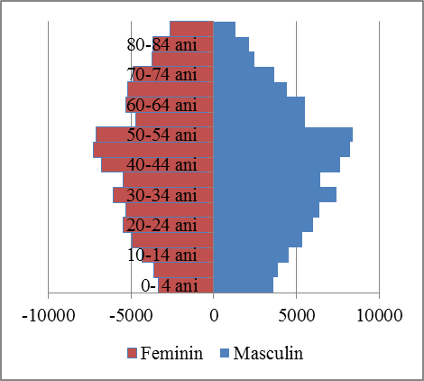
Demographic radiography of the rural area in Gorj County
The population of Gorj County had, on January 1, 2020, 16.3% of the population of the region and 1.6% of the country's population.
The rural population represents 54.5% of the county's population. Gorj County is facing a decrease in the number of inhabitants, a trend manifested in recent years.
In addition, Gorj County also experienced a decrease in the active population, registering in 2019 the lowest value in the last 5 years (61.7 thousand people).

Slide 3
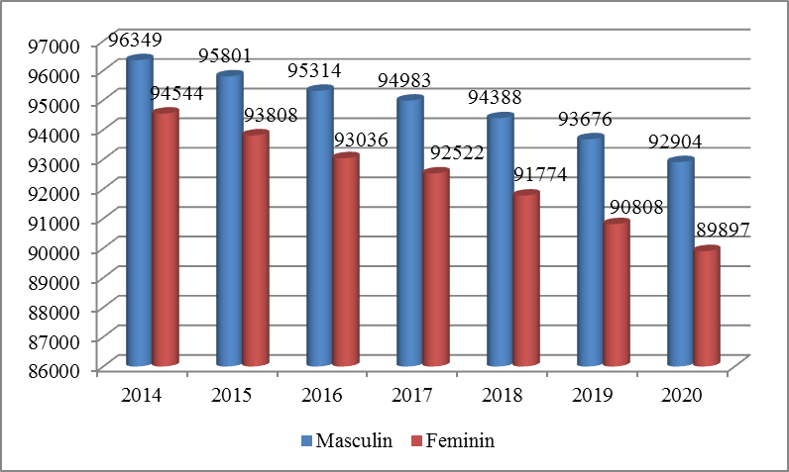
The analysis of the evolution of the rural population in the period 2014-2020 shows that in 2020, compared to 2019, in 6 communes out of 61, the number of inhabitants increased, and in the rest, it had a decreasing evolution. In Gorj County, 11 communes were declared areas without cities within a radius of about 25-30 km, which require priority actions for the development of localities with the role of inter-municipal service.
Dynamics of the rural population in Gorj County during 2014-2020

Slide 4
The migratory balance in Gorj county has remained constant negative in the last 5 years (-2790 people in 2019), as a result of a similar trend followed by both departures and arrivals from urban (-1272 people in 2019) and rural areas (- 1518 people in 2019).
The evolution of emigrations and temporary immigrations of people from the rural area of Gorj county in the period 2014-2019

Slide 5
The economic activities in the rural area of Gorj County concentrated 37.85% of the total economic agents in the county and a turnover of 13.19% of the total from the county.
By categories of activities of the national economy, in the rural area of Gorj county predominates, depending on the number of employees, trade, construction works, forestry and forestry, road transport of goods, bakery manufacturing and activities in rural tourism, - there is a low level of diversification of economic activities.
The competitive advantage of rural tourism, agritourism and ecotourism is related to authenticity / originality. In Gorj county these forms of tourism are practiced especially in the area at the base of the mountain range in the northern part of the county, being closely related to the detachment from the accelerated life of the present, by accessing the slow and relaxing time of the Gorj village and by reconnecting with the healthy roots of humanity.
The practice of gastronomic and oenological tourism in Gorj County is ensured by the existence of numerous locations and points of tourist attraction that offer interested visitors the opportunity to taste the traditional cuisine developed in the South-West Oltenia region.

Slide 6
Solutions to revive economic activity in the rural area of Gorj
In several communes of the county there were traditional craft centers that have lost their importance in the last 20 years and can be revived by involving the nuclei of folk craftsmen who still produce traditional items: Tismana - fabrics, Pocruia - fabrics, Câlnic - Găleşoaia - pottery, Padeş, Polovragi, Baia de Fier - braids, Teleşti wooden household objects.
The peasant household specific to certain localities has individualized over time, depending on the historical and socio-economic conditions.
There are many examples of peasant houses made with artistic mastery, true architectural monuments in wood and masonry. Oak wood was the main building material, and the high pedestal, columns and arches are made of stone and brick.

Slide 7
Analysis of tourist indicators for the rural area of Gorj
The largest increases in tourist arrivals took place in the localities of Novaci, Baia de Fier, Arcani, Cătunele, Peștișani and Runcu.
Thus, in 2019 the number of tourist arrivals increased compared to 2014 in the following types of reception structures:
in hotels by 11.7%, especially in Baia de Fier by 63%, in Novaci a substantial increase by 546, 5%;
in motels with 29.7%; in tourist villas it increased substantially by 381.1%; in tourist chalets with 38.7%;
in tourist pensions increased by 94.3%;
in agritourism pensions it increased substantially by 271.4%, especially in the localities of Baia de Fier, Novaci and Polovragi.
The largest increases in the number of tourists were registered in tourist villas, tourist pensions and agritourism.

Slide 8
Arrivals of tourists in tourist reception structures | 2014 | 2015 | 2016 | 2017 | 2018 | 2019
Arcani | 58 | 91 | 832 | 1633 | 1986 | 2107
Baia de Fier | 8338 | 10129 | 12526 | 22076 | 22929 | 20797
Bumbești - Pitic | : | : | : | : | : | 82
Câlnic | 73 | 53 | 37 | 131 | 149 | 122
Cătunele | 38 | 90 | 130 | 103 | 146 | 204
Crasna | 12 | 41 | 173 | 96 | 131 | 188
Drăguțești | : | : | : | : | : | 198
Glogova | : | : | : | : | 19 | 422
Godinești | : | : | : | : | 152 | 40
Mușetești | 190 | 165 | 39 | 170 | 433 | 515
Negomir | : | : | : | : | 100 | 22
Padeș | : | : | : | 58 | 36 | 37
Peștișani | 101 | 134 | 527 | 503 | 399 | 357
Plopșoru | : | : | : | 604 | 502 | 238
Polovragi | 1859 | 1208 | 2020 | 2310 | 1983 | 1922
Runcu | 431 | 511 | 293 | 4192 | 5681 | 3256
Săcelu | 3505 | 1455 | 1906 | 475 | : | :
Scoarța | : | : | : | 126 | 100 | 113
Stănești | : | : | : | : | 21 | 595
Stejari | : | : | : | : | 237 | 233
Telești | : | : | : | : | : | 80
Turcinești | : | : | : | : | 2158 | 2652
Number of tourist arrivals in the rural localities of Gorj County

Slide 9
The number of tourist overnight stays in rural localities in Gorj County evolved between 2014 and 2019 as follows: at the level of Arcani locality increased substantially from 77 to 3471, as the number of arrivals in Baia de Fier increased by 109.8 %, in Câlnic increased by 88.6%, in Cătunele increased substantially, by 647.9%, in Crasna increased substantially from 36 to 712 tourists, in Mușetești increased by 130.2%, in Peștișani increased by 268.1%, in accordance with the number of arrivals, at the level of Polovragi locality it increased by 30.2%, and in Runcu it increased substantially, by 434.3%.
From the data analysis, it is observed that the total number of overnight stays in accommodation units has experienced an upward trend, starting with 2017 and 2018, after a decrease in 2015 and 2016.
Thus, in 2019 the number of overnight stays increased compared to 2014 within the following types of reception structures: in motels with 90.3%; in tourist villas it increased substantially by 378.8%; in tourist chalets with 52.3%; in tourist pensions increased by 121.8%; in agritourism pensions with 150%.

Slide 10
 | 2014 | 2015 | 2016 | 2017 | 2018 | 2019
Total county | 168737 | 147156 | 149869 | 185057 | 203786 | 204872
Arcani | 77 | 156 | 1489 | 2581 | 4029 | 3471
Baia de Fier | 20753 | 21272 | 23262 | 37711 | 46974 | 43547
Bumbești - Pitic | : | : | : | : | : | 164
Câlnic | 132 | 99 | 82 | 139 | 177 | 249
Cătunele | 48 | 128 | 212 | 115 | 155 | 359
Crasna | 36 | 67 | 331 | 229 | 325 | 712
Drăguțești | : | : | : | : | : | 475
Glogova | : | : | : | : | 38 | 569
Godinești | : | : | : | : | 304 | 40
Mușetești | 497 | 428 | 94 | 277 | 1145 | 1144
Negomir | : | : | : | : | 542 | 154
Padeș | : | : | : | 78 | 108 | 126
Peștișani | 285 | 459 | 1475 | 968 | 1217 | 1049
Plopșoru | : | : | : | 6007 | 3570 | 1092
Polovragi | 3359 | 1915 | 3769 | 4087 | 4127 | 4375
Runcu | 1194 | 1039 | 618 | 9118 | 11218 | 6380
Săcelu | 14077 | 7823 | 11683 | 2156 | : | :
Scoarța | : | : | : | 262 | 277 | 240
Stănești | : | : | : | : | 42 | 1299
Stejari | : | : | : | : | 597 | 591
Telești | : | : | : | : | : | 380
Turcinești | : | : | : | : | 3070 | 4092
Number of tourist’s overnight stays in the reception structures with accommodation function at the level of rural localities in Gorj county

Slide 11
A breakdown of the index of net capacity utilization highlights the poor results recorded in Gorj County. According to available statistics, almost three quarters of the operating capacity has not been used in recent years.
Higher indices of net use of accommodation in rural areas were registered in agritourism pensions (24.3%) and tourist chalets (22.8%).
The average length of stay decreased from 1.88 days in 2015 to 1.82 days in 2019. The average length of stay was higher in certain calendar months, for example, in February 2018 it was 1, 9 days (1.9 days for Romanian tourists and 2.8 days for foreign tourists). The average length of stay in April 2020 was 3.08 days (2.95 days for Romanian tourists and 8.84 days for foreign tourists).

Slide 12
Conclusions
Tourism represents for the rural area of Gorj county an economic sector that has a valuable development potential, not yet sufficiently exploited and which can become a source of attractiveness for both investors and tourists (Romanians and foreigners).
Contributing to the well-being of local communities, by preserving and promoting cultural authenticity can be achieved by reconverting the workforce in natural areas where the aggressive exploitation of the natural environment (mining, gravel pits) took place, by directing the workforce to the tourist area.
Another initiative aims to contribute to the creation of a platform dedicated to farmers interested in tourism entrepreneurship (to be integrated into the common online platform on sustainable tourism in the Carpathians, according to the Carpathian Convention).

