Slide 1


Soil mite fauna as bioindicator of management type of praticolous ecosystems from Bucegi Mountains -Romania
Manu M.¹, Băncilă R.I.^{2,3}, Mountford O.⁴, Maruşca T.⁵, Blaj V.A.⁵, Onete M.¹
¹Romanian Academy, Institute of Biology Bucharest, Department of Ecology, Taxonomy and Nature Conservation, street Splaiul Independenţei, no. 296, zip code 0603100, PO-BOX 56-53, fax 040212219071, tel. 040212219202, Bucharest, Romania, email: minodoramanu@gmail.com and marilena.onete@gmail.com
²Faculty of Natural Sciences, University Ovidius Constanţa, Constanţa, Romania
³Department of Biospeleology and Soil Edaphobiology, “Emil Racoviţă” Institute of Speleology, Romanian Academy, 13 Septembrie Road, No. 13, 050711, Bucharest, Romania, bancila_ralucaioana@yahoo.com
⁴Centre for Ecology and Hydrology, Maclean Building, Benson Lane, Crowmarsh Gifford, Wallingford, Oxfordshire, OX10 8BB, UK, email: om@ceh.ac.uk
⁵Grassland Research and Development Institute Braşov, Romania, Cucului str., No. 5, 500128, Braşov,
Romania, email: maruscat@yahoo.com; blajadi@pajisti-grassland.ro

Slide 2
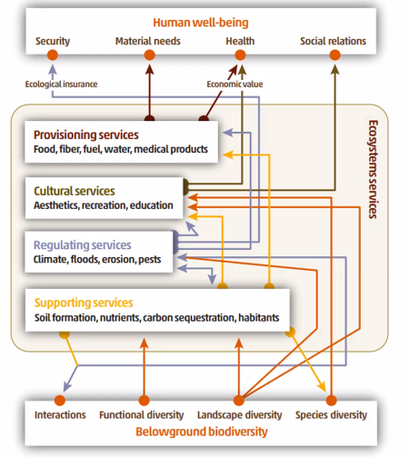
WHY BIODIVERSITY as BIOLOGICAL INDICATOR?

Slide 3
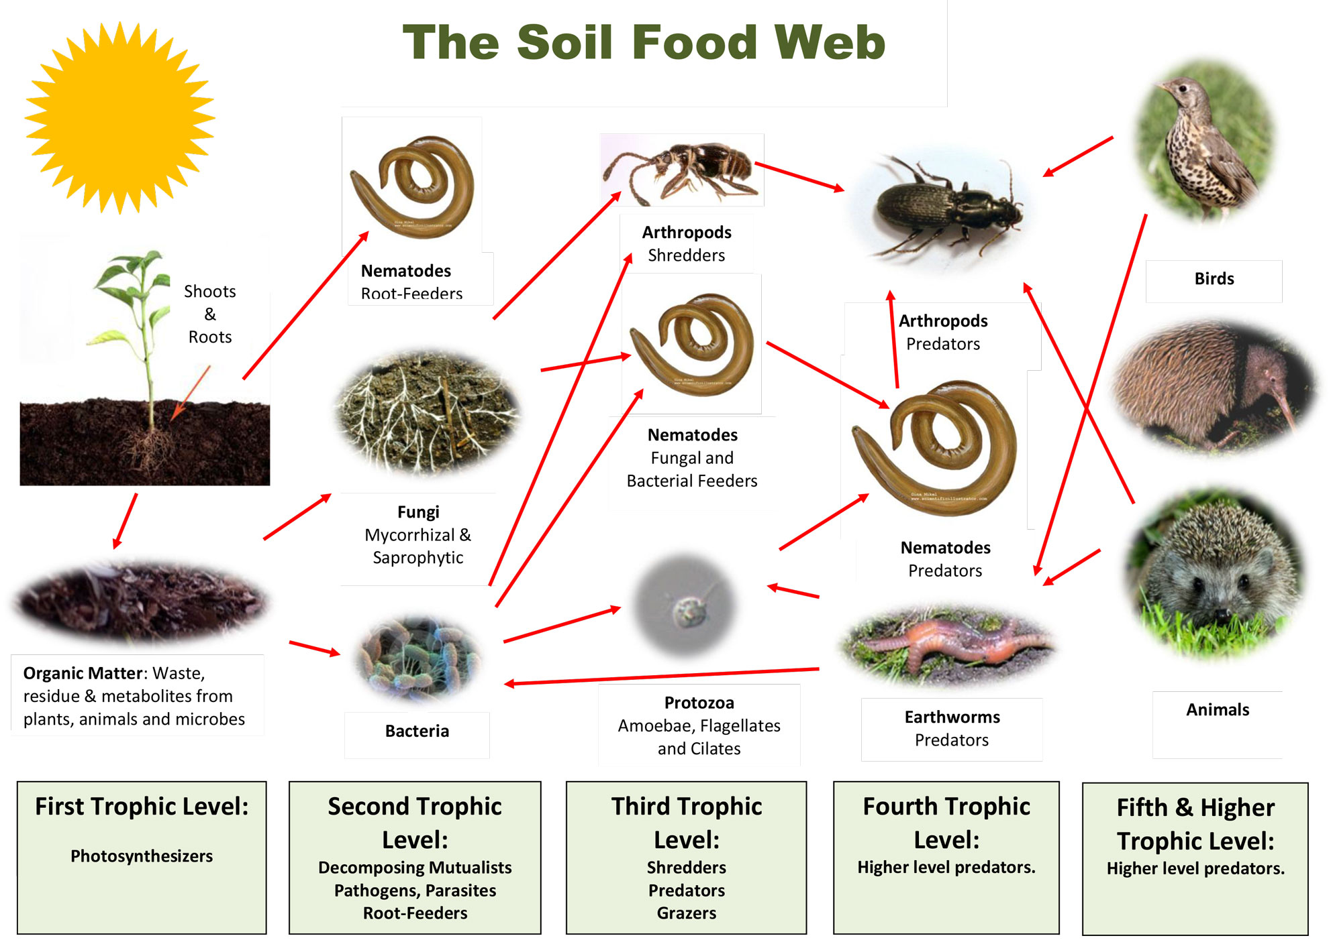
Importance of soil invertebrates in terrestrial ecosystems:
they represent a good assessment tool for the biodiversity status,
they respond in a short time to any environmental disturbance (due to the rapid generation times),
they are easy to collect,
they are present at many trophic levels in soil,
they are important in terms of ecosystem services correlated with anthropic changes (McIntyre, 2000; Jones & Leather, 2012).

Slide 4
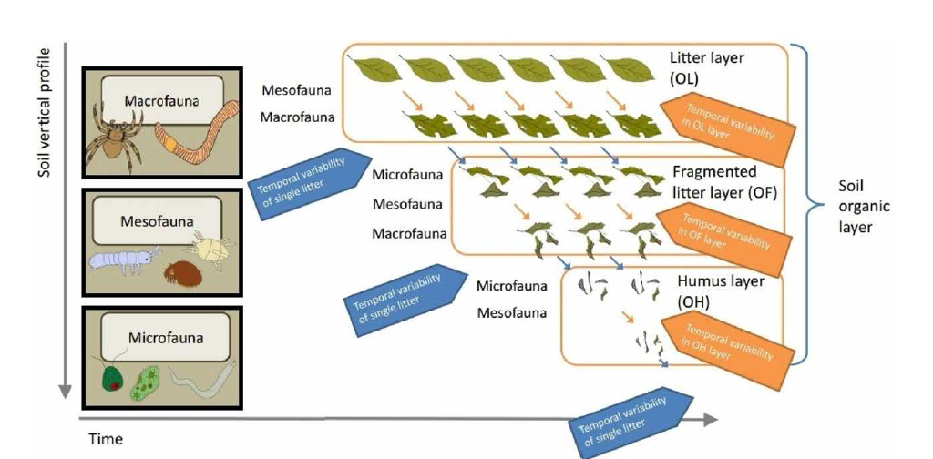
THE ROLE OF SOIL FAUNA
Crotty F.V., 2021. Assessing soil health by measuring fauna. In: Otten W (eds). Advances in measuring soil health (Burleigh Dodds Series in Agricultural Science, 92)

Slide 5
ORGANIZATION OF SOIL FOOD WEB
Mesostigmata mites
FAO, ITPS, GSBI, SCBD and EC. 2020. State of knowledge of soil biodiversity - Status, challenges and potentialities, Report 2020. Rome, FAO. https://doi.org/10.4060/cb1928en

Slide 6
SOIL BIODIVERSITY
FAO, ITPS, GSBI, SCBD and EC. 2020. State of knowledge of soil biodiversity - Status, challenges and potentialities, Report 2020. Rome, FAO. https://doi.org/10.4060/cb1928en

Slide 7
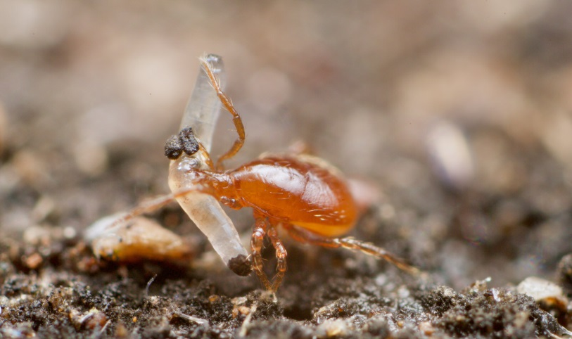
Predatory mites- Mesostigmata order
include both soil and plant living mites (Ruf and Beck, 2005).
are the most important predators of the soil micro and mesofauna, feeding on nematodes, enchytraeids and microarthropods (including springtails, mites, small insects and their larvae).
they also serve as prey to larger arthropod species, thus providing an important link between the soil microfauna and macrofauna.
are highly mobile, and many are r-selected, allowing them to track resource pulses (Cao et al., 2011).
play a role in carbon transformations through their top-down effects on the herbivorous and decomposer fauna on which they feed, as well as through respiration.
the effect of predatory mites on nutrient cycles has been attributed to trophic cascades, their feeding on microbial or fungal-grazers altering the microbiome of the soil.
they have little direct impact on soil structure.
are very important for the regulation of both herbivores and decomposers – biological regulation.
FAO, ITPS, GSBI, SCBD and EC. 2020. State of knowledge of soil biodiversity - Status, challenges and potentialities, Report 2020. Rome, FAO. https://doi.org/10.4060/cb1928en

Slide 8

THE STUDY OBJECTIVES
the structural differences between mite communities from five fertilised experimental plots;
II) the differences between certain key abiotic factors recorded in the five fertilised experimental plots;
III) the influence of these abiotic factors on the structure of mesostigmatid mite communities;
IV) the dispersal rates of the mite communities between experimental plots.

Slide 9
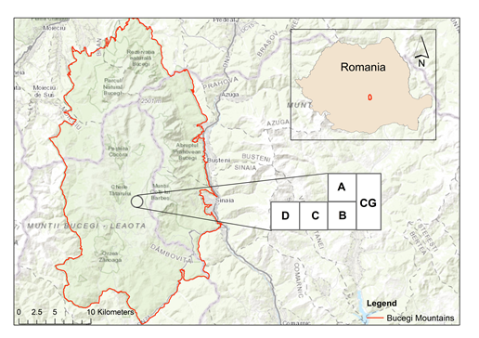
THE STUDY AREA
The plots were grazed for 85 - 90 days per year, by three Schwyz brown cows, fed exclusively with grass.
The type of soil in all experimental plots is podzol.
The area of a plot is 0.75 hectares.
The shape of each investigated plot is a rectangle, with a length by 125 meters and width by 60 meters.
July, 2017
The research was carried out at the Mountain Grasslands Research Centre (MGRC) in the Bucegi Mountains, Romania, on gently sloping land situated at the base of Blana Peak (1875 metres altitude).
The Bucegi Mountains are located on the east side of the Southern Carpathians, with an area of 300 km2.

Slide 10
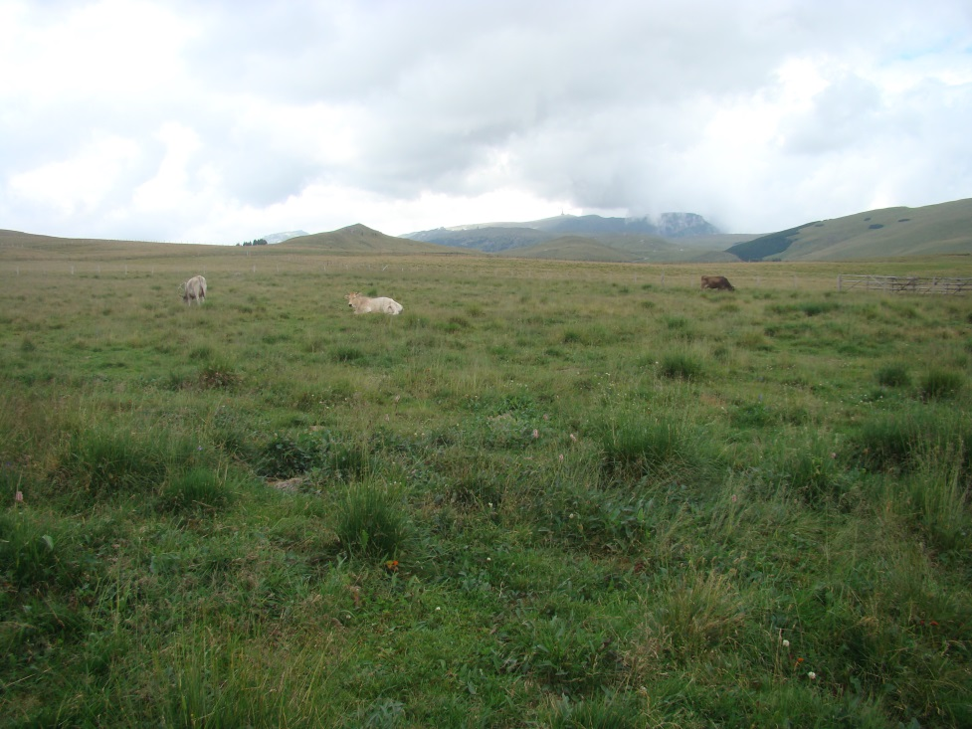
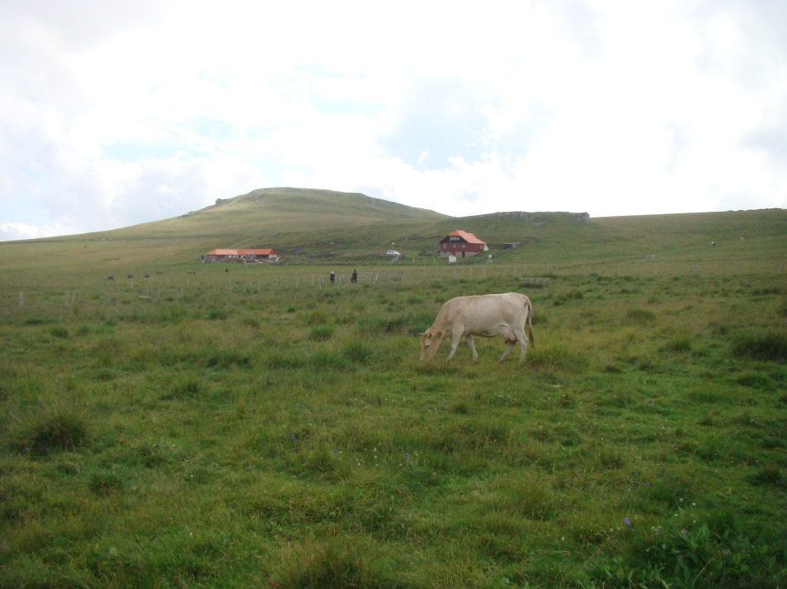
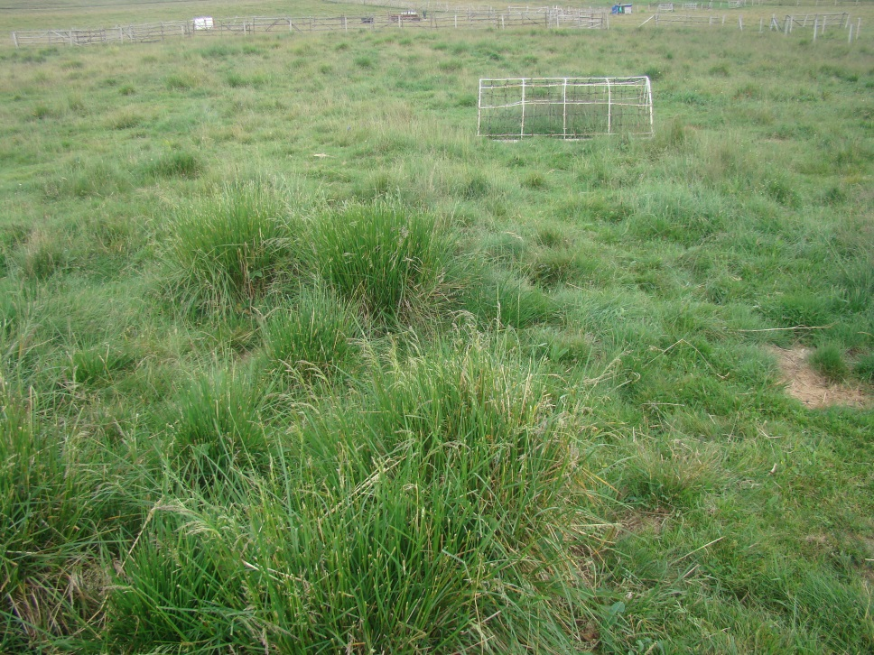
• Plot A is a semi-natural pasture, located at 1758 metres altitude, with an eastern exposure and a slope by 5 degrees.
The dominant plant species were: Agrostis capillaris L., Deschampsia cespitosa (L.) P. Beauv., Festuca rubra L., Phleum alpinum L., Poa pratensis L. and Polygonum bistorta L.
It was fertilised with chemical fertilisers in three periods 2000-2002, 2010-2012, and 2014-2016 with an average application rate per year by 100 kg ha-1 N + 50 kg ha-1 P2O5 + 50 kg ha-1 K2O.

Slide 11
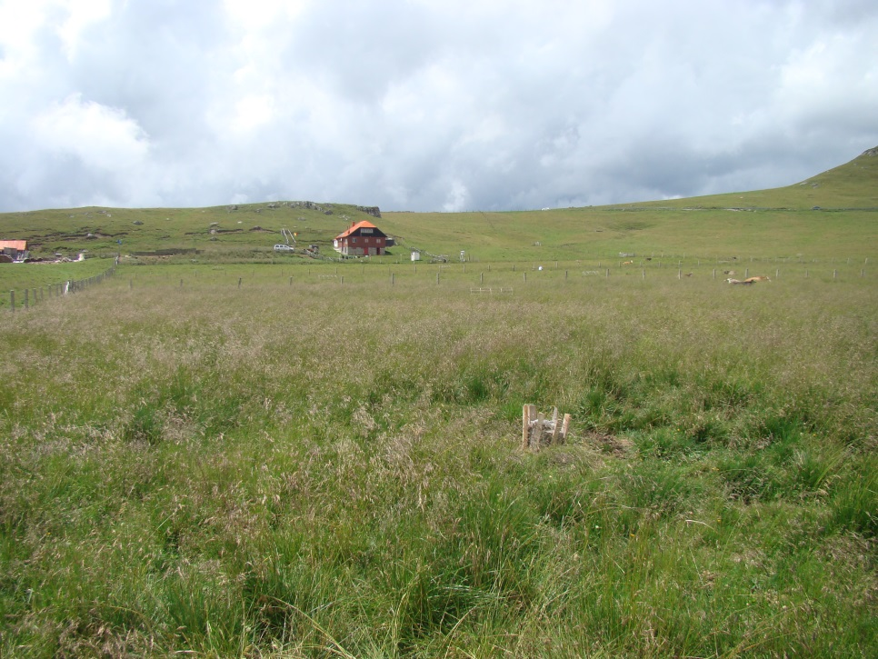
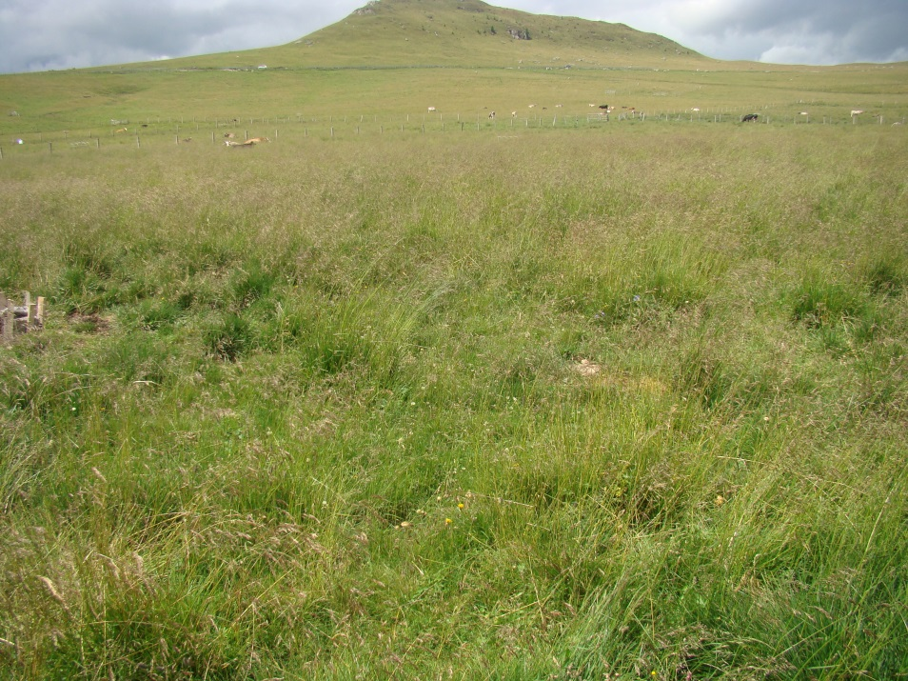
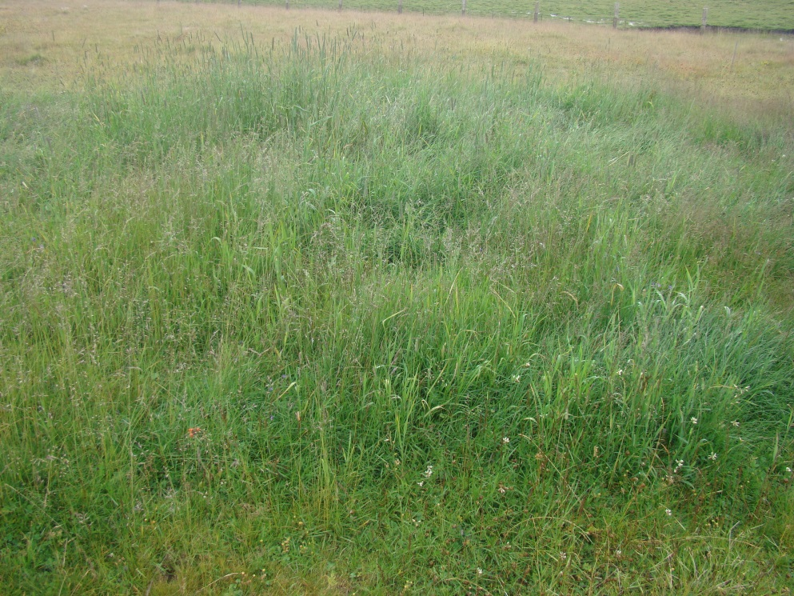
•Plot B is a semi-natural pasture, located at 1782 metres altitude, with an eastern exposure and no slope.
The dominant plant species were: Deschampsia cespitosa (L.) P. Beauv., Phleum alpinum L., Phleum pratense L., Ranunculus acris L. and Trifolium repens L.
It was chemically fertilised in 1996-1998 with an average application rate of 150 kg ha-1 N + 75 kg ha-1 P2O5 + 75 kg ha-1 K2O and organically fertilised in 2004, 2010 and 2016 by paddocking with dairy cows. Cattle manure was added as an input of organic matter.

Slide 12
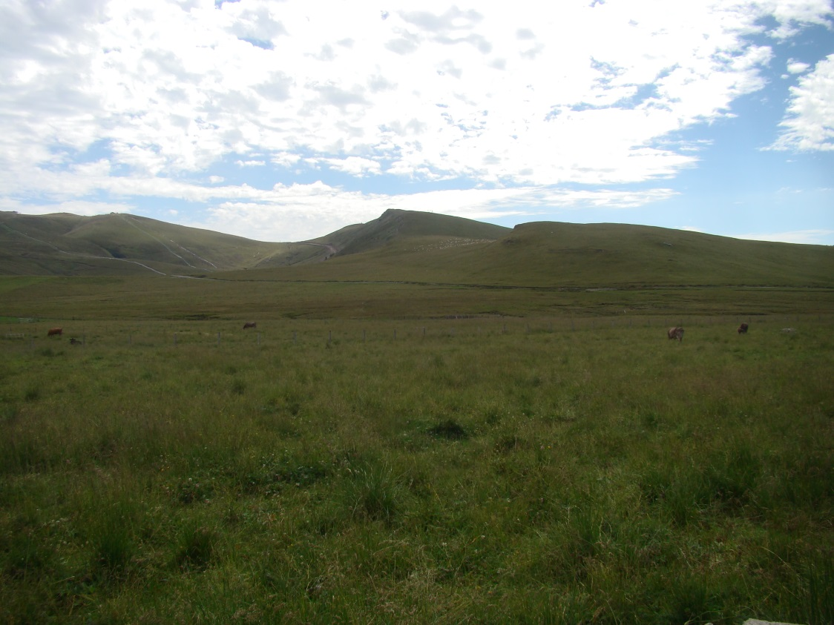
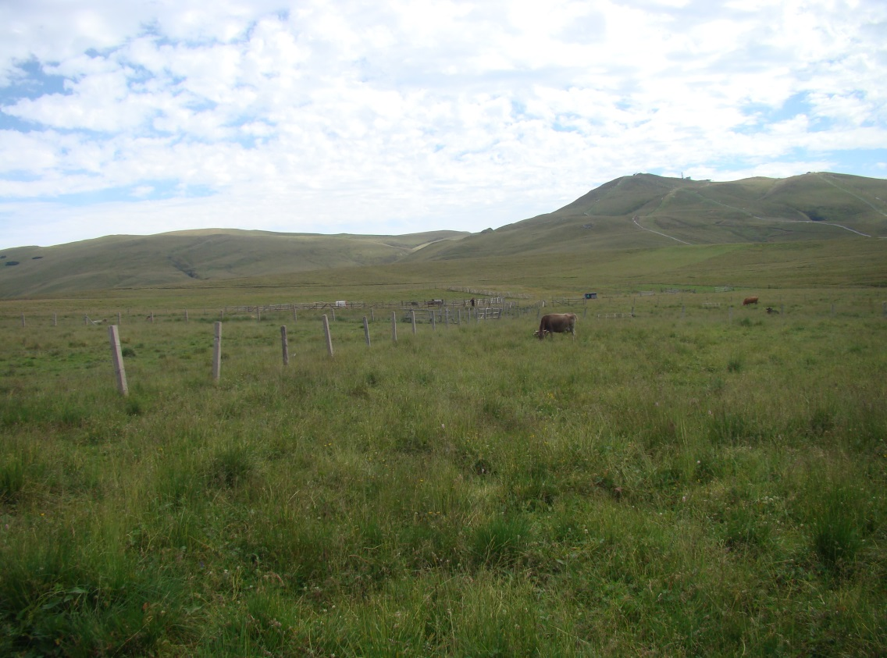
•Plot C is a semi-natural pasture, situated at 1782 metres altitude, with an eastern exposure and a slope by 5 degrees.
The dominant plant species were: Agrostis vinealis Schreb., Ligusticum mutellina (L.) Crantz, Poa annua L., Poa pratensis L., Polygonum bistorta L. and Trifolium repens L.
It was limed in 1995, chemically fertilised similarly to the B variant and paddocked in 2003, 2009 and 2015. To correct the acidity of the soil to 2/3 Ah (hydrolytic acidity), sterile lime powder (CaO) was used, in a dose of approximately 7.5 tons / ha, only once at the beginning of the experiments in the summer of 1995.
In plot C, the powdered lime was spread on the surface of land, without incorporation.
Cattle manure was added as an input of organic matter.

Slide 13
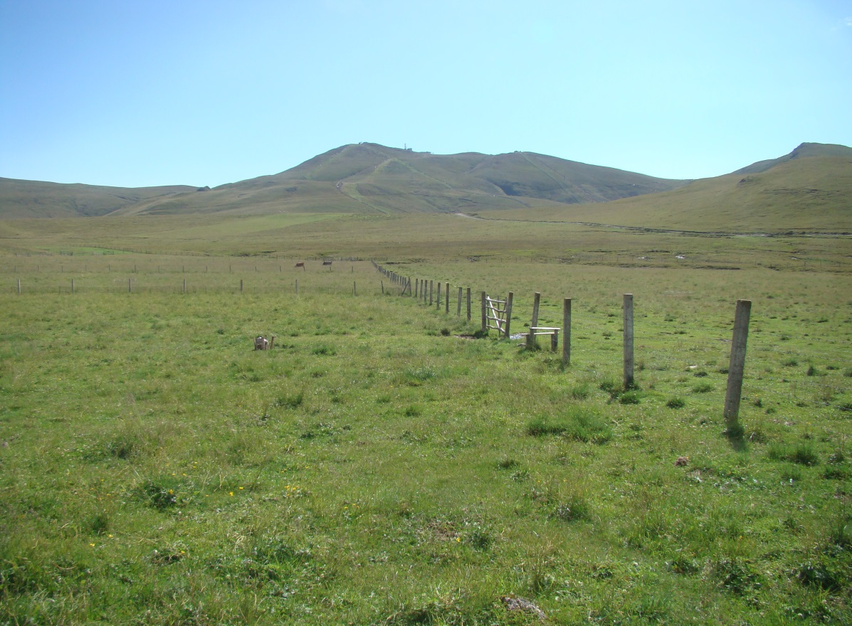
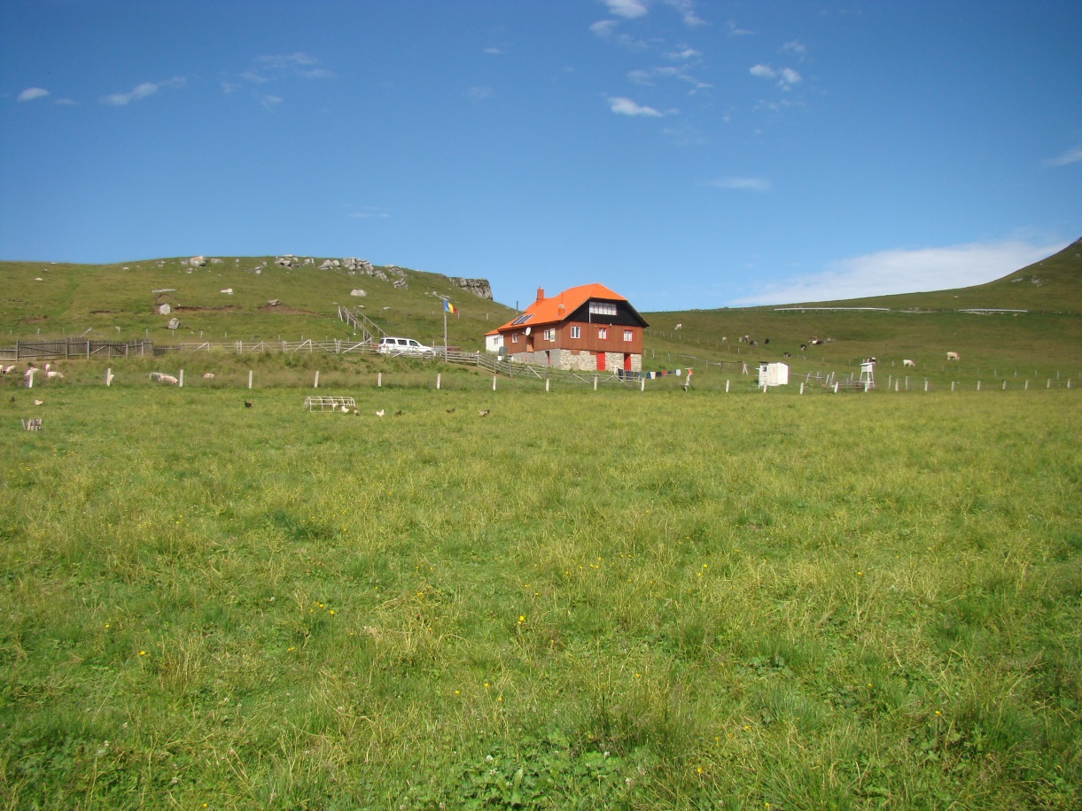
•Plot D is a pasture that was reseeded in the late summer of 1995, after herbicide Roundup at 5 l ha-1, calcium liming (the CaO was incorporated in soil) and chemically fertilised similarly to the plot C variant and paddocked in 2002, 2008 and 2014.
It is situated at 1784 metres altitude, with an eastern exposure and a slope by 5 degrees.
The sown mixture of grasses and perennial legumes comprised: Phleum pratense L. Favorit variety (40%), Festuca pratensis Huds. Transilvan variety (25%), Lolium perenne L. Marta variety (5%), Trifolium hybridum L.- local population from Braşov (15%), Lotus corniculatus L. Livada variety (15%). Cattle manure was added as an input of organic matter.
The dominant plant species were: Alchemilla vulgaris L., Deschampsia cespitosa (L.) P. Beauv., Holcus lanatus L., Ranunculus acris L., Taraxacum officinale F.H.Wigg., Trifolium repens L.

Slide 14
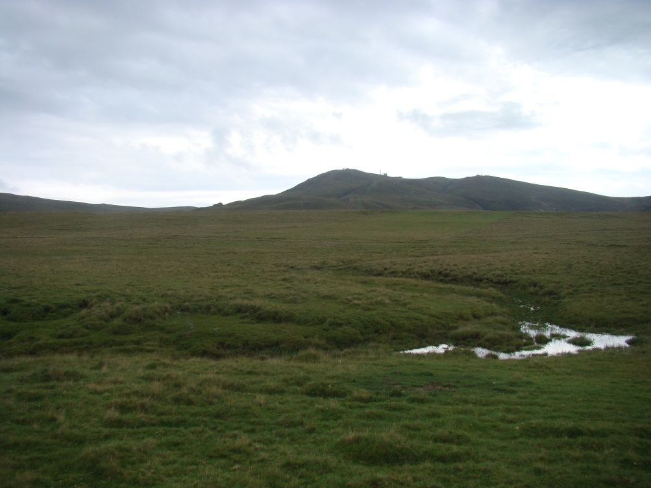
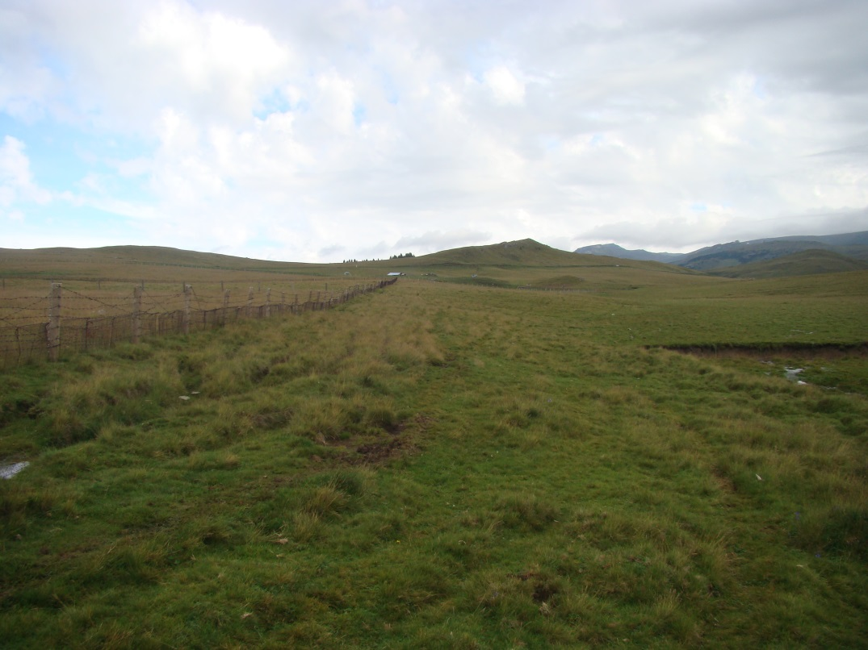
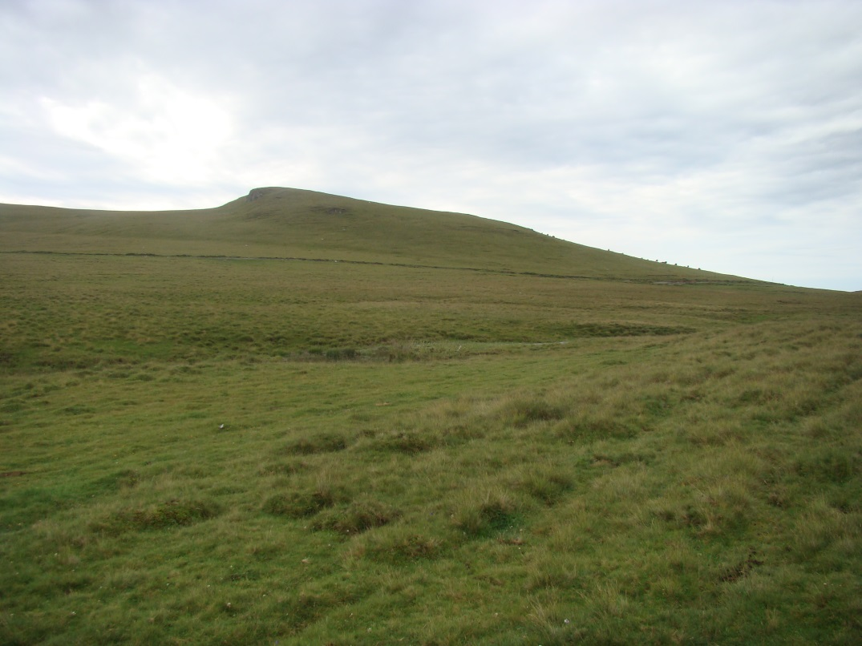
Control plot-grassland (CG) is a semi-natural pasture, unimproved, grazed in summer with cows. It is located 1758 metres altitude, with an eastern exposure and a slope by 5⁰.
The dominant plant species were: Agrostis capillaris L., Festuca ovina L., Pilosella aurantiaca (L.) F.W.Schultz & Sch.Bip., Ligusticum mutellina (L.) Crantz, Nardus stricta L., Potentilla aurea L., Polytrichum sp., Ranunculus acris L. and Trifolium repens L.

Slide 15
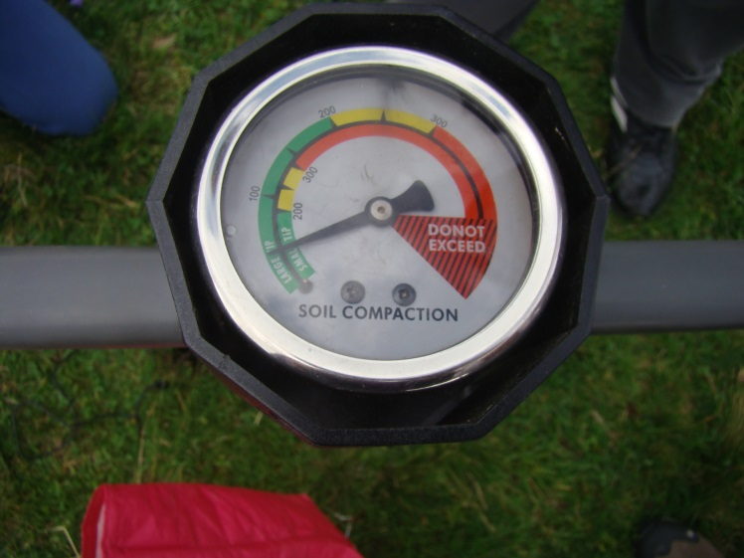
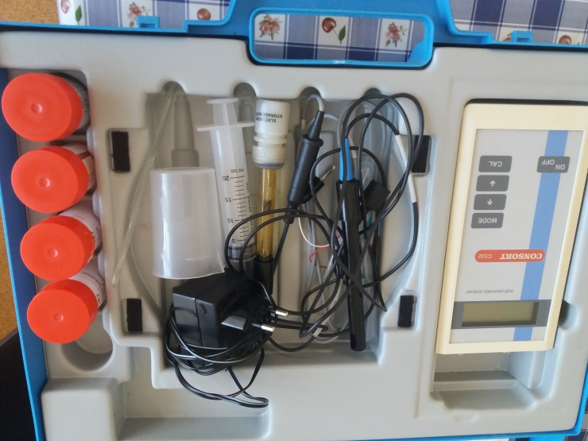
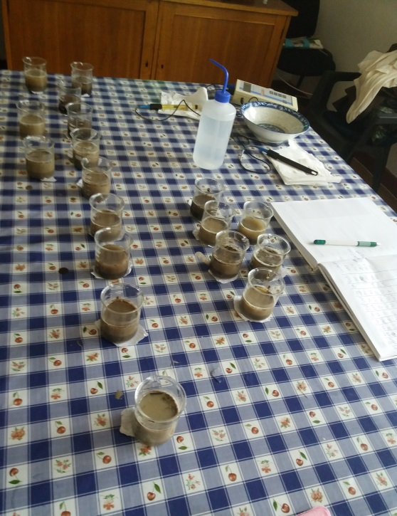
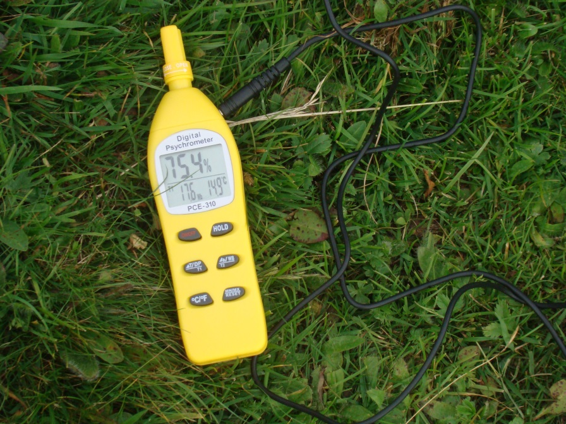
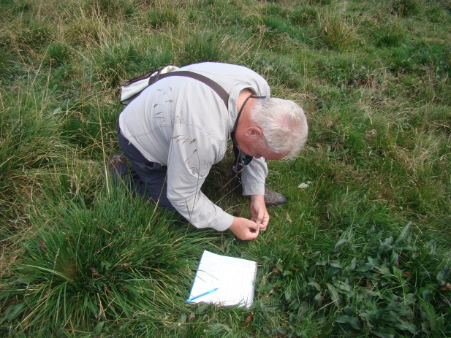
MATERIALS AND METHODS
ENVIRONMENTAL FACTORS
Soil penetration resistance (RPs) (Map).
Soil acidity (pH)
Vegetation cover (VegCovr) (%)-pratological method
Soil moisture content (H) (%), soil temperature (Ts) (0C)

Slide 16
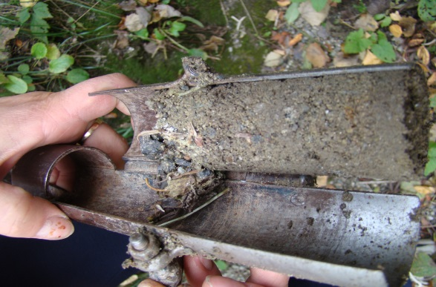
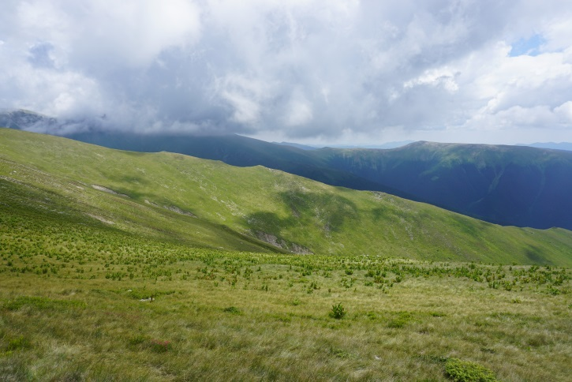
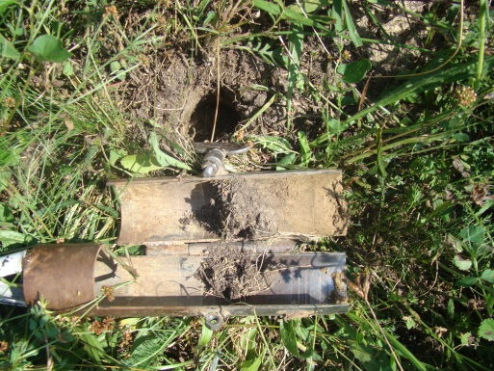
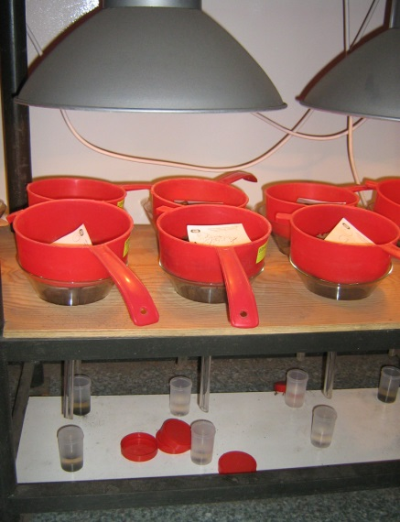
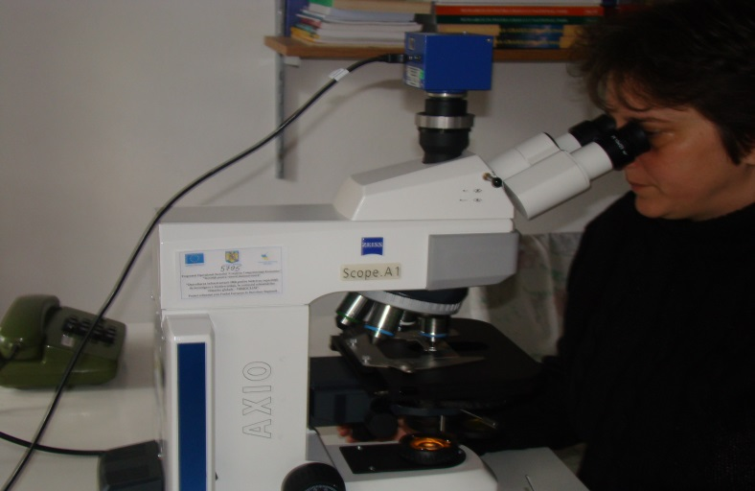
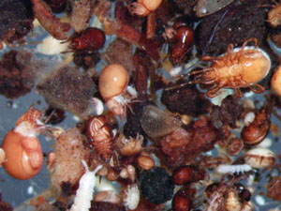
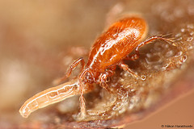
MATERIAL and METHODS- MITES SOIL SAMPLES
3. Soil sample (50 samples/grassland)
250 samples
1.Sample area
(100 sq.m/ecosystem)
2. MacFadyen soil core
(ø = 5 cm, depth = 10 cm)
5. Fauna sample
7. Soil mites
4. Tullgren-Berlese extractor
(in ethylic alcohol)
6. Taxonomic identification

Slide 17

DATA ANALYSIS
All the statistical procedures were implemented in R 4.0.2 (R Development Core Team 2006).
The dispersal rate was measured using the following formula:
(DD4) = [2W/(A+B)][(A-B)/(A+B-W)], where:
W represents the sum of the minimum frequency for the rarest species,
A and B are the sum of frequencies of all species in each studied ecosystems (Madej and Skubala 2002).
We considered the rarest species those classified as accessory (F2) and accidents ones (F1).

Slide 18

30 mites species (Mesostigmata) with 1163 individuals

Slide 19

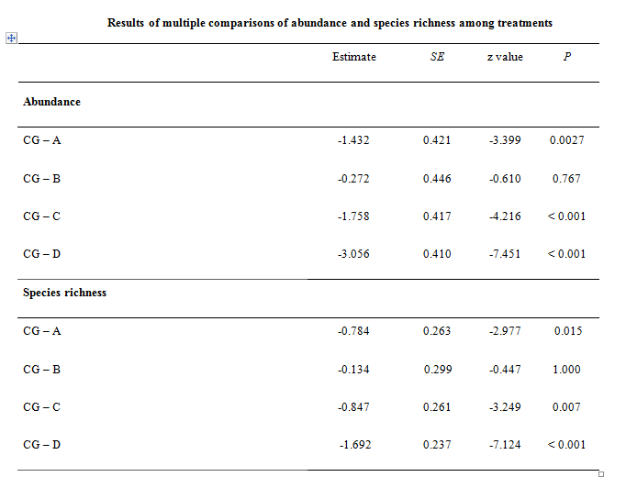

Slide 20

plot A had the highest average values of vegetation cover, soil moisture content and the lowest average value of soil resistance at penetration;
plot B had the highest average value of soil resistance at penetration and the lowest average value of soil pH;
plot C had the highest average value of soil temperature and soil pH, the lowest average values of soil water content and vegetation coverage;
plot D had the lowest average value of soil temperature;
plot CG had medium average values of all the investigated variables.

Slide 21
The most significant abiotic factors were vegetation coverage and soil temperature. Veigaia planicola, Hypoaspis nolli and Gamasellodes insignis were species influenced by the vegetation cover.

Slide 22
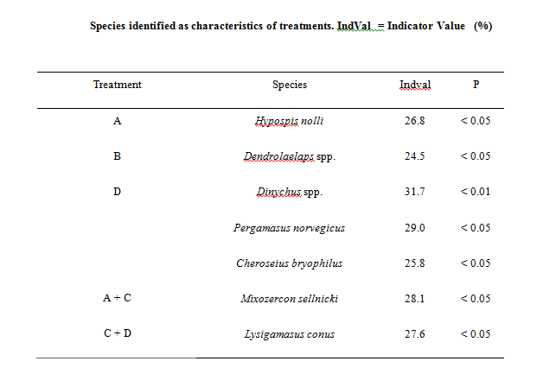

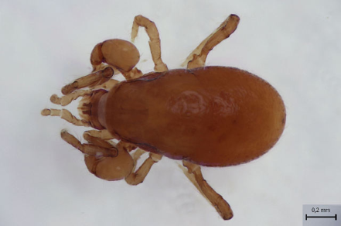
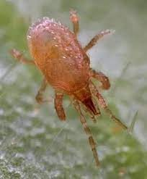
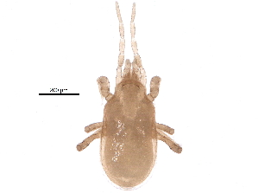
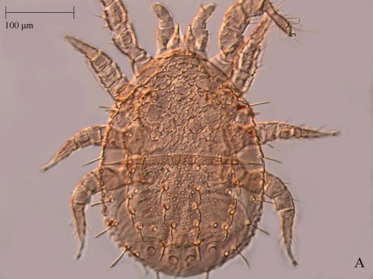
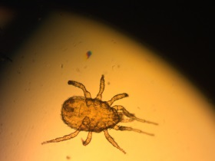
Pergamasus norvegicus is a species characteristic of alpine areas, inhabiting cold habitats, and is resistant to the impact of agrochemicals (Karg 1993; Messer et al. 2000).
Hypoaspis nolli= species tolerating dry eco-systems, with soil poor in organic matter (polluted or natural grasslands, urban green areas, coastal habitats)
Lysigamasus conus = in plots C and D, where both CaO and organic fertilisers (cattle manure) were added. Lysigmasus conus = in another type of experimental plot (TNT contaminated soils), in reclaimed post-mining spoil-heaps and adjacent forest habitats, in Europe.
Mixozercon sellnicki = wide ecological amplitude: from dry to wet soil and preferring mildly acidic soils (mean pH= 5.05). It is characteristic for dry meadows or high altitude grasslands in Slovakia, and in forest litter, soil and moss elsewhere in Europe.
Cheroseius bryophilus = from the lowlands to the mountains, in litter, moss or even bark galleries (Gwiazdowicz 2007).

Slide 23
THE DISPERSAL RATES
High dispersal rates of mites between control plot and plots A, B, which are no limed, reseeded or herbicide treated, due to the specifically/favourable environmental condition for the mobile predatory mites (highest average values of vegetation cover, soil moisture content, the lowest average value of soil resistance at penetration; lowest average value of soil pH).
Low dispersal rates of mites between plots D, C, which are limed, reseeded or herbicide treated.

Slide 24
CONCLUSIONS
250 soil samples were analysed, 30 species of predatory mites (Mesostigmata), with 1163 individuals.
Vegetation cover, soil moisture content and soil temperature differed significantly between the experimental grassland treatments.
Each experimental plot was defined by characteristic environmental conditions, showing clearly distinguishable patterns.
Each experimental plot was defined by specific indicator species, which are characteristic of temperate grassland eco-systems, being resistant to the different chemical treatments of soil.
The structural characteristics of mite communities, specific to each grassland, are due to the significant differences of environmental variables between plots, demonstrated through multivariate analysis.
The effect of these variables was demonstrated even at species level
Between the experimental grasslands dominated by the accessory and accidental species, the mobility of these invertebrate communities was higher, (A-B-CG), in comparison with those from plots D and C, were these populations were more stable.
This study demonstrates the importance of knowing the ecology of the mite communities, as important tools for environment assessment.

Slide 25
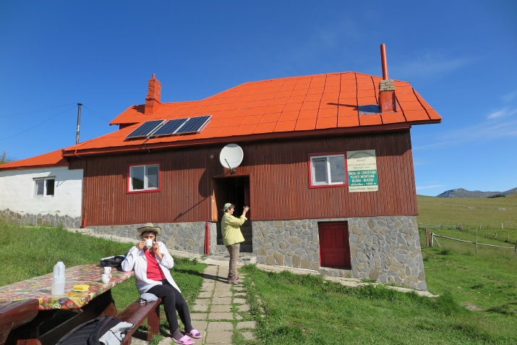
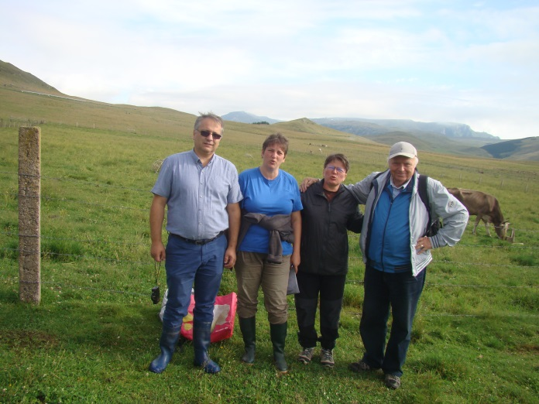
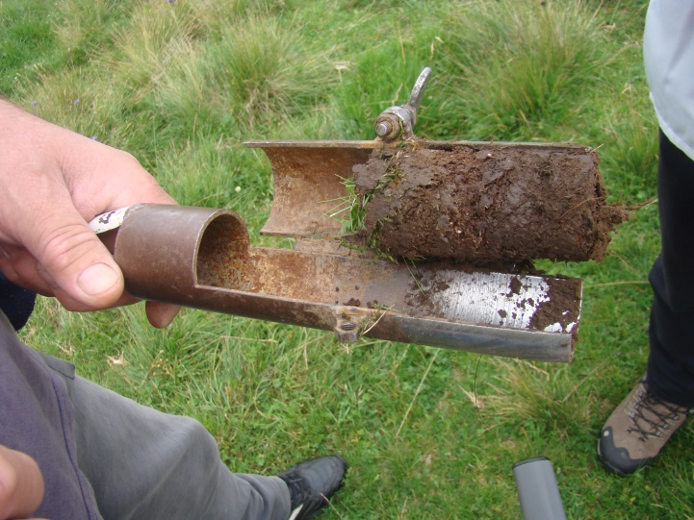
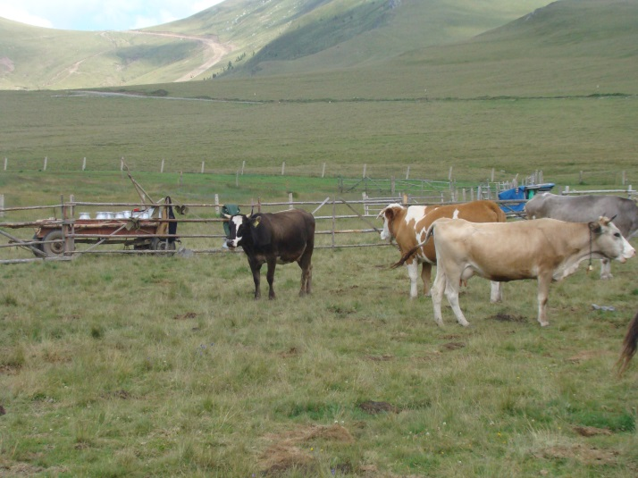
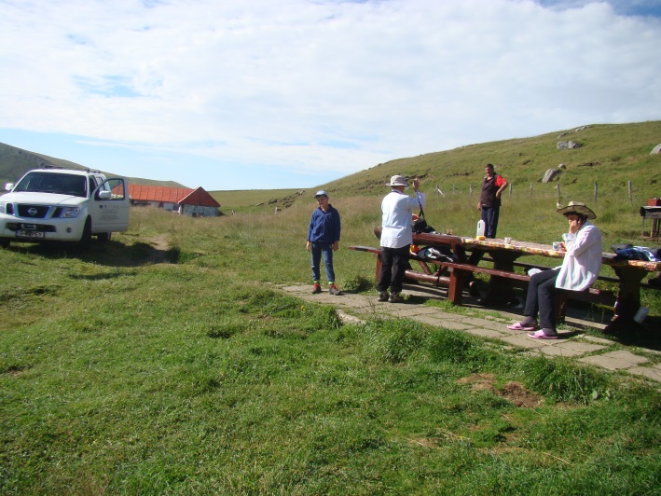
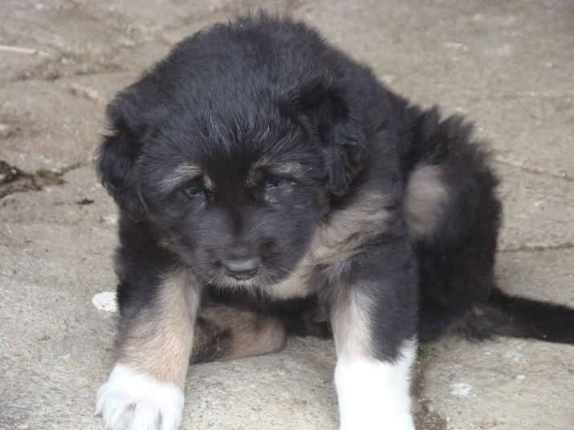
THANK
YOU
FOR
YOUR
ATTENTION!

