Slide 1
PROTECTION, PRESERVATION, PROMOTING VERNACULAR ARCHITECTURE AND DESIGN AND THE LOCAL ECONOMIC DEVELOPMENT THROUGH RURAL TOURISM IN SIBIU AREA
Elena – Manuela IȘTOC
Ionel IȘTOC

Slide 2
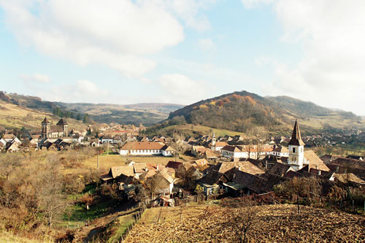
RURAL TOURISM
The tourism product ‘that gives visitors a personalized contact, a taste of physical and human environment of countryside and as far as possible, allow them to participate in the activities, traditions, and lifestyles of local people’ (UNWTO)

Slide 3
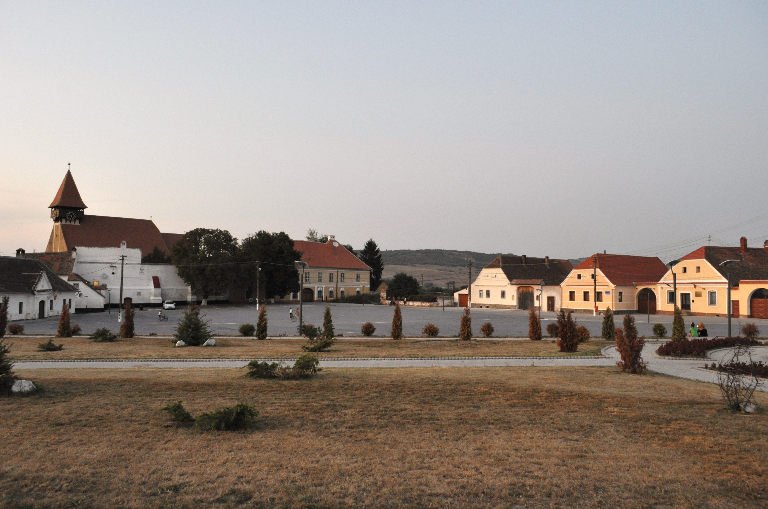
VERNACULAR ARCHITECTURE
Is the buit environment (architecture and interior spaces) created based on the society needs. It is built in accordance with the natural environment (geography, topography, site, climate, local building materials, labor experience, and building techniques) fulfilling people’s physical, economic, social, and cultural norms.

Slide 4
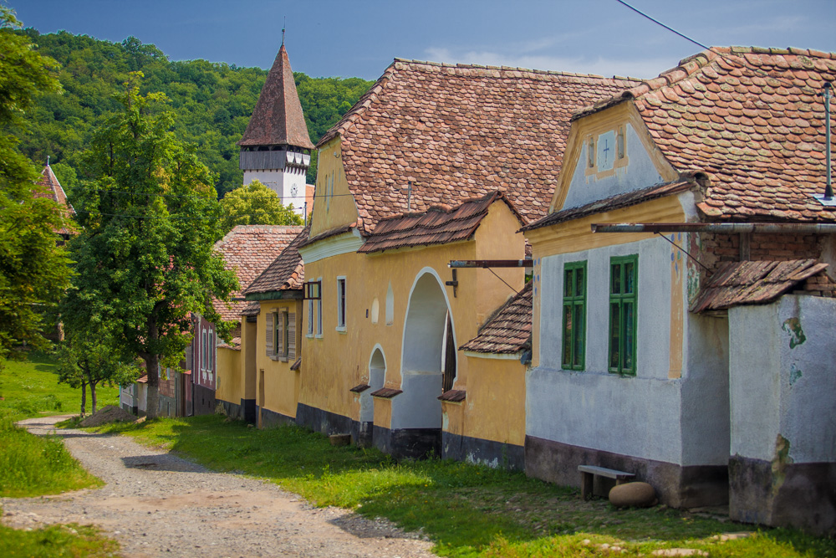
VERNACULAR ARCHITECTURE
Is a sign of identity; it is the ‘mirror’ of nations that reflects place, time and culture.
Architecture is built by people to people; it has developed through time and modified itself through trial and error fulfil society’s needs in harmony with the ambient environment.

Slide 5
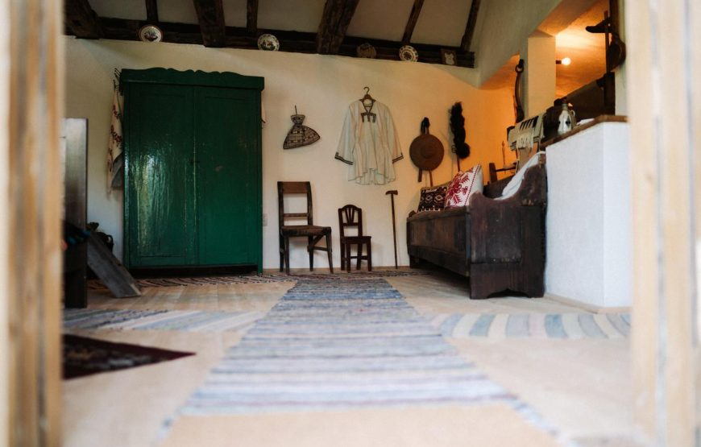
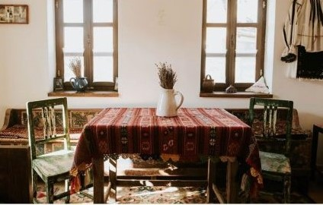
VERNACULAR DESIGN is based on local needs, materials and traditions
It’s what gives a place its character.

Slide 6
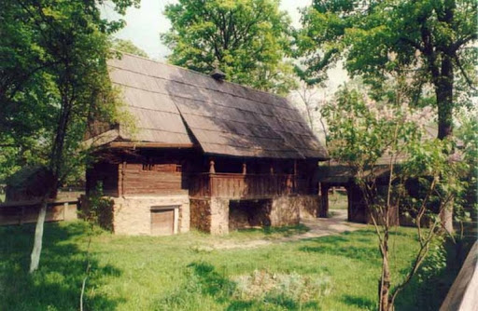
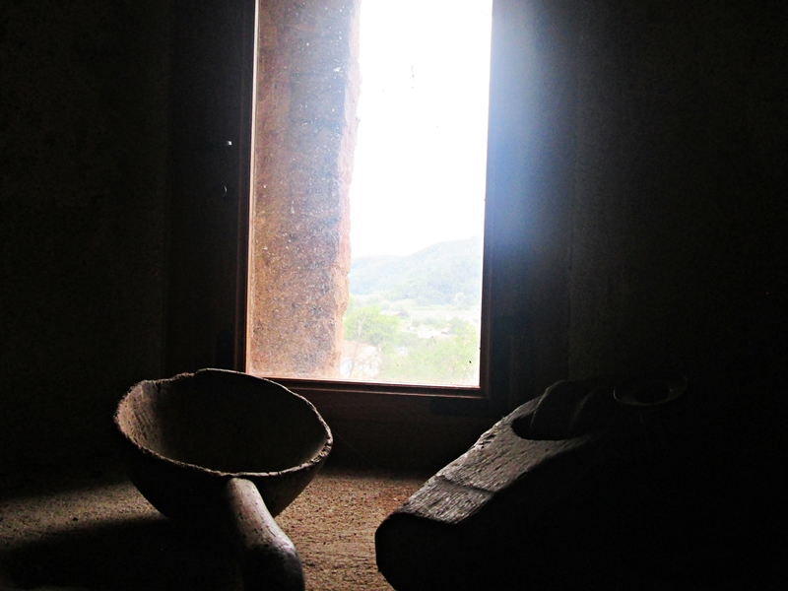
VERNACULAR ARCHITECTURE AND DESIGN IN SIBIU AREA

Slide 7
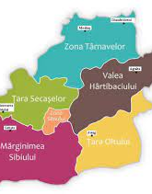
VERNACULAR ARCHITECTURE AND DESIGN IN SIBIU COUNTY
Sibiu County is located in the center of the country, in Southern Transylvania, in a plateau and mountain area, the architecture of the buildings being specific to the hill-mountain region whose coexistentence of different ethnic populations, each with its own cultural elements distinct, they gradualy gave it a specific multicultural nature.

Slide 8
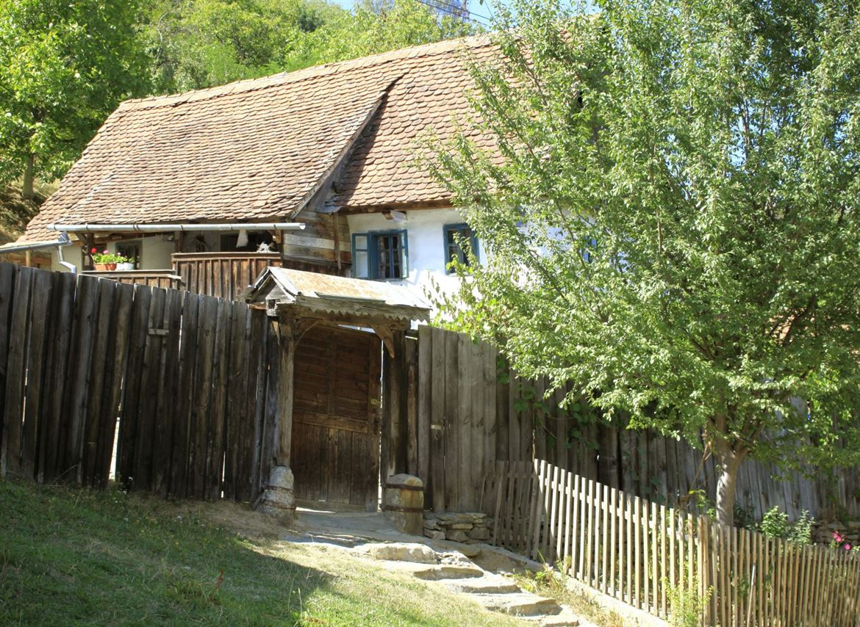
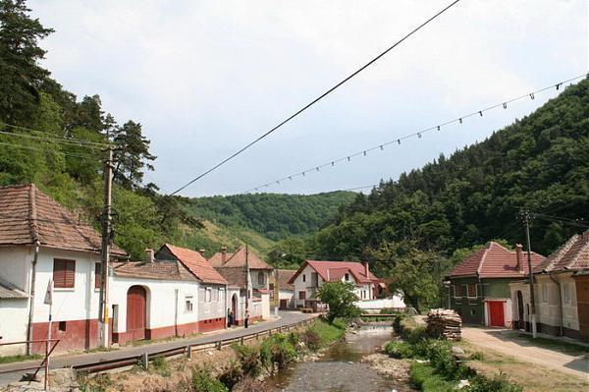
MĂRGINIMEA SIBIULUI

Slide 9
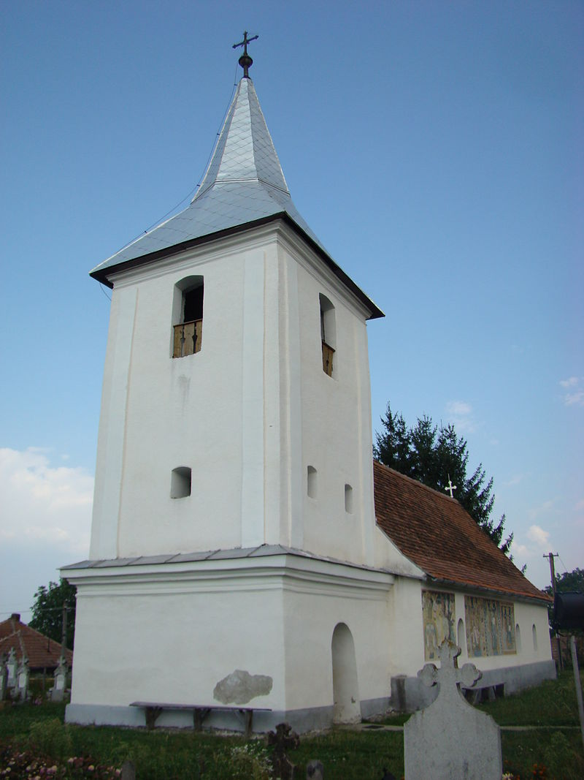
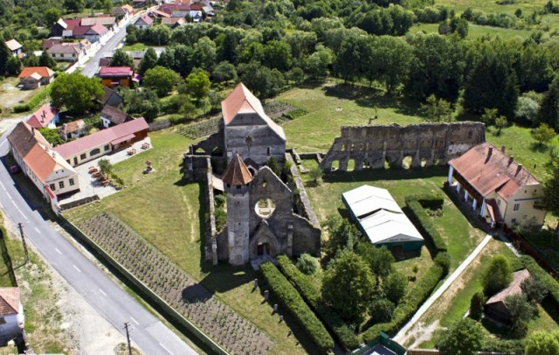
ȚARA OLTULUI

Slide 10
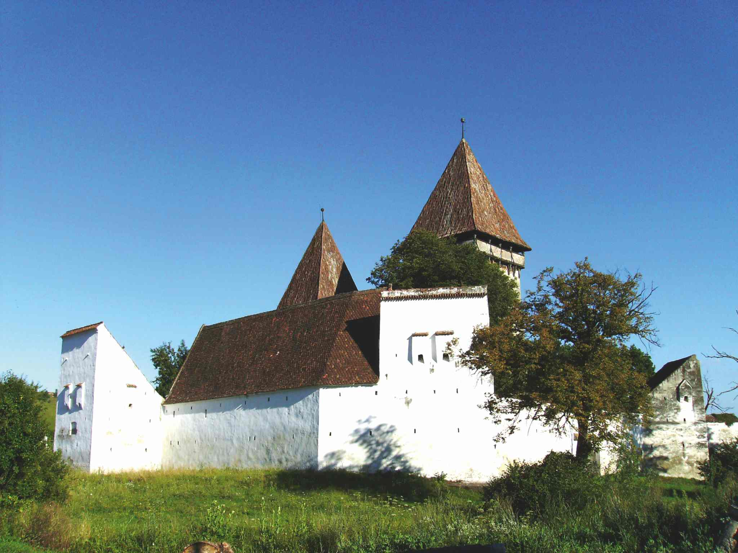
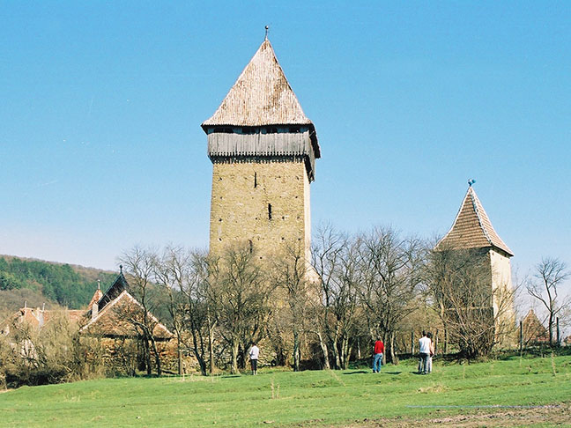
VALEA HÂRTIMBACIULUI

Slide 11
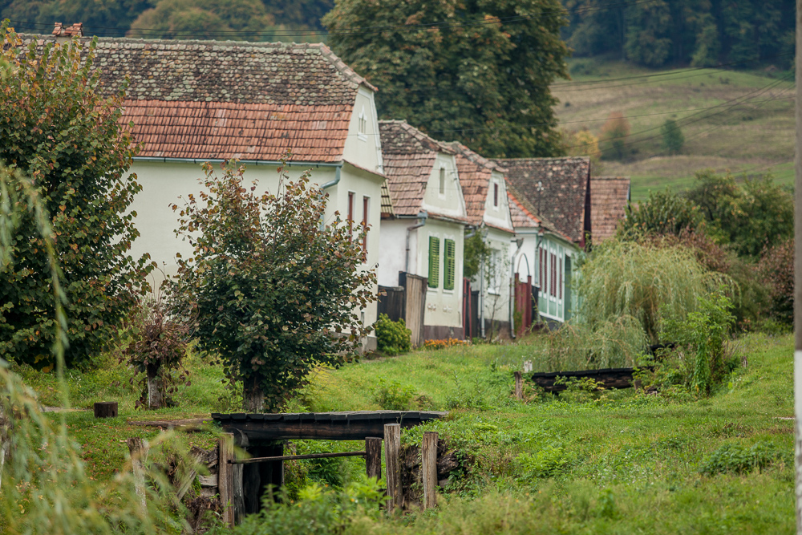
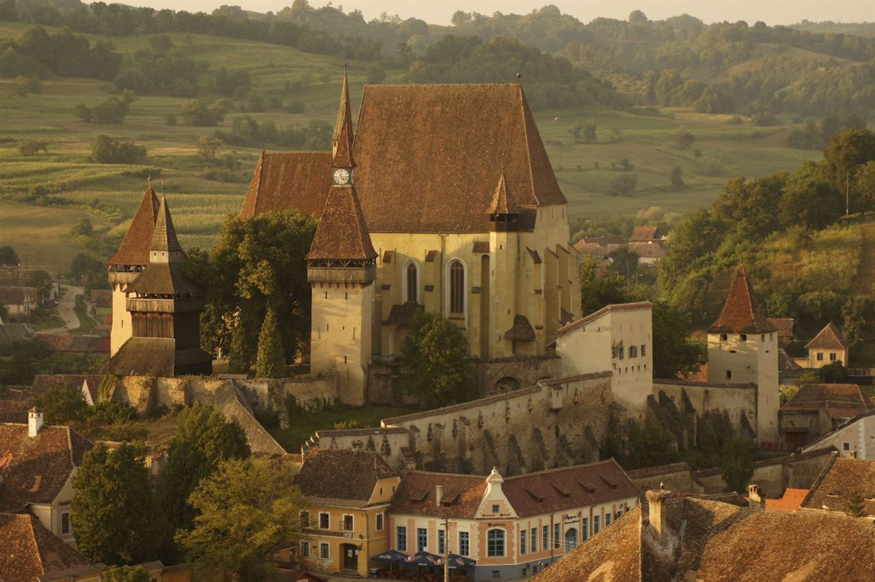
VALEA TÂRNAVELOR

Slide 12
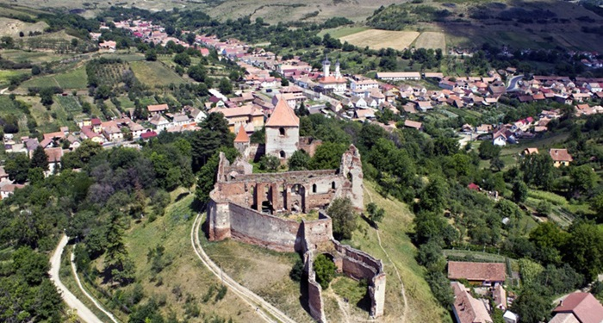
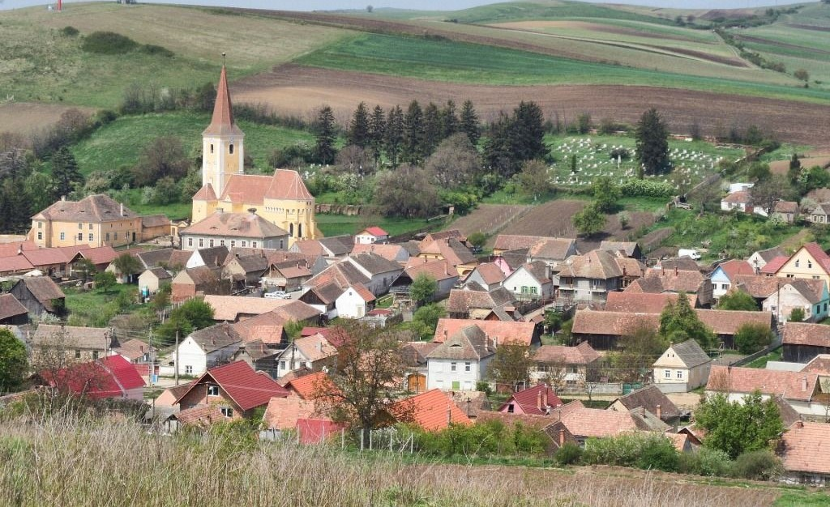
PODIȘUL ȘECALELOR

Slide 13
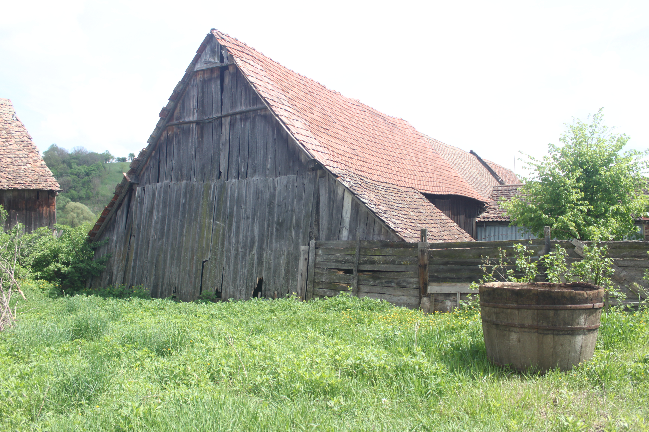
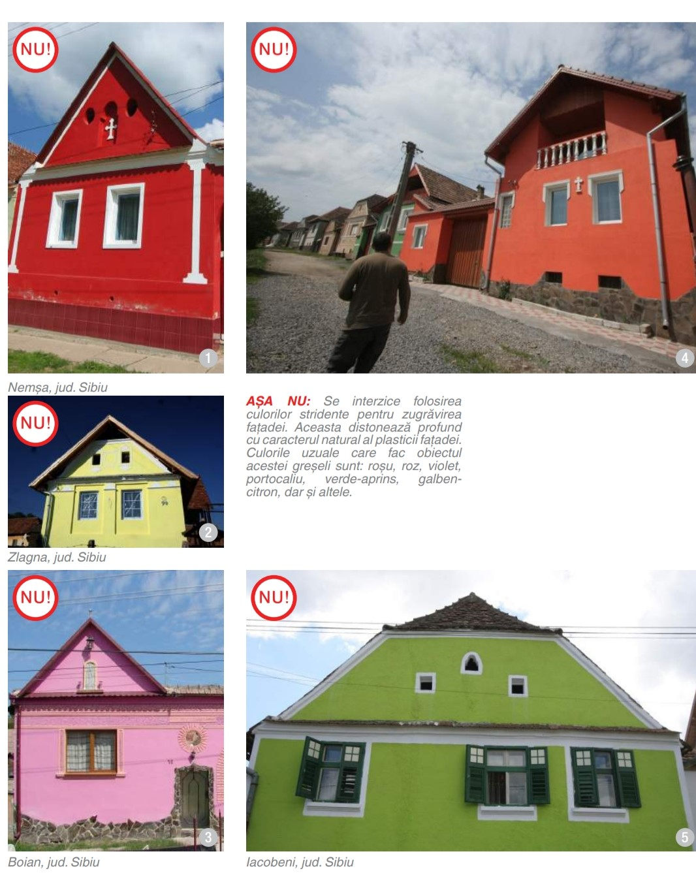
Unfortunately, in many villages, there is sometimes a higher degree of building degradation or non-compliant renovations

Slide 14
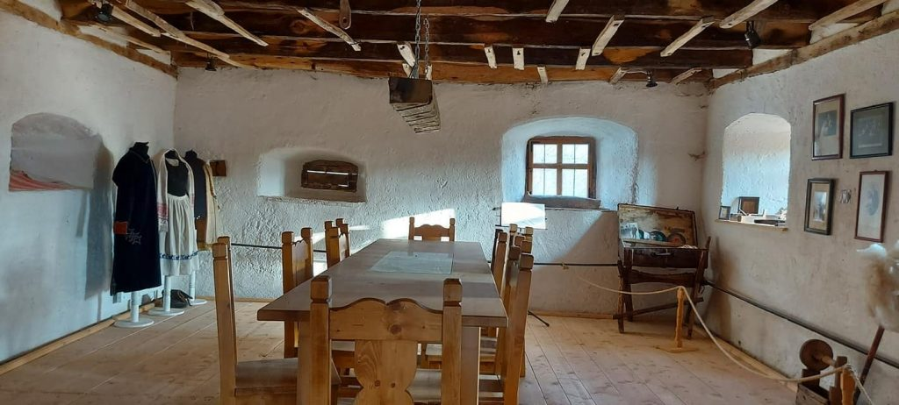
(Re) use of vernacular architecture and design for tourism purposes responsibly can be one of the ways of sustainable development of the rural area of Sibiu

Slide 15
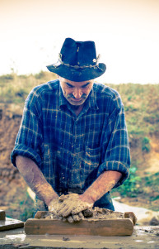
Economy:

Slide 16
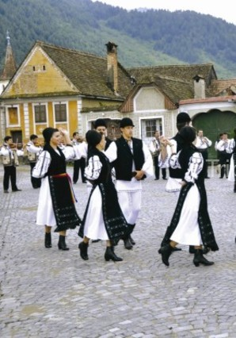
Social:
      Promoting the innovative use of cultural heritage to encourage integration, inclusion, cohesion and participation.
      Creating and maintaining a valuable source of documentation about the local culture, recovering local construction techniques, and improving the rural landscape making it more attractive to visit
      Raising awareness, both among visitors and locals, about the heritage value and the need to protect it.
      Strengthening the identity and cohesion of the local community and pride.
      Improving external support for minority groups and preserving their culture
      Promoting intercultural understanding
      Improving the quality of life

Slide 17
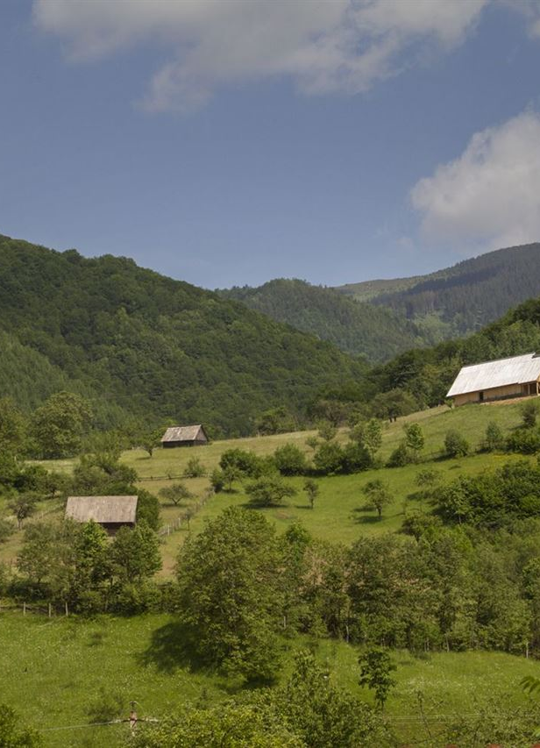
Environmental
      Promoting the innovative and sustainable use of vernacular architecture and design to enable them to realize their full potential to contribute to the sustainable development of rural landscapes and environments
      Use of local building materials and traditional building techniques

Slide 18
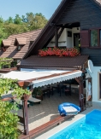
Threats:
But the development of rural tourism must be done responsibly because often conceived as a powerful means of attracting income and an easy way to stimulate the economy, sometimes tourism development is taken to the extreme, reducing the vernacular architectural heritage to a mere commodity, minimizing or completely ignoring its social, cultural, historical, and environmental character. Many times the false portrait of the culture of the host community, to entertain tourists, leads to the loss of cultural values, identity, and authenticity of the place.
Moreover the supply of rural tourism must be balanced with other uses of the rural environment so that harmony is achieved and avoiding the conflict between uses and the dependence of an area on a single economic activity.

Slide 19
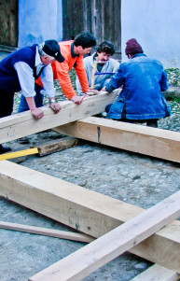
Examples of good practice
The project of Mihai Eminescu Trust: ”Alma Vii, the first training center in traditional trades in Romania”. The old school from Alma Vii village, Sibiu county, was saved from demolition and rebuilt. Here the locals can follow professional training programs in traditional trades: masonry, carpentry, blacksmithing, wood joints, restoration of traditional gates and windows. In addition, English language courses, primary accounting, agrotourism are available, just to make it easier for the villagers to interact with visitors. The old school also has a Heritage Information Center that offers free advice to locals. The center is also open to the citizens for the organization of seminars, courses, summer schools, accommodation and meals being provided in the guest houses of the locals.

Slide 20
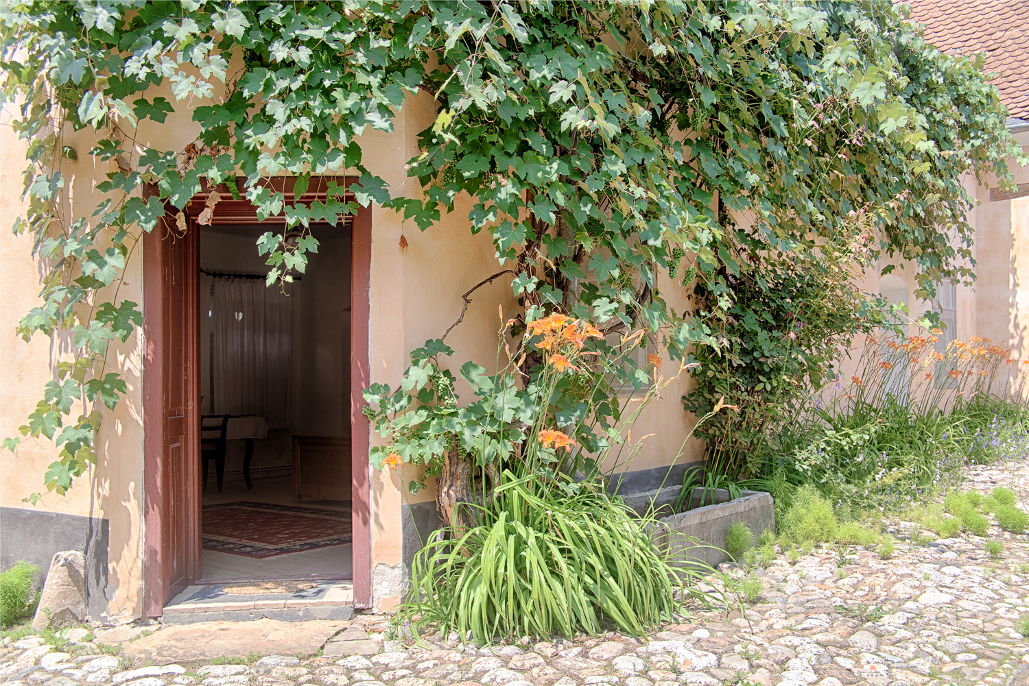
Examples of good practice
„The Lasting Village”, a project of Mihai Eminescu Trust: the Lasting Village is a a rural sustainable development program. The village becomes durable after three types of actions are encouraged and developed in an integrated way: restoration of cultural heritage: buildings, landscape, crafts and traditional agricultural practices; development of local entrepreneurial capacity, by supporting small rural enterprises, professional qualification of locals, job creation; and development of sustainable cultural tourism, by promoting rural heritage, hiking trails, traditional guest houses, organic products and the unique experience of country life. The lasting village is being implemented in the villages: Mălâncrav, Floresti, Alma Vii, and Richiș

Slide 21
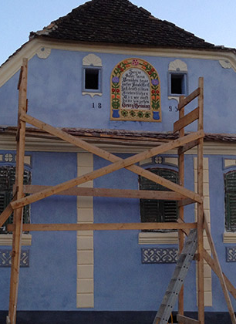
Examples og good practice
”The Daia Project” of the Monumentum Association. The project aims to restore a considerable number of facades so that the traditional village with buildings dating from the late 18th and early 19th centuries regains its former image. A number of 60 facades have been identified and are in the process of being restored with the support of the community and local authorities. The houses are both privately owned and owned by the council. In general, the association has borne the costs of materials and labor, but the owner must work voluntarily at home and cook for workers in some cases

Slide 22
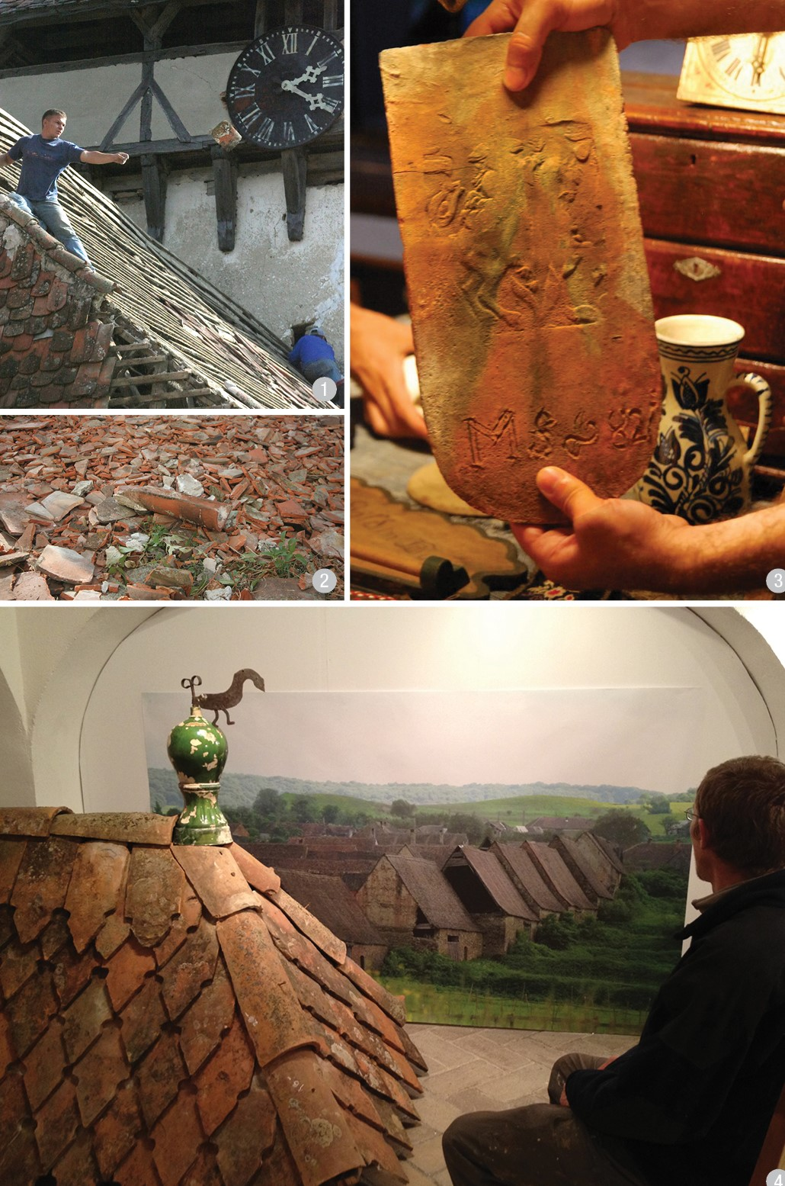
Examples og good practice
”Traditional Tile Project” of the Monumentum Association. Noticing the danger of extinction to which the historical roofs of Transylvania are subjected, under the threat of industrial products, the Monumentum Association starts at the beginning of 2013 the construction of a traditional tile at Apos in Sibiu County. By reintroducing traditional roofs in the landscape of Transylvanian villages, it is desired to revive an endangered craft that can only be transmitted from generation to generation; the secret of the production of the manual tile being extremely difficult to understand otherwise.

Slide 23
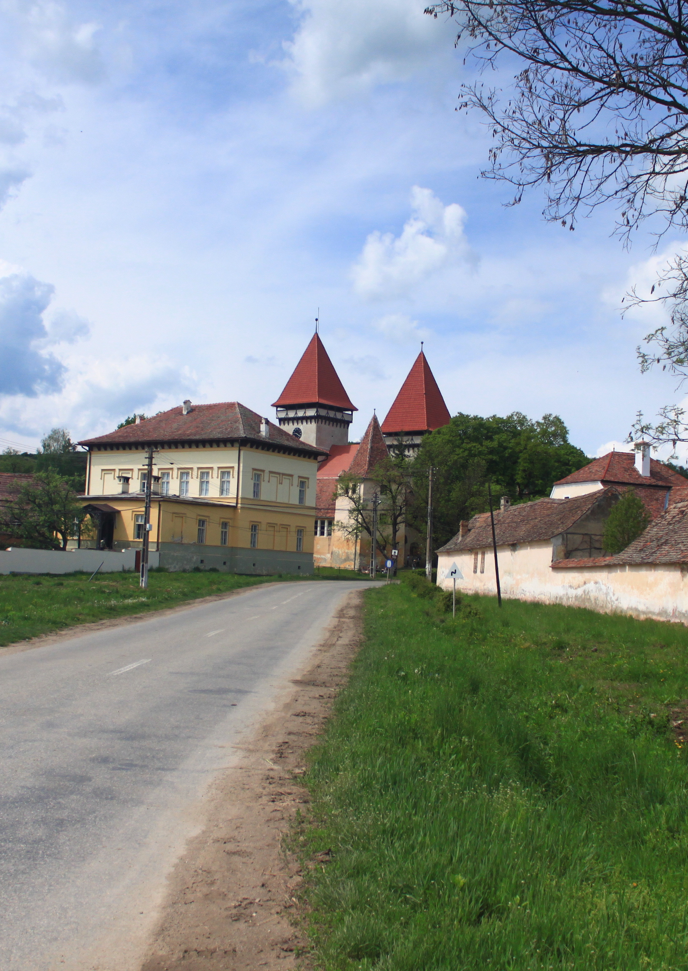
Examples of good practice
”Center for Architectural Studies Vernacular” from Dealu Frumos is an initiative of the “Ion Mincu” University of Architecture and Urbanism in Bucharest. ”The activation of the Evangelical Fortress at Dealu Frumos-Schönberg to become a research center is in itself a model for transposing the principles of restoration and conservation of the Venice Charter (1966). Here can be held various workshops, exhibitions, live-studios, participatory projects for the local community, through national and international collaborations.”

Slide 24
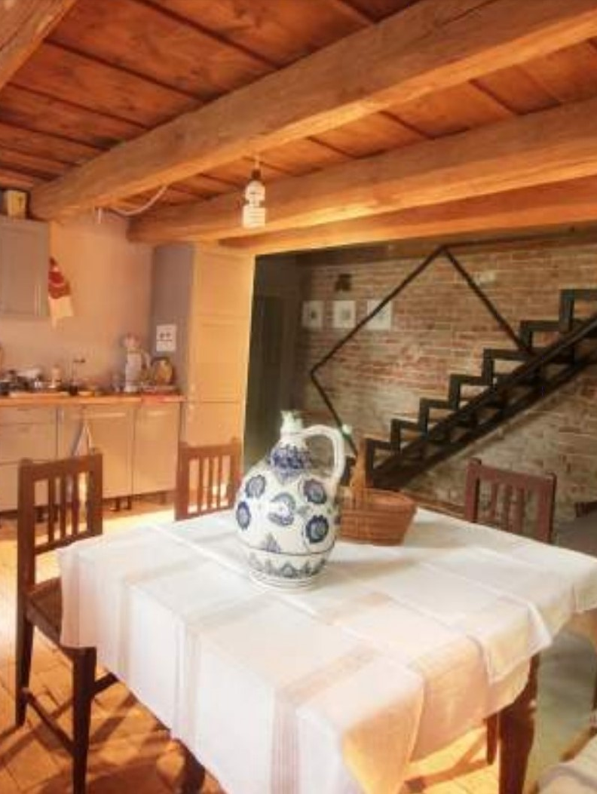
CONCLUSIONS
The rural world as a whole is an invaluable part of the heritage of Sibiu County, and the vernacular architecture of the Sibiu villages reflects and supports their identity.
Vernacular rural architecture is a direct testimony to human activity in a certain place and, if left to be destroyed, part of our past will be lost forever. The landscape, the environment, the people, and the cultural lifestyle are a unitary whole and the cultural heritage should be preserved not only as a memory of the past but also as a resource for the future.
Responsible tourism and the preservation of vernacular architecture and design are strongly interdependent. Environmental quality is a strong factor for tourism attraction while tourist development could provide the necessary income for restoration and preservation of vernacular buildings.
The improvement of vernacular architecture should be an intrinsic element in a boarder and complex strategy of tourist development, as the conservation and promotion of vernacular architecture may became essential for a long term sustainability of tourist activity in Sibiu rural area.

Slide 25
Thank you!

