Slide 1
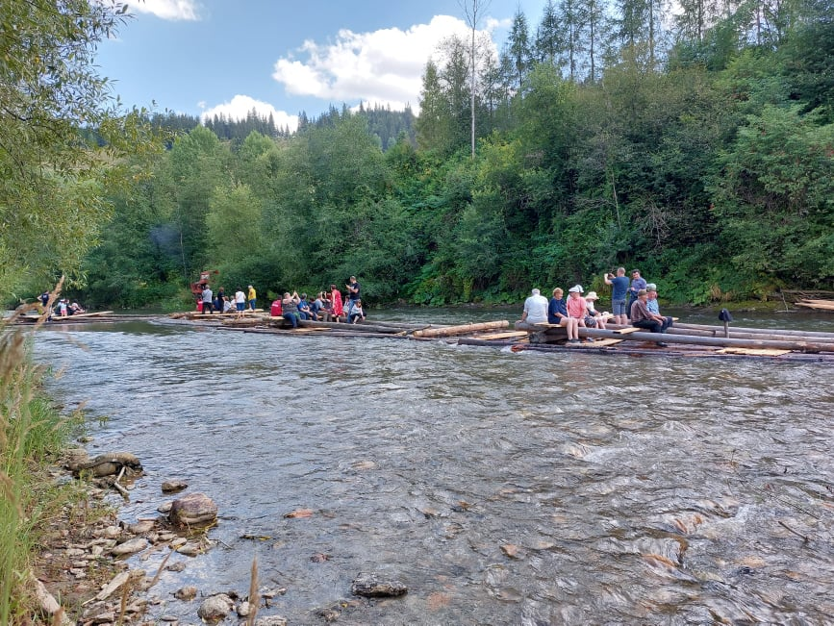
Rural tourism in the Bistrița Aurie Valey
Teacher. Mihaela Nedelea
Secondary School "Ștefan cel Mare" Cârlibaba

Slide 2
Appeared and developed on the most varied forms of relief since the time of the Thraco-Dacians, the Romanian rural settlements have preserved and still preserve to a good extent the ancient traditions and customs, a rich and varied folklore, original handicraft elements, which can be exploited for tourism in the development of rural tourism. Rural tourism in our country has always been practiced, but spontaneously, sporadically, randomly and unorganized. Its form of materialization is the lodging of occasional visitors of a rural settlement with citizens.
Rural tourism represents a possibility of returning to nature, a return to origins, always pleasant. Tourism in rural areas is increasingly appreciated and requested by people who live and work in increasingly stressful conditions, a fact demonstrated in recent years. Quality rural tourism also implies quality services and benefits. The village is the expression of man's connection with nature, and the preservation of nature in the Bistrița Aurie valley is a very good one. Natural healing factors: climatic factors, air ionization, medicinal plants.

Slide 3
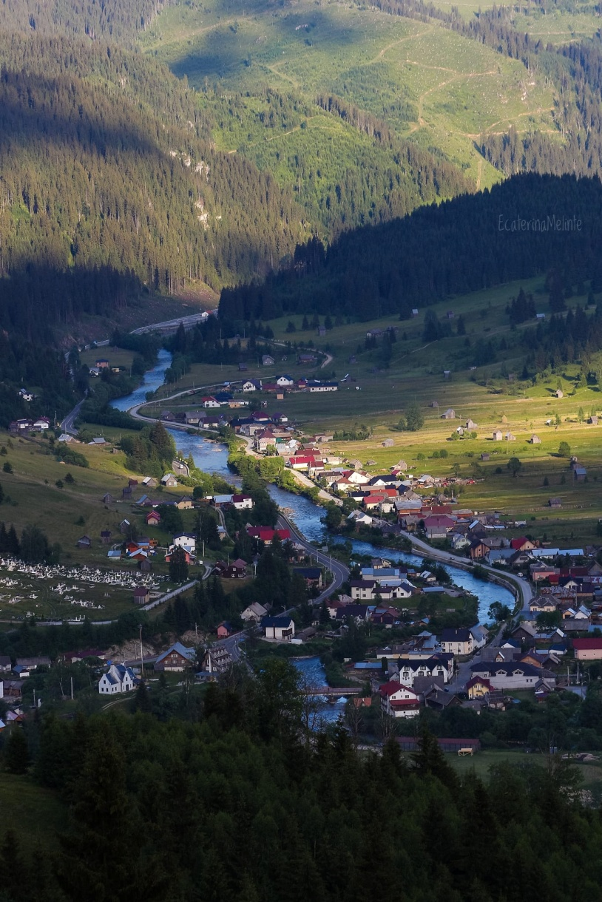
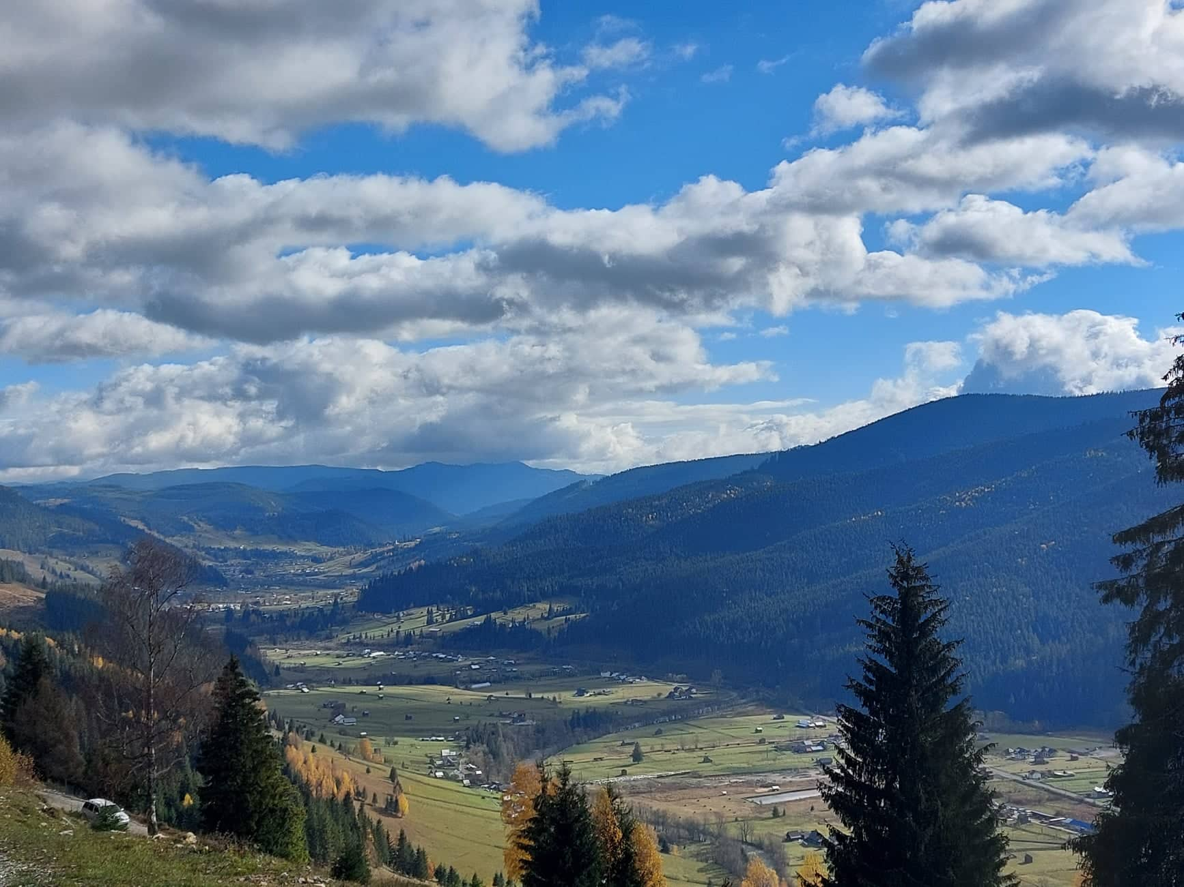
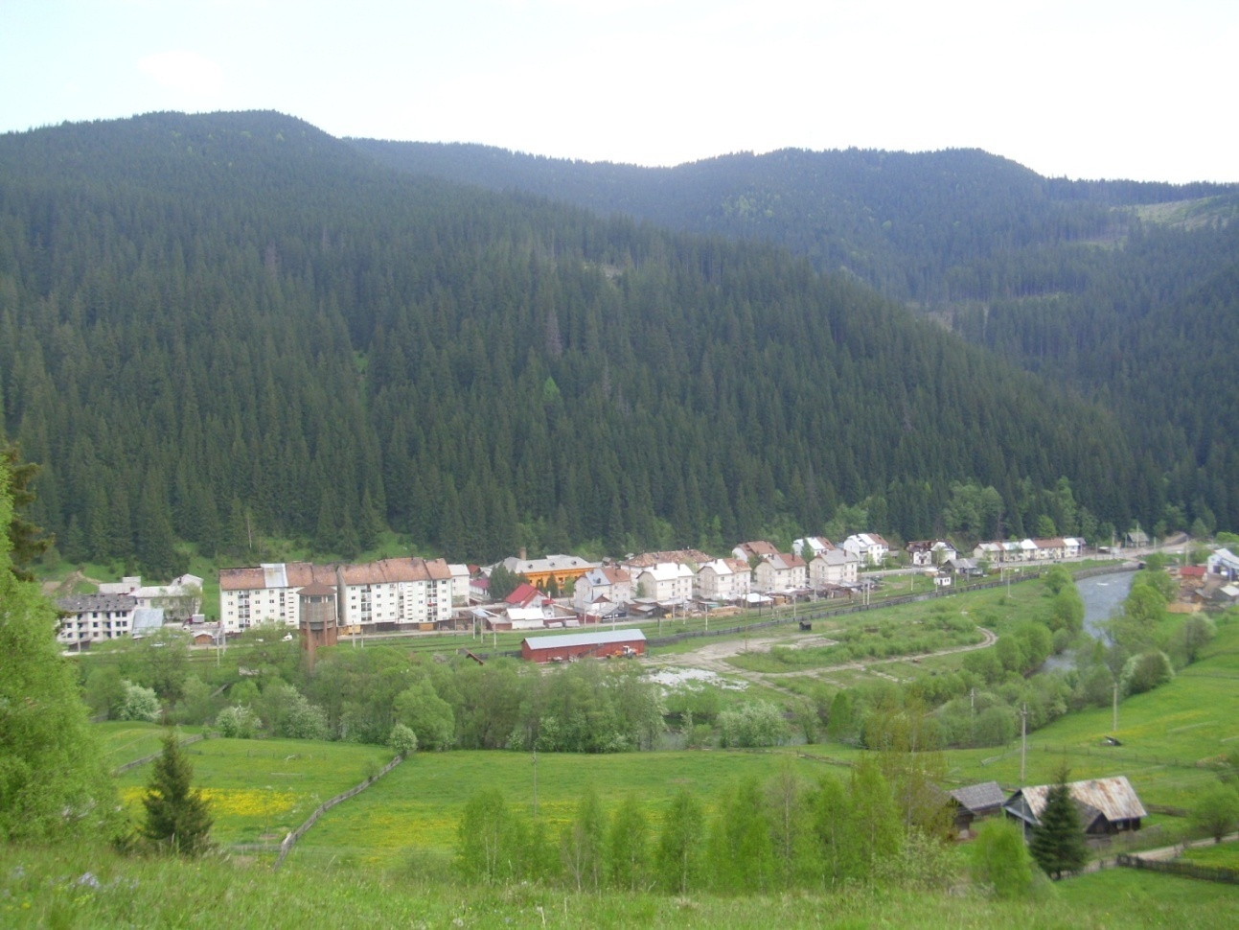

Slide 4
The organization of rural tourism in activities such as recreational (dancing, excursions, shows), sports (horse riding, fishing, sledding, skiing) or cultural (traditional museums, trips to craftsmen and folk craftsmen), is the way of economic revitalization of this area. Premises and motivations for the development of rural tourism The daily activity in the conditions of the accelerated transformations taking place on all levels: social, economic or technological favors the appearance of mental overcrowding, of stress, which gradually turns into an increasingly powerful weapon against people. There is a desire to escape from the daily routine to unpolluted, quiet places, suitable for rest, movement in the open air.
Rural tourism takes place in relatively pollution-free spaces, inhabited by rural communities that have preserved their traditions, and that respond to the needs of maintaining or restoring health, of "escape" to reduce tension. The development of sustainable rural tourism is also based on the market niche made up of people of the third age who have free time, but a lower budget and greater needs for recovery and recreation.

Slide 5
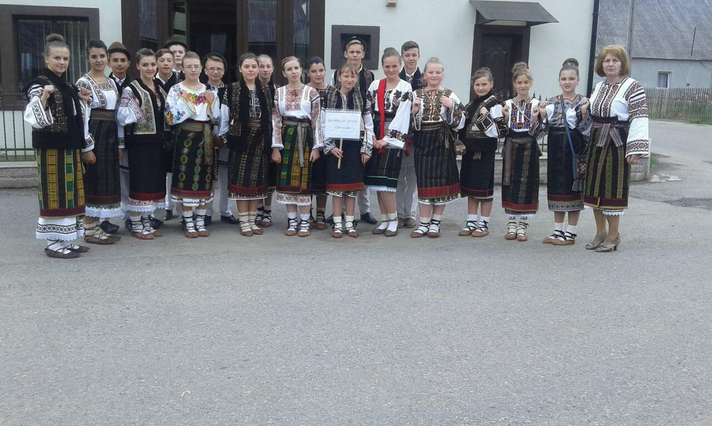
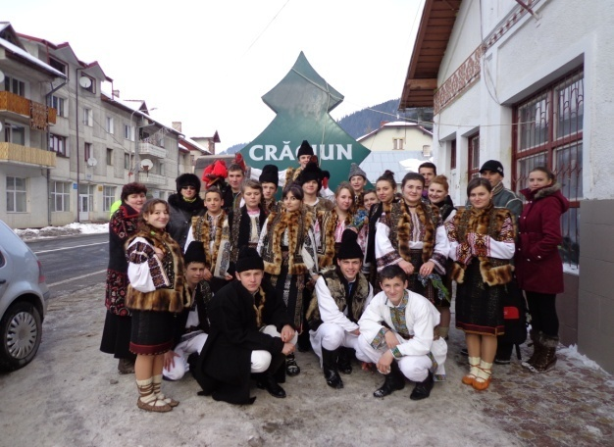
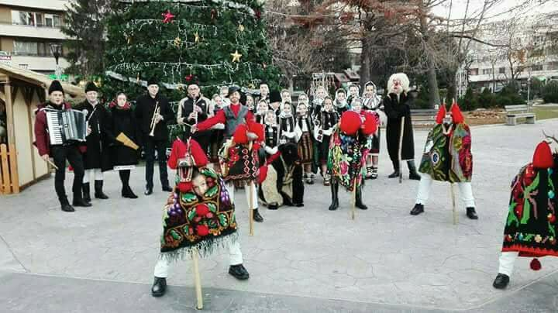
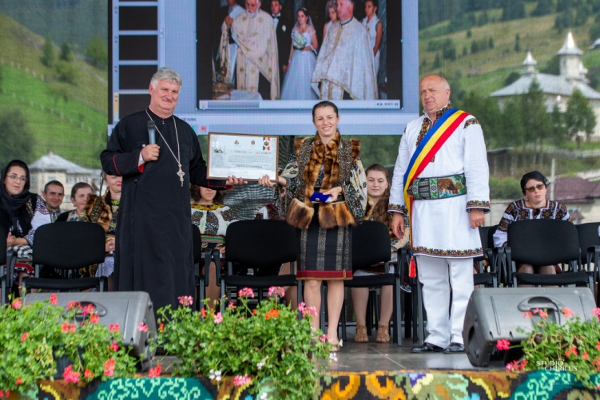
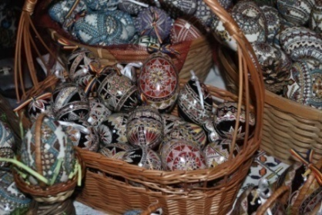
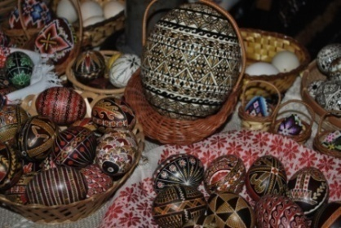
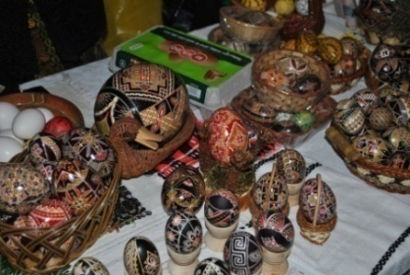

Slide 6
For carrying out the activity in rural tourism, several motivations can be established, which are the most frequently encountered:
increasing the level of education;
the picturesque landscapes, the clean air, the consumption of organic food;
return to nature, curiosity, creativity, relaxation, desire for knowledge and escape;
the diversified offer of inexpensive recreational activities that can be practiced: sports, hiking, walking, fishing, cycling and others;
discovering and participating in the traditions and customs of the place on different occasions belonging to the life of the village or the inhabitants and the way of life in the country;
increasing the duration of the time affected by rest;
improving transport and telecommunications
the increasing presence of personalized tourist offers;
the authenticity of each rural space;
peace and mental comfort;
the numerical increase of pensioners;
- the gradual increase in the interest of local and county administrations.

Slide 7
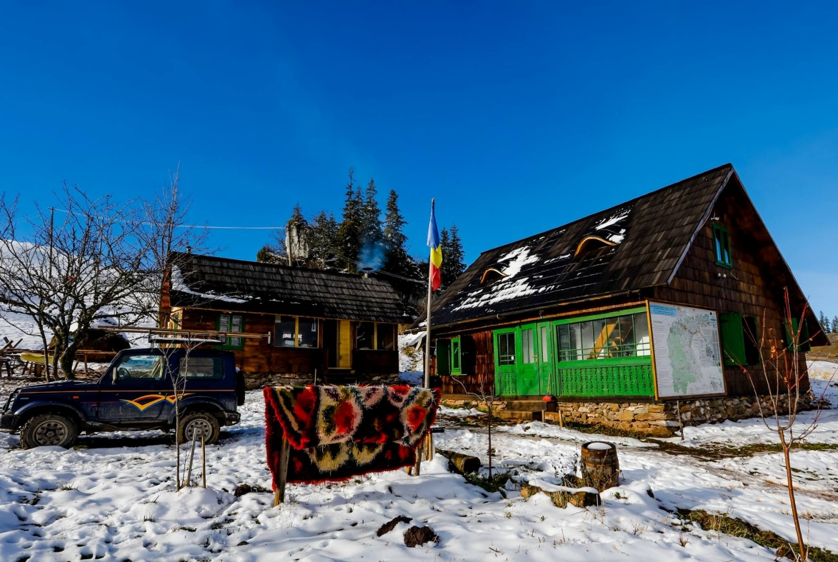
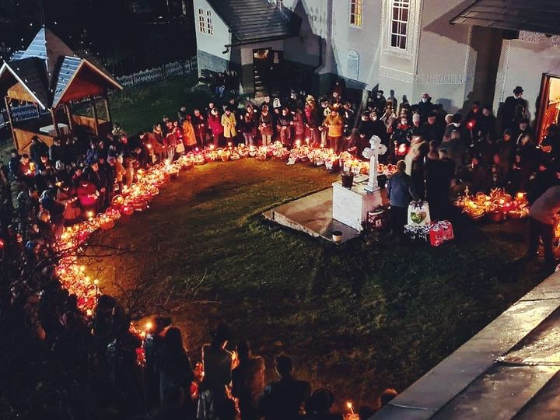
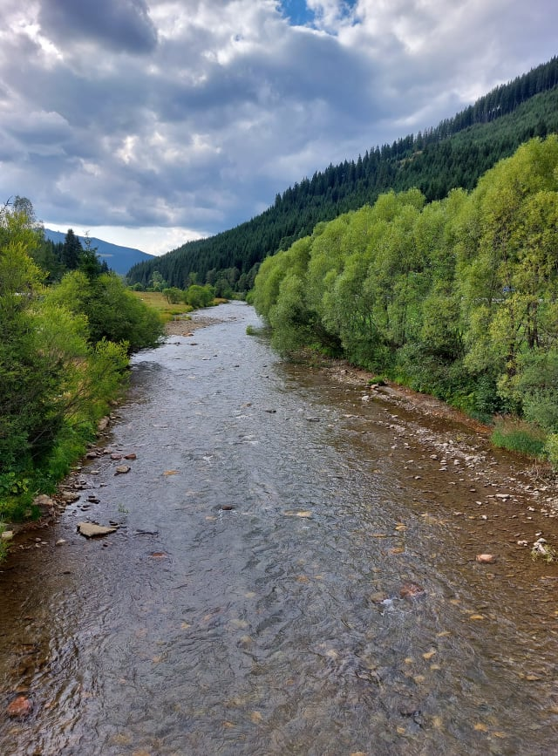
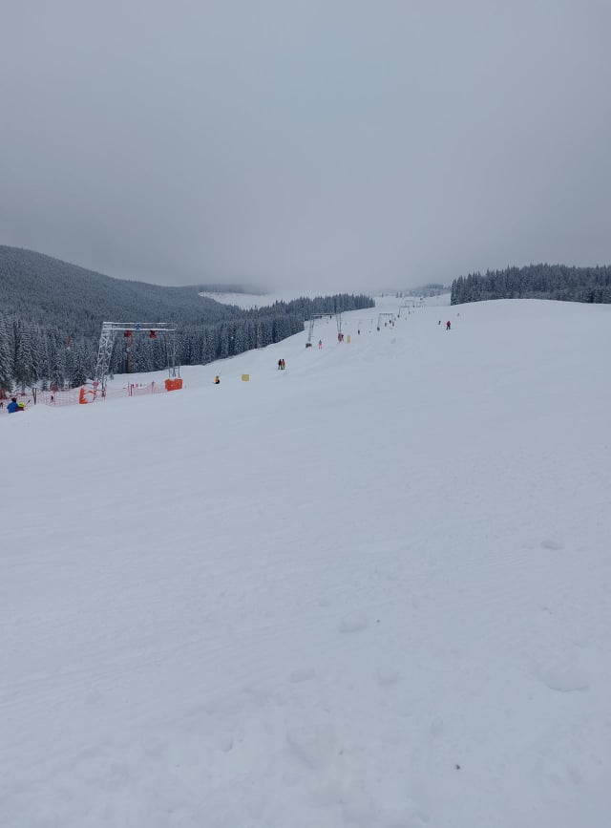

Slide 8
