Slide 1
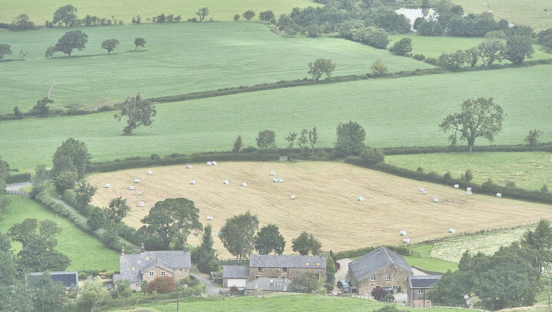

Climate changes and their impact on Romanian rural tourism- a review of actionable knowledge
Liliana VELEA, Anișoara IRIMESCU, Roxana BOJARIU, Zenaida CHIȚU
Administrația Națională de Meteorologie, București, România
Liliana.velea@meteoromania.ro; Anisoara.irimescu@meteoromania.ro; bojariu@meteoromania.ro; zenaida.chitu@meteoromania.ro

Slide 2

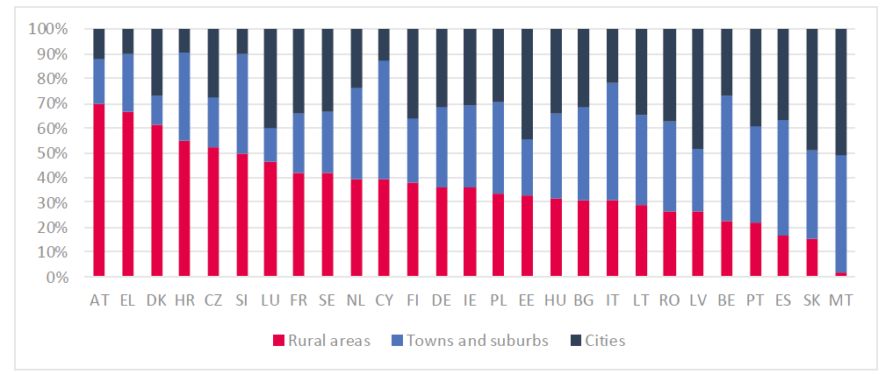
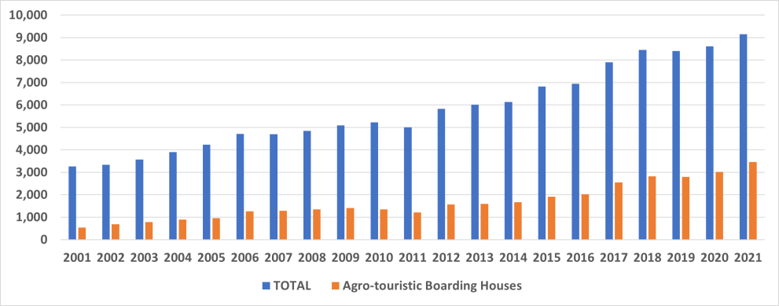
Motivation
Rural tourism is increasingly more
appealing to both tourists and
tourism investors.
Scientific research focusing on
Romanian
rural tourism strongly
21.4%
Share of nights spent at tourist accommodation at European level in 2021 (Šajn and Finer, 2023)
intensified in the last ten years (Stanciu et al, 2023).
Sustainable development -> need for
43.8%
adaptation
and mitigation
measures related to climate
changes.
The variety of factors impacting the
success of touristic rural
destinations emphasizes the
multitude of vulnerability sources
in relation to climate changes
relevant to rural tourism.
Touristic reception establishments with functions for tourist accommodations in 2021, in Romania (Velea et al, 2022)

Slide 3

Objective: to assemble a national-scale overview of scientific findings, products and services regarding the links between climate change and tourism/rural tourism in Romania in order to provide a readily accessible starting point on this information for a large pool of tourism stakeholders.
Research questions:
which are the main observed and expected changes in climatic patterns in Romania and how they (will) impact on rural tourism?
what other indirect impacts of climate change may be reflected on Romanian rural tourism?
what is the current policy framework at European and national level pertinent to rural tourism?
where can be found freely available climate products and/or services relevant for Romanian rural tourism actors in the context of climate change?
Methods:
review of scientific publications regarding the observed and expected climate change and its direct and indirect impacts on tourism and rural tourism. (key words: ‘rural tourism’, ‘Romania’, ‘climate change’, ‘impact’, + more focused like ‘energy’, ‘orchards’, ‘motivations’, ‘eco-tourism’ etc.;
identification of policy documents on the relevant EU
and national governmental sites
search of sources of climate products and services freely available and relevant to tourism/rural tourism provided through national and international platforms or European research projects websites.
In all cases, the searches focused on the period 2015-
2024 and on Romania as geographical area.

Slide 4

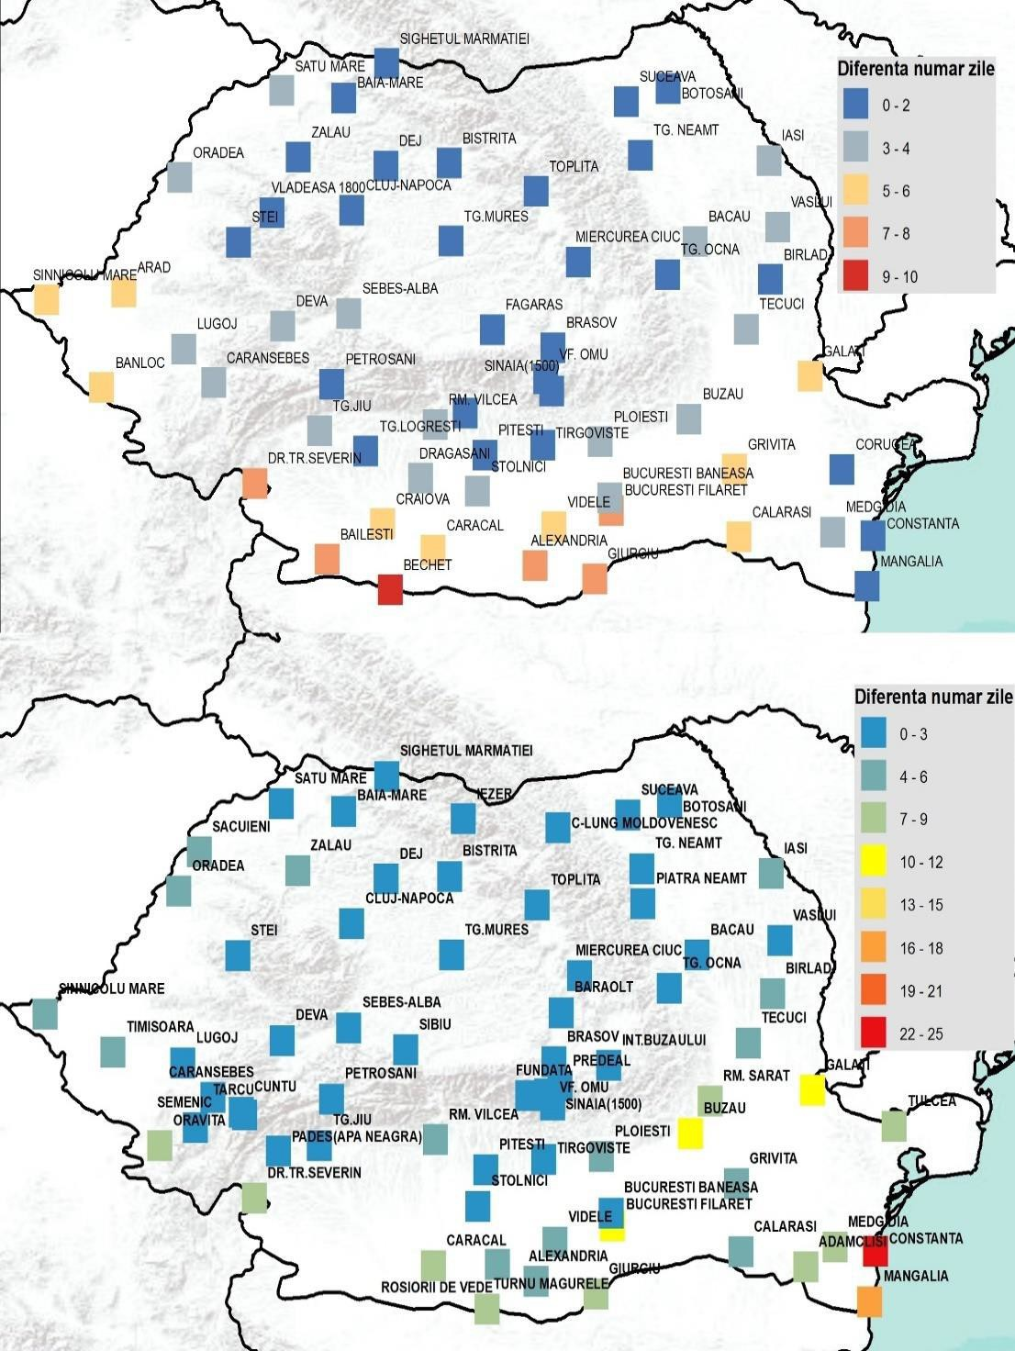
Observed changes of climate conditions (1961-2020)
No. of days with Tmax >35degC [(1991-2020)-(1961-1990)]
increasing trends for the air temperature and the number of sunshine hours in winter, spring and summer (Dumitrescu et al, 2014)
fewer days with light precipitation but an increasing trend for the number of days with moderate and heavy precipitation (Croitoru et al, 2016)
significant upward trend in the number of heatwave-days days, especially in plains from the southern and western part of Romania (Bojariu et al., 2021)
decreasing trend in the number of days with snow cover and in the mean snow depth, affecting the intra-Carpathian region and Northeastern Romania, was found (Birsan and Dumitrescu, 2013; Bojariu et al., 2021).
significant declines in snow cover duration, snow cover day frequency, and increases in snow-free days at elevations below 2000m (Amihaiesei et al, 2024)
No. of nights with Tmin >20degC [(1991-2020)-(1961-1990)]

Slide 5

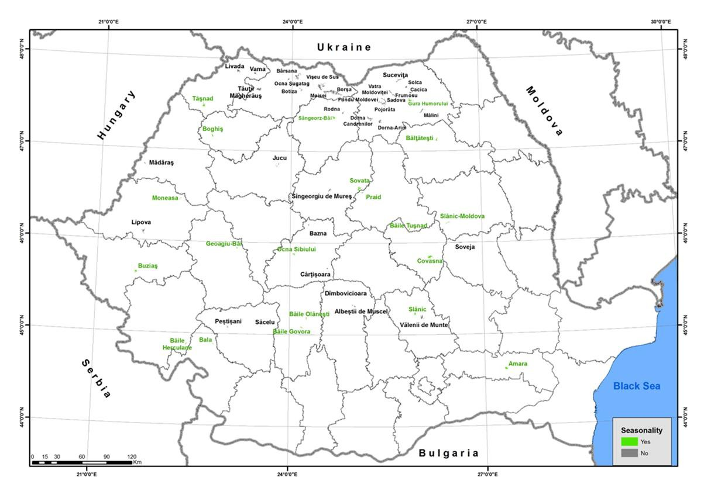
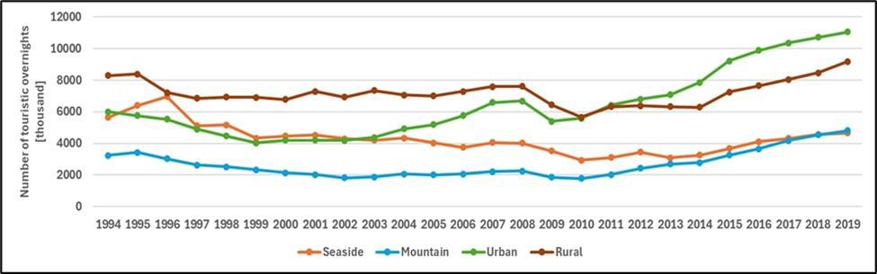
Direct impact on tourism of observed changes
not easy to be assessed, as the socio-economic conditions also knew major changes (e.g., end of communist regime in 1989, economic crisis in 2009- 2010)
strong correlation between tourism intensity (i.e.,
Touristic overnights during period 1994-2019 by destination type: seaside (except for Constanta city); blue – mountain; green – urban (excluding Tulcea); red – rural destinations including spas and touristic routes). Source: TEMPO database (www.insse.ro), Table TUR105C.
overnights) and suitability of climate conditions for
outdoor leisure activities in some rural destinations especially if they also have a balneary character (Velea et al, 2022)
rural mountain tourism has been significantly intensified in the last years (Linca and Toma, 2021)

Slide 6

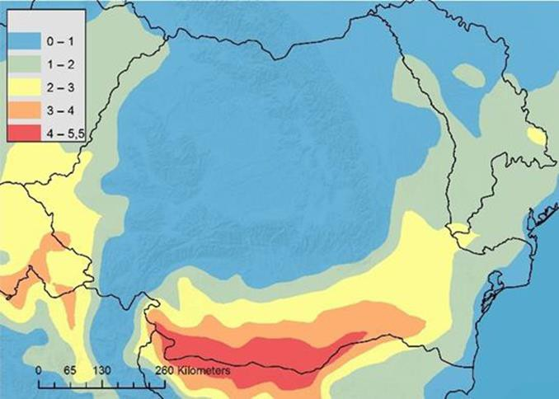
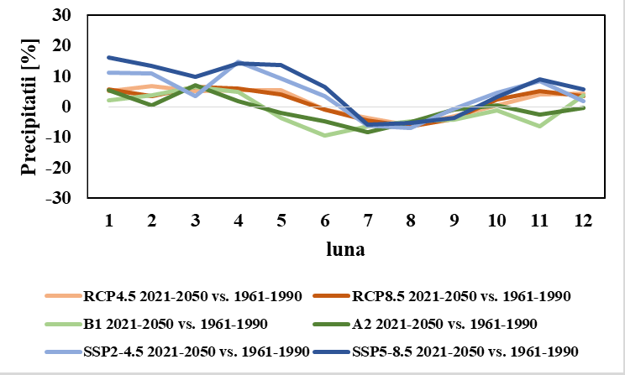
Projected changes of climate conditions (2021-2050/2100)
Increases in the frequency of very heavy precipitation days and the annual total wet-day precipitation are also likely to occur (Harpa et al, 2019).
Snow amount expected to decrease, especially W, central and S Romania (up to 80% toward de end of the century, in the context of the high-emission scenario).
Increase in the mean annual number of canicular days (Tmax>35 degC) and tropical nights (Tmin>20 degC) compared to current climate, more pronounced in the S and W regions (Bojariu et al, 2021).
Reduced amount
monthly mean precipitation during the summer months and
increased amounts during spring and winter (Bojariu et al, 2021).

Slide 7

Physical impact in tourism of projected changes
Rural destination | Relative increase (%) of touristic overnights (2021-2040 vs 2010- 2018)
Amara | 3.77
Băile Govora | 4.18
Băile Herculane | 8.31
Băile Olănești | 6.67
Băile Tusnad | 8.88
Bala | 4.49
Băltățești | 14.79
Boghiș | 4.33
Buziaș | 2.79
Covasna | 6.77
Geoagiu | 3.10
Gura Humorului | 5.77
Moneasa | 7.86
Ocna Sibiului | 4.67
Praid | 9.89
Sângeorz_Bai | 11.08
Slănic Moldova | 12.45
Sovata | 6.15
Tășnad | 2.94
Slănic (Prahova) | 5.65
At European level, ‘climate change would induce better conditions for most regions, resulting in more bed nights and inducing a relatively small EU-wide positive impact’ (Ciscar et al, 2009)
Climate conditions suitable for tourism in Romania to become less appealing during summer and improve during colder seasons until the end of century (Perch- Nielsen et al (2010)
Tourism demand in Romania may experience a decay of 0.03-0.4% compared to 2019 level till the end of the century in the context of climate change (Matei et al, 2023)
In Romania, beach tourism may benefit from the changes in climate conditions (Dumitrascu et al, 2021) and some mountain destinations may already present resilience to these challenges (Surugiu et al, 2011)
Rural tourism may also benefit from the changes in climate conditions.
(Velea et al, 2023)

Slide 8

Indirect impact of projected changes in climate conditions
Indirect impact on rural tourism | Potential negative consequences | Possible/applied solutions
Increased energy consumption for cooling +higher energy prices | Higher operating costs Lower quality of services Decreased demand/lower affordability | use of energy-efficient appliances use of green energy : geothermal energy (e.g., in Călimănesti- Căciulata resort (Dimitriu et al, 2010)) lor solar energy
Changes in water availability (e.g., precipitation distribution and amount) | Lower local food production Less appealing vegetation landscape usually associated with rural tourism Secondary tourism products (e.g., fruit picking) negatively affected | implementation of adaptation measures related to agriculture and water management Efficient exploitation of local resources (e.g., Local Gastronomic Points)
Less snow (amount, cover, depth) | Lower demand for winter tourism -> lower demand for rural areas associated with winter resorts Lower attractivity of natural environment (‘white winter’) | - enlarging the product offer (e.g., outside the winter season/alternative leisure options).
Land-use management (land cover, landslides, buildings) | New/large accommodation facilities-> higher prices for touristic offers in lower-population-density areas (Gordan et al, 2022) Increased energy and water consumptions Loss of cultural /local specifics | - preservation of ‘the existing traditions and cultural landscape’ (53 architectural guidebooks freely provided by the Order of Architects from Romania (https://turism.gov.ro/web/2022/03/17/protocol-de- colaborare-intre-m-a-t-si-o-a-r-pentru-sustinerea-turismului- rural/)

Slide 9

Policies at national and European level supporting rural tourism resilience
Important positive impact of the European funds at national level (e.g., Galluzzo, 2021) and at regional/local level (e.g., Czuczor et al, 2023).
Currently, directions for the development of rural tourism in Romania, including eco-tourism and balneary tourism, are defined through several targeted national strategies or action plans:
National strategy of Romania for tourism development 2023-2035’
Strategy for development of balneary tourism
Masterplan of tourism investments’
National strategy for eco-tourism development –
context, vision and objectives- 2019-2029
Action plan of the national strategy for eco-tourism development 2023-2029
A review of policy framework, initiatives and actions at European level regarding the development of sustainable tourism, including rural tourism (Beck, 2018) is available from the INSiGHT project [INSiGHT, 2018].
For the financial framework 2021-2027, at European level, the online ‘Guide on EU funding for tourism’ (https://single-market- economy.ec.europa.eu/sectors/tourism/eu- funding-and-businesses/funding-guide_en ) provides comprehensive information on current opportunities

Slide 10

Climate products and services relevant for Romanian rural tourism
Name of the platform | Access link | Information type (general or customized for tourism) | Focus on observed/projection of changes or impacts | Spatial characteristics
Copernicus Data Store (CDS) | https://cds.climate.copernic us.eu/cdsapp#!/search?type =application | General Customized | Observed (e.g., ERA5 Explorer) Projections (e.g., European temperature statistics; Heat wave days for European countries; Fire weather indicators for Europe) Observed and projections (Mountain tourism meteorological and snow indicators for Europe) | European or global coverage; gridded data/ at national level or NUTS1/NUTS2/NUTS3 level
INDECIS | http://indecis.eu/indices.php | General Customized | Observed | European coverage; gridded data
Ro-ADAPT | https://roadapt.ro/geoportal- harta-interactiva.php | Customized | Projections | Covering Romania; NUTS2 and NUST3 level
WeCENT | https://pric.unive.it/projects/ wecent/home#c4212 | Customized | Observed | 20 touristic destinations (5 rural) in Romania; locality level
WeCTOU | http://wectou.meteoromania .ro/ | Customized | Observed | 175 touristic destinations (54 rural) in Romania; locality level

Slide 11
Conclusions
At least on short-term, Romanian rural tourism, as well as beach tourism, may benefit from the changes in climate conditions attractivity and, overall, the tourism flow at national level is expected to decrease in a very low degree
Additional challenges are associated with the (negative) impacts of climate changes in other related sectors
Climate-related information, customized for the users needs, may help in building resilience of rural tourism sector in relation to climate change.
Limitations of the study are related to the narrow focus of the investigated subject (rural tourism) and limited geographical area (Romania).

Slide 12
References
Amihăesei, V.A., Micu, D.M., Cheval, S., Dumitrescu, A., Sfîcă, L. & Bîrsan, M.V. (2024). Changes in snow cover climatology and its elevation dependency over Romania (1961–
2020), Journal of Hydrology: Regional Studies, 51, 101637. https://doi.org/10.1016/j.ejrh.2023.101637.
Bojariu, R. et al (2021). ‘Schimbările climatice – de la bazele fizice la riscuri și adaptare -Editie revizuita si adaugita [Climate change – from physical bases to risks and
adaptation - Revised and added edition, In Romanian with a summary in English], Ed. Printech, București. 220 p. https://www.meteoromania.ro/clima/adaptarea-la-
schimbarile-climatice
Ciscar, J.C., et al. (2009). Climate change impacts in Europe. Final report of the PESETA research project, JRC Research Reports JRC55391, Joint Research Centre (Seville
site). https://publications.jrc.ec.europa.eu/repository/bitstream/JRC55391/jrc55391.pdf
Croitoru, A-E., Piticar, A., & Burada, D.C. (2016a). Changes in precipitation extremes in Romania, Quaternary International, 415, 325-335. https://doi.org/10.1016/j.quaint.2015.07.028
Czuczor, K., Kozma, G., & Radics, Z. (2023). The territorial tourism development strategies and implemented cross border cooperation projects in Bihor County. An
assessment of the 2007-2013 and 2014-2020 programming periods and exploitation of the EU funds from the point of view of tourism. GeoJournal of Tourism and Geosites,
48(2spl), 798–809. https://doi.org/10.30892/gtg.482spl14-1080
Galluzo, N. (2021). A quantitative analysis on Romanian rural areas, agritourism and the impacts of European Union’s financial subsidies, Journal of Rural Studies, 82, 458- 467, https://doi.org/10.1016/j.jrurstud.2021.01.025
Harpa, G.V., Croitoru, A.E., Djurdjevic, V. & Horvath, C. (2019). Future changes in five extreme precipitation indices in the lowlands of Romania. Int J Climatol. 39, 5720–5740.
https://doi.org/10.1002/joc.6183
https://oportunitati-ue.gov.ro/en/meat-lanseaza-in-consultare-publica-strategia-nationala-a-romaniei-pentru-dezvoltarea-turismului/].
https://turism.gov.ro/web/programe-si-strategii-2/
https://turism.gov.ro/web/wp-content/uploads/2022/11/Plan-de-actiune_SE-final-2022.pdf
https://turism.gov.ro/web/wp-content/uploads/2022/11/SNRDT-actualizat-var-pt-HG-2023-2035.pdf
https://turism.gov.ro/web/wp-content/uploads/2022/11/SNRDT-actualizat-var-pt-HG-2023-2035.pdf
INSiGHT, 2018. https://www.interreg-danube.eu/approved-projects/insights
Linca, A. & Toma, E. (2021): Study regarding the evolution of mountain tourism and rural mountain tourism
https://managementjournal.usamv.ro/pdf/vol.21_1/Art53.pdf
in Romanian Carpathians.
Matei, N., Garcia Leon, D., Dosio, A., Batista E Silva, F., Ribeiro Barranco, R. & Ciscar Martinez, J.C. (2023). Regional impact of climate change on European tourism demand,
https://data.europa.eu/doi/10.2760/899611
Šajn, N. & Finer, K. (2023). Rural tourism -briefing, https://www.europarl.europa.eu/RegData/etudes/BRIE/2023/751464/EPRS_BRI(2023)751464_EN.pdf
Surugiu, C., Surugiu, M.R., Frent, C. & Breda, Z. (2011). Effects of climate change on Romanian mountain tourism: Are they positive or mostly negative? Eur. J. Tour. Hosp.
Recreat., 2, 42–71. https://core.ac.uk/download/pdf/15565816.pdf
Velea, L., Bojariu, R., Irimescu, A., Craciunescu, V., Puiu, S., & Gallo, A. (2023). Climate Suitability for Tourism in Romania Based on HCI: Urban Climate Index in the Near-
Future Climate. Atmosphere, 14, 1020. https://doi.org/10.3390/atmos14061020
Velea, L., Gallo, A., Bojariu, R., Irimescu, A., Craciunescu, V. & Puiu, S. (2022): Holiday Climate Index:Urban — Application for Urban and Rural Areas in Romania,
Atmosphere, https://doi.org/10.3390/atmos13091519

