Slide 1
IMPACT OF COVID 19 ON ECO-TOURISM OF THE STATE OF MADHYA PRADESH, INDIA
DR NEERJA NIGAM
Assistant Professor
School of Applied Management, Rajiv Gandhi Proudyogiki Vishwavidyalaya, Bhopal, Madhya Pradesh, India

Slide 2
INTRODUCTION
Tourism and Hospitality industry :
With the Annual growth rate of 11.9% it contributes 9.2% to GDP and is the third largest employment generator (42.7million).
Tourism as a service sector helps :
people to develop a variety of skills , creates millions of business and employment opportunities thus have strong impact on various sectors like agriculture, construction, and handicrafts,
However, the flip side of increasing tourism is loss of natural habitat of wildlife (habitat fragmentation) and declining biodiversity apart from climatic variations, pollution and rest.
Thus, ecotourism has gained significance by the Ministry of Tourism for promoting responsible and sustainable tourism. Ecotourism entails the sustainable preservation of a naturally endowed area while ensuring not to damage the ecological balance. (As mentioned in Tourism Marketing by Devashish Dasgupta, Pg 79.)

Slide 3
THE HIT OF COVID -19 TO TOURISM INDUSTRY:
In year 2003 it was declined by just 0.4% due to SARS outbreak
In year 2009 international tourist arrivals declined by 4% because of the global economic crisis
But during the first three months of year 2020, it caused a 22% fall in international tourist arrivals,
Reasons :- flight cancellations, border closures, travel restrictions and global lockdown. It was reported that 91% of world’s population were restricted on international travel . UNWTO predicted 80% down in international tourism in year 2020. They promoted a campaign with hashtag (#Travel Tomorrow) and hope that by staying today at home, tomorrow we can travel

Slide 4
TOURISM IN MADHYA PRADESH , INDIA
Incredible India has many attractive destinations with its unique charm and diversity. As the name suggests, Madhya Pradesh lies at the centre of the country and is sometimes referred to as the “Heart of India”. The culture and tradition of the State is also very versatile.
Madhya Pradesh Tourism is blessed with heterogeneity of topography (Panchmarhi, Madai), beautiful wildlife (Kanha, Bandhavgarh, Pench), cosmopolitan heritage (Mandu, Shivpuri, Gwalior), world heritage sites (Bhimbetika, Sanchi) and religious sites (Ujjain, Narmada, Amarkantak) is becoming one among the top tourist destination. The natural panorama and breathtaking wildlife sightings have captivated not only the domestic tourists but across world.
This state of India, has a total of11 national parks and 24 wildlife sanctuaries and 6 tiger reserves. The state is home to the highest number of tigers and the world’s first white tiger was found in Rewa, a district in Madhya Pradesh. The state is also very rich in its culture and heritage. The UNESCO world heritage sites at Khajuraho, Bhimbetka & Sanchi are the iconic sites in the state, apart from two Jyotirlingas.

Slide 5
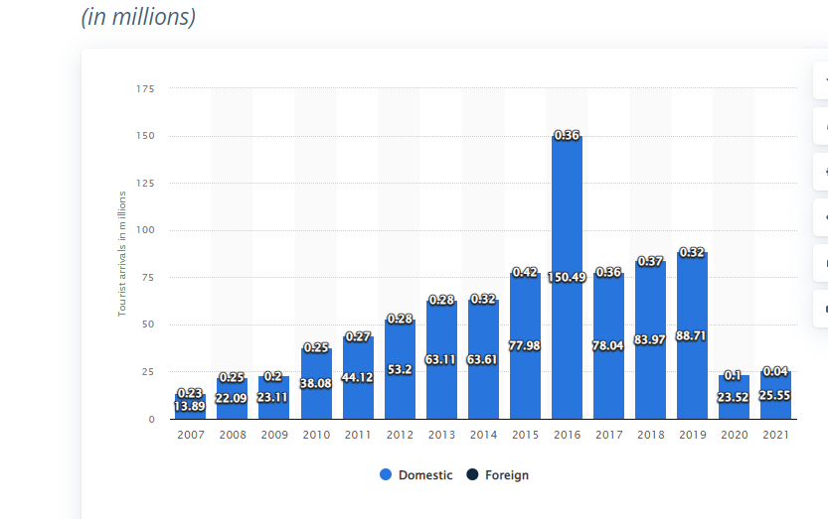
FOREIGN AND DOMESTIC TOURIST ARRIVALS ACROSS MADHYA PRADESH IN INDIA BETWEEN 2007 AND 2021(IN MILLIONS)

Slide 6
COVID 19 IMPACT ON TOURISM IN MADHYA PRADESH,INDIA
The outbreak of COVID-19 triggered unprecedented job losses and revenues in entire Tourism sector. Reports by CARE Ratings projected the sharp decline in Indian Tourism Industry nearly by 40% in 2020 due to COVID-19 with recorded fall in Foreign Exchange Earnings (FEEs) to Rs 56,150 crore, nearly 50% (Ranasinghe et al., 2020; Gössling et al., 2020a)
The share of GDP from travel and tourism was 10.4% in 2019, which came down to 5.5%
in 2020 due to the pandemic.

Slide 7
POST COVID SCENARIO IN MADHYA PRADESH
Impact of Covid crisis not just damaged and destructed image of a destinations but also reduced the confidence of tourist to visit. So, for restart and the survival of the tourism industry, effective crisis management plans and strategies were adopted by the state.
Travel and tourism council adhered to the protocols to support the safe, healthy and responsible tourism on the basis of frameworks developed by the Global Association for the Attraction Industry (IAAPA).
To recover travel and tourism industry from the COVID -19 crisis, more focus on traveler’s need and expectations with health, safety and physical distancing standards was done. Attempts were made to make visitors to feel assured of the safety of travel

Slide 8
EFFORTS BY GOVERNMENT TO PROMOTE TOURISM AFTER COVID :
Sheo Shekhar Shukla, Principal Secretary, Tourism & Culture, Government of Madhya Pradesh, and Managing Director of Madhya Pradesh Tourism Board, specific strategies
of promoting tourism was drafted, reflecting the true spirit of ‘Sab kuch jo Dil Chahe’.
After lifting all travel restrictions, Madhya Pradesh Tourism Board (MPTB) introduced numerous Campaigns: State started focusing on both the lesser-known
destinations as well as the better-known destinations. The strategy is to promote road trips in Monsoons in collaboration with the renowned influencers and a campaign #Monsoon Magic was launched with an objective to promote the monsoon destinations of Madhya Pradesh to their thousands of followers. The campaign was amplified through radio jingles and also on social media platforms.
#Buffer main safar Campaign is also launched to promote the buffer areas of tiger reserves to the potential wildlife enthusiasts, as the beauty of monsoon at its peak along with the greenery of jungles is something which no wilderness lover would like to miss. Another digital media campaign # IntezaarAapka was carried out through a series of social media posts covering various destinations of Madhya Pradesh including Bandhavgarh, Gwalior, Khajuraho, Mandu, Pachmarhi, etc. Intezaar Aapka campaign to attract tourists who would like to visit the state. The campaign includes a series of communication about The destination is waiting for you to explore.The campaign was successfully supported on all social handles of the state tourism board and was much apprecisted by tourists. The tagline which says Intezaar Aapka states that the state tourism understands the current situation of travellers who were under lockdown for quite some time now and now state want to engage travellers by featuring the popular monsoon destinations across Madhya Pradesh.
Additional 5% Capital Investment Subsidy shall be given to the tourism projects established in distant and interior areas of the state.
Further in this direction of promoting tourism, state also signed MoU with 'eco-tourism society of India' for sustainable and responsible tourism with the aim to create future eco-tourism
warriors by involving youngsters in various activities at the nature camp spread all over the State.

Slide 9
EFFORTS STARTED PAYING US
In the year 2021, the domestic tourists arriving to the central state of Madhya Pradesh increased to approximately 25 million,
though the foreign tourist arrivals were less than 42 thousand.
Tourist footfall in state increased by 33% in 2022. In the year 2022, over 3.4 crore tourists including domestic and foreign visited Madhya Pradesh, up by 33 per cent from the previous year, according to the data from the Ministry of Tourism. Religious, heritage and wildlife circuits were the most visited destinations in the state.
The economy of Madhya Pradesh improved its health after two years of Covid-19 pandemic. It has recorded a growth rate of 18.02% in current fiscal year.
The state's tourism board is putting its efforts in promoting these tourism offerings to make them more relevant to the evolving travellers. The attempt is to present a more community-based, holistic, green, and eco-friendly model of tourism.
•

Slide 10
CONCLUSION:
We can take this pandemic as an opportunity by finding short-term improvements, analyzing old wrong practices and rebuilt art of exploring. Mutual collaboration, coordination, information sharing and mutual efforts with common goal is important today. Current situation is not a stopping sign but to prepare and think innovate and new ideas to bounce back.
The unprecedented crisis in the tourism & hospitality sector because of COVID-19 will be instrumental in bringing significant changes that will transform the industry outlook forever.
The Travel & Tourism industry will not be the same as before with consumers becoming more sensitive to environmental concerns, change in preferences towards natural hinterlands and landscapes in domestic nations.
Indigenous tourism products with greener landscapes and responsible behaviour are believed to be the silver bullet. A smarter marketing push to green or sustainable tourism with collaborated project teams, policing and stimulus will share the economic load.
Users generated engaging digital content on social networks to garner travelers’ interest in eco-destinations will be a catalyst in addressing growing energy and environmental concerns which will lead to development of indigenous ecotourism products and independent properties.
Keeping In mind tourists' preferences from urban areas towards natural surroundings. State must efforts to promote home stays, gram stays and farm stays as a safe and culturally rich stay option for the guests to experience the rich rural culture, food and traditions of the State and have healthy non polluted tourism..

Slide 11
Thank you!!

