Slide 1
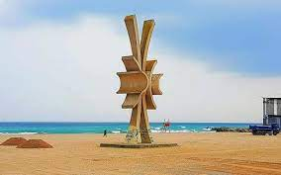
COSTINEȘTI- MEDICAL HYSTORY AND BALNEOTHERAPY Oana Nicole Stoican , Facultatea de Medicină, Universitatea Transilvania din Brașov, Prof. dr. ec. Mirela Stoican CNEAB, Braşov Prof. dr. Daniela Vărvăruc Liceul Tehnologic de Servicii Sf. Ap. Andrei, Ploiești

Slide 2
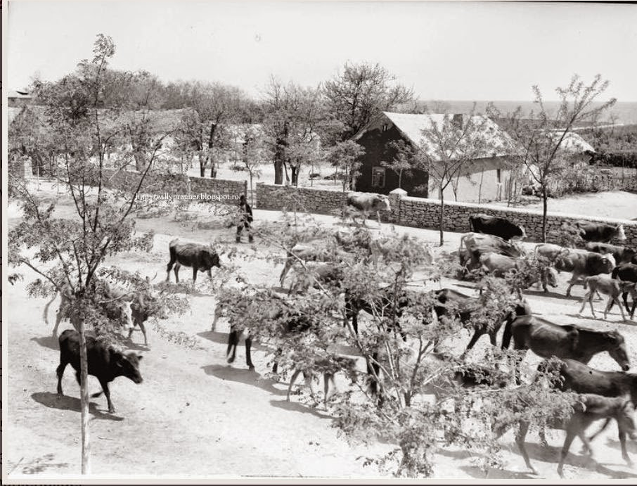
Historical data
Over time, the town has known different names, depending on the peoples who have transited and occupied the area, among them we mention:
- Stratoni, during the Byzantine Empire;
Mangeapunar, during the Ottoman Empire, until 1840;
Büffelbrunen, during the time of the Dobrogean Germans, in Romanian the Fountain of the Buffaloes
was translated into Romanian; name used until 1940;
The release, in 1960, a well-known name due to the young students who attended
the area during the summer

Slide 3
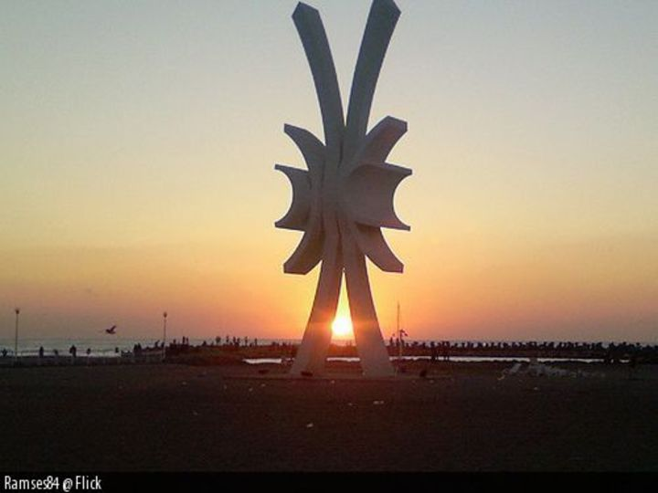
The obelisk, an important symbol of Costinesti, "was inaugurated in June 2006" ,
after being destroyed by floods in 2005.
Initially, it was built "in 1969, by Dobrogea architect Wilhelm Demeter"
. The construction was a tourist attraction and a meeting place for young people.
“In occult literature, the obelisk has the shape of a hell, representing a Masonic symbol,
because of its shape - split and eccentric.
Initially, the emblem of the three concentric circles was used,
which plays a very important role in occult beliefs.
Hell symbolizes the "Three Worlds" of divine creation,
each of the three circles having the same center. "

Slide 4
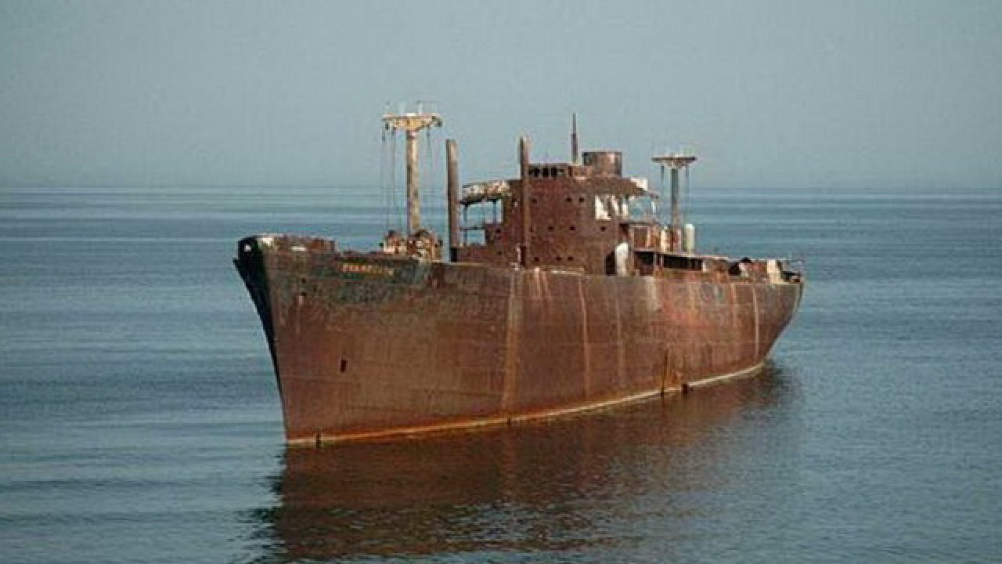
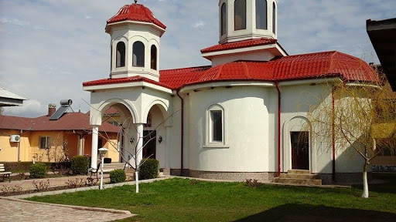
Anthropic tourist heritage, the resort has
- The nunnery “Sfânta Elena de la Mare” located 3 km from the village of Schitu,
dating from 1929;
The obelisk;
- Epava Evanghelia;
- Summer Theater.

Slide 5
Spa treatment conditions The natural healing factors specific to Costinesti resort are the following:
- Psmatotherapy, favored by the fine sand of the beach;
Heliotherapy, especially in the summer season, when an average
of 10 to 12 hours of sunshine per day is estimated;
- pelloidotherapy;
Thallassoterrapy;
Climatotherapy.

Slide 6
disorders of the nervous system o neuritis, polyneuritis, o sequelae after different types of central nervous system infections;
gynecological diseases a metritis, a cervicitis, or amenorrhea, oligomenorrhea, dysmenorrhea;
dermatological conditions o squamous dermatoses
▪ psoriasis,
▪ keratoderma; a seborrheic syndrome
▪ seborrheic dermatitis, ▪ polymorphic acne; or allergodermias
▪ eczema and hives;
mental illness a state of anxiety, a depression .

Slide 7
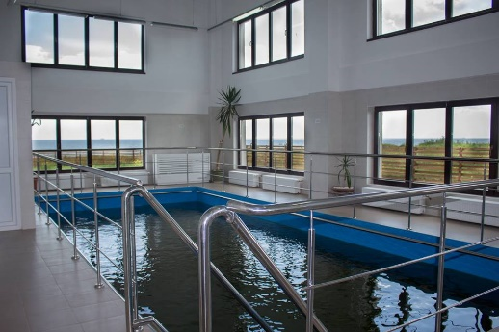
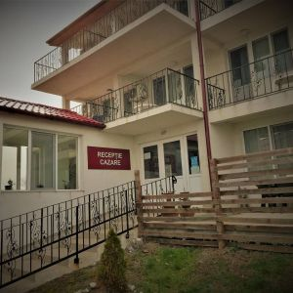
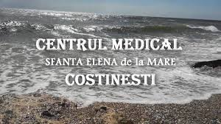
The hotel units in the spa area offer tourists :
"physiotherapy, - gymnastics in the pool,
Techirghiol mud baths
galvanic baths
massage
ozone therapy
laser therapy
electrotherapy

Slide 8
Costinesti has a real potential, which has not been properly exploited so far,
the destination can become a real therapeutic sanctuary, with the following conditions:
attracting funds and investors for the creation of modern therapeutic complexes;
- promoting the spa side of the area both nationally and internationally;
- hiring the state for the training of medical staff specialized in the field.

